Slide 1
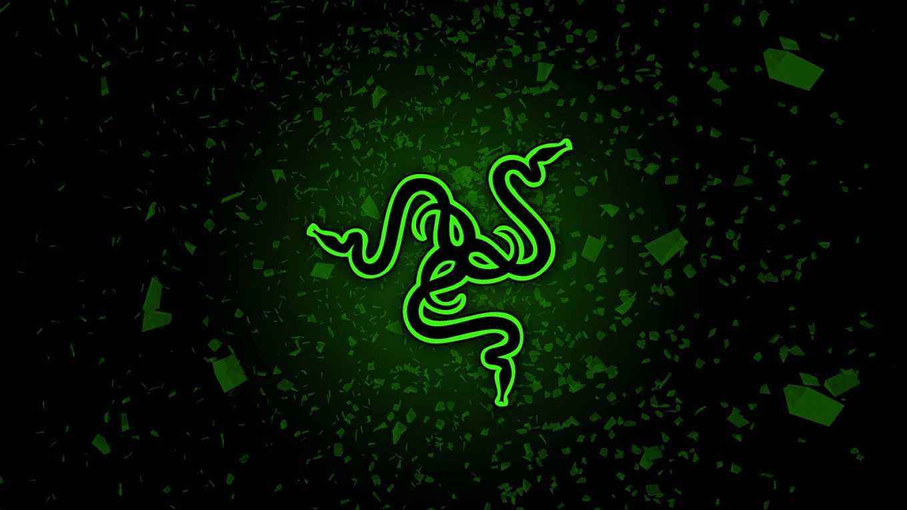

ADVANCED GLUTTONOUS SNAKE FINAL PRESENTATION
SLYTHERIN
SHANSHAN ZHAO
LIYI CAO
YUJIA WANG
YINZHU SU
http://tech.sina.com.cn/roll/2017-07-21/doc-ifyihrwk1647246.shtml

Slide 2

GOAL OF OUR PROJECT
Source of inspiration:
We are trying to build a video game based on FPGA and Verilog, which game is similar with Gluttonous Snake. But Advanced!!
Different：
Two user play together --- Compete
Different function item --- Diversification
Designers Enthusiasm：
VGA display, Snake movement and growth algorithm, Random apple algorithm, Two-player design, Multifunctional Apple Design and Algorithm
https://cn.technode.com/post/2017-10-13/razer-phoneleak-8gb-ram/

Slide 3
HIGH LEVEL OVERVIEW OF THE FUNCTIONALITY
VGA --- our project basic fundamental
Snake Move --- change direction and move
Random apple appear --- Apple randomly appears within the game interface (excluding game frames)
Snake Growth --- When a snake eats an apple, the snake’s body grows
Two Snakes --- Design two different snakes (colors different) they compete for eating apples to get higher scores
7-segments show Score--- The first two show green snakes, the last two show blue snakes
Keyboard Design --- use keyboard PS/2
Died Version --- When one of the two snakes triggers a death condition, the game enters the death interface
Speed-up apple item --- When one of the two snakes eats the apple, it accelerates until it eats the next apple.
https://cn.technode.com/post/2017-10-13/razer-phoneleak-8gb-ram/
https://cn.technode.com/post/2017-10-13/razer-phoneleak-8gb-ram/
Notes:
So our overall design process is as follows：

Slide 4
SHORT SPECIFICATION
How to play our game :
1. Display the game interface, and the first apple ---------- and a “died” word (We are trying to fix this problem)
2. When you press the reset button, the game begins. You can control the direction of the snake‘s movement with “awsd”. Your partner can control their snakes via the “jikl” button to control their snake.
3. We have two kinds of apples (red and green) that appear at random. When you eat red apple, your score will increase, and when you eat green apple your controlled snake will move faster! However, please note that there will be not increase in scores for green apple. Sometimes green appear will appear near the death border. Whether to eat or not will be considered.
4. After eating an apple, you will receive a corresponding reward. Note that if you are accelerating at this time, you will resume normal speed after eating red fruits.
5. When one of two snake touches the border of the game, or hits himself and hits other snakes, that snake lose the game. (If ”died” is green, then the green snake is lost, if the “died” is blue, the blue snake is lost.)
https://cn.technode.com/post/2017-10-13/razer-phoneleak-8gb-ram/
https://cn.technode.com/post/2017-10-13/razer-phoneleak-8gb-ram/
Notes:
How does the user play our game? Our game rules and status are as follows:

Slide 5
SHORT SPECIFICATION
Design Tradeoffs and Decision:
If two snake head collision, we cannot determine which user lose this game. ------ show different color death interface
The score show on the 7-segements, the first two number is show green snake’s score and the last two number show the blue snake’s score. We trying to add a colon, but spartan 6 not allowed. ---- just show scores without colon
https://cn.technode.com/post/2017-10-13/razer-phoneleak-8gb-ram/
https://cn.technode.com/post/2017-10-13/razer-phoneleak-8gb-ram/
Notes:
When we are implementing some designs, sometimes we have to compromise on some things. For example：

Slide 6
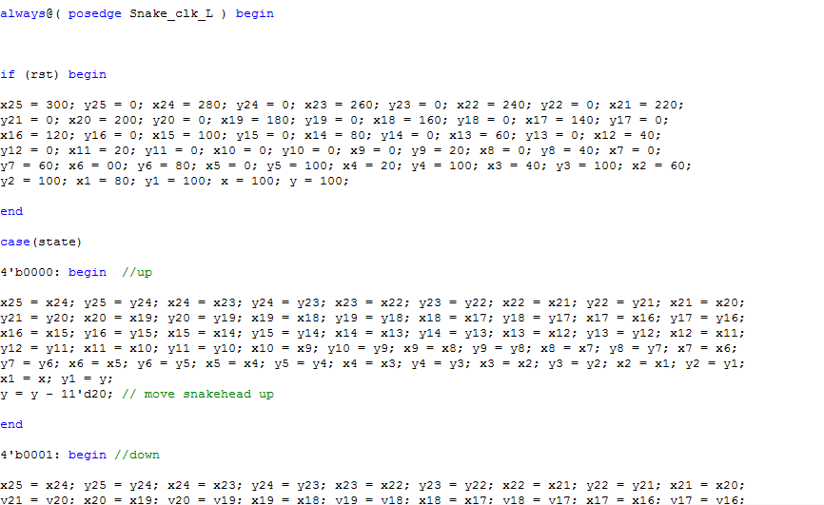
DETAILED FUNCTIONALITY
https://cn.technode.com/post/2017-10-13/razer-phoneleak-8gb-ram/
https://cn.technode.com/post/2017-10-13/razer-phoneleak-8gb-ram/

Slide 7
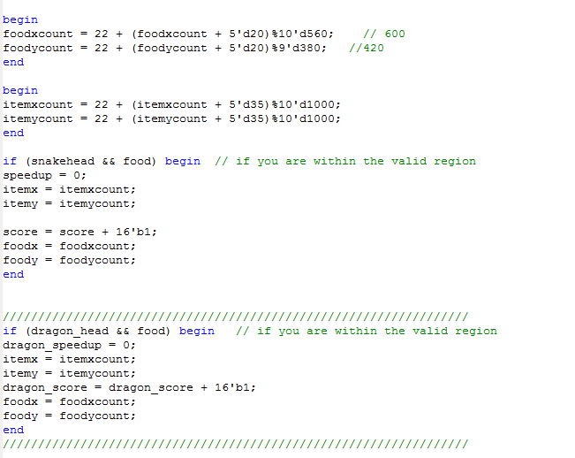
DETAILED FUNCTIONALITY
https://cn.technode.com/post/2017-10-13/razer-phoneleak-8gb-ram/
https://cn.technode.com/post/2017-10-13/razer-phoneleak-8gb-ram/

Slide 8
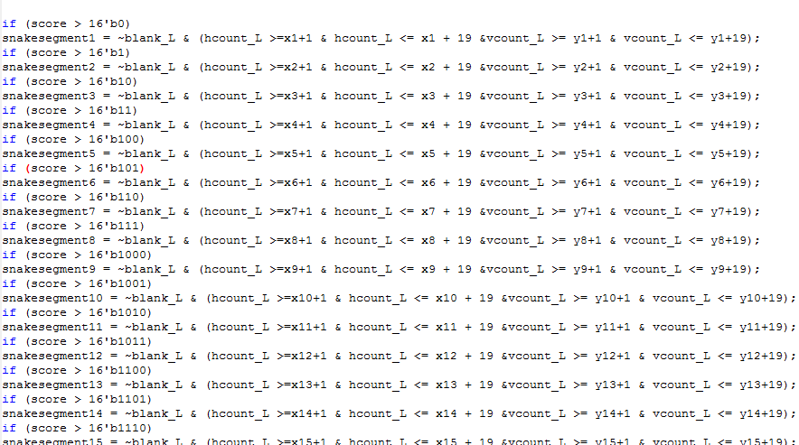
DETAILED FUNCTIONALITY
https://cn.technode.com/post/2017-10-13/razer-phoneleak-8gb-ram/
https://cn.technode.com/post/2017-10-13/razer-phoneleak-8gb-ram/

Slide 9
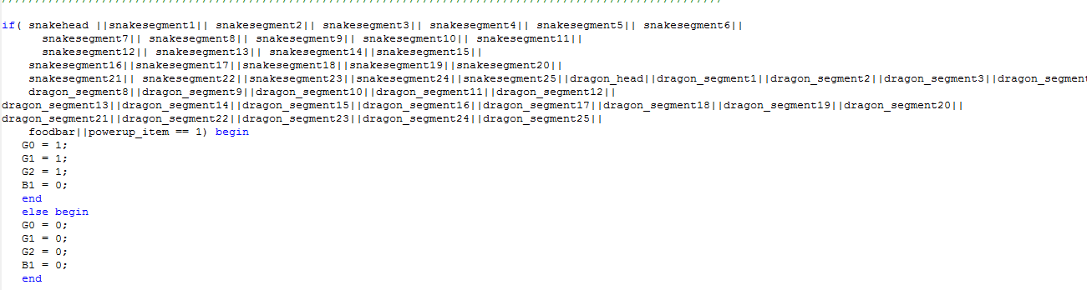
DETAILED FUNCTIONALITY
https://cn.technode.com/post/2017-10-13/razer-phoneleak-8gb-ram/
https://cn.technode.com/post/2017-10-13/razer-phoneleak-8gb-ram/

Slide 10

DETAILED FUNCTIONALITY_Speed Choice
Once the snakes begin to move, we want them to move faster. So we create another apple with the function of speedup.
For the top module:
If it scanned both snakehead and apple signal are 1, the speedup signal would be 1. Which would be a trigger signal for the clock divider modules.
https://cn.technode.com/post/2017-10-13/razer-phoneleak-8gb-ram/
https://cn.technode.com/post/2017-10-13/razer-phoneleak-8gb-ram/

Slide 11
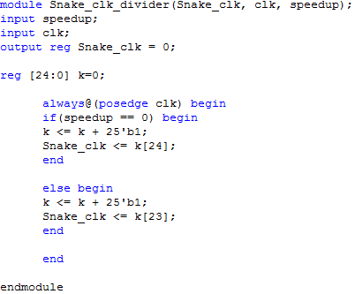
DETAILED FUNCTIONALITY_Speed Choice
Then we create two clock divider modules for the two snakes respectively.
Using a 25-bit counter to determine the frequency of moving clock. The counter increase one after the positive edge of clock.
For the normal situation (without speedup), giving the counter[24] to the clock for the snakes’ movement.
Once the speedup signal is valid, giving the counter[23] to the clock for the snakes’ movement.
Those can make sure the speed is twice as before.
https://cn.technode.com/post/2017-10-13/razer-phoneleak-8gb-ram/
https://cn.technode.com/post/2017-10-13/razer-phoneleak-8gb-ram/

Slide 12
DETAILED FUNCTIONALITY_Collision
However if the snake moves faster, it probably win faster or die faster.
When one of the snakes in our game collided with walls, another snake or itself, then it would be died.
As we mentioned before, it scanned the whole screen pixel by pixel, so it can identify every signal corresponding to the whole screen.
https://cn.technode.com/post/2017-10-13/razer-phoneleak-8gb-ram/
https://cn.technode.com/post/2017-10-13/razer-phoneleak-8gb-ram/

Slide 13
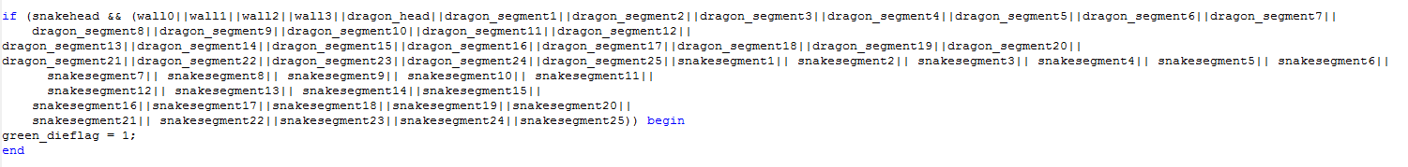
DETAILED FUNCTIONALITY
Collision
https://cn.technode.com/post/2017-10-13/razer-phoneleak-8gb-ram/
https://cn.technode.com/post/2017-10-13/razer-phoneleak-8gb-ram/

Slide 14
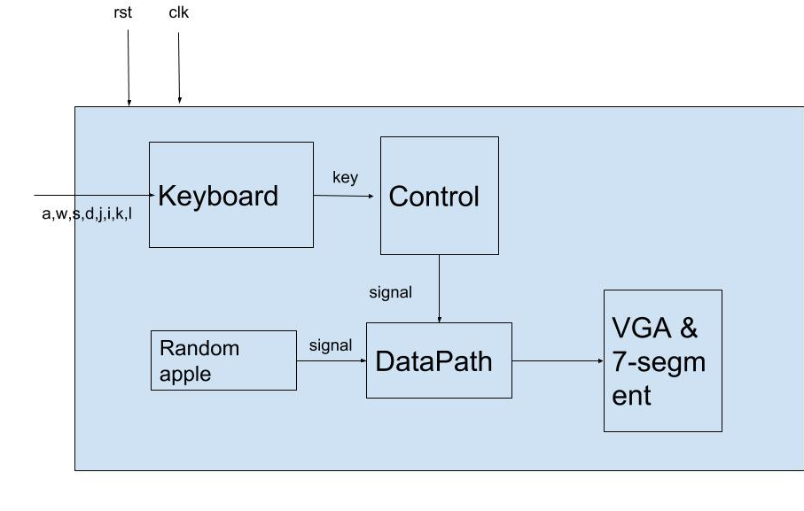
DETAILED BLOCK DIAGRAMS
https://cn.technode.com/post/2017-10-13/razer-phoneleak-8gb-ram/
https://cn.technode.com/post/2017-10-13/razer-phoneleak-8gb-ram/

Slide 15
SUCCESSES
1.More practical: players can use keyboard to play our game. It’s easy for them to control their snakes.
2.More interesting: two players involved in our game. Only one player can win the game.
3.More tactical: Whether to eat the ‘faster apple’ or not. players need to take both time and stability into consideration.
https://cn.technode.com/post/2017-10-13/razer-phoneleak-8gb-ram/

Slide 16
FAILURES
1.We planed to create different levels for the game by final presentation. However it needs more time to calculate the coordination of new barriers than we thought. We would make this part in the rest days before final demo.
2.The keyboard can only be control by one player at one time since only one 12-bit signal can be transmitted each time.
https://cn.technode.com/post/2017-10-13/razer-phoneleak-8gb-ram/

Slide 17
TEAMMATE CONTRIBUTION:
Shanshan Zhao:
Two Snake Design, Speed-up, Collision, Test and Debug
Liyi Cao:
Keyboard Design, Random apple appear, Test and Debug
Yujia wang:
VGA , Snake Move & Growth, Died Version(two snakes)
Yinzhu Su:
System Diagram, 7-segement for 2 snake, Snake Move & Growth
https://cn.technode.com/post/2017-10-13/razer-phoneleak-8gb-ram/

Slide 18
DEMO
https://cn.technode.com/post/2017-10-13/razer-phoneleak-8gb-ram/

Slide 19
THANK YOU！
https://cn.technode.com/post/2017-10-13/razer-phoneleak-8gb-ram/

