Slide 1

Scripting & Parallelization
SLURM
Sbatch, JobArray, OpenMP/MPI
Daniel Valle Millares
(Bioinformatics Platform - CIBERINFEC)
BU-ISCIII
29 sept - 03 de octubre de 2025
1ª edición

Slide 2
Index
Scripting on the cluster — sbatch & job arrays
Parallel computing on the cluster — OpenMP vs MPI (when to use each)
Nextflow pipelines in HPC - Deploy a Nextflow DSL2 pipeline in HPC
Wrap-up & Q&A

Slide 3
Sbatch File

Slide 4
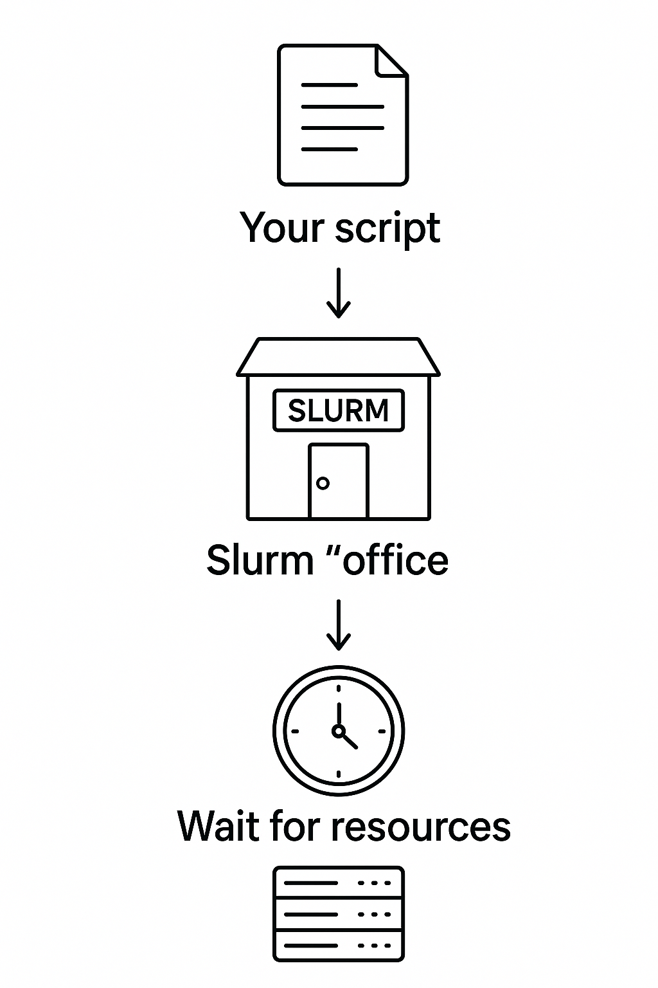
Scripting on the cluster — Slurm: sbatch
What is sbatch?
Command to submit a job script to Slurm; runs in the background on compute nodes.
Delegate the work to de cluster:
  Submit once, let the cluster work
Example:
  Your script → Slurm "office" → Wait for resources → Cluster runs it

Slide 5

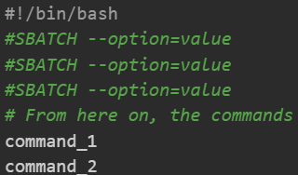
Scripting on the cluster — Slurm: sbatch
Set up a sbatch script file
0) Open a <file-name>.sbatch file
1) Init with shebang

Slide 6
Scripting on the cluster — Slurm: sbatch
Set up a sbatch script file
0) Open a <file-name>.sbatch file
1) Init with shebang
2) Set up slurm directives at the beginning of the script by using “#SBATCH”
List of SLURM params:
https://slurm.schedmd.com/sbatch.html

Slide 7
Scripting on the cluster — Slurm: sbatch
Set up a sbatch script file
0) Open a <file-name>.sbatch file
1) Init with shebang
2) Set up slurm directives at the beginning of the script by using “#SBATCH”
3) After directives, you can:
  Load dependencies with ‘module load’
  Set your commands you want to run
List of SLURM params:
https://slurm.schedmd.com/sbatch.html

Slide 8
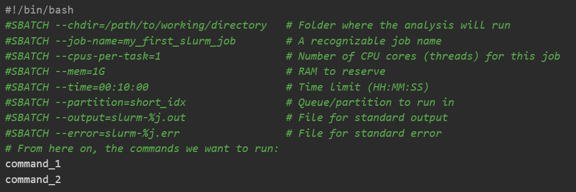
Scripting on the cluster — Slurm: sbatch

Slide 9
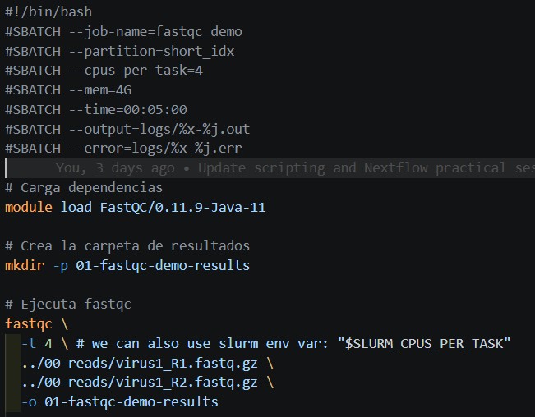

Slurm ENV Vars

Slide 10
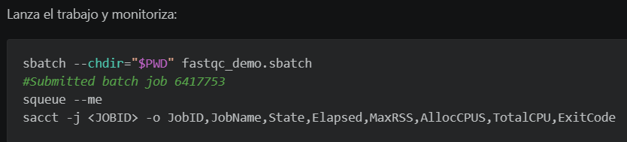
Scripting on the cluster — Slurm: deploy with sbatch

Slide 11


Scripting on the cluster — Slurm: deploy with sbatch
Slurm JobID

Slide 12
Scripting on the cluster — Slurm: monitor with squeue

Slide 13
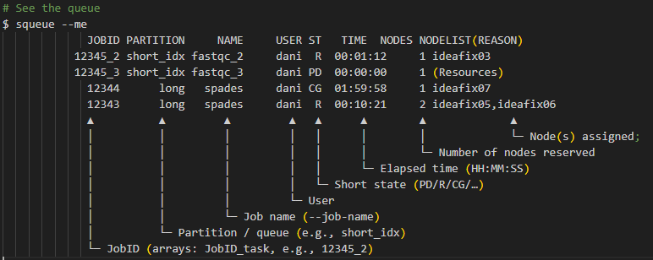
Scripting on the cluster — Slurm: monitor with squeue​

Slide 14
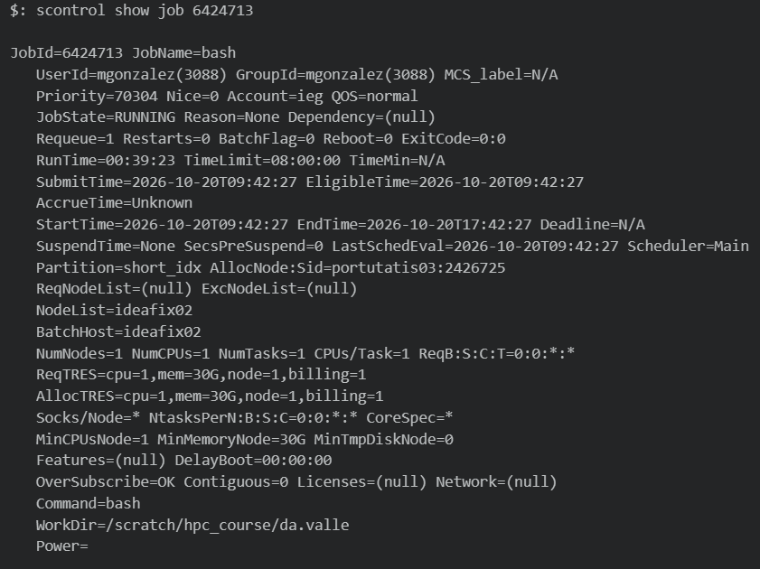
Scripting on the cluster — Slurm: monitor with scontrol

Slide 15
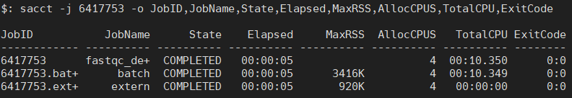
Scripting on the cluster — Slurm: monitor with sacct

Slide 16

Scripting on the cluster — Slurm: cancel a job
When do we cancel a job?
A job does not meet the requirements and remains in the PD (pending) state.
I made a mistake when submitting or configuring the job and want to cancel it before it continues.
I realize that I allocated more resources than necessary.
Something unexpected happened and the job appears to be stuck.

Slide 17
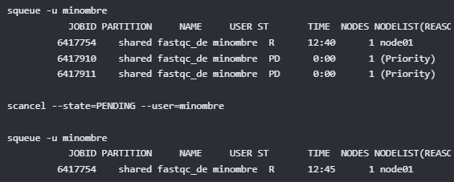
Scripting on the cluster — Slurm: cancel a job
When do we cancel a job?

Slide 18
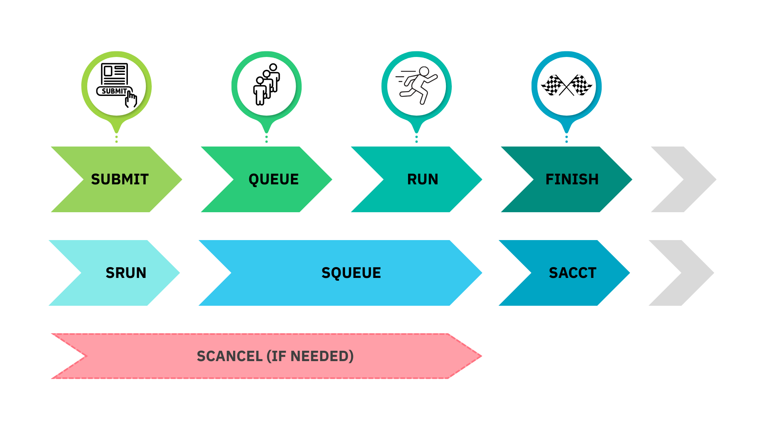
Monitoring and job states
SBATCH

Slide 19

Scripting on the cluster — Slurm: sbatch
Bigger asks = longer wait, not faster.

Slide 20

Scripting on the cluster — Slurm: Redirecting Job Output
Once the job/s have finished → Output files
Standard output: Standard outputs of your program.
For example, if you used: --output=slurm-%j.out
Standard error: Potential errors you face during execution appear here.
For example, if you used: --error=slurm-%j.err
slurm-12345.out
slurm-12345.err

Slide 21

Scripting on the cluster — Take-home message
Good Practices:
✅Descriptive --job-name; comment your script.
❌Never run heavy jobs on the login node !!!! Use sbatch/srun.
❌Do not request more resources than need!!!!
✅Test small first, then scale.
✅Version your scripts (Git).

Slide 22
Thank you for your attention
Questions?

Slide 23
JobArrays (Embarrassingly parallel)

Slide 24
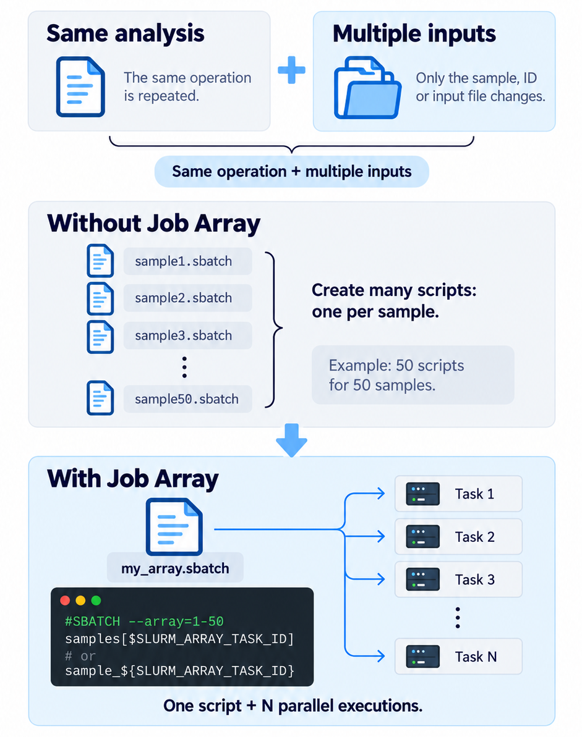
Scripting on the cluster — Slurm: job arrays
What are JobArrays and what are they used for?
Sbatch script designed to launch many jobs
  Same operation / multiple inputs
Instead of creating 50 scripts for 50 samples, you create one script and tell Slurm to run it N times → In Parallel
If your shell for loop only changes a filename/ID, make it a job array.

Slide 25
Scripting on the cluster — Slurm: job arrays
For Loop
JobArray
Task 1 | fastqc sample1.fastq.gz
Task 1 | fastqc sample1.fastq.gz
1
2
3
4
5
1
2
3
4
5
Task 2 | fastqc sample2.fastq.gz
Task 2 | fastqc sample2.fastq.gz
Task 3 | fastqc sample3.fastq.gz
Task 3 | fastqc sample3.fastq.gz
Task 4 | fastqc sample4.fastq.gz
Task 4 | fastqc sample4.fastq.gz
Task 5 | fastqc sample5.fastq.gz
Time
Time

Slide 26
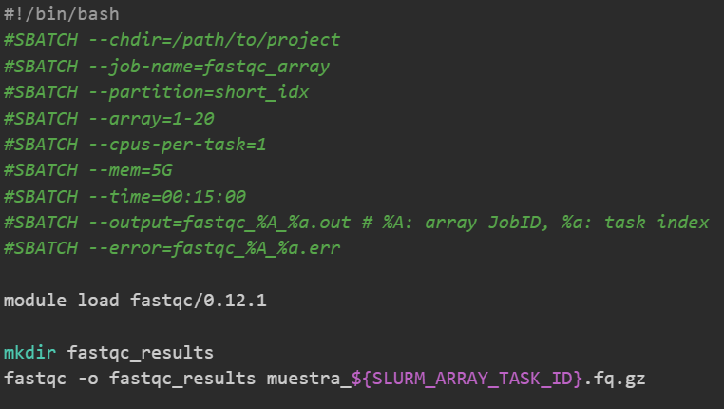
Scripting on the cluster — Slurm: job arrays
Create a JobArray script?
As simple as using the `--array` inside the sbatch script
Plus Slurm env variables
https://docs.hpc.shef.ac.uk/en/latest/referenceinfo/scheduler/SLURM/SLURM-environment-variables.html#gsc.tab=0
Notes:
https://docs.hpc.shef.ac.uk/en/latest/referenceinfo/scheduler/SLURM/SLURM-environment-variables.html#gsc.tab=0

Slide 27
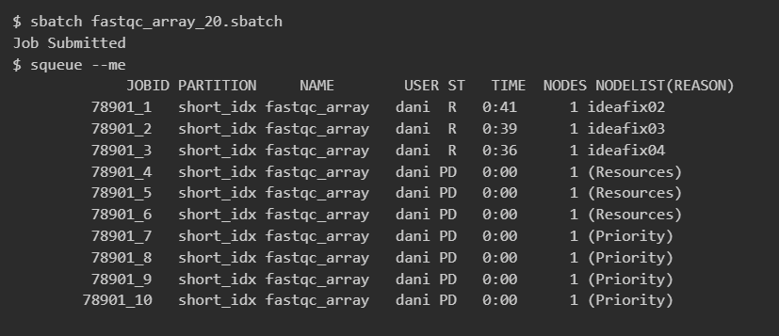
Scripting on the cluster — Slurm: job arrays
Monitoring Arrays

Slide 28
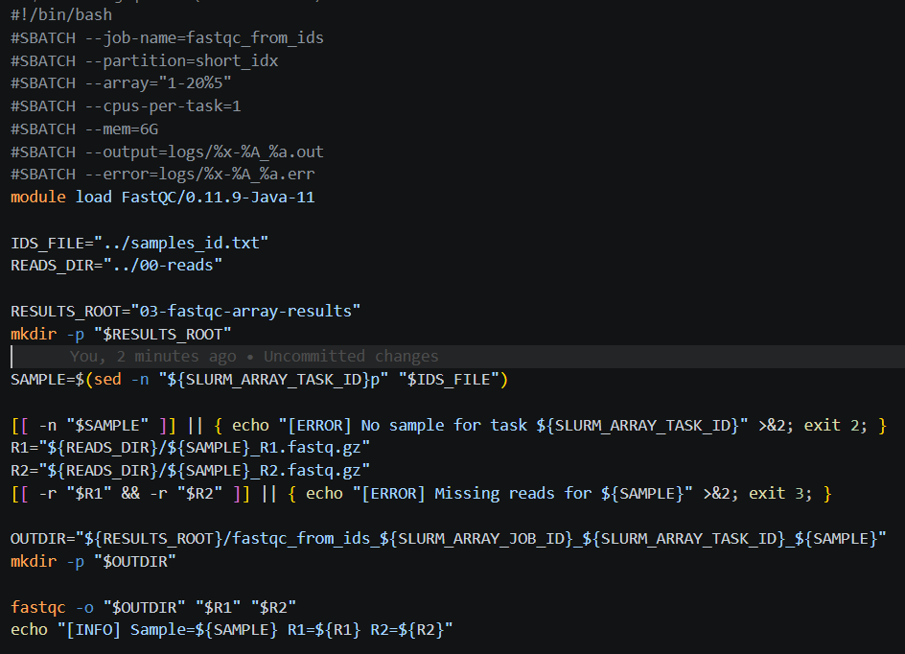
Scripting on the cluster — Slurm: job arrays
Get sample's file name using array index?

Slide 29
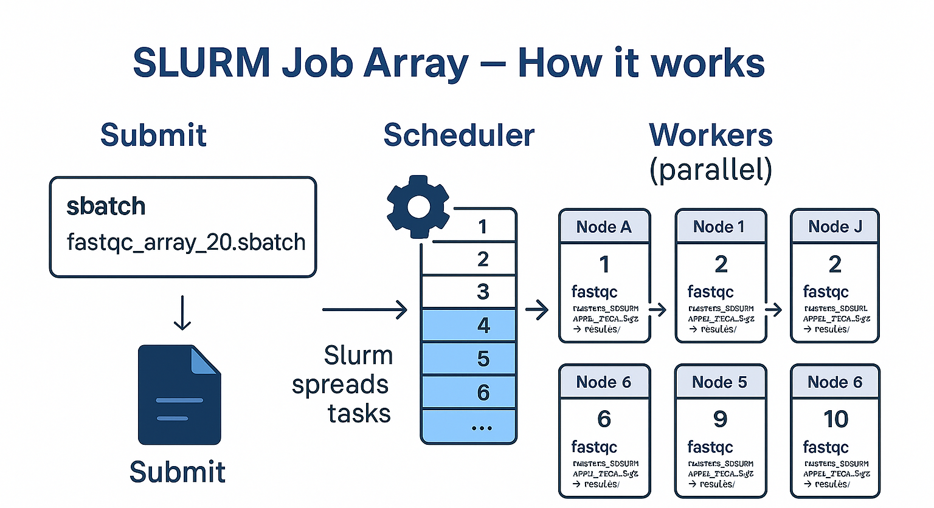
Scripting on the cluster — Slurm: job arrays

Slide 30
Thank you for your attention
Questions?

Slide 31
Index
Scripting on the cluster — sbatch & job arrays
Parallel computing on the cluster — OpenMP vs MPI (when to use each)
Nextflow pipelines in HPC - Deploy a Nextflow DSL2 pipeline in HPC
Wrap-up & Q&A

Slide 32
OpenMP v.s. MPI
(Open Multi-Processing) (Message Passing Interface)

Slide 33
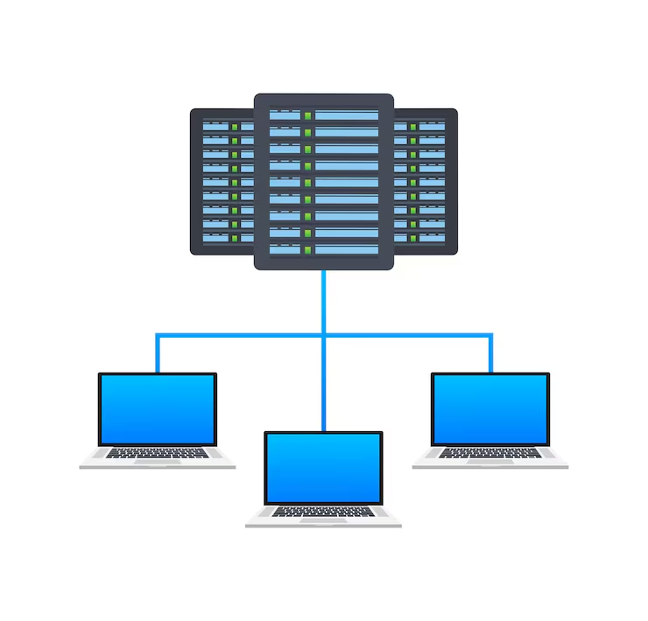
Parallelization on our cluster — Why parallelize?
Why Parallelize?
To reduce time-to-results by using multiple computing resources simultaneously.
Parallel programming can:
Get your analysis done in minutes instead of hours or days.
Maximize the utilization of available cluster resources.
Enable massive, computationally demanding workflows (e.g., population-scale genomics)
Main Parallel Models in HPC
OpenMP — Shared-Memory Parallelism
Multiple threads (~CPUs) work together inside a single node, sharing a common pool of RAM.
MPI — Distributed-Memory Parallelism
Multiple independent processes work across multiple separate nodes, communicating data over the high-speed network.
In short:​
OpenMP → one node, many threads​
MPI → multiple processes, potentially across many nodes​
​
Notes:
Parallel programing -- OpenMP and MPI
Parallel programming splits a job into smaller pieces that run at the same time on multiple CPU cores and/or machines.
We use it to finish faster and to handle larger datasets than a single core or single machine can manage.
In HPC, it reduces time-to-results, makes better use of cluster resources, and cuts wall-clock time for analyses.
The two most used HPC models are OpenMP and MPI.
They target different scenarios: OpenMP (shared memory, one node) vs MPI (distributed memory, many nodes).
Parallel programing -- OpenMP and MPI
Parallel programming splits a job into smaller pieces that run at the same time on multiple CPU cores and/or machines.
We use it to finish faster and to handle larger datasets than a single core or single machine can manage.
In HPC, it reduces time-to-results, makes better use of cluster resources, and cuts wall-clock time for analyses.
The two most used HPC models are OpenMP and MPI.
They target different scenarios: OpenMP (shared memory, one node) vs MPI (distributed memory, many nodes).

Slide 34
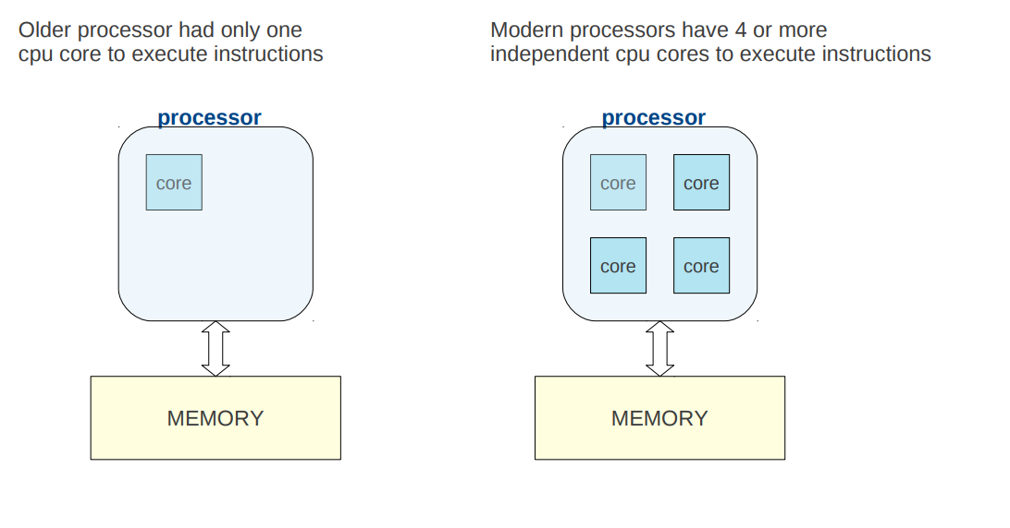
Parallelization on our cluster — OpenMP vs MPI
Parallelization on our cluster — OpenMP
Why parallel computing?
Why parallel computing?

Slide 35
Parallelization on our cluster — OpenMP vs MPI
Parallelization on our cluster — OpenMP
Why parallel computing?
Why parallel computing?

Slide 36
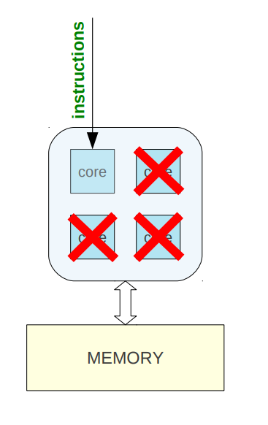
Parallelization on our cluster — OpenMP vs MPI
Why parallel computing?
When you run a sequential program it has an instruction to run a task on 1 core.
Other cores are idle

Slide 37
Parallelization on our cluster — OpenMP vs MPI
Why parallel computing?
When you run a sequential program it has an instruction to run a task on 1 core.
Other cores are idle
Waste of available resources…

Slide 38
Parallelization on our cluster — OpenMP
OpenMP Essentials
Intra-Node Parallelism:
multiple computational workers (threads) inside a single process running on one node.
1 Thread ≈ 1 CPU:
The program dynamically splits its workload among the available CPU cores of that machine.
Shared RAM:
Every thread can directly read from and write to the same central memory space.
Most bioinformatics tools use the OpenMP model
Aligners
Assemblers
Read Processing
Variant Callers
…

Slide 39
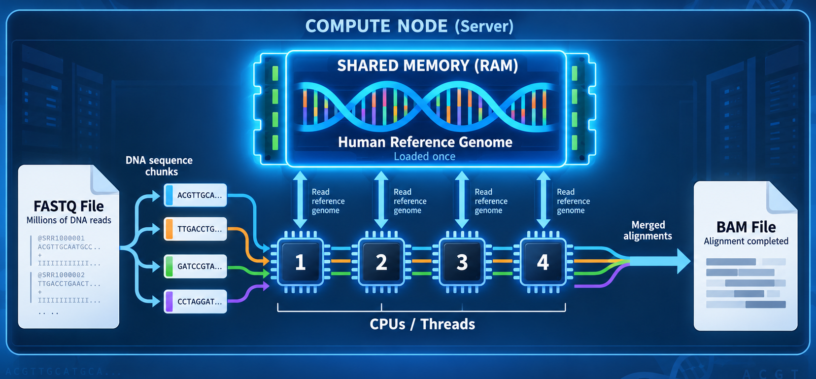
Parallelization on our cluster — OpenMP

Slide 40
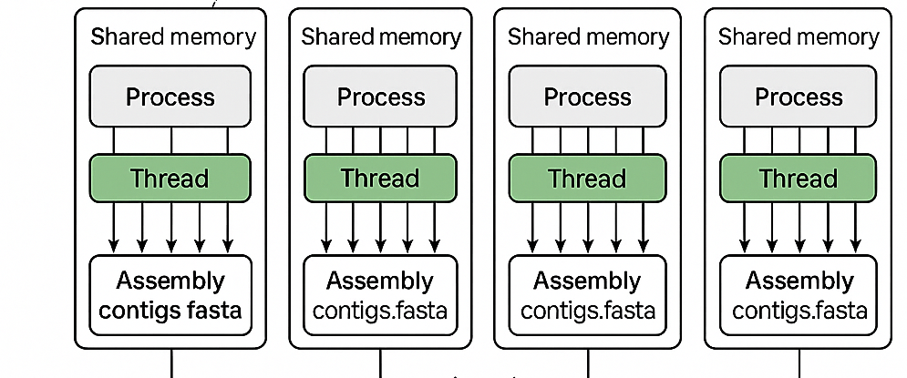
Parallelization on our cluster — OpenMP
Sample 1
Sample 2
Sample 3
Sample 4
Nodo 1
Nodo 2
Nodo 3
Nodo 1

Slide 41
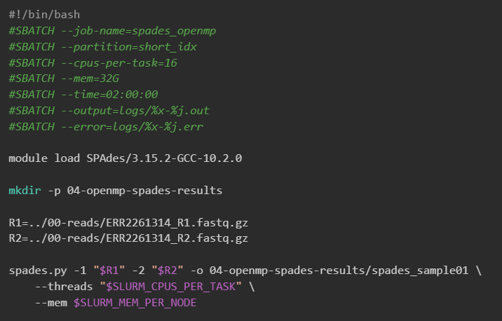
Parallelization on our cluster — OpenMP

Slide 42
Parallelization on our cluster — MPI
MPI Essentials
It is designed to run an application using multiple separate processes, possibly on different nodes of a cluster
When: multinode scaling & very large memory needs.
Shares resources by passing messages over the cluster’s network → network issues can stop the job
Only a few bioinformatics tools use the MPI model
RAxML
IQ-Tree

Slide 43
Parallelization on our cluster — MPI
MPI Essentials
It is designed to run an application using multiple separate processes, possibly on different nodes of a cluster
When: multinode scaling & very large memory needs.
Shares resources by passing messages over the cluster’s network → network issues can stop the job
Otras áreas
Modelos de propagación de enfermedades
Reconstrucción de imágenes 3D
Modelos climáticos y de contaminación
Sincronización de modelos ML (gradient descent trees)

Slide 44

Ejemplo de MPI con herramienta bioinfo RAxML
Imagina un alineamiento de 100.000 secuencias.
No cabe en memoria de un solo nodo.
Necesitas usar varios nodos, cada uno procesa una parte del árbol y comparten información vía mensajes.

Slide 45
Ejemplo de MPI con herramienta bioinfo RAxML
Imagina un alineamiento de 100.000 secuencias.
No cabe en memoria de un solo nodo.
Necesitas usar varios nodos, cada uno procesa una parte del árbol y comparten información vía mensajes.

Slide 46
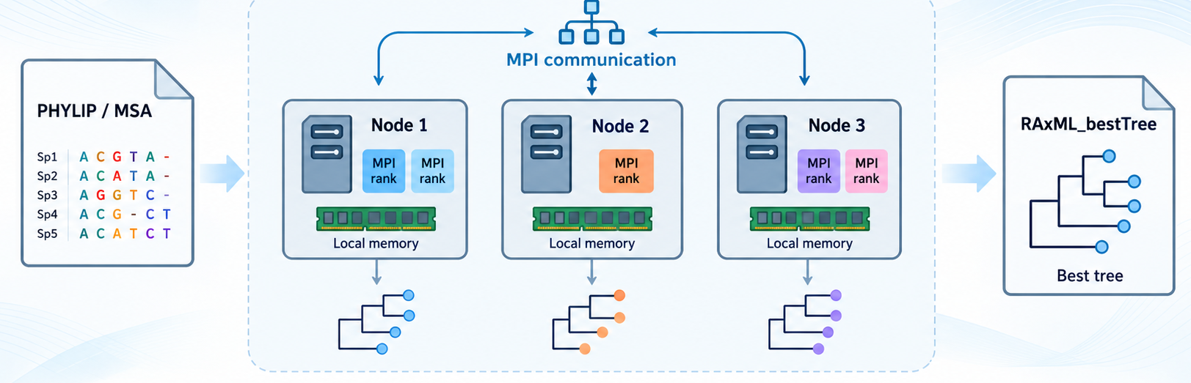
Ejemplo de MPI con herramienta bioinfo RAxML
MPI ranks communicate by exchanging messages; across nodes, those messages travel through the cluster network.

Slide 47
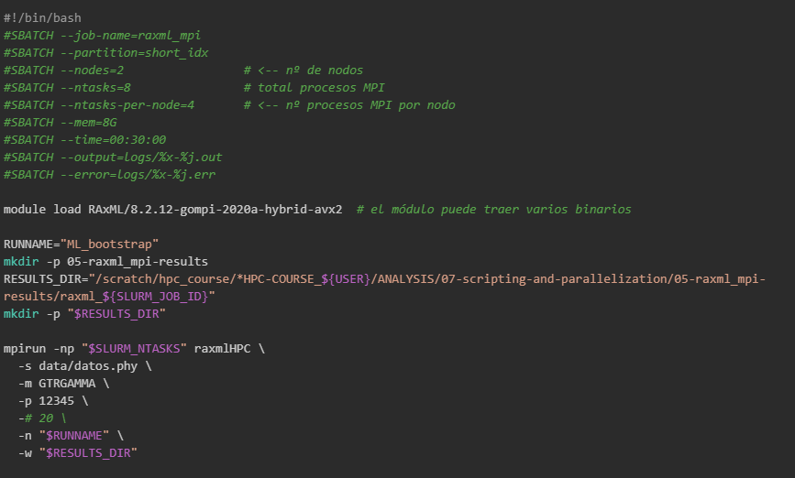
Ejemplo de MPI con herramienta bioinfo RAxML

Slide 48
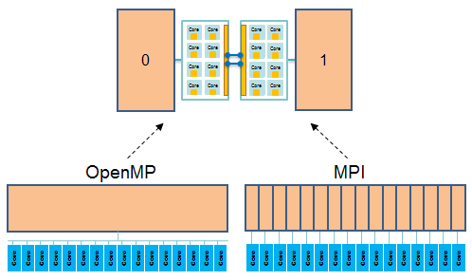
Summary
OpenMP
  launch one process per node, just on a single node
  share data using shared memory
  can't share data with a different process
MPI
  launch one process per core, on one node or on many nodes.
  pass messages among processes without concern for node location: allows intra and inter node communication.
https://cvw.cac.cornell.edu/hybrid-openmp-mpi/intro/node-views

Slide 49
Parallelization on our cluster — OpenMP vs MPI
KEY DIFFERENCES
Technology | Parallelization level | Communication between processes | Typical use case | Usage (sbatch script)
OpenMP | Within one node | Shared memory: all threads access the same RAM | Align 200 million reads on one node using all its cores | --cpus-per-task (threads) --mem (Ram for the whole process)
MPI | Across multiple nodes | Distributed memory: each node has its own RAM; communication by network | Build a very large phylogenetic tree by splitting the work over 4 nodes | --nodes --ntasks --ntasks-per-node

Slide 50
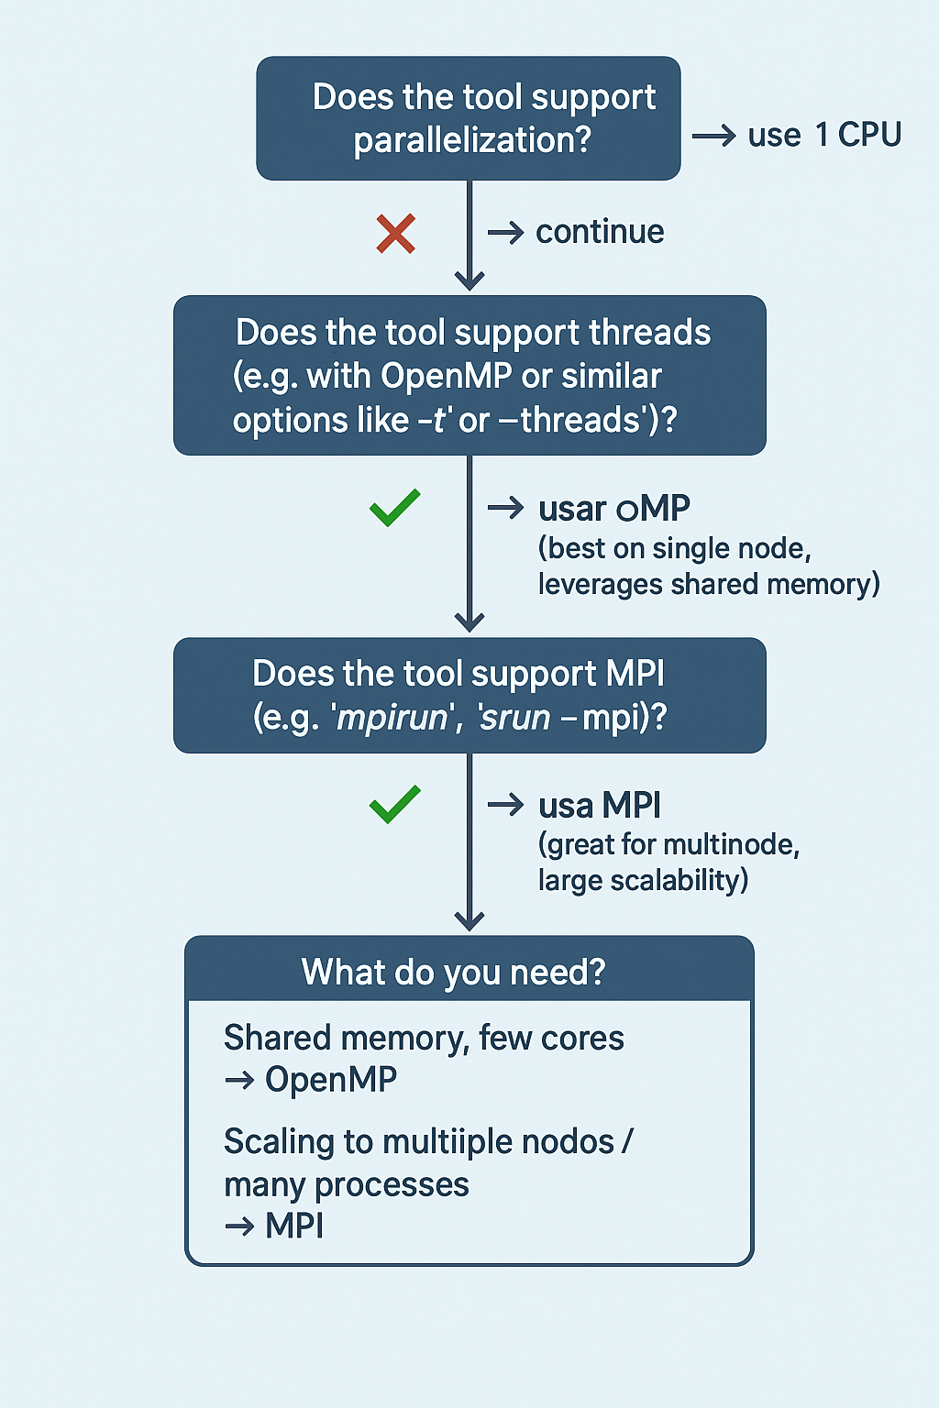
Parallelization on our cluster — OpenMP vs MPI
When to use OpenMP vs MPI?

Slide 51
Thank you for your attention
Questions?

Slide 52

HANDS-ON

