Slide 1
Exploratory data analysis on Air passenger data and Best burger place data
Example Project I slide

Slide 2
Air passenger data
Dataset Description
The AirPassengers dataset records monthly totals of international airline passengers from 1949 to 1960 (144 observations). It is a classic time series dataset built into R.
Preprocessing
No missing values. Data loaded directly as a ts object in R. Year and Month variables were extracted for EDA. Values represent thousands of passengers.
R Summary Output
Min: 104 1st Qu: 180 Median: 265 Mean: 280 3rd Qu: 360 Max: 622

Slide 3
The best burger place
Dataset Description
Survey data collected from SurveyUSA asking respondents their favorite burger place, also recording gender. Total of 500 respondents (252 Female, 248 Male).
Variables
best_burger_place (categorical): In-N-Out Burger, Tommy’s Hamburgers, Other, Fat Burger, Not Sure, Five Guys Burgers, Umami Burger
gender (categorical): Male / Female
Key Finding
In-N-Out Burger is the dominant preference (343/500 = 68.6%), far ahead of all other options.

Slide 4
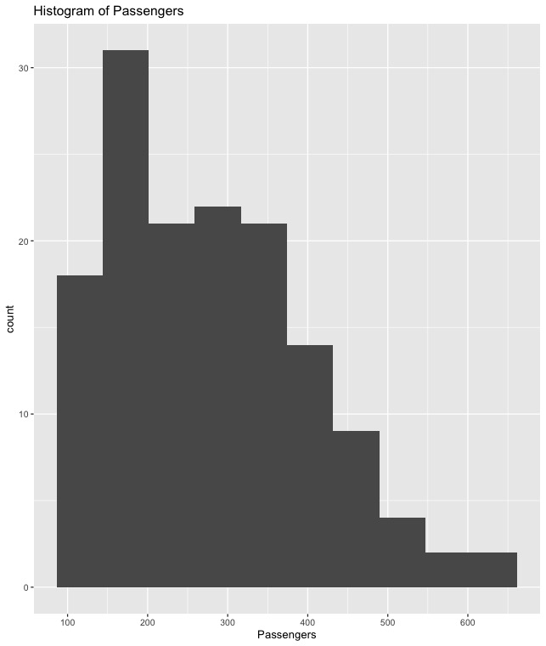
Air passenger data
Histogram: Distribution of Monthly Passengers
The histogram shows a right-skewed distribution. Most months fall between 100–300K passengers, with a long tail extending toward 622K.
Table: Average Annual Passengers (thousands)
Year 1949: 126 | Year 1950: 150 | Year 1951: 179 | Year 1952: 199
Year 1953: 226 | Year 1954: 237 | Year 1955: 284 | Year 1956: 316
Year 1957: 357 | Year 1958: 374 | Year 1959: 422 | Year 1960: 476

Slide 5
The best burger place
Contingency Table: Burger Preference by Gender
Best burger place | Male | Female
Fat Burger | 12 | 10
Five Guys Burgers | 6 | 5
In-N-Out Burger | 181 | 162
Not Sure | 5 | 13
Other | 20 | 26
Tommy's Hamburgers | 27 | 27
Umami Burger | 1 | 5

Slide 6
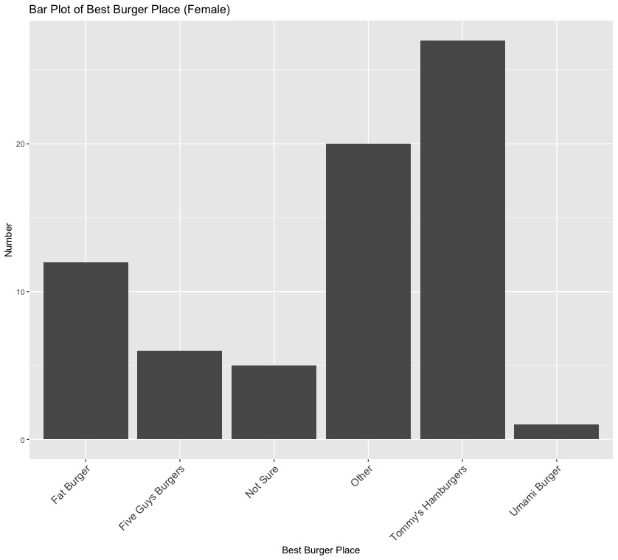
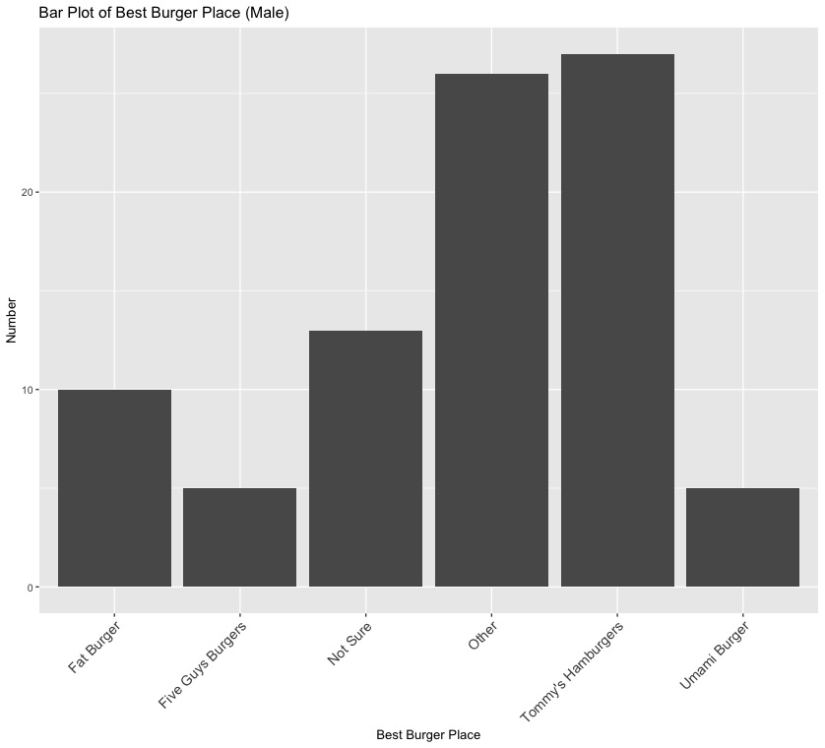
Barplot

Slide 7
Conclusion and future work
Conclusion 1: Air Passenger Trend
International air travel grew steadily from 1949 to 1960, with average annual passengers nearly quadrupling from 126K to 476K per month, indicating rapid post-war aviation growth.
Conclusion 2: Seasonality Pattern
Strong seasonal patterns are present each year, with passenger peaks in July–August and troughs in November–February, reflecting summer vacation travel habits.
Conclusion 3: Burger Preferences
In-N-Out Burger is overwhelmingly preferred (68.6%), with similar preferences across genders. Tommy’s Hamburgers and “Other” are distant second choices.
Future Work
Expand burger survey to include additional demographics (age, income, location) and test statistical significance of gender differences using chi-square test.

Slide 8
Roles and responsibilities
Ronald Fisher: Air Passenger Data EDA
David Cox : Burger Place Data numerical EDA
C. R. Rao : Data quality assessment and preprocessing
Andrey Markov : Coordination, documentation

Slide 9
reference
Box, G. E. P., Jenkins, G. M., Reinsel, G. C., & Ljung, G. M. (2015). Time Series Analysis: Forecasting and Control (5th ed.). Wiley.
R Core Team (2023). R: A Language and Environment for Statistical Computing. R Foundation for Statistical Computing, Vienna, Austria. https://www.R-project.org/
SurveyUSA (2012). Best Burger Place Survey. Retrieved from https://www.surveyusa.com/client/PollPrint.aspx?g=3f69bdaa-a964-4b39-b34a-cab2112e3e31&d=0
Hyndman, R. J., & Athanasopoulos, G. (2021). Forecasting: Principles and Practice (3rd ed.). OTexts. https://otexts.com/fpp3/

Slide 10
Questions?

