Slide 1
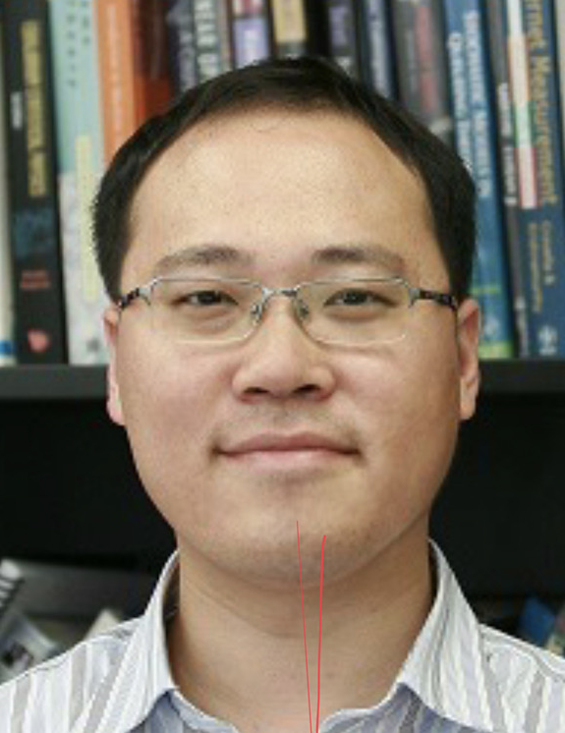
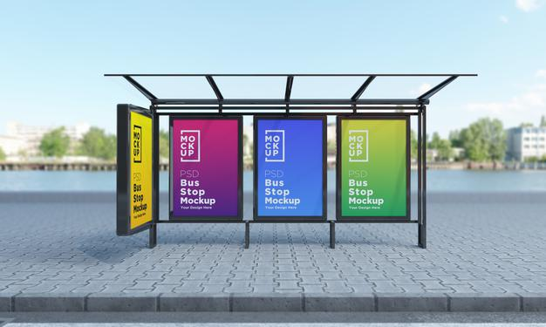
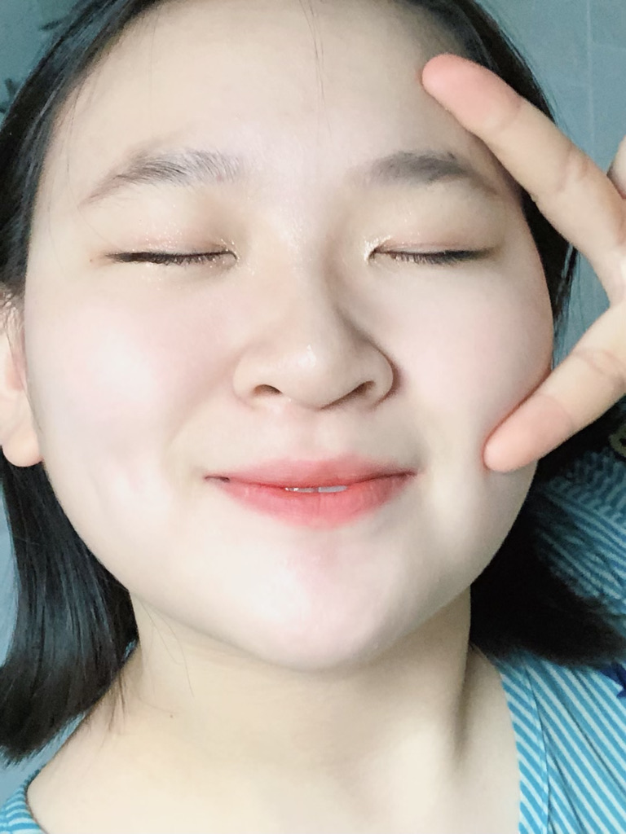
How long do I have to wait?
No bus arrives
Yung arrives
time
0
m mins
time
0
m mins
How long do I have to wait?
Lin arrives

