Slide 1
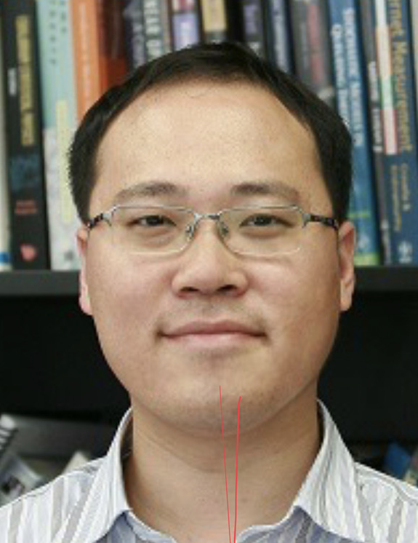
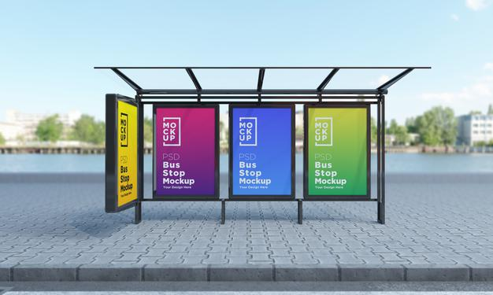

How long do I have to wait? Probability of waiting for more than n mins?
No bus arrives
Yung arrives
time
0
m mins
A bus left at time 0
time
0
How long do I have to wait? Probability of waiting for more than n mins?
Lin arrives

