Slide 1

Curating Log files
Gopalika Sharma Prachi ved
Paarth Kotak Rashi Chauhan

Slide 2
Purpose of our project
To build a system which will start to capture the system logs generated at MOC, automate the process of anonymizing logs and organize logs by a methodology which will help to see if there is a pattern such as demands on different services and how they are correlated.

Slide 3
Technology Overview
OpenShift: Enterprise-ready Kubernetes container platform with Full–stack automated operations to manage hybrid cloud and multi-cloud deployments.
Elasticsearch: Search engine which provides a distributed multi-tenant capable full text search engine.
Kibana : Open source data visualization plugin for Elasticsearch.

Slide 4
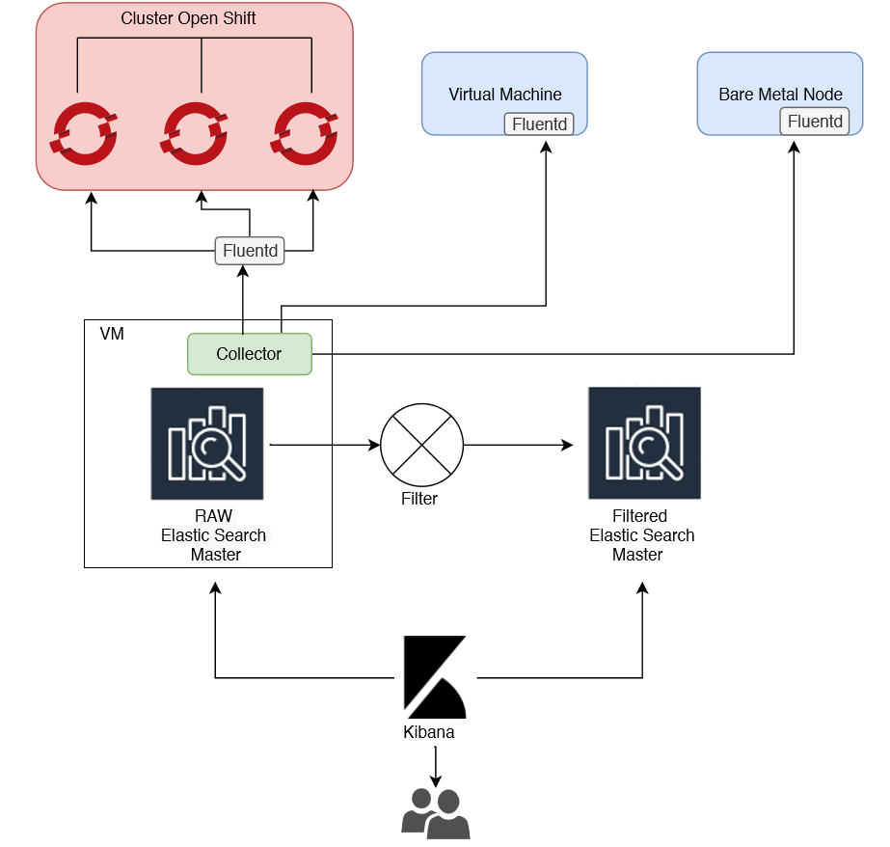

Slide 5
Component Description
Sources: (OpenShift Cluster, VMs and Bare metal nodes) - Fluentd pods consisting of multiple containers will collect all the logs pertaining to that pod and store it in a file named fluentd.log.
Collector: Script to collect logs from all fluentd.log on all sources and push them in ElasticSearch index.
RAW ElasticSearch Master: Index containing all raw log files.
Filter Script: Filter the raw log files using Machine Learning algorithms (After analyzing PII we will decide on a feasible algorithm).
Filtered Elastic Search Master: Index containing all curated log files.
Kibana:View the logs.

Slide 6
Lets have a look at the logs..

Slide 7


