Slide 1
Network Programmability as a Cloud Service
Akshay Battaje
Amey Uchagaonkar
Anuj Tyagi
Deepanshu Lulla
Mentor
Dr. Somaya Arianfar

Slide 2
Sprint 3 Goal
Creating two hardware domains
Extracting databases from both domains
Combining databases as per tenants

Slide 3
Network Topology
1
s1
2
3
3
Virtual Port Number
1
s2
2
1
s5
2
3
3
3
3
s3
s4
s6
s7
1
2
1
2
1
2
1
2
h1
h2
h3
h4
h5
h6
h7
h8
Legend
= Tenant 1
Hardware Domain 1
Hardware Domain 2
= Unallocated

Slide 4
Hardware Domain 1
1
s1
2
3
3
1
s2
2
1
s5
2
3
3
3
3
s3
s4
s6
s7
1
2
1
2
h1
h2
h3
h4
Legend
= Tenant 1
= Unallocated

Slide 5
Hardware Domain 2
1
s1
2
3
3
1
s2
2
1
s5
2
3
3
3
3
s3
s4
s6
s7
1
2
1
2
h5
h6
h7
h8
Legend
= Tenant 1
= Unallocated

Slide 6
Problems Faced
A

Slide 7
Demo

Slide 8
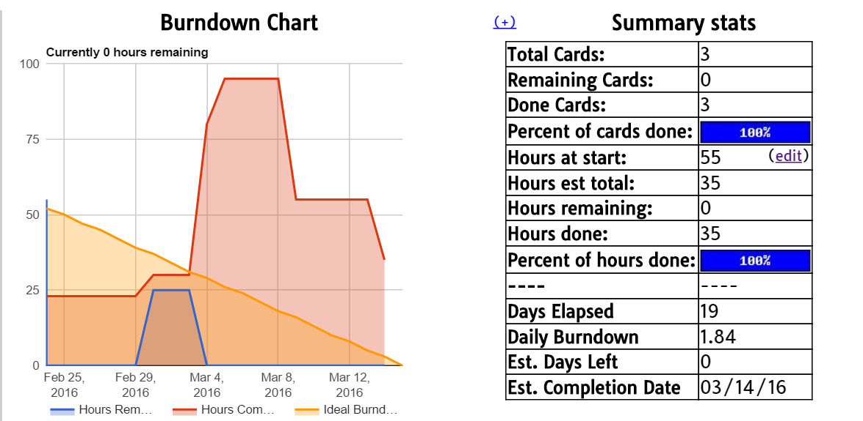
Burndown Chart

Slide 9
Questions?

Slide 10
Thank You

