Slide 1
Network Programmability as a Cloud Service
Deepanshu Lulla Anuj Tyagi
Akshay Battaje Amey Uchagaonkar
Mentor: Dr. Somaya Arianfar

Slide 2
PROJECT OVERVIEW
Goals
Offer Network Programmability as a service
Solving problem of scaling across multiple IaaS providers
Users
Infrastructure as a Service (IaaS) providers
End Product
Provide APIs to IaaS providers

Slide 3
Proposed Project Architecture
Controller 1
Controller N
Controller 1
Controller N
OpenVirteX
OpenVirteX
Switch 1
Switch 2
Switch 3
Switch 4
Host 1
Host 2
Host 3
Host 4
Host 5
Host 6
Host 7
Host 8
Network 1
Network 2

Slide 4
Sprint 1
Create a simple network topology in Mininet
Send packets across multiple OpenVSwitches using OpenDaylight controller

Slide 5
Mininet
Network emulator to create host/servers, switches and routers
Uses Python to create topologies
Hosts behave like real machine (SSH)
Hosts transmit packets with stated speed and delay
Switches queue packets
Advantages
Create custom small to complex large-scale topologies quickly
Runs on any Linux box or Amazon EC2 cloud
Provides flexibility to customize packet forwarding using OpenFlow protocol

Slide 6
OpenFlow
Open standard to control forwarding tables of network devices
Standardized protocol – control forwarding of switches across multiple vendors
Separates data path and control path
OpenFlow Switch and Controller

Slide 7
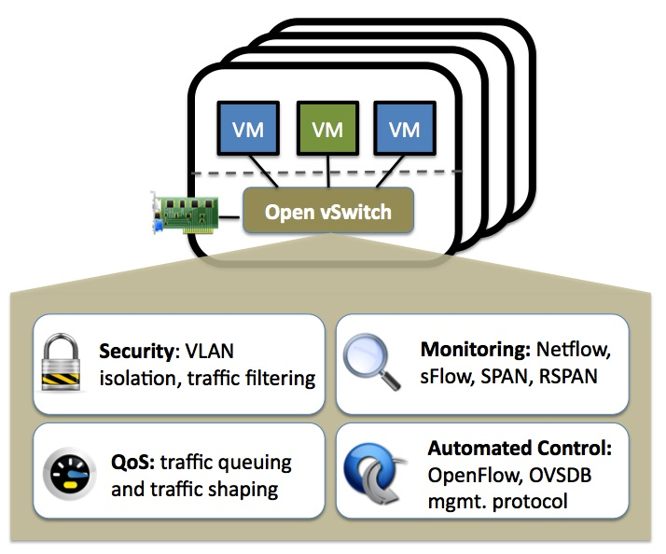
Open virtual switch
Open-source distributed virtual multilayer switch
Switching stack for hardware virtualization environments
Enable massive network automation through programmatic extension
Supports distribution across multiple physical servers

Slide 8
Controller opendaylight
Multi-protocol controller infrastructure
Highly available, Modular, Extensible, Scalable
Model-driven service abstraction platform
Supports modern heterogeneous multi-vendor networks

Slide 9
Sprint 1:Creating a network
10.2
Controller
Switch 1
Switch 2
Switch 3
Host
A
Host
B
Host
C
10.0.0.1
10.0.0.2
10.0.0.3

Slide 10
NETWORK CONTROL AND DATA PLANE SHARING
Concerns:
Switches shared and controlled by multiple cloud providers
Who manages what
Who interacts with whom
Minimal infrastructure to support
Offer network resources and control as independent service
Full partioning/virtualization of network resources
Notes:
I am nor sure why this slide is there?

Slide 11
DEMO

Slide 12
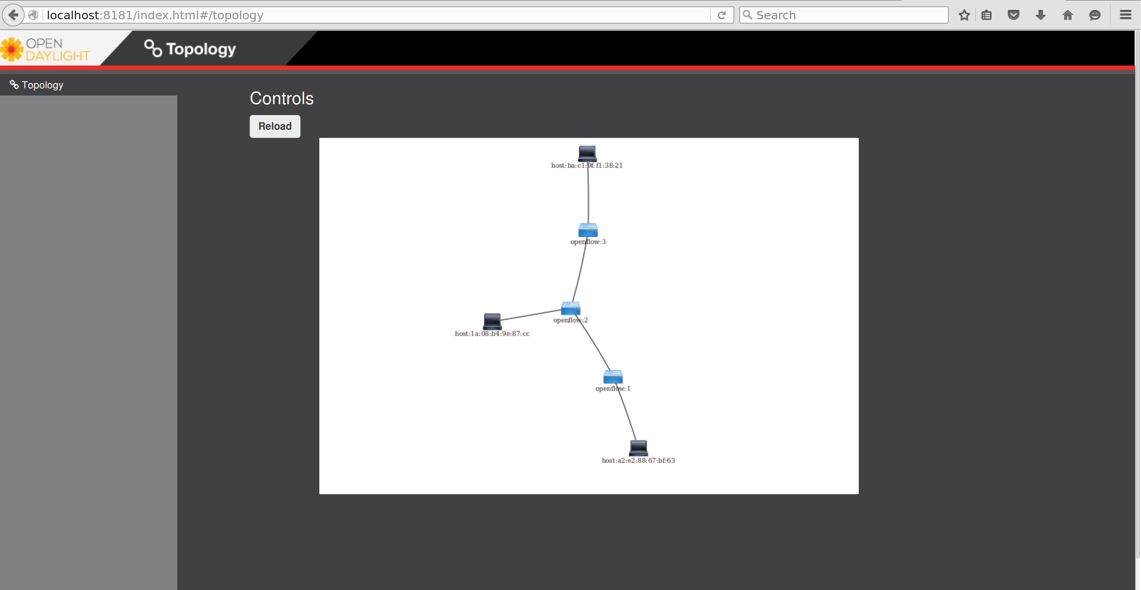
$sudo mn --controller=remote,ip=127.0.0.1 --topo=linear,3

Slide 13
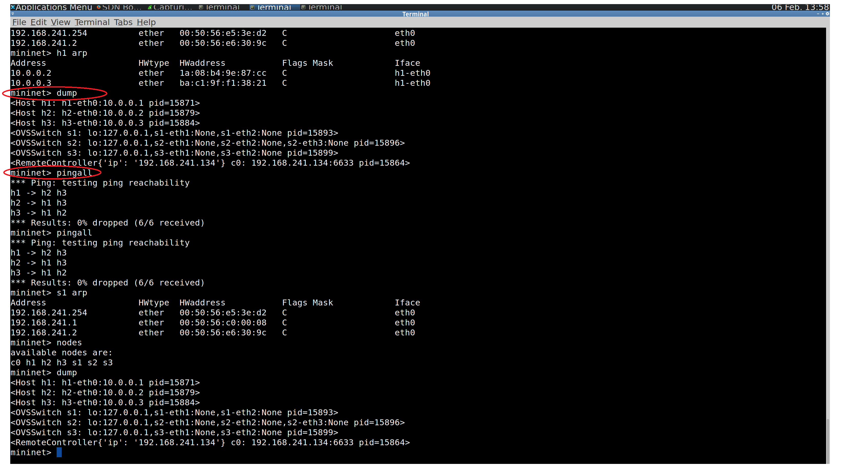

Slide 14
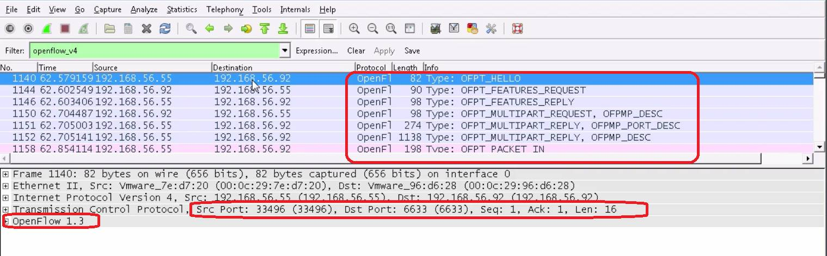
Analysis of packets

Slide 15
SPRINT 2
Configure learning switch with OpenDaylight
Add flows and flow table using OpenFlow in OVS.
Create administrative domain with multiple networks
Connect the multiple networks in current topology

Slide 16
Sprint 2:Scaling to multiple networks
Controller
Switch 1
Switch 2
Switch 3
Switch 4
Host
A
Host
B
Host
C
Host
D
Subnet 1
Subnet 2

Slide 17
QUESTIONS?

