Slide 1
Network Programmability as a Cloud Service
Akshay Battaje
Amey Uchagaonkar
Anuj Tyagi
Deepanshu Lulla
Mentor
Dr. Somaya Arianfar

Slide 2
Sprint 3 Goal
Creating two hardware domains
Extracting databases from both domains
Combining databases as per tenants

Slide 3
Network Topology
1
s1
2
3
3
Virtual Port Number
1
s2
2
1
s5
2
3
3
3
3
s3
s4
s6
s7
1
2
1
2
1
2
1
2
h1
h2
h3
h4
h5
h6
h7
h8
Legend
= Tenant 1
Hardware Domain 1
Hardware Domain 2
= Unallocated

Slide 4
Hardware Domain 1
1
s1
2
3
3
1
s2
2
1
s5
2
3
3
3
3
s3
s4
s6
s7
1
2
1
2
h1
h2
h3
h4
Legend
= Tenant 1
= Unallocated

Slide 5
Hardware Domain 2
1
s1
2
3
3
1
s2
2
1
s5
2
3
3
3
3
s3
s4
s6
s7
1
2
1
2
h5
h6
h7
h8
Legend
= Tenant 1
= Unallocated

Slide 6
Problems faced in this Sprint
1) Figuring out how Open virtex stores its virtual topology database and extracting it.[Solved]
2) Setting up environment to build java projects in custom Ubuntu Images like Openvirtex often result in errors. Run time errors are difficult to debug.

Slide 7
Problems We are still facing…
Designing and implementing a protocol that automatically communicates the virtual topology database(OVX DB) is a big challenge within this limited time range.
Trying to setup environment with Ubuntu images. The project required setting up 7 Virtual Machines each for
-4 Controllers(to represent 2 IaaS providers)
-2 OVX instances
-1 Mininet
Need to set up 7 virtual machines takes lot of memory and storage and laptop often gets very slowed down and starts giving weird errors.
3) Open virtex is not very good with its documentation and has lot of unpredictable errors. [Not Solved]

Slide 8
Demo

Slide 9
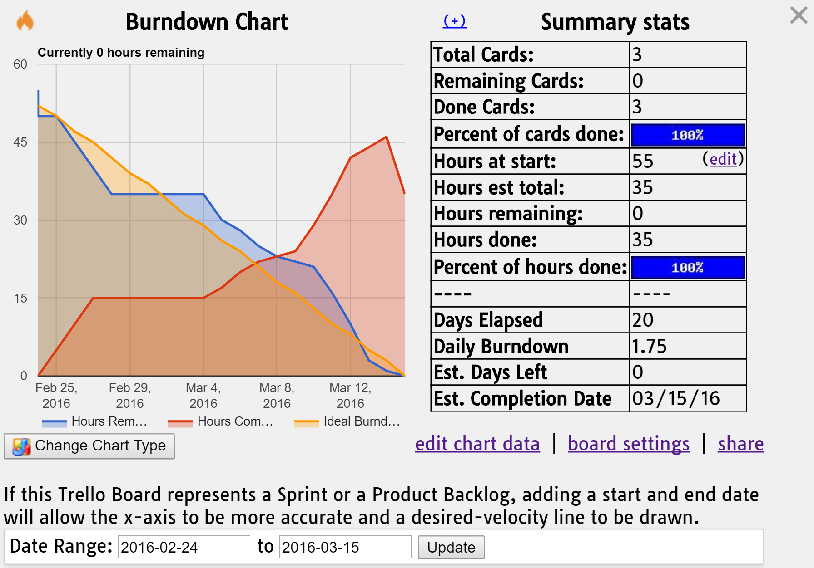
Burndown Chart

Slide 10
Questions?

Slide 11
Thank You

