Slide 1
Network Programmability as a Cloud Service
Deepanshu Lulla Anuj Tyagi
Akshay Battaje Amey Uchagaonkar
Mentor: Dr. Somaya Arianfar

Slide 2
PROJECT OVERVIEW
Goals
Offer Network Programmability as a service
Solving problem of scaling across multiple IaaS providers in MOC
Users
Infrastructure as a Service (IaaS) providers
End Product
Provide APIs to IaaS providers

Slide 3
Software defined networks(overview)
Software Defined Networking (SDN) is an emerging network architecture where network control is decoupled from forwarding and is directly programmable.
Application
Layer
Business Applications
API
API
Control
Layer
SDN
Control
Software
Network Services
Control Data Plane Interface (e.g. OpenFlow)
Network Devices
Network Devices
Network Devices
Infrastructure
Layer
Network Devices
Network Devices
Network Devices

Slide 4
Terms and definitions
Administrative Domain
Group of networks under one IaaS provider.
Network Abstraction Layer
Separates control plane into two parts. (eg OpenVirteX, Flow visor)

Slide 5
Proposed Project Architecture
Controller 1
Controller N
Controller 1
Controller N
Network Abstraction layer
Network Abstraction layer
Switch 1
Switch 2
Switch 3
Switch 4
Host 1
Host 2
Host 3
Host 4
Host 5
Host 6
Host 7
Host 8
Administrative Domain 1
Administrative Domain 2

Slide 6
Sprint 1
Create a simple network topology in Mininet
Send packets across multiple OpenV Switches using Open Daylight controller

Slide 7
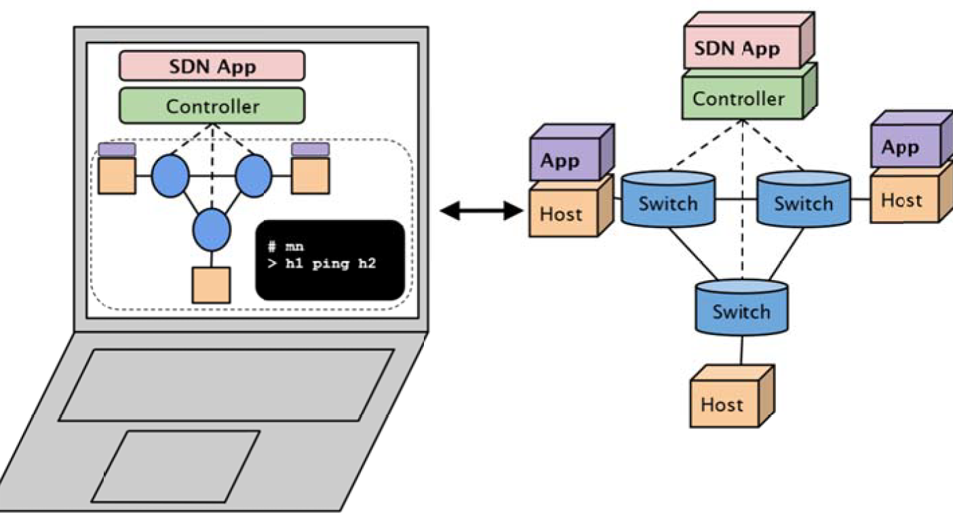
Tools and Technologies: Mininet
Network emulator
Hosts behave like real machine.
Allows modelling of network based on bandwidth, latency etc.
Uses Python/Command line arguments(mn) to create topologies
Figure adapted from [3]

Slide 8
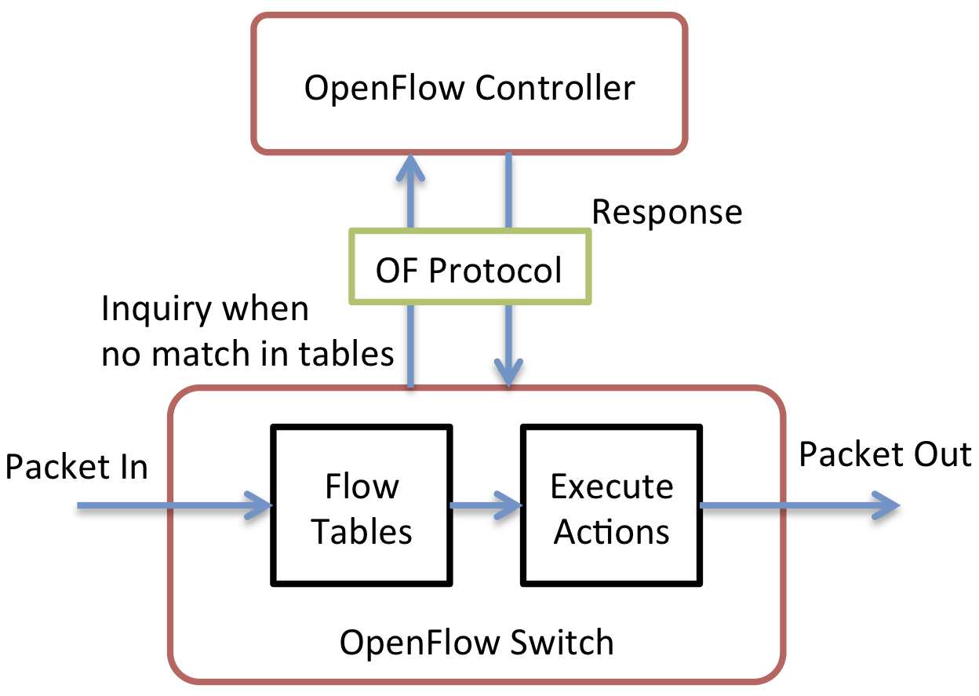
Tools and Technologies: Open Flow
Open standard to control forwarding tables of network devices
Standardized protocol – control forwarding of switches across multiple vendors
Separates data plane and control plane
Figure taken from [1]

Slide 9
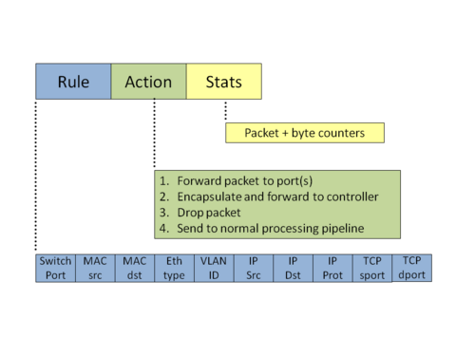
Tools and Technologies: Flow table
Figure adapted from [2]

Slide 10
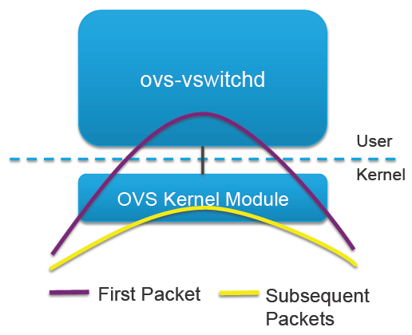
Tools and Technologies: Open virtual switch
Open-source distributed virtual multilayer switch. Main components: OVS-vswitchd, OVS-database(OVSDB)-server and OVS-kernel
Decides how to process packet made in user space
In a virtual network, virtual switch acts like an advanced edge switch for VMs.

Slide 11
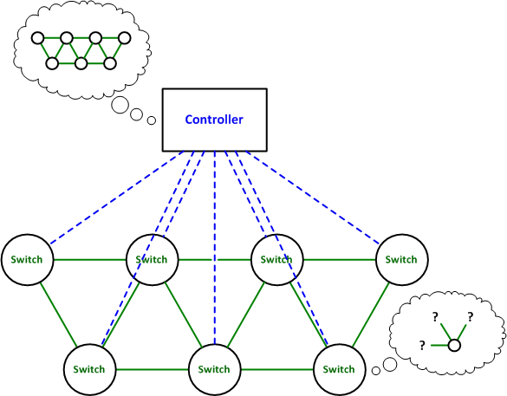
Tools and Technologies: Controller
An SDN Controller in a software-defined network (SDN) is the “brains” of the network.
It is the strategic control point in the SDN network, relaying information to the switches/routers ‘below’ (via southbound APIs) and the applications and business logic ‘above’ (via northbound APIs). [4]
Adapted from [5]

Slide 12

Tools and Technologies: Open daylight Controller
Formed in April 2013
Open source SDN project hosted by the Linux Foundation.
Created in order to advance software-defined networking (SDN) adoption and
form basis for a strong network functions virtualization (NFV).
Founding members included Arista Networks, Big Switch Networks, Brocade, Cisco, Citrix, Ericsson, HP, IBM, Juniper Networks, Microsoft, NEC, Nuage Networks, PLUMGrid, Red Hat, and VMware

Slide 13


Lithium
DLUX
VTN Coordinator
OpenStack Neutron
SDNI Wrapper
Network Applications
Orchestrations & Services
AAA AuthN Filter
OpenDaylight APIs REST/RESTCONF/NETCONF
Base Network Functions
Network Services
Network Abstractions (Policy/Intent)
Platform Services
OpenFlow Stats Manager
Service Function Chaining
OVSDB Neutron
Authentication, Authorization & Accounting
Controller Platform Services/Applications
OpenFlow Switch Manager
Reservation
Device Discovery, Identification & Driver Management
OpenFlow Forwarding Rules Mgr
Virtual Private Network
ALTO Protocol Manager
Neutron Northbound
L2 Switch
Virtual Tenant Network Mgr.
LISP Service
Network Intent Composition
Persistence
Host Tracker
Unified Secure Channel Mgr
DOCSIS Abstraction
Group Based Policy Service
SDN Integration Aggregator
Topology Processing
Link Aggregation Ctl Protocol
SNMP4SDN
Time Series Data Repository
Messaging (Notifications / RPCs)
Service Abstraction Layer/Core
Data Store (Config & Operational)
OpenFlow
OVSDB
NETCONF
LISP
BGP
PCEP
CAPWAP
OPFLEX
SXP
SNMP
USC
SNBI
HTTP
CoAP
LACP
PCMM/COPS
Southbound Interfaces &
Protocol Plugins
OpenFlow Enabled Devices
Open vSwitches
Additional Virtual & Physical Devices
Data Plane Elements
(Virtual Switches, Physical Device Interfaces)
Notes:
Lithium Diagram, July 2015

Slide 14
Sprint 1:Creating a SDN based network
10.2
Controller
Switch 1
Switch 2
Switch 3
Host
A
Host
B
Host
C
10.0.0.1
10.0.0.2
10.0.0.3

Slide 15
DEMO

Slide 16
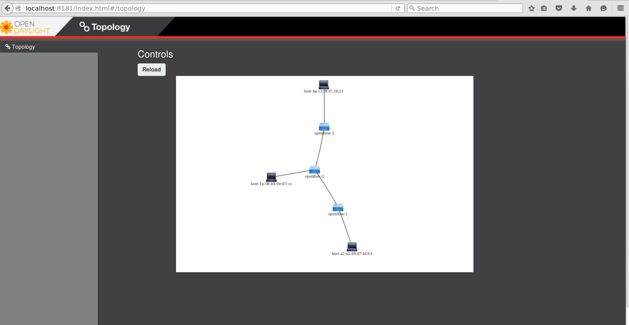
$sudo mn --controller=remote,ip=127.0.0.1 --topo=linear,3

Slide 17
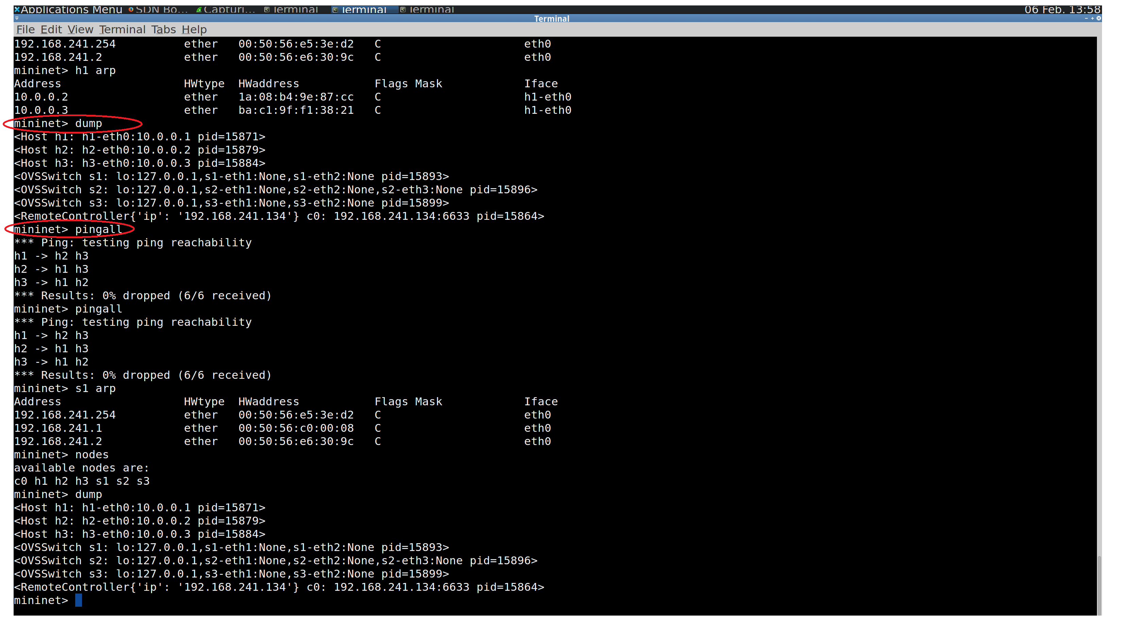

Slide 18
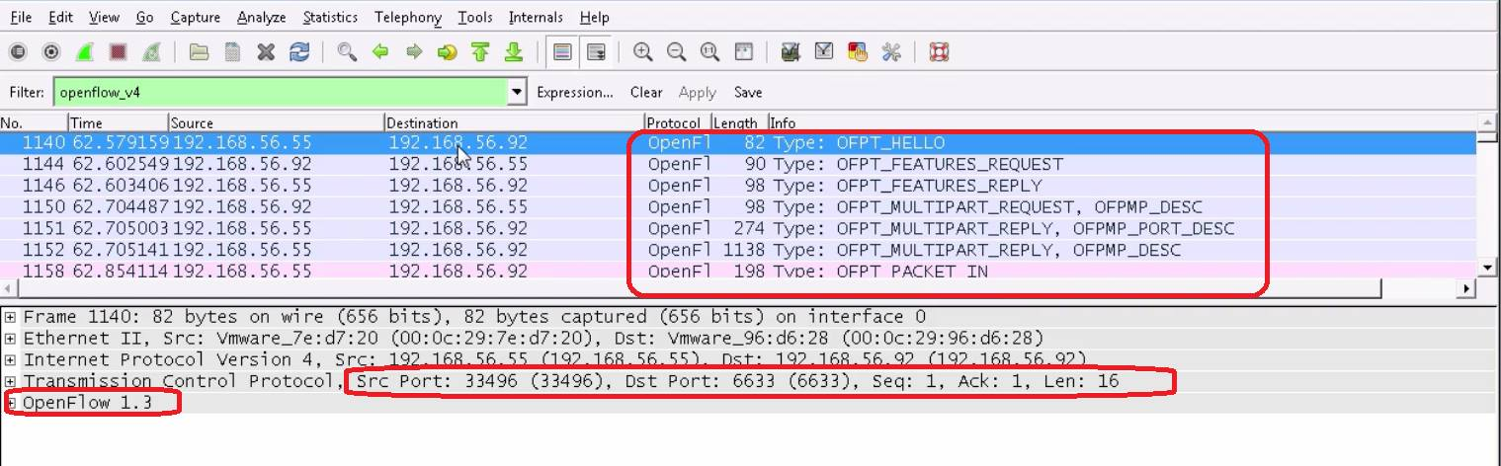
Analysis of packets
Notes:
We need to show a pcap file here for analysis. Also need to add a sl

Slide 19
SPRINT 2:goals
User Story: Create administrative domain with multiple networks
Developing a learning switch(layer 2 or 3) with OpenDaylight.
Connect the multiple networks in current topology

Slide 20
Sprint 2:Scaling to multiple networks
Controller
Switch 1
Switch 2
Switch 3
Switch 4
Host
A
Host
B
Host
C
Host
D
Subnet 1
Subnet 2

Slide 21
References
[1] https://s3f.iti.illinois.edu/usrman/openflow.html
[2] http://yuba.stanford.edu/cs244wiki/index.php/Overview
[3] Stanford seminars
[4] http://searchsdn.techtarget.com/definition/SDN-controller-software-defined-networking-controller

Slide 22
QUESTIONS?

