Slide 1
Network Programmability as a Cloud Service
Akshay Battaje
Amey Uchagaonkar
Anuj Tyagi
Deepanshu Lulla
Mentor
Dr. Somaya Arianfar

Slide 2
Terminologies
Pods:
A collection of hardware resources.
Hardware Domain :
A collection of pods managed by an Administrative entity.
Eg: NEU HW domain is a collection of pods managed by NEU
IaaS Provider (Tenant) :
HW domain can be partitioned based on tenants
A tenant can reserve resources across multiple HW domains.
Notes:
Eg: Amazon can be a tenant having few storage resources within NEU pod and few computation resources within BU pod. Similary Microsoft can

Slide 3
Project Overview
Expanding across multiple hardware domains for tenants in MOC.
A tenant should be able to allocate resources in multiple hardware domains and should be able to have control over them as with those in a single domain.
Minimum Acceptance Criterion:
Communication among hosts in multiple HW domains. (achieved within this sprint)

Slide 4
Technologies
Mininet: Simulation of Physical topology of switches and hosts using Open Virtual Switches
Controller: Control plane for managing the physical topology
OpenVirtex: Network Virtualization layer between Controllers and Switches.
Mongodb: Virtual topology is stored in MongoDb NOSQL Database.

Slide 5
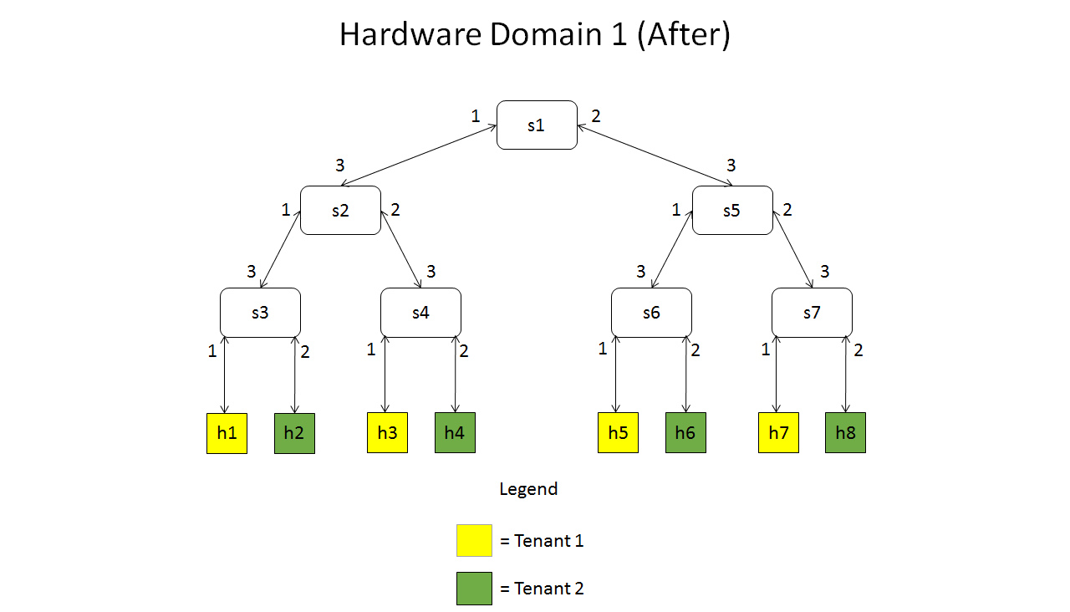
Network Topology

Slide 6
Assumptions
Tenant IDs are global.
Host IDs are unique.
There exists a central database to which all OVX instances connect and sync.
All the hosts are in the same subnet.
All the OVXs are in the same subnet.

Slide 7
Accomplishments per Sprint
Sprint 1
Getting familiar with technologies
Sprint 2
Creation of one HW domain with multiple tenants
Sprint 3
Created two hardware domains
Extracted databases from both domains

Slide 8
Sprint 4 Accomplishments
Upload/Create VMs on MOC
Combine the necessary parts of databases from both hardware domains
Write python script to make the required changes in OVX virtual topologies

Slide 9
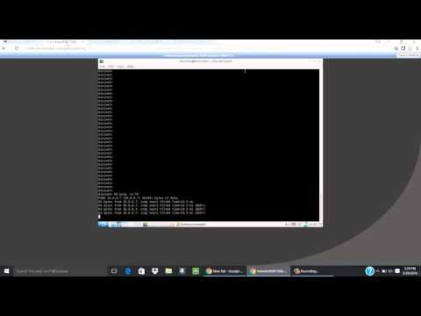
Demo

Slide 10
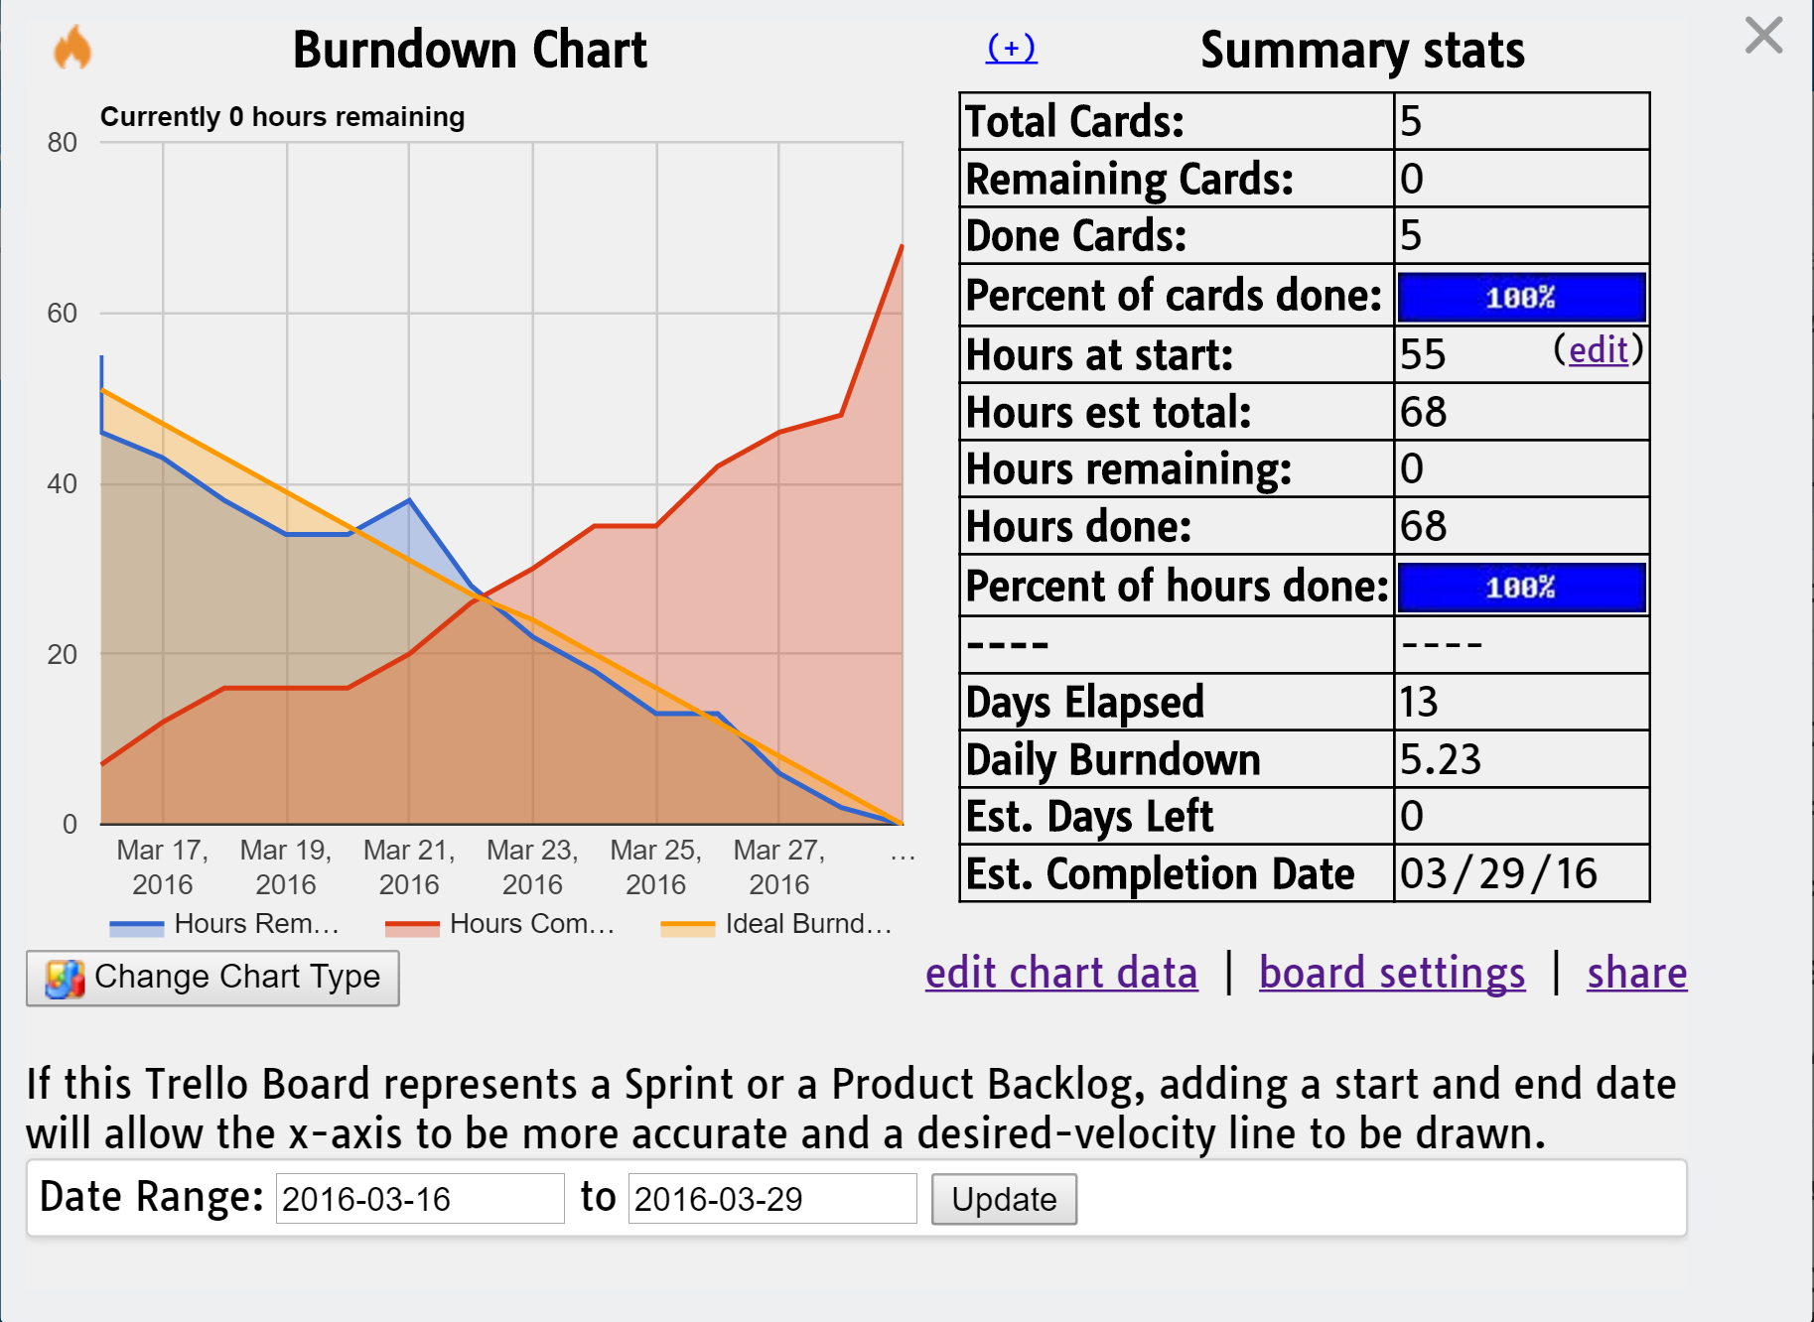
Burndown Chart

Slide 11
Sprint 5 Plan
Automation of data transfer across multiple HW Domains

Slide 12
Questions?

Slide 13
Thank You

