Slide 1
CLOUD GATEWAY
Mania Abdi
Rahul Bahal
Chienli Ma
Ayush Singh
Mentors:
Kyle Forster
Ted Elhourani

Slide 2
Background
Private Clouds require extra resources during peak workloads
Borrow resources from public cloud in a hybrid cloud model
Our solution offers a gateway Virtual Machine(s)
Rests on private and scales on demand via cloud burst

Slide 3
The sprint in a Nutshell..
Knowledge acquisition of OpenStack, AWS's network and API
Creating instances and network topology on cloud
Connecting them to simulate our end goal scenario
Successfully established a tunnel b/w MOC and AWS
Connected two worker nodes using our CGs
Documented the process and bootstrapped automation

Slide 4
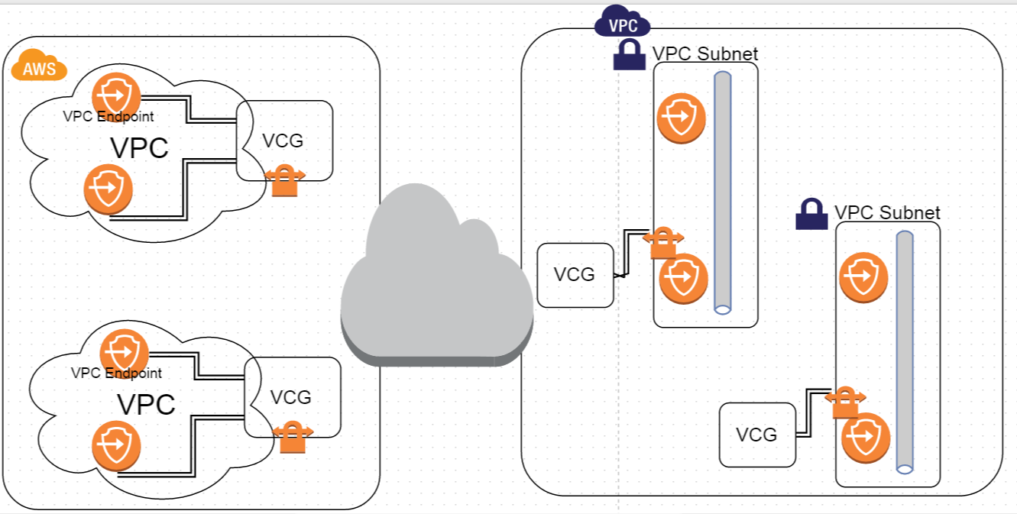
Cloud Gateway Solution – Big Picture

Slide 5
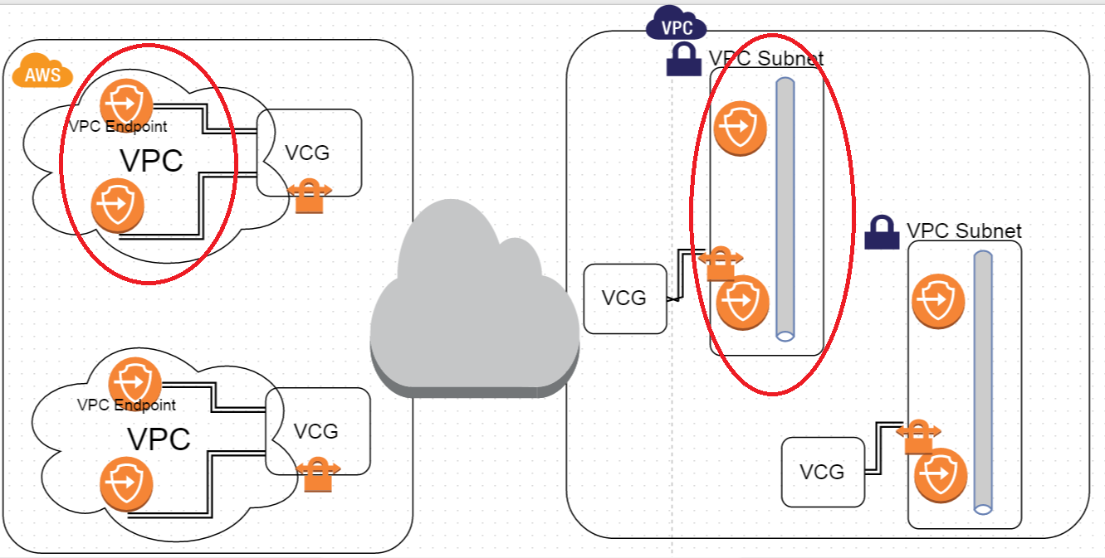
Virtual Subnet

Slide 6
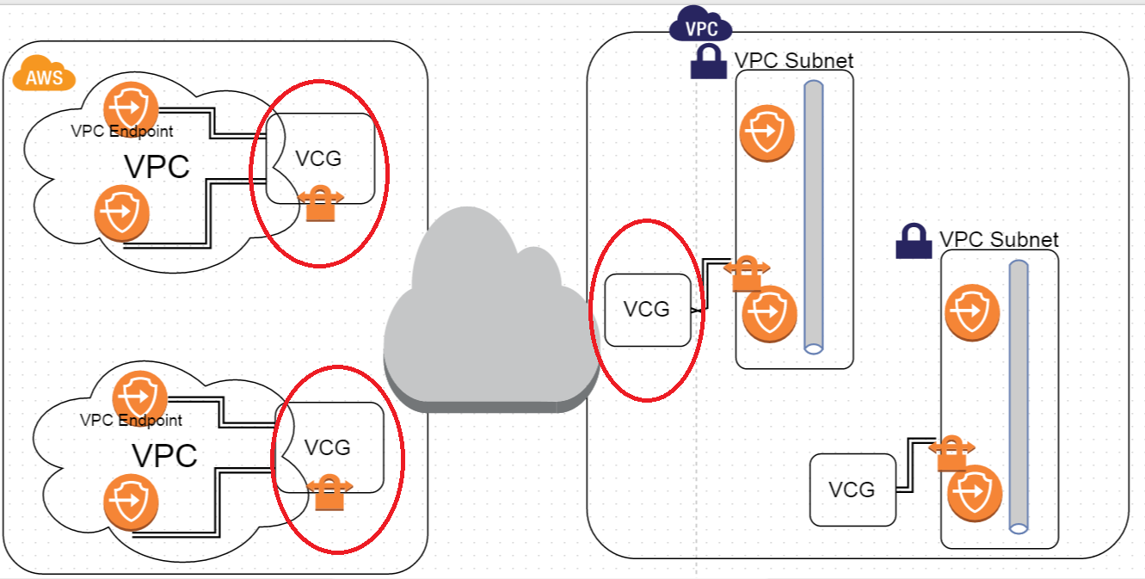
Virtual Gateway
NAT
IPSEC

Slide 7

VPC Endpoint
Processing Node
Storage

Slide 8
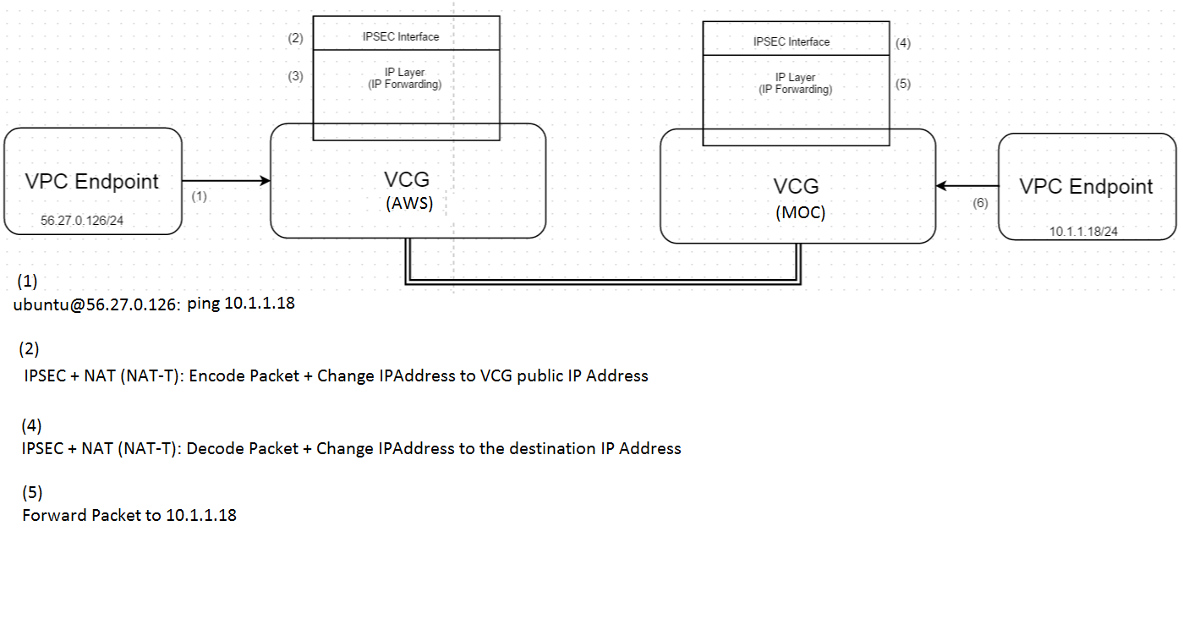
Detailed Picture

Slide 9
Current Problems
Overlapping subnet space
Internet traffic routing（OpenSwan out of control）
MOC network problems
Automation

Slide 10
What's Next?
NAT
Figure out a way to route internet traffic
Isolate OpenSwan
Scripts
Troubleshooting MOC network problem

Slide 11
TRELLO

Slide 12
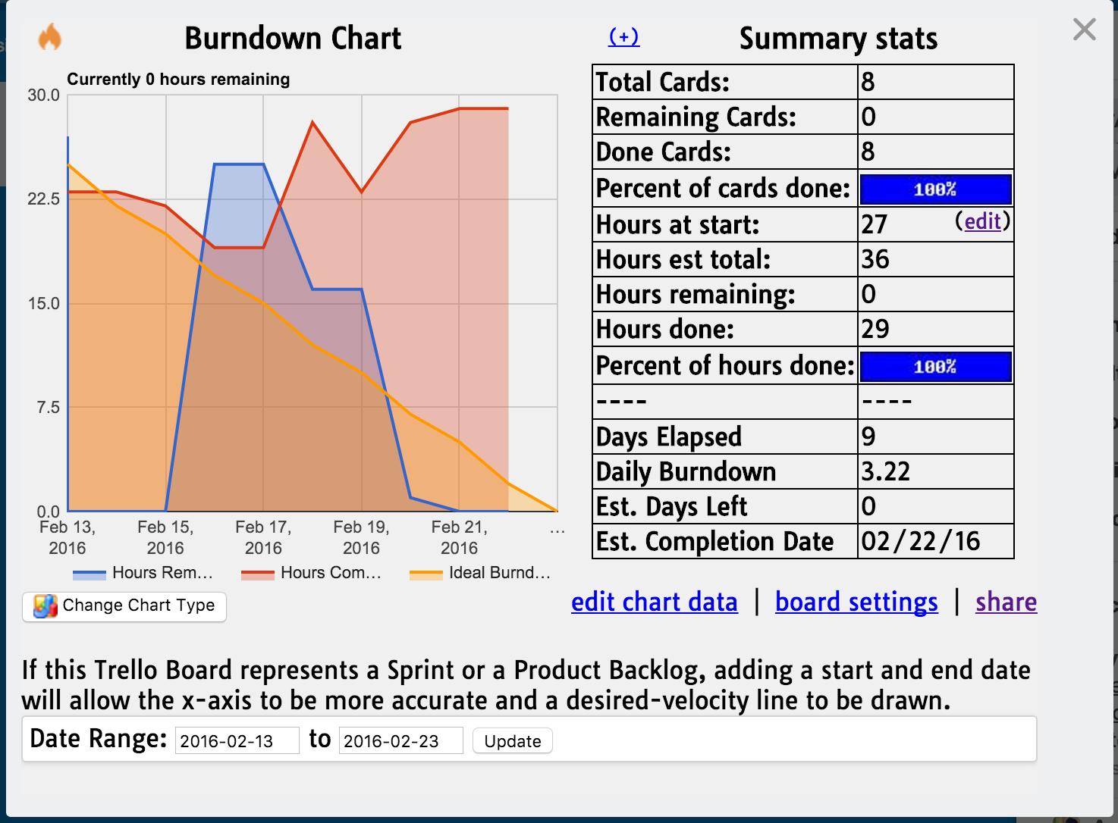

Slide 13
DEMO

Slide 14

Thank you!

