Slide 1
CLOUD GATEWAY
Mania Abdi
Rahul Bahal
Chienli Ma
Ayush Singh
Mentors:
Kyle Forster
Ted Elhourani

Slide 2
Background
Cloud Computing is a delivery model of computing services over Internet
Services & Solutions delivered and consumed in real time
Modern Day Business have highly fluctuating workloads
A need for flexible and more deployment options.

Slide 3
Problem
Private Vendors only install resources for the average workload
Provisioning resources for peak workloads is expensive
Public Cloud requires no significant initial capital expenditure
Computational Resources are served on-demand
Customers only pay for the resources they consume

Slide 4
Solution
The hybrid cloud model is a cost-effective method
The average-size workload stays in private cloud
Peak workload is provisioned in the public cloud
Our Cloud Gateway (CG) VM would run on an OpenStack network to expand the local resource via an AWS VPC
Machines use CG to send traffic b/w different cloud subnets

Slide 5
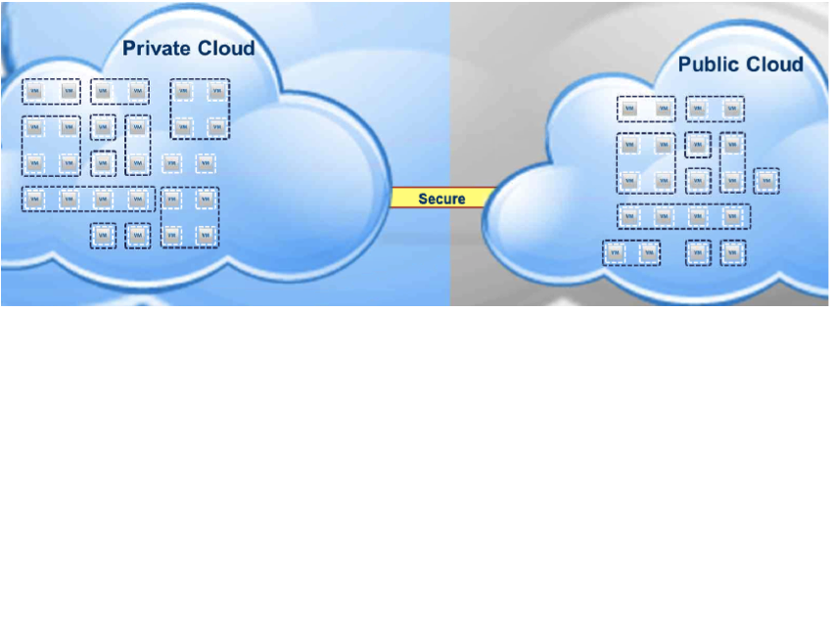
Horizontal Workload Placement using the Gateway

Slide 6
Novelty
Not the first Cloud Gateway, But!
Working on connecting different clouds
Goal is to make it easy to use and configure
And..
Why should people care?

Slide 7
Importance
Efficient way to dynamically expand resources
Give choice to the user to pick from multiple destinations
Ability to work with multiple clouds
Cost-effective model to scale for peak demand

Slide 8
Implementation
Environment
Amazon AWS
OpenStack Cloud
Virtual private network on laptop
Technical Approach

Slide 9
Implementation
Environment
Technical Approach
NAT Protocol
VPN Connection

Slide 10
NAT Protocol
Remap one IP Address into another by modifying datagram packet
NAT changes the layer 3 address, and even checksum
One IP multiple hosts

Slide 11
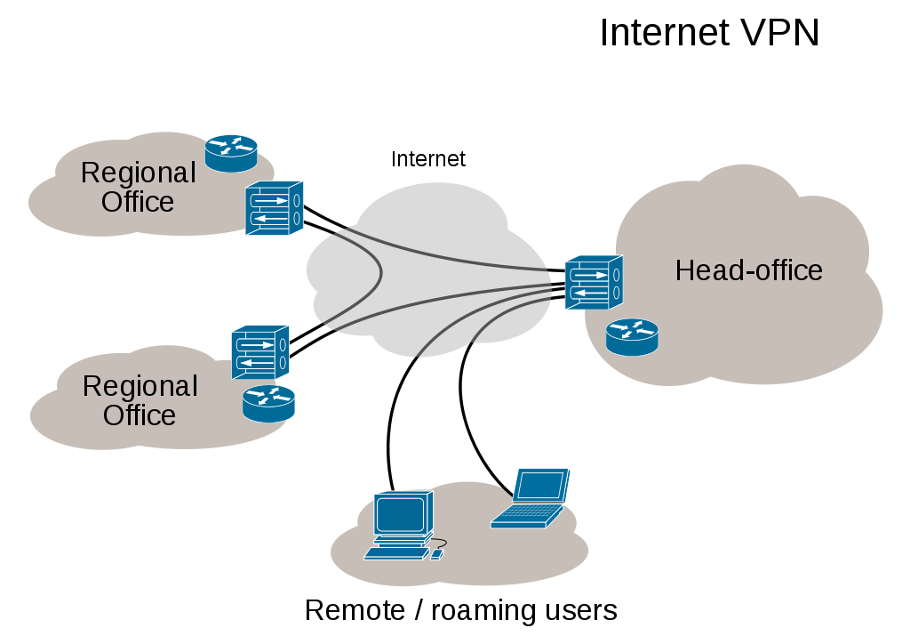
VPN
To extend a private network across a public network
To provide a secure point-2-point virtual connection
Types
Ipsec
SSL

Slide 12
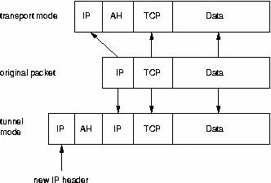
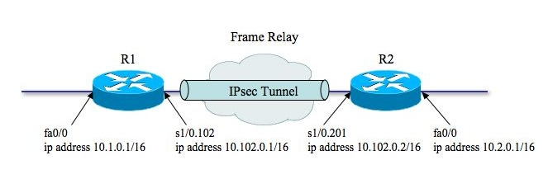
Why IPSEC?
IPSEC = Internet Protocol Security
Provide IP layer security
Ipsec encapsulate packet within another packet
Applied to any packet goes through network interface
Operation Modes
Transport
Tunnel
Security
Authentication
Encapsulation

Slide 13
DEMO

Slide 14
What's Next?
Configure the gateway to work for multiple clouds like AWS and MOC
Possibly route all the traffic through the gateway
Consolidate configuration scripts

Slide 15
TRELLO

Slide 16

Thank you!

