Slide 1
END-TO-END TRACING, TRACING KUBERNETES
Aditya Chechani
Reet Chowdhary
Runzhou Han
Taiga: https://tree.taiga.io/project/msdisme-2018-bucs528-template-7/
GitHub: https://github.com/BU-NU-CLOUD-SP18/Cross-Layer-Tracing-in-Kubernetes

Slide 2
REVIEW
Kubernetes: Kubernetes is a orchestration system serves on cluster of computers.
Tracing: Trace events labeled by a unique request ID to know applications’ behavior.
Control plane: The decision making part of Kubernetes which decides what has to be done with each containers according to its description
Data plane: enforces all of control plane’s decisions, Allows applications to remain agnostic to their surroundings
Jaeger: A distributed tracing system used for monitoring microservices-based distributed systems.
HotRod: An application that can find out drivers nearby.

Slide 3
VISION & GOALS
End-to-end tracing for app behavior on Kubernetes
Identify issues (bottlenecks, latency issues etc.)
Add in trace points to “data plane” features
Make it scalable

Slide 4
PREVIOUS WORK
Read paper about Google Dapper
Read paper about Facebook Canopy
Run Hotrod locally and tracing with Jaeger

Slide 5
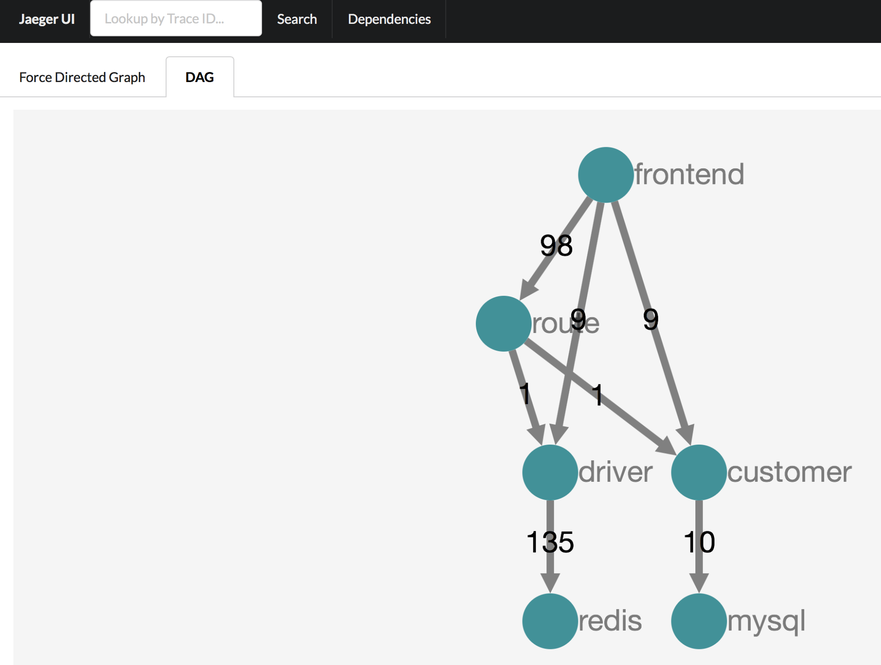
TRACING WITH JEAGER
Micro-service
Number of RPCs
Storage backend

Slide 6
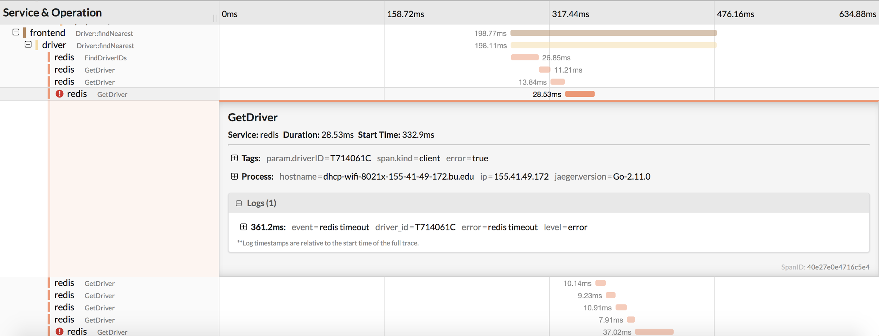
TRACING WITH JEAGER
2 errors
What causes the error?

Slide 7
ARCHITECTURE
Kubernetes
Node1
Node2
Node3
Pod1
Pod2
Pod3
MOC
VM
Pod2
Kubernetes
Kubernetes
Container
of
HotRod
Request A
Jaeger
Request A
Request B
Docker
Other containers, Services, APIs…
Docker image
Container information
Trace these requests by Tracing ID

Slide 8
CURRENT WORK
Deploy MiniKube on MOC to find local datapath
Run a hello world program in Kubernetes and check the verbose log
Using the log, Understand the Kubernetes’ source code related to dataplane
MOC
VM
MiniKube

Slide 9
RELEASE PLANNING
One person
Deploy Kubernetes in the MOC(1 week)
Deploy HotROD into the Kubernetes (1 week)
Deploy Jaeger in Kubernetes and show that we can collect tracing events with Jaeger(2 weeks)
Other people
Find Kubernetes datapath(core work, >=1 month)
Read source code
Deploy a logging tool
Add tracing points in datapath(core work, >=1 month)

Slide 10
THANK YOU!
Questions?

