Slide 1
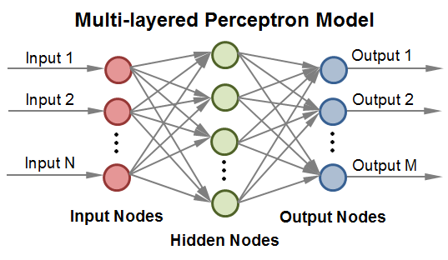
Machine Learning with Artificial Neural Networks

Slide 2
What does it take to make an Artificial Neural Network?
Setting up the network structure.
Training the network to “learn” how to perform its task.
Testing the network on new data.

Slide 3
What is a function?
What is a function?
Input
Function
Output
X
Y
An artificial neural network is just a function!

Slide 4
Perceptrons
 | T | F
T | T | F
F | F | F
 | 1 | -1
1 | 1 | -1
-1 | -1 | -1
AND-gate
 | T | F
T | T | T
F | T | F
 | 1 | -1
1 | 1 | 1
-1 | 1 | -1
OR-gate
 | T | F
T | F | T
F | T | F
 | 1 | -1
1 | -1 | 1
-1 | 1 | -1
XOR-gate

Slide 5
Perceptrons
Input Layer
Statistical Weights
Output Layer

Slide 6
Perceptrons
OR-gate
Input Layer
Statistical Weights
Output Layer
T
1
F
-1

Slide 7
Perceptrons
OR-gate
Input Layer
Statistical Weights
Output Layer
1
1
-1

Slide 8
Multi-layered Perceptrons
OR-gate
Input Layer
Hidden Layer
Output Layer
Statistical Weights
Statistical Weights

Slide 9
Multi-layered Perceptrons
OR-gate
Input Layer
Hidden Layer
Output Layer
T
1
F
-1

Slide 10
Multi-layered Perceptrons
OR-gate
Input Layer
Hidden Layer
Output Layer
???
1
1
1
???
-1
-1
-1
???

Slide 11
Multi-layered Perceptrons
OR-gate
Input Layer
Hidden Layer
Output Layer
???
???
1
???

Slide 12
Artificial Neural Networks
Input Layer
Hidden Layer
Output Layer
1
Bias Nodes
1

Slide 13
Artificial Neural Networks
OR-gate
Input Layer
Hidden Layer
Output Layer
T
1
F
-1
1
Bias Nodes
1

Slide 14
Artificial Neural Networks
OR-gate
Input Layer
Hidden Layer
Output Layer
???
1
1
1
???
-1
-1
-1
???
1
1
1
Bias Nodes
1

Slide 15

Artificial Neural Networks
OR-gate
Input Layer
Hidden Layer
Output Layer
Sigmoidal Function
$$S\left(t\right)=\frac{1}{1+e^{−t}}$$
???
???
1
???
Bias Nodes
1

Slide 16
Types of Neural Networks
General Regression Neutral Network
Only a single output node which represents a continuum of possible results. E.g., a network which accepts weather data as input and outputs the expected rainfall in inches.
Probabilistic Neural Network
Multiple output nodes which represent the possible resultant states. The node with the highest value represents the most probable answer. E.g., a network which accepts weather data as input and outputs to two nodes, one that indicates the chance of sun and one that indicates the chance of rain.

