Slide 1
Stock Market and Social Media
Matt Gilgo, George Padavick

Slide 2
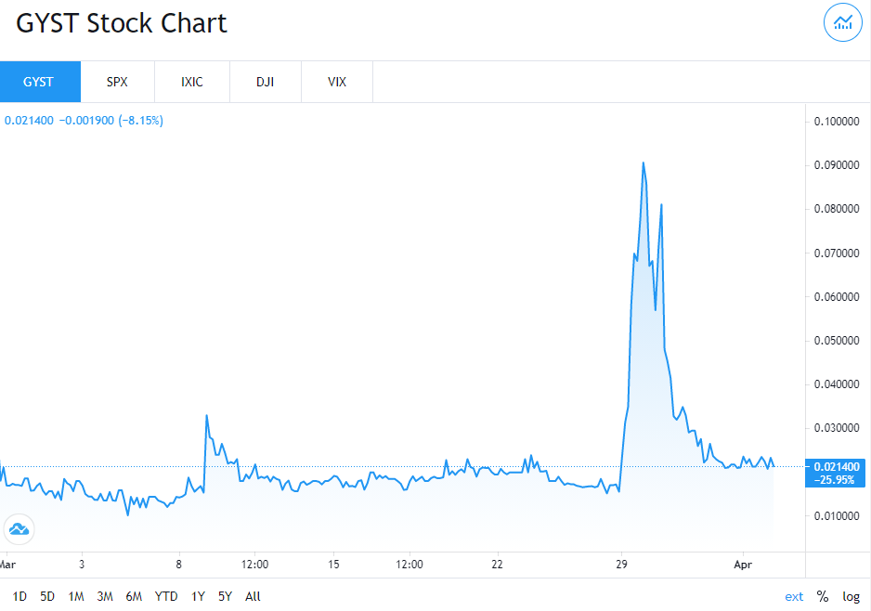
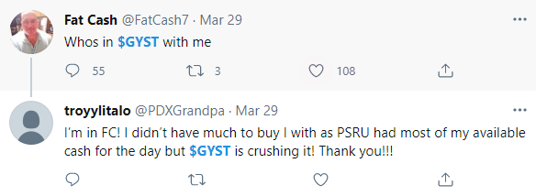
Motivation/Goals
Picture of a tweet from a known pumper
Graph of a known pump
COVID driven market downturn and lack of activities to spend money on turned many new investors to the market (2020: 500%+ transactional value in Robinhood YoY)
Major increase in new/unskilled investors has led to a surge in predatory market manipulation through means of social media
Goals were to map potential pump and dumps amongst social media influencers and quantify impact to those falling into the scheme

Slide 3
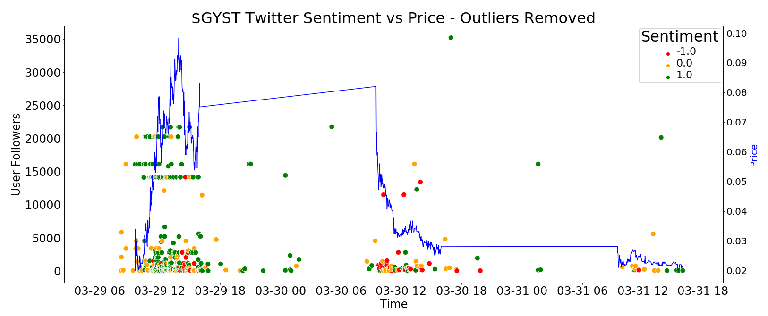
Results/Analysis
10000+ Tweets scored for Sentiment, Known Pumper Profiles, Buy/Sell Region, and Price Inflection Point across 10+ examples of known pumps
Correlation between price and sentiment found in labeled data

Slide 4
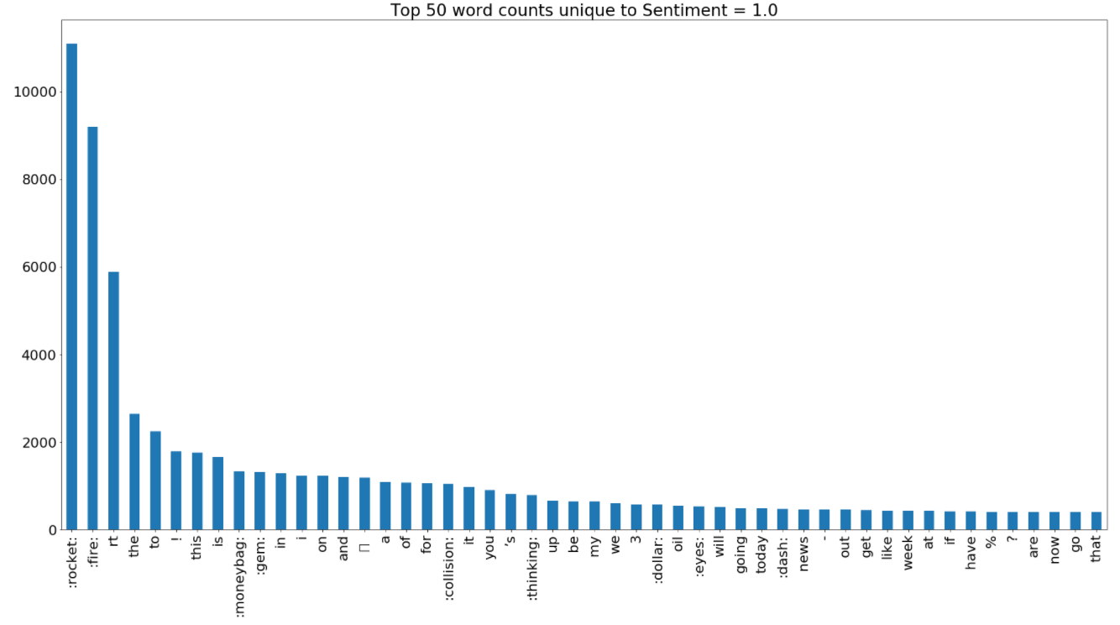
Results/Analysis
Determined high use words for each sentiment classification
Positive sentiment: 🚀,🔥, 💰
Neutral sentiment: “news”, “today”, “highest”
Negative sentiment: “dump”, “offering”, “sell”
Incorporated top words into vocabulary for Countvectorizer and TF-IDF

Slide 5
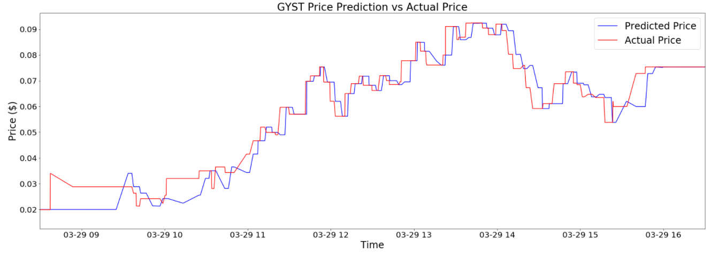
Results/Analysis
Generated sentiment classification models based on TF-IDF features - test results provided below
Applied classification model to remaining unscored tweets
Initial price model does not show predictive capability but demonstrates importance of sentiment in price prediction
 | Test Accuracy | Cross Validation Accuracy
Logistic Regression | 87% | 88%
Random Forest | 87% | 88%
KNN | 75% | 87%
SVM | 87% | 87%

Slide 6
Challenges
Tweepy API rates and tweet limit hindered collection of tweets
Determined pulling trailing 7 days on a weekly basis would be most effective strategy
Stocks like GME, AMC, and KODK off the table due to not being recent enough
Found recent, short term pump and dumps like GYST, EEENF, etc. to pull tweets from
“Fintwit” lingo is different then the lingo used in traditional sentiment analysis
Supervised Learning through manually scored tweets to ensure sentiment scored correctly
Majority of tweets about stocks are positive, limiting negative sentiment examples
Even split between positive, neutral, and negative tweets when developing models

Slide 7
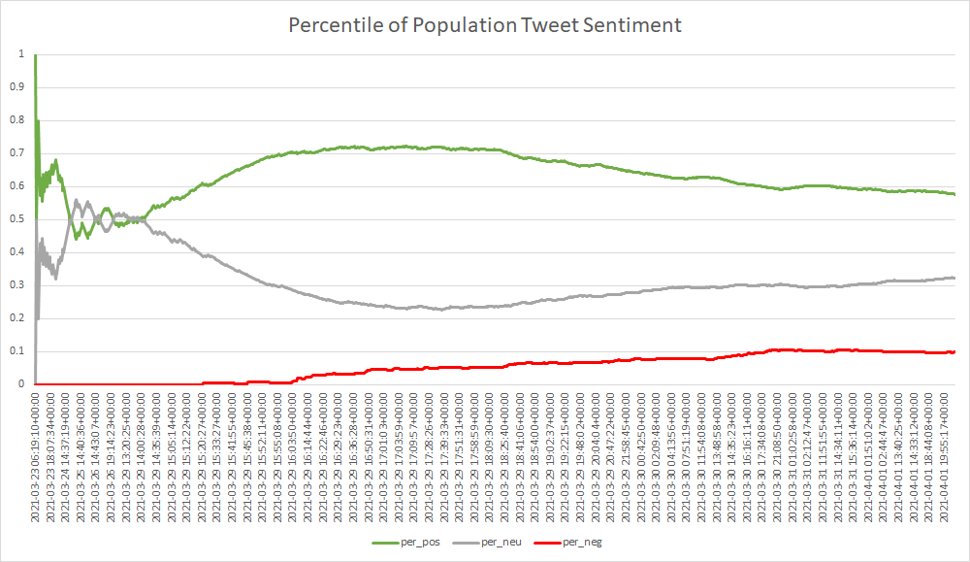
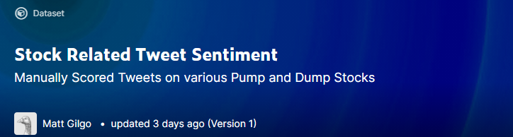
Limitations/Nexts Steps
Limited datasets and time prevented long term studies on sentiment as well as price models
Next steps would be further data collection, feature extraction (example to right), and development of price based models
For further research, the dataset used in our sentiment analysis as been uploaded to Kaggle for others in the community to do studies with
https://www.kaggle.com/mattgilgo/stock-related-tweet-sentiment

Slide 8
Thank you!

Slide 9
Appendix/Backup Slides

Slide 10
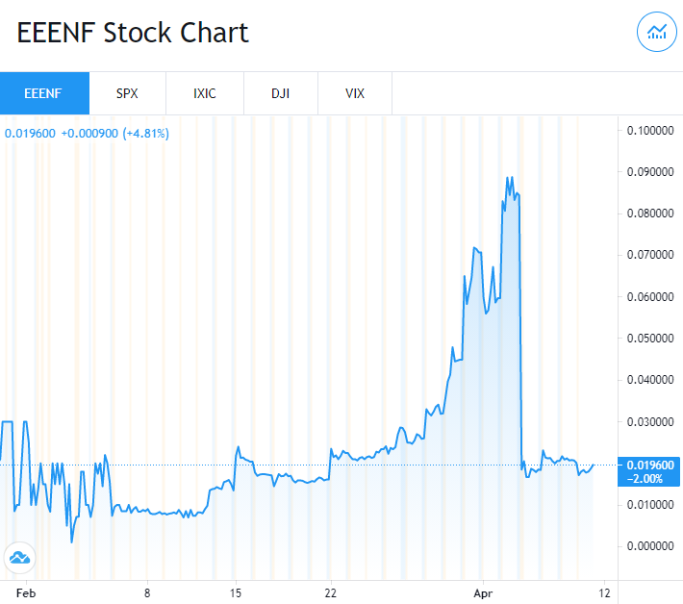
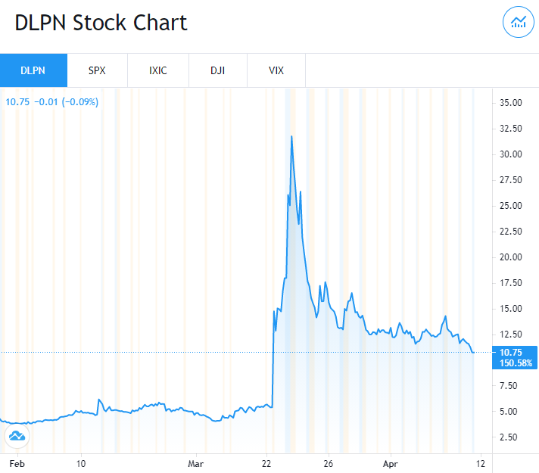
Data Collection
Stocks used for investigation:
DLPN - (Digital Media & NFTs)
EEENF - (Australian Oil Driller)
GYST - (Precious Metal Mining Developer)
10 others
Tweepy (Twitter API) used for pulling tweets tagged with specified stock tickers
Yahoo Finance API used for pulling interval stock price/volume data

Slide 11
Or Data Collection
Stocks used for investigation:
DLPN - (Digital Media & NFTs)
EEENF - (Australian Oil Driller)
GYST - (Precious Metal Mining Developer)
10 others
Tweepy (Twitter API) used for pulling tweets tagged with specified stock tickers
Yahoo Finance API used for pulling interval stock price/volume data

Slide 12

Data Progression
Data issues
Performed investigation into relationship between available data using $DLPN as an example case
Tweepy
Sentiment Model
Predicted Sentiment Tweets
Correlating
Stock Price to
Tweet Sentiment
CSV
yFinance

Slide 13
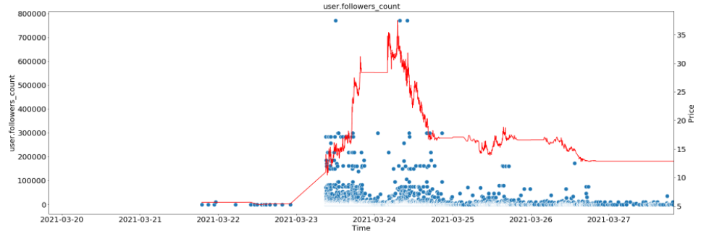
Data Progression/Cleaning
Developed scripts for pulling data using Tweepy
Performed investigation into relationship between available data using $DLPN as an example case

Slide 14
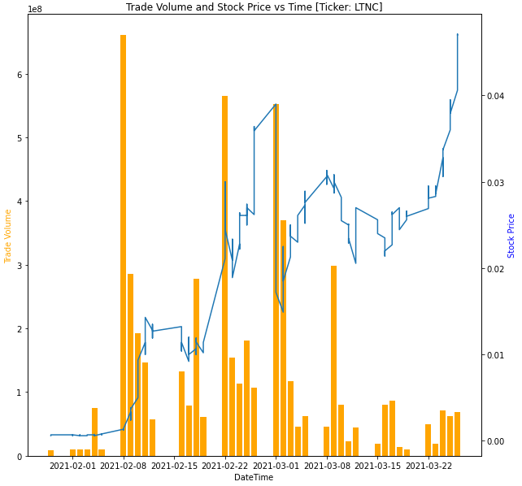
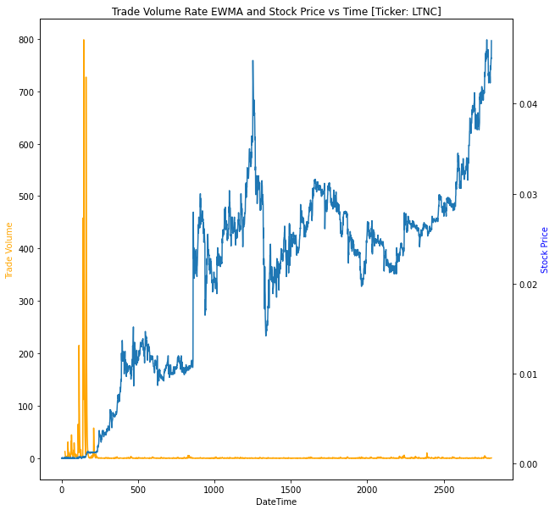
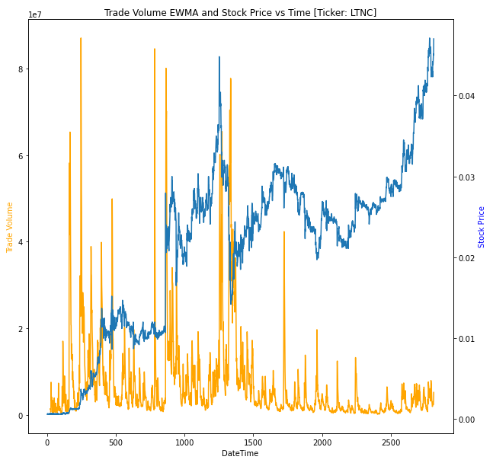
Feature Extraction
Example below: Seeking various methods of capturing change in market behavior
Fig 1: Total Volume vs Time
Fig 2: Total Volume Rate EWMA vs Time
Fig 3: Total Volume EWMA vs Time

