Slide 1
Predicting COVID-19 Diagnosis from Clinical Data
Runsheng Wang, Jinqi Lu

Slide 2
Data?
Covid-19 Clinical Data from Carbon Health
93995 observations, 46 Features (Symptoms, Comorbidities, Vitals, Radiological Findings, etc.)

Slide 3
Goal?
Classification
Predict Covid-19 test result based on categorical input features
Low false positive

Slide 4
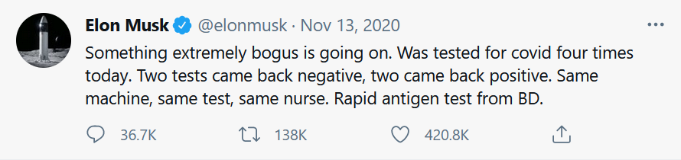
Why?
Prioritize testing when test kits are scarce
Aid diagnosis in ambiguous cases and provide further recommendations

Slide 5
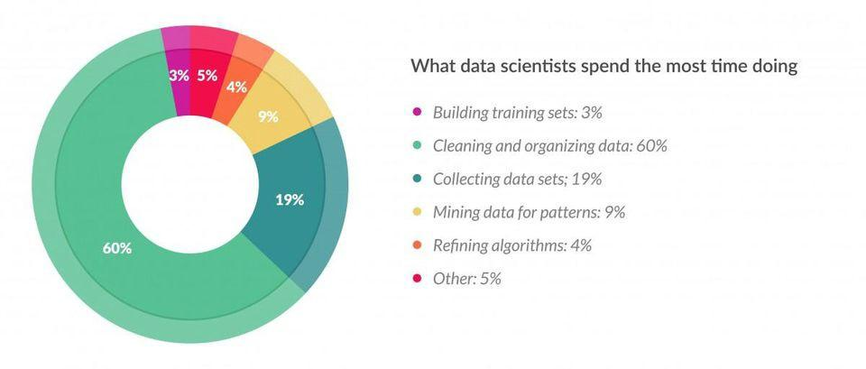

Slide 6
Data Collection
HIPAA
CDC Restricted Data
Israeli Ministry of Health De-Identified Patient Data (Partial)
Carbon Health De-Identified Patient Data

Slide 7
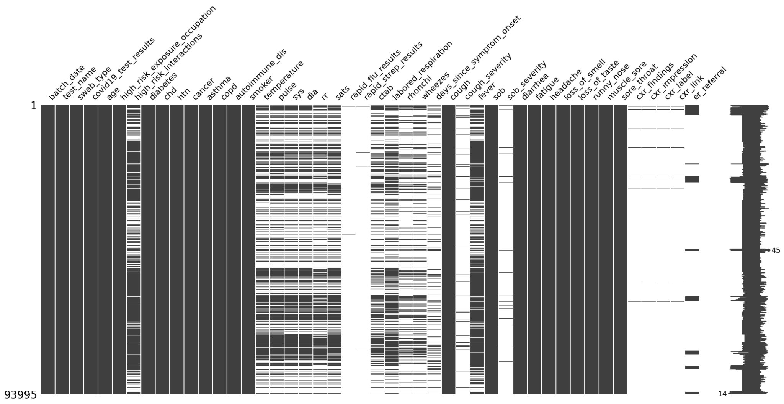

Slide 8
Encoding
Binary to 0 & 1
“Age” to binary→ Age above 60
RF → threshold; NB → quartiles

Slide 9
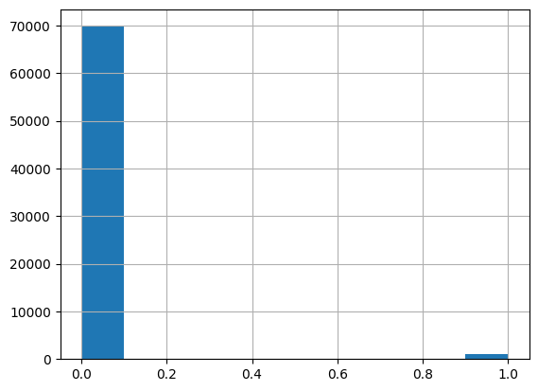
Train-Test Split
Stratified not Randomized
Severe class imbalance (99:1)
Resembles raw data for resampling techniques to be applied
80:20
CV instead of Validation Set

Slide 10
Feature Selection
High Dimensionality
Why not PCA?
Chi-Squared
Mutual Information

Slide 11
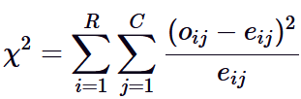
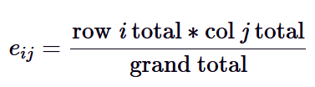

Slide 12
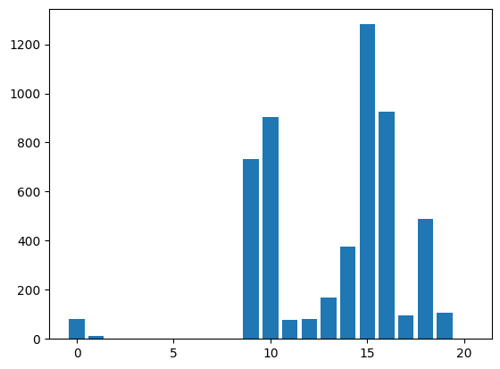
Feature 9: Cough
Feature 10: Fever
Feature 14: Headache
Feature 15: Loss of Smell
Feature 16: Loss of Taste
Feature 18: Muscle Sore

Slide 13



Slide 14
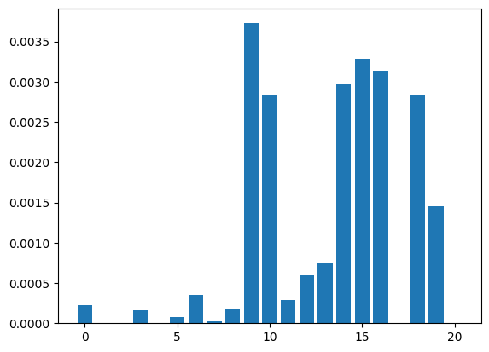
More sensitive to weak features
Sklearn entropy estimation based on kNN, randomness
Repeated MI 10 times, decrementing boundary

Slide 15
Resampling
Severe Imbalance (99:1), majority swamp
Why Random resampling is bad
Oversampling via SMOTE-N
Undersampling via One-Sided-Selection

Slide 16
SMOTE-N???
Use VDM instead of Euclidean Distance
a new sample is generated where each feature value corresponds to the most common category seen in the neighbors samples belonging to the same class
Obtained 5:1

Slide 17
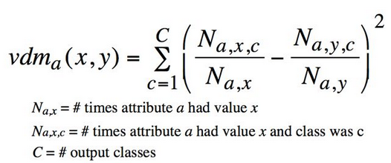

Slide 18
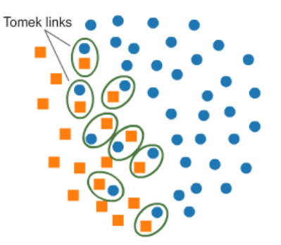
One-Sided-Selection
Tomek Links
pairs of examples of opposite classes in close vicinity
Better decision boundary
Condensed Nearest Neighbors
A subset of examples which correctly classify the original set using 1-NN

Slide 19
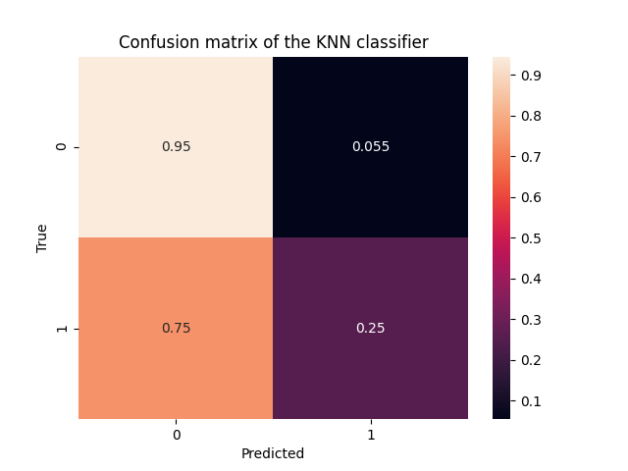
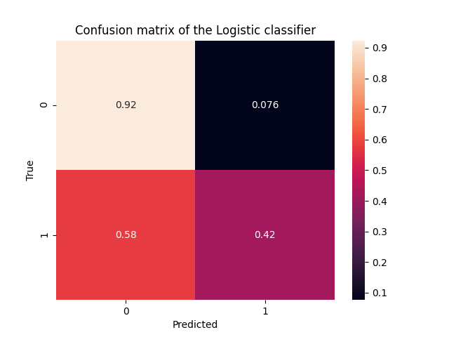
Spot Checking

Slide 20
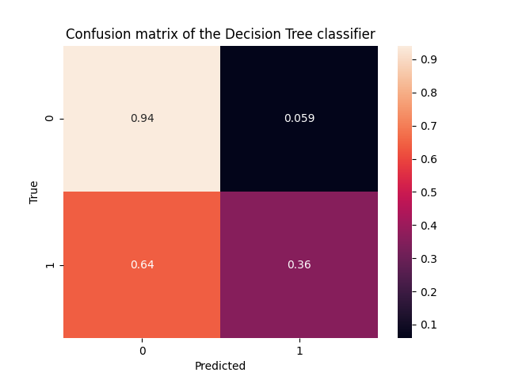

Spot Checking

Slide 21
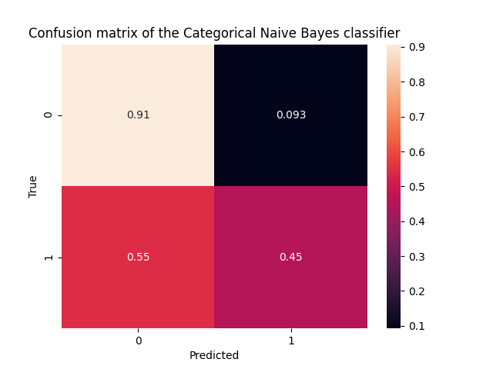
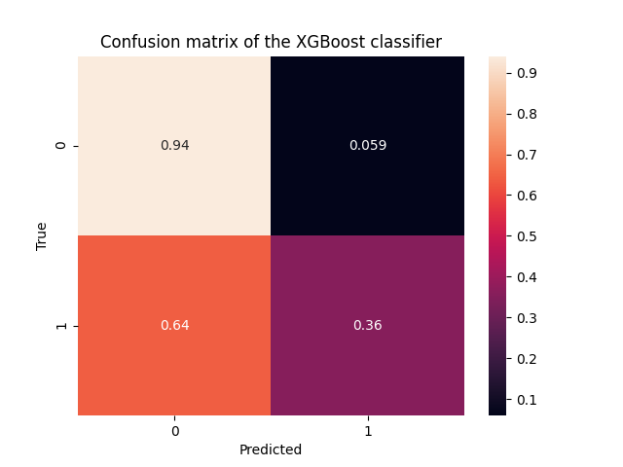
Spot Checking

Slide 22


Slide 23
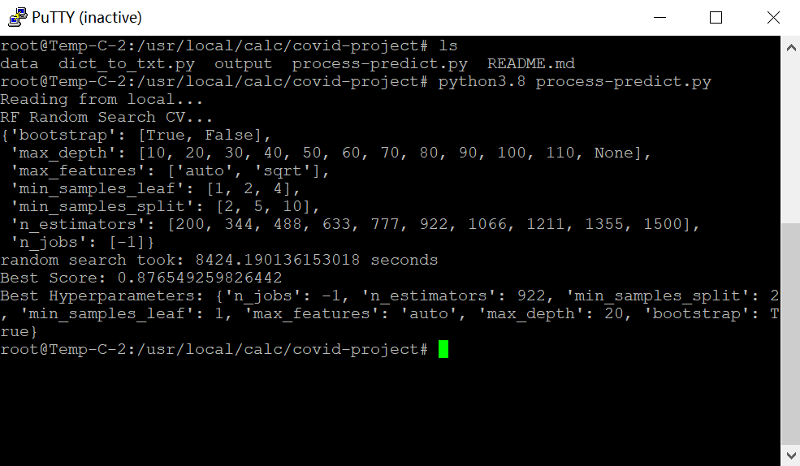

Slide 24
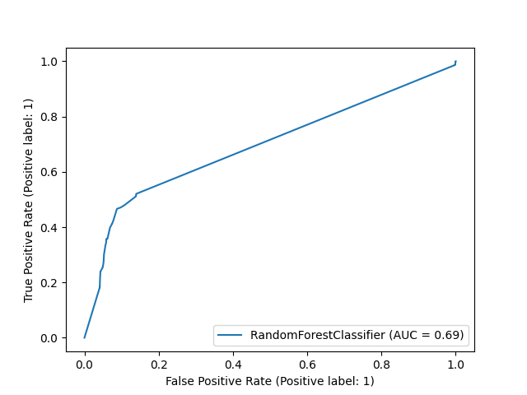
Testing F1_Macro ~ 0.6

Slide 25
Challenges & Limitations
Data collection
Class imbalance
Processing power
Novel methods

Slide 26
Next Steps
Obtain restricted Data
Obtain mortality data in combination with testing data
Attempt to tune anomaly detection algorithm such as Isolation Forest on the original (non-resampled) dataset

Slide 27
