Slide 1
Analyzing children’s interactions in a
Repeated Prisoner’s Dilemma Game
Team 1
Maha Alrashed
Jessica Chen
Andrew Coughlan
Brendan Leap
Abhishek Samal

Slide 2
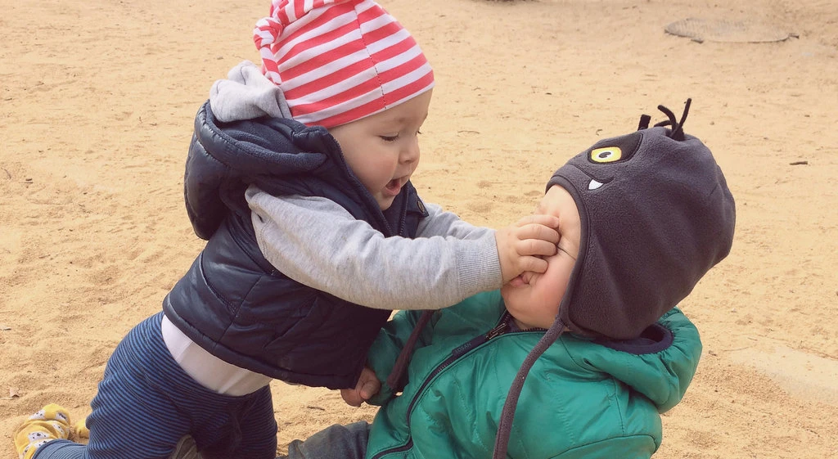
Our objective
To study children's social interactions and understand what cognitive and social factors affect children's aggressive versus forgiving responses.

Slide 3
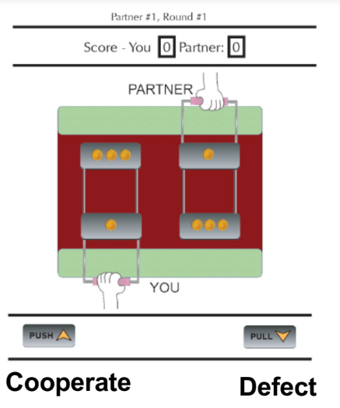
The Repeated prisoner’s dilemma game
10 round game
3 types of pre-programmed partners:
Cooperative
Defects on rounds 3 and 7
Tit-for-tat
Cooperates in the 1st round and
then just copies what the child
did in the previous round.
Defecting
Cooperates on round 3 and 7

Slide 4
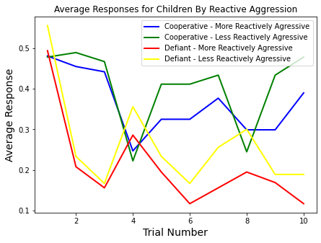
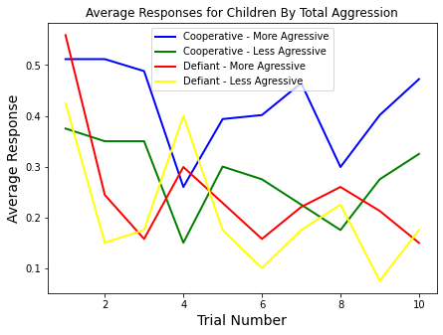
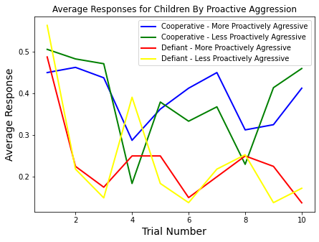
Preliminary Analysis Graphs

Slide 5
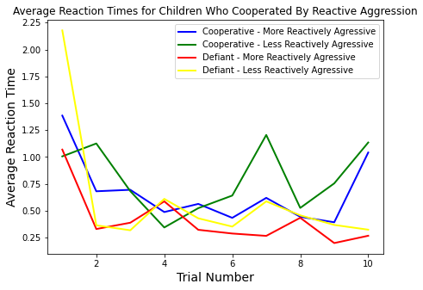
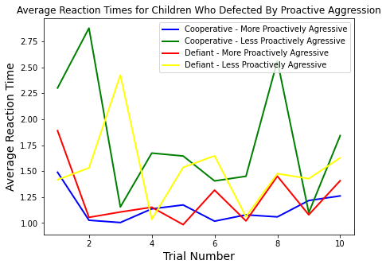
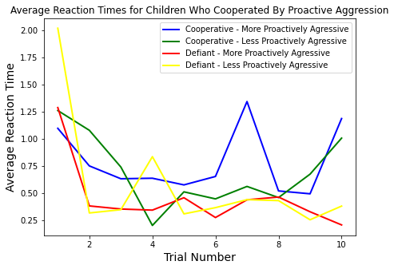
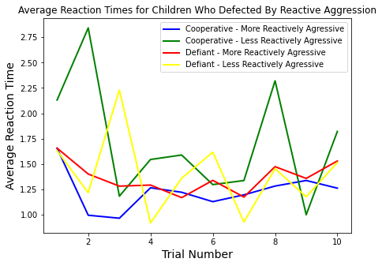
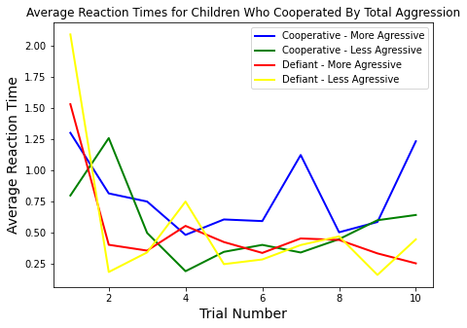
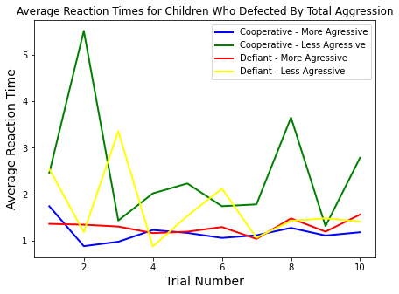
Reaction Time Graphs

Slide 6
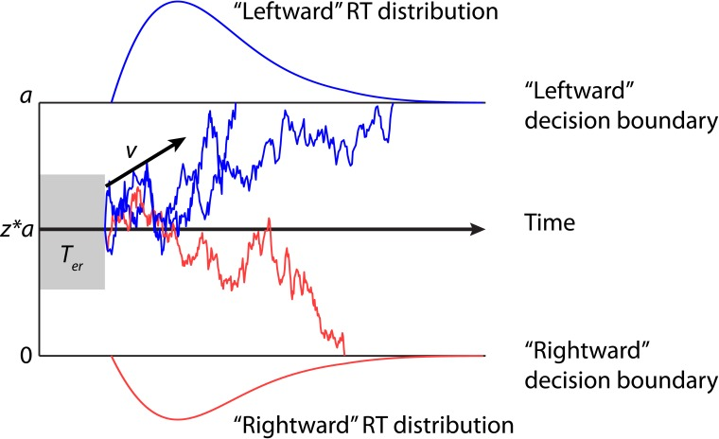
Drift Diffusion Model

Slide 7
Moving Away from Drift Diffusion Model
Reaction times are much longer than 1000-1500 ms, which is the ideal range for the DDM
The decisions made in this experiment are not one-step intuitive decisions but rather a process that requires reasoning and strategy planning

Slide 8
Models Tested to predict Aggression Levels:
Logistic Regression
Linear Regression, Support Vector Regression and Random Forest Regression
Current Results on Models tested:
Given the limited size of the data set and lack of variability in player choices, our predictions are not accurate so far.
Notes:
Hi hi

Slide 9
Next Steps
Long Short Term Memory (LSTM) neural network
Bayesian statistical model (eg. using libraries such as PyMC3).
Limitations
Very small dataset Difficult to train accurate models using the available
data.

