Slide 1
Understanding the Determinants of Health
Team members:
Gagan Kaushal, Chengyuan E, Tiam Moradi

Slide 2
PROBLEM

Slide 3
Objective
BU School of Public Health has access to clinician notes.
Using the patients records, predict diagnosis of:
substance abuse
alcohol use
tobacco smoking
Different patients with different background can have different response to diseases. So, information extraction for above 3 phenotypes would help in cohort studies in HIV and Hepatitis C.

Slide 4
Dataset
Total Number of notes: 2218
Number of patients: 23 at Boston Medical Center.
i) inpatient visits (ie patients who were hospitalized),
ii) outpatient visits (ie visits with primary physicians or specialists)
iii) emergency room visits (ie patients who were admitted to the emergency room).

Slide 5
METHODS

Slide 6
Machine Learning Method 1 (Medical Annotation Tool)
Technologies used: scispaCy, MedCAT, python

Slide 7
MedCAT (Medical Annotation Tool)
Pretrained SciSpaCy model on:
4, 632 concepts,
96,529 names
Leverages information from:
Concept database (medcat.cdb) (portion of UMLS - Unified Medical Language System)
Medical Vocabulary (medcat.utils.vocab.)

Slide 8
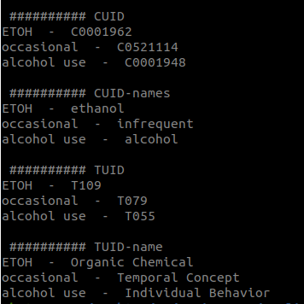
Extracting medical entities

Slide 9
MedCAT - Epic and Logistic notes
Generated csv files containing ‘Medical entities’ extracted from Epic and Logistic notes.

Slide 10
Machine Learning Method 2 (Three standard ML models on the basis of Spacy)
Technologies used: scispaCy, python, sklearn, matplotlib, pandas, Linear SVM, KNN, Naive Bayes

Slide 11
Data Preprocessing
Columns: ID, notes, alcohol use, drug use, smoking
Split the new dataframe to 3 parts
Delete NAN rows
Change ‘Y’ to 1 and ‘N’ to 0

Slide 12
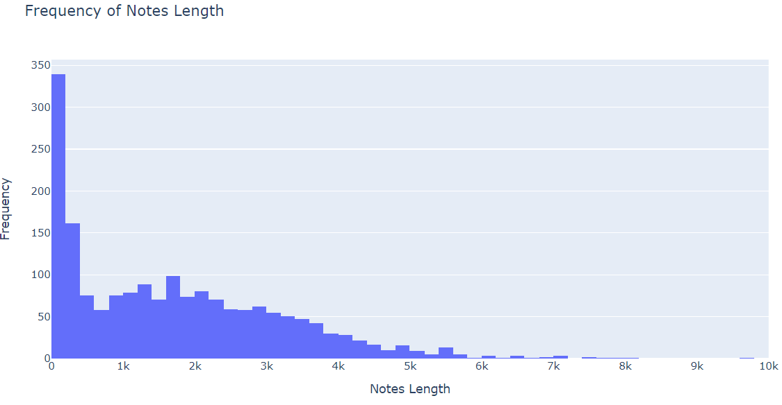
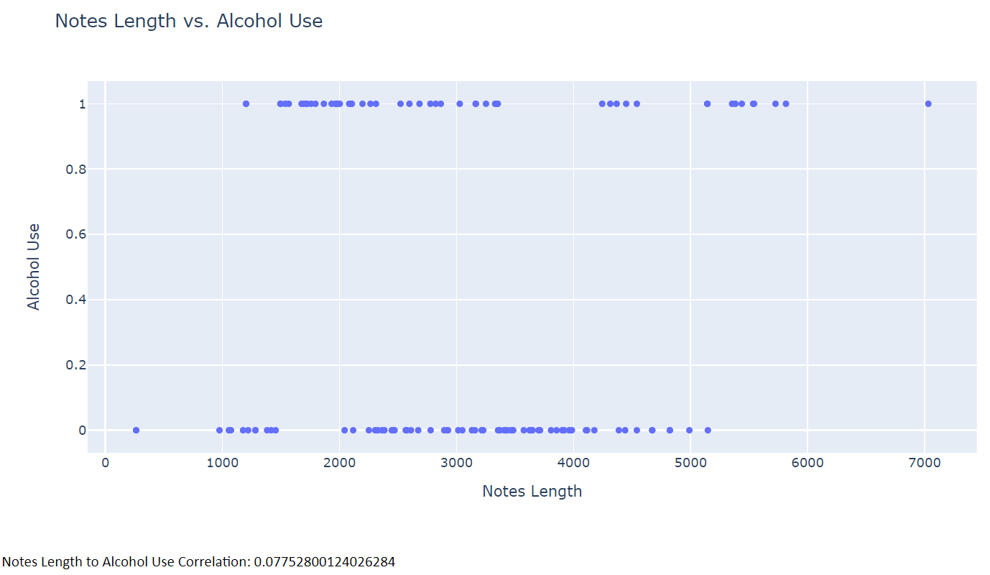
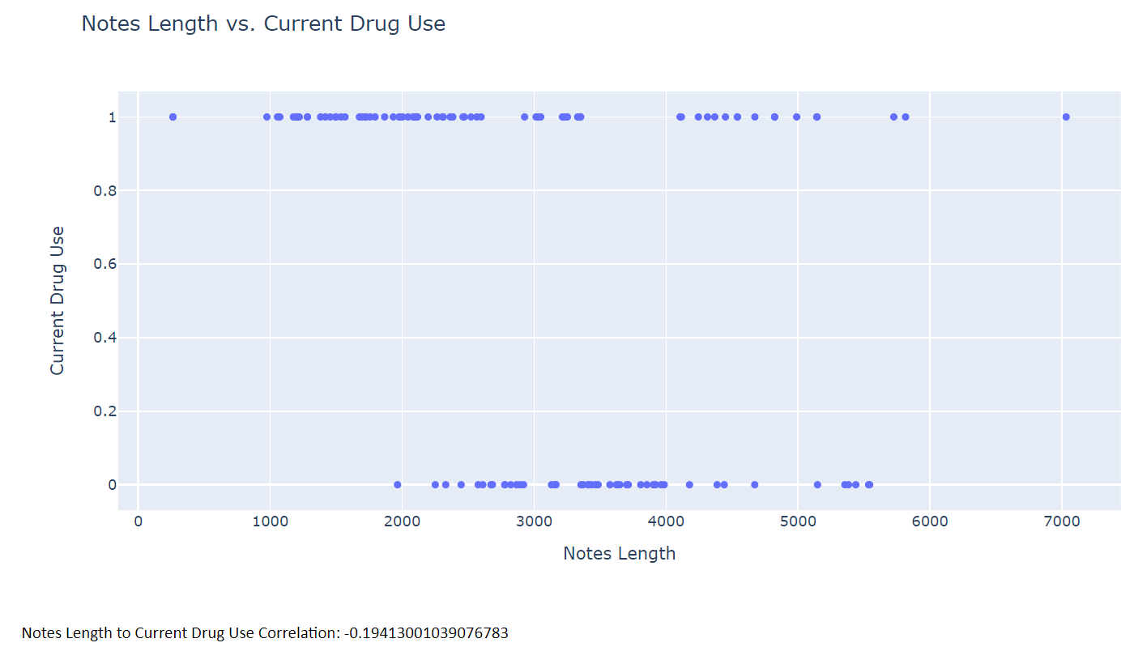
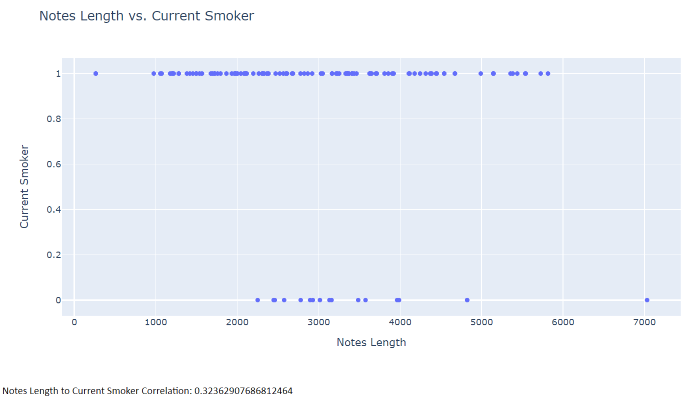
Data Analysis

Slide 13
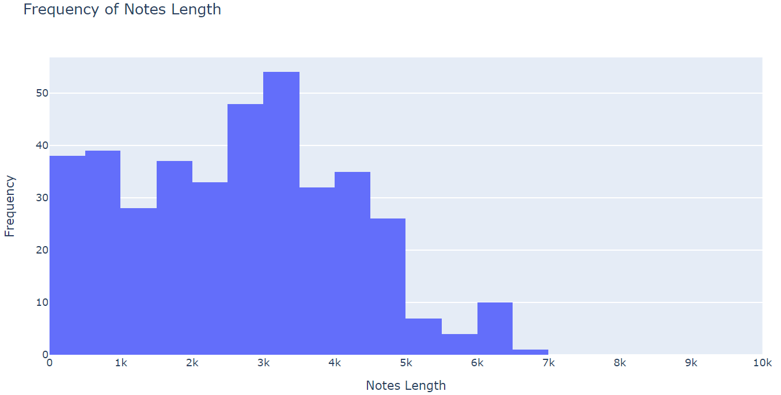
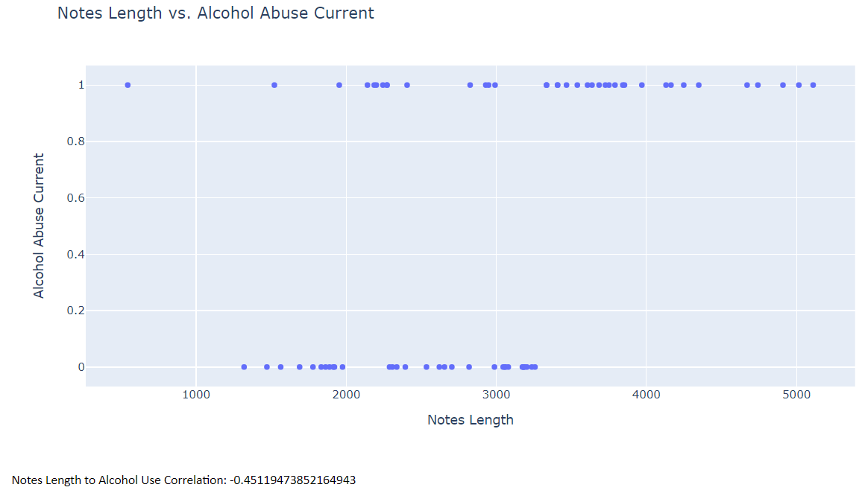
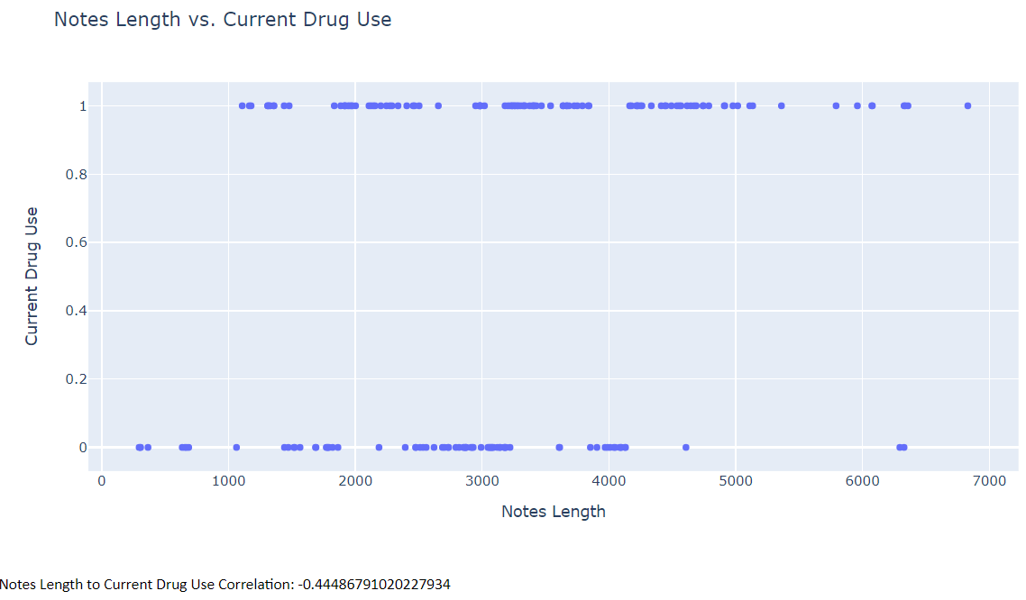
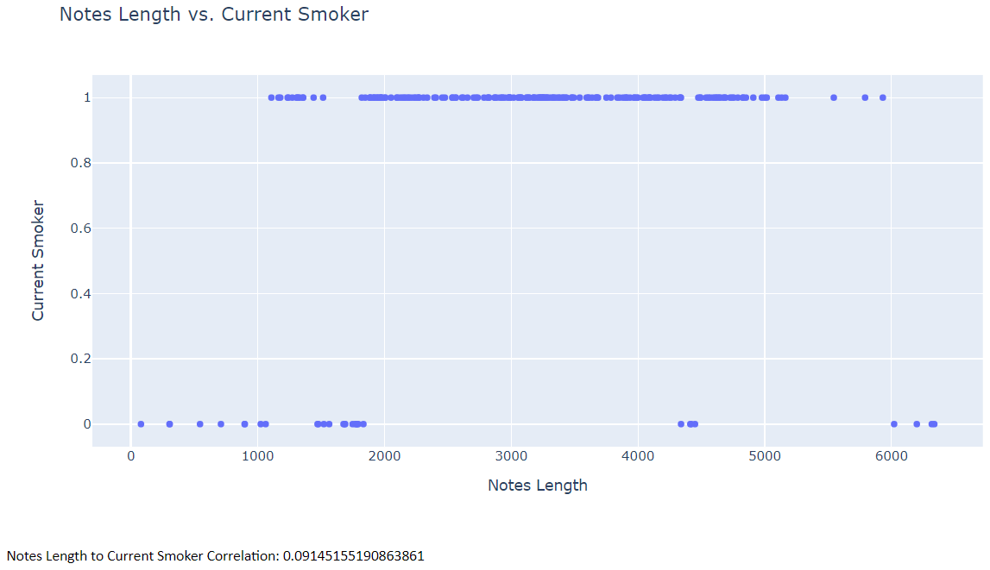

Slide 14
Steps of the Models
Spacy: extract the medical-related terms
“en_core_sci_sm”
locating and classifying entities in an unstructured text -> extract the medical texts
Replace the original column of notes by these extracted texts
medical texts -> tf-idf , unigrams + bigrams
3 classification algorithms:
1. Linear SVM
2. KNN (k = 2)
3. Naive Bayes
Training set 75% Test set 25%

Slide 15
Comparison between models
KNN vs SVM :
SVM -> outliers
SVM -> large features + small training data
KNN vs Naive bayes:
Naive bayes is much faster than KNN
*** larger dataset, efficiency! ***

Slide 16
RESULTS

Slide 17
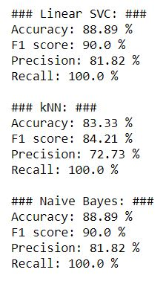
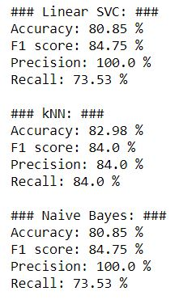
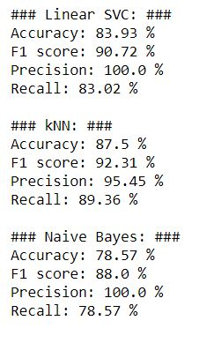
Results Logician Notes
Alcohol use
Drug use
Smoking use

Slide 18
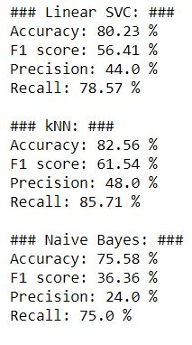
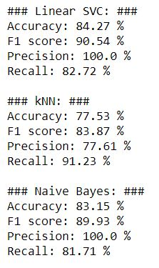
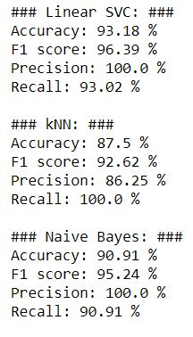
Results Epic Notes
Alcohol use
Drug use
Smoking use

Slide 19
CHALLENGES

Slide 20
Challenges / Obstacles
Completing training to access data
Sparsity from one of the data sources
Limiting our dataset further
Annotating Tool
Formatting for Deep Learning Models.
Negative notes-> “experiences no pain”

Slide 21
CONCLUSIONS

Slide 22
Conclusions
Using standard machine learning algorithms, were able to classify each of the determinants and performed well with a limited dataset.
Create entities for all of the notes, to be utilized for further processing that an then be used for Deep Learning approaches.

Slide 23
Thank You
(Q and A)

