Slide 1
Understanding the Determinants of Health
Team members:
Gagan Kaushal, Chengyuan E, Tiam Moradi

Slide 2
About the project
BU School of Public Health has access to clinician notes collected during routine medical visits at the Boston Medical Center.
These notes are written free-text reports of visits capturing the clinician’s findings, observations, and diagnoses.

Slide 3
Objective of the project
Using the patients records, predict diagnosis of:
substance abuse
alcohol use
tobacco smoking

Slide 4
Type of dataset
Excel file containing data of patients in care at Boston Medical Center.
Notes come from:
Inpatient visits (ie patients who were hospitalized),
Outpatient visits (ie visits with primary physicians or specialists)
Emergency room visits (ie patients who were admitted to the emergency room).

Slide 5
Technology leveraged
Natural Language Processing (NLP)

Slide 6
Descriptive Statistics
Number of Logician Notes: 393
Number of Epic Notes: 1824
Number of patients: 22 (Based on the number of unique IDs)
Target labels:
alcohol use
current smoking status
drug use

Slide 7
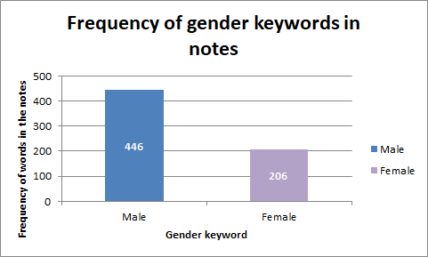
Bar graph to shows frequency of different labels / unique features
Bar graph to shows frequency of different labels / unique features

Slide 8
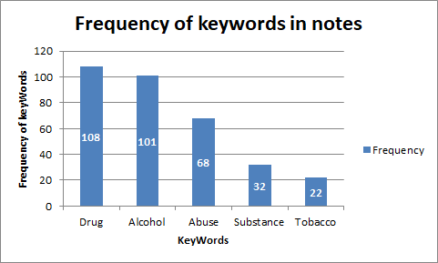
Bar graph to shows frequency of different labels / unique features
Bar graph to shows frequency of different labels / unique features

Slide 9
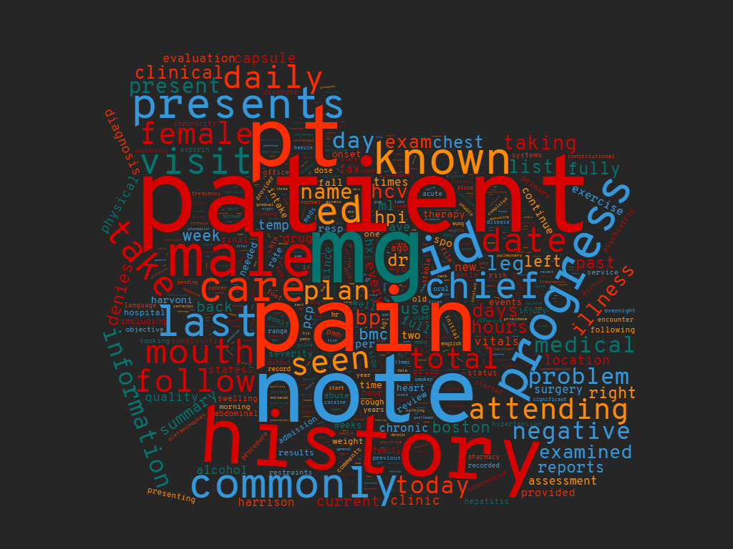
Epic Notes

Slide 10
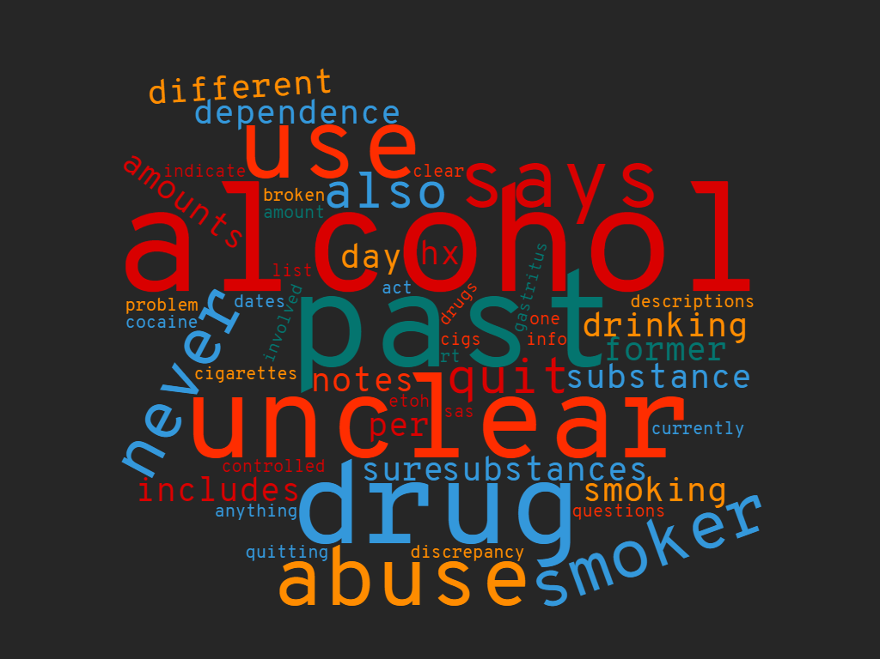
Logician Notes

Slide 11
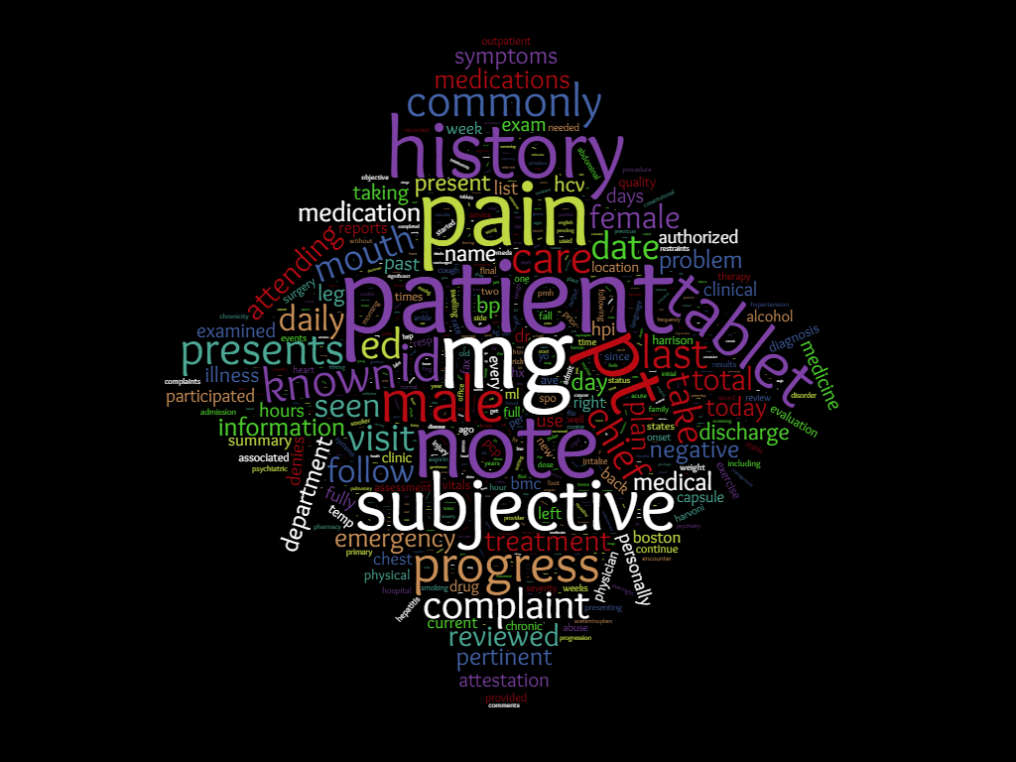
Epic Notes and Logician Notes

Slide 12
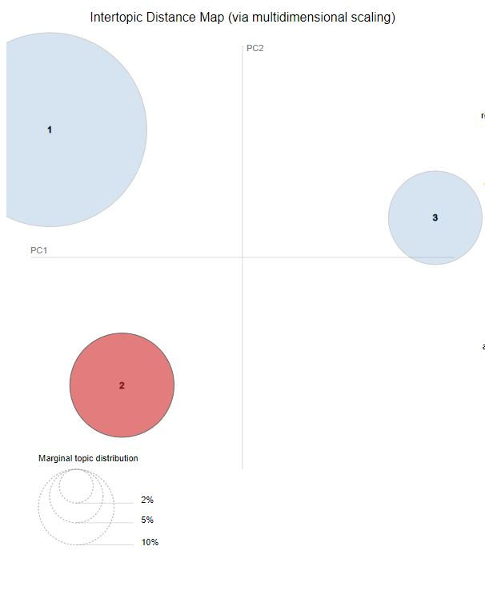
Topic Modeling: Logician Notes
Topics = 3
Topic 1: Medications/treatments
Topic 2:Symptoms
Topic 3: Measurements/vital signs

Slide 13
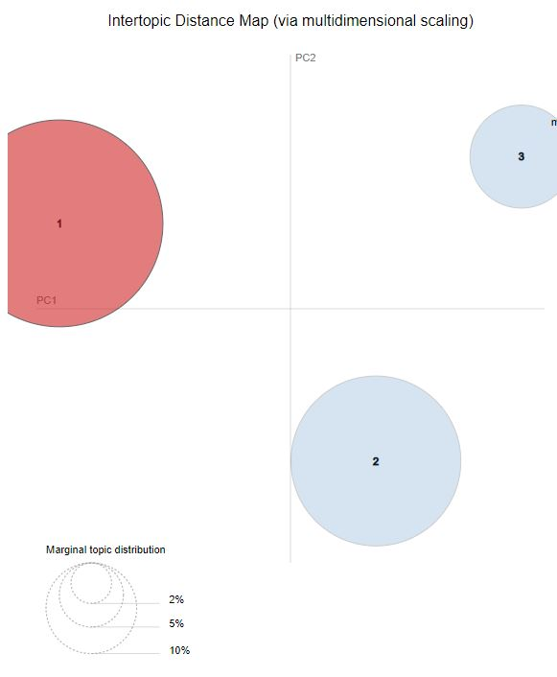
Topic Modeling: Epic Notes
Topics = 3
Topic 1: Symptoms
Topic 2: Medications/treatments
Topic 3: Measurements/vital signs

Slide 14
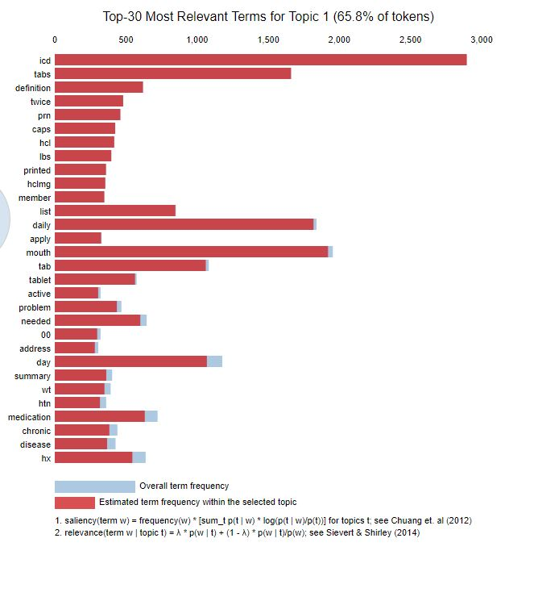
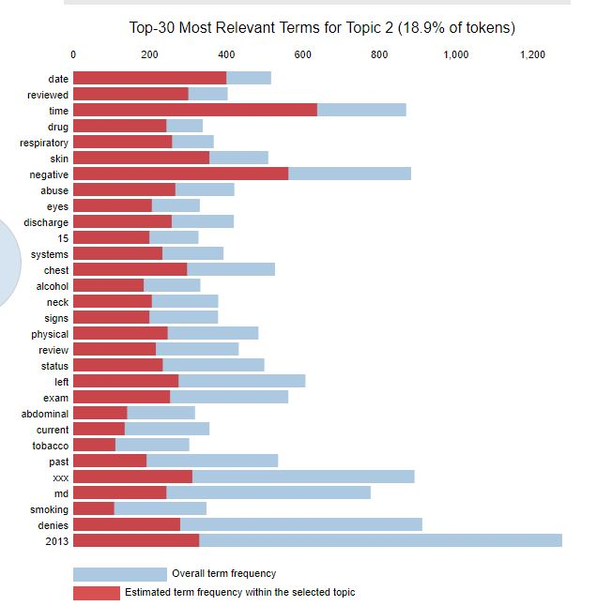
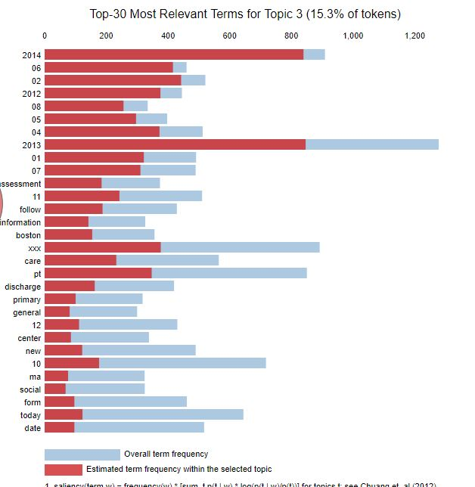
Rankings: Logician Notes

Slide 15
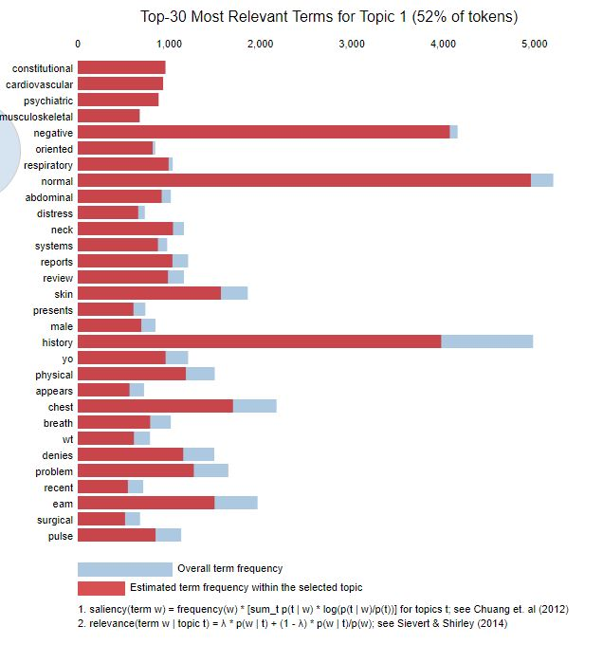
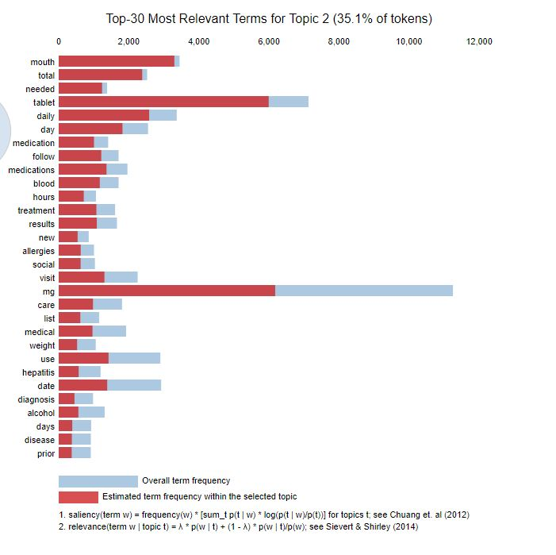
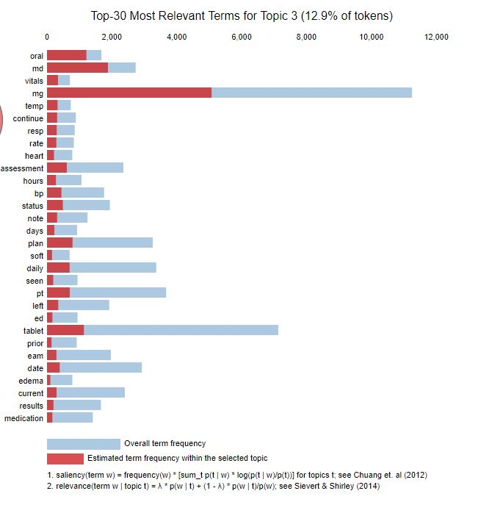
Rankings: Epic Notes

Slide 16
Questions ?

