Slide 1
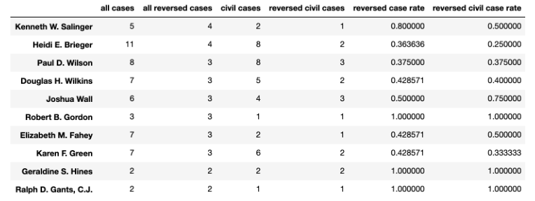
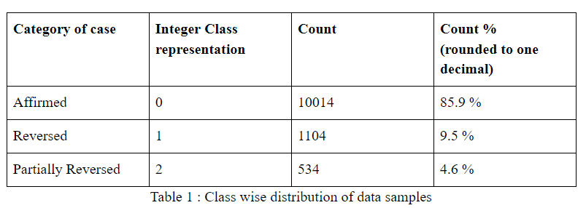
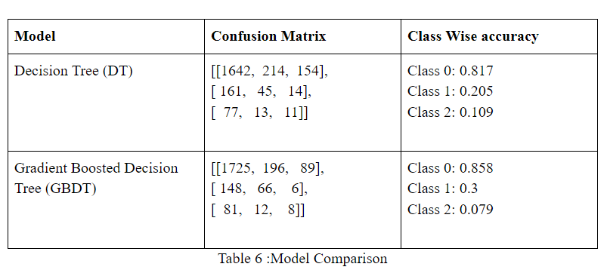
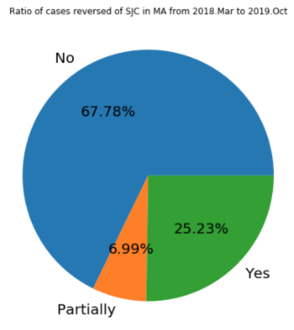
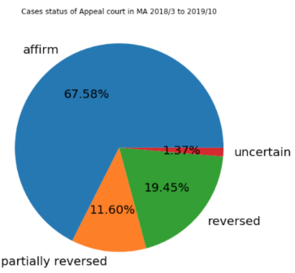
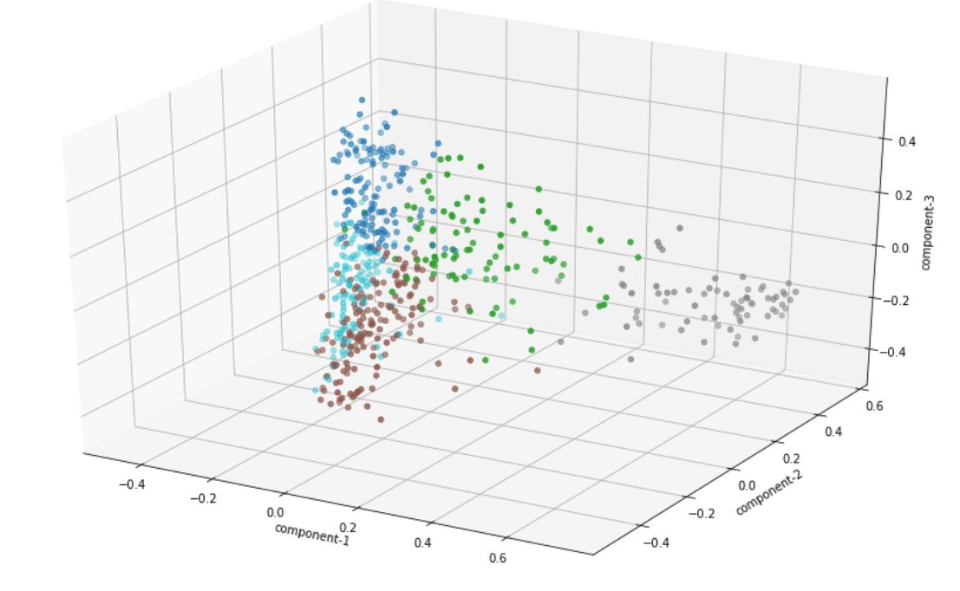
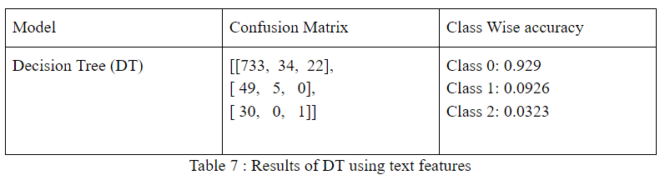
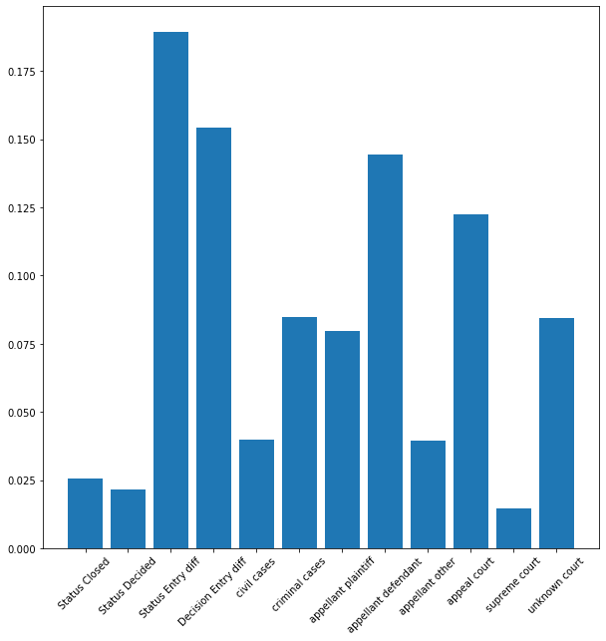
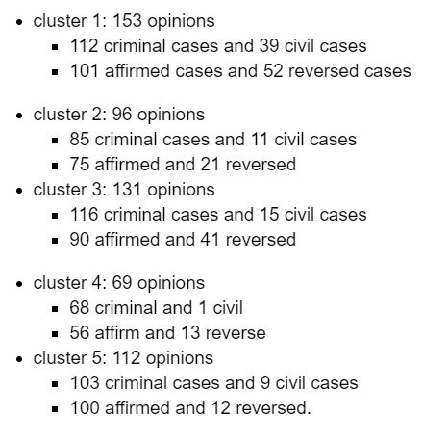
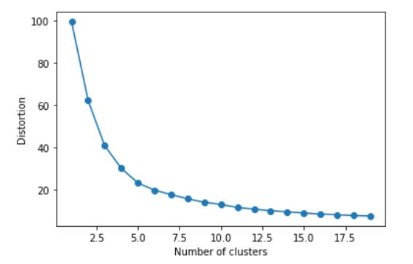
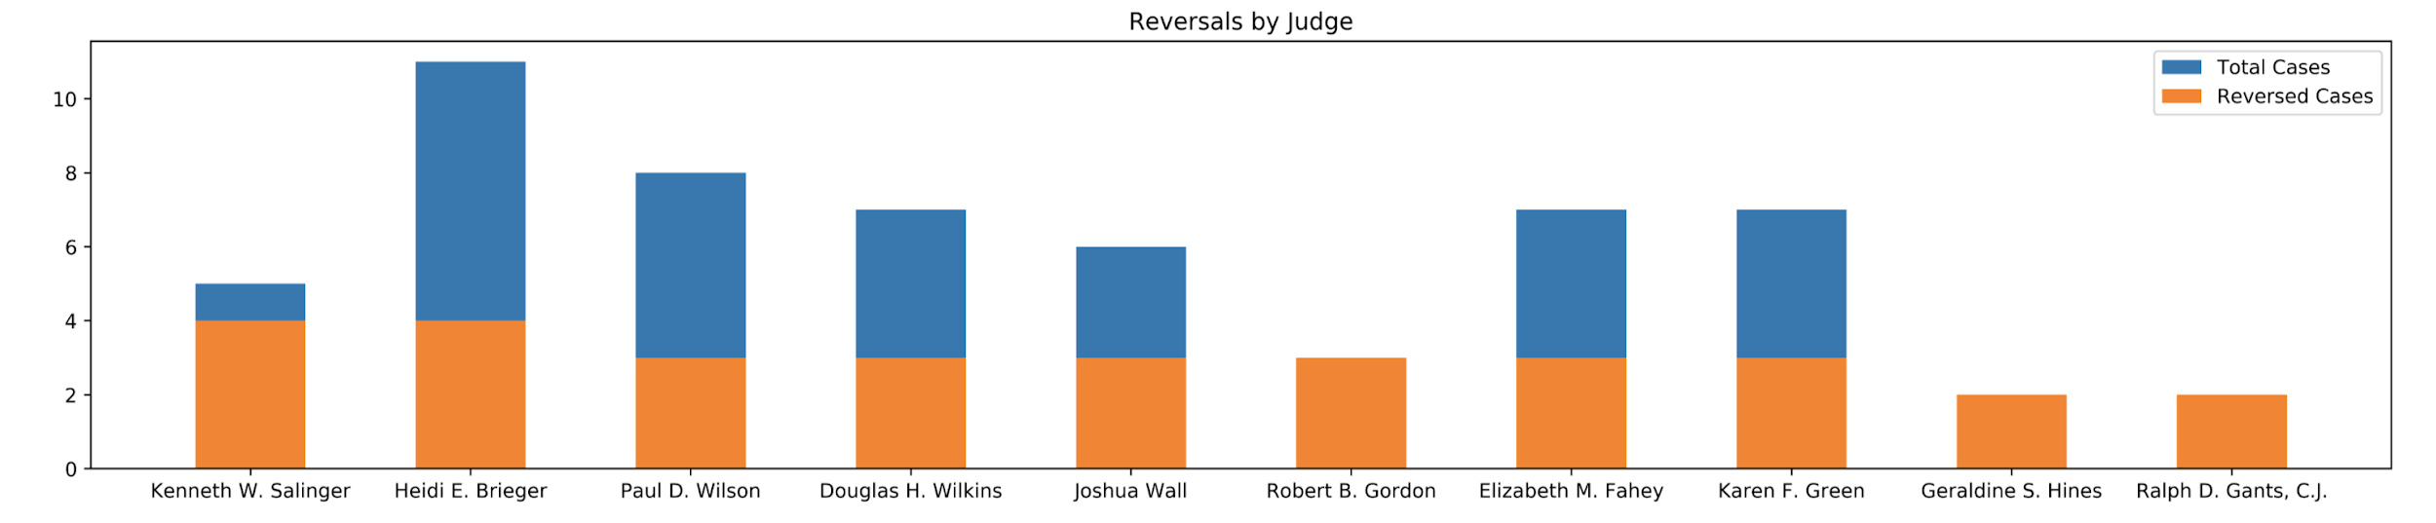
BENCHMARKS: A Citizen’s Scorecard on Judicial Accountability in Massachusetts
Tiam Moradi, Rahul Suresh, Helena, Arthur E
Spark! Advisor: Professor Maggie Mulvihill
Introduction
Analysis
Predicting Case Reversal
Conclusions
We worked with BENCHMARKS: A Citizen’s Scorecard on Judicial Accountability in Massachusetts to determine the conditions under which judicial rulings are likely to be reversed. Focusing on cases appealed to the Massachusetts Supreme Judicial Court and Appellate Courts from 2008–2019, our goal was to use data science as a tool of investigative journalism to uncover never before-seen patterns of judicial behavior.
The graph above shows judges who presided over more than five cases and had more than 50% of cases they presided over reversed.
Can we predict when a case is going to be reversed ?
With the current data not yet, not with a high accuracy.
A more descriptive dataset is required along with an in depth legal knowledge to process them.
Features like case text and headnotes would be helpful which currently could not be scrapped due to high website security.
Also given any dataset the technique of handling missing values is important. This is more so in the case of case of variables representing legal features. Hence good legal knowledge or working in collaboration with people with judicial is recommended.
Here are our learnings on the current dataset.
To correct skewed nature of the data different sampling techniques (oversampling and undersampling) were tried. ADASYN oversampling was observed to be best.
Here are the final results using only numerical data
Results by including features about the nature of the case
Thus the nature of the case doesn't effect case reversal.
Feature importances using Gradient Boosted Decision Tree (GBDT)
Top five features are difference between status date and entry date, decision date and entry date and Appellant Defendent. court type and type of case.
The fact that Appellant defendant matters is worth investigating. Also on a whole criminal cases seem to have higher reversals than civil cases
For our new data, we were able to identify judges who have a reversal rate of over 50 percent:Where Kenneth W. Salinger, Robert B. Gordon, Geraldine S.Hines, and Ralph D. Gants
From analyzing the opinions text, there were no clear patterns for clustering opinions of affirmed or reversed cases.
The current dataset is not descriptive enough for breakthrough pattern analysis using machine learning.
Beyond that for predicting reversals while the type of the case matters the specific nature of the case doesn't seem to matter.
Appellant Defendant and the type of court involved seem to have a correlation with case reversals that is worth examining.
Judges with most reversed cases recently
The graph above shows 10 top judges who mostly likely to reverse a case of both SJC and Appeal Court in MA. Kenneth W. Salinger, Robert B. Gordon, Geraldine S.Hines, and Ralph D. Gants have the highest reversed case rate where the latter 3 judges reversed all cases they processed, also these cases are all civil cases.
Questions we aim to answer
What proportion of cases are reversed in Massachusetts?
What are the similarities between cases that are reversed?
Is it possible to predict when a case is going to be reversed ?
For this section of the analysis, we wanted to examine text data to possibly identify patterns between affirmed and reverse cases.We separated the affirmed and reversed cases into separate data frames. We found that that affirmed and reversed cases shared over half of their features
we wanted to see if clustering to use these features to group similar cases together. We utilized KMeans++, and here our the results.
Data
Future Steps
The first main data source is masscases, a collection of reports, from the Massachusetts government website. Here we got public opinions text of the Supreme Judicial Court (SJC) and the Appeals Court cases.
More descriptive data including which includes case text and other features need to be scraped.
Given the difficulty in scraping government website, future teams need to discover other methods; while data obtained by our team is a good foundation, it has limited potential for pattern recognition with machine learning.
Extensive feature engineering in collaboration with legal experts will be key to make any any scraped data useful for this task.
Finally, given that sufficient “good” data is collected, the next group can attempt to use anomaly detection algorithms to detect outliers as potential reversals
Ratio of SJC and appealed cases reversed from 2018.3 - 2019.10
We cleaned the scraped data and determined how often each lower court judge is reversed. The previous two graphs show that the reversed cases ratio that Supreme Judicial Court and Appeal Court had from Mar. 2018 to Oct. 2019. we can see that the reversed cases rate between the Supreme Judicial Court and Appeal Court is no much difference.
Acknowledgements
We would like to thank Lance Galetti, Maggie Mulvihill and Ziba Parissa for sponsoring a Spark! Project.
Judges with a reversal ratio of greater than 50%

