Slide 1
Final Insights Report Updates
NCF and BIPOC Philanthropy:
Equity and Philanthropic Giving in Massachusetts
CS506
Team C: Sharon, Fiona, Justin, Tyler, Esther
26 April, 2024

Slide 2
Base Analysis Overview
General Ideas:
Funding for the Black/LatinX community have had an overall upwards trend throughout the years.
23.68% of funding for Black/LatinX community is going towards non-profits led by members of that community
Top categories between non-profit mission and grant issues tend to surround Youth Development, Education, and Human Services, although this may differ depending on whether we sort by quantity or quality of grants.
Most organizations being funded are located in Boston.
Interesting Findings:
‘Education’ came out on top for being the category with the most money received, but it was nowhere in the top 10 when we looked at the top categories based on number of grants received – this may be an interesting phenomenon to keep in mind.
There’s more information lacking than we originally thought from the initial insight report.
Notes:
2. How much funding is going toward nonprofits led by Black or LatinX individuals (president, executive director, board chair, etc.) in Massachusetts?
3. What are other trends related to the type of organizations and grants that are being funded serving the Black and LatinX communities in Massachusetts e.g. missions of the nonprofits, issue focus of the grants, changes in amounts donated over time, etc.

Slide 3
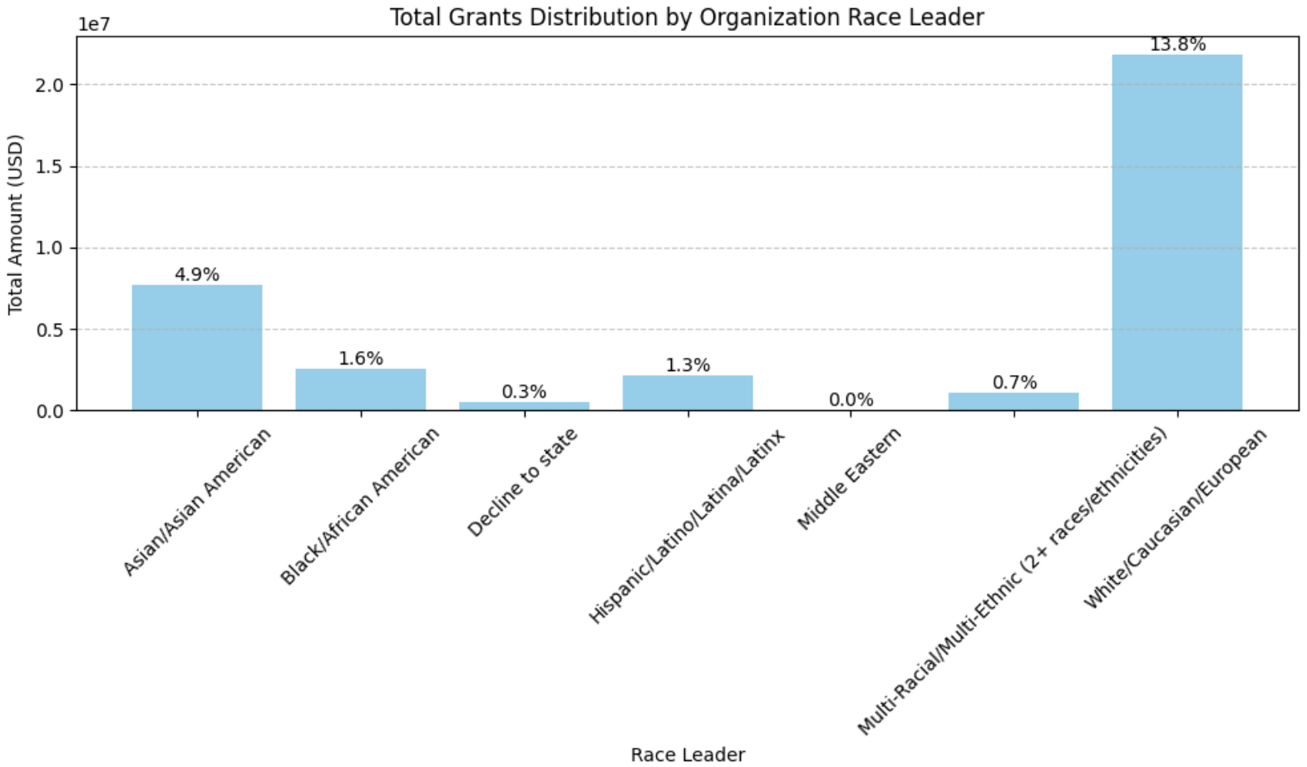
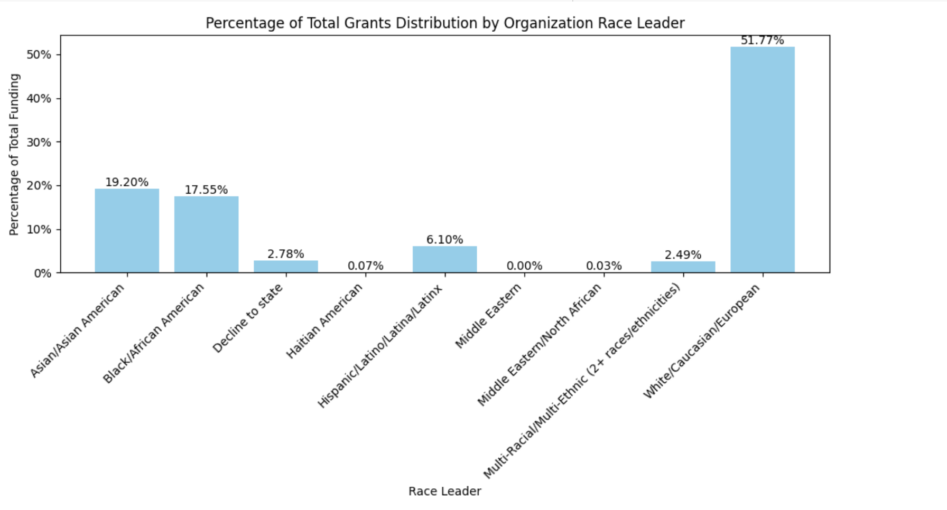
Key Question #2 Revised
2. How much funding is going toward nonprofits led by Black or LatinX individuals (president, executive director, board chair, etc.) in Massachusetts?
as asked by NCF, we revised the methodology by joining data bundles using a ‘EIN’ to ensure more consistency!
Total Grants Distribution based on Leadership Race
Total Grants Distribution based on Leadership Race
Source: ‘Grants’ Bundle, ‘Organizations’ Bundle joined on ‘org_name’
Columns used: ‘amount_usd’, ‘recip_name’, ‘org_name’, ‘race_leader’
Source: ‘Grants’ Bundle, ‘Organizations’ Bundle joined on ‘ein’
Columns used: ‘amount_usd’, ‘recip_name’, ‘org_name’, ‘race_leader’

Slide 4
Extension Question #1
Filter out hospitals, churches, and higher education institutions.
Note: There were no organizations that fell into these categories, but we still need to look at NTEE codes, which will provide us with more information – we will include this analysis in the final report!
Source: ‘Organizations’ Bundle
Columns used: ‘organization_name’; checking if it contains corresponding word
Notes:
$9,047,457 increase overall from 2019-2020

Slide 5
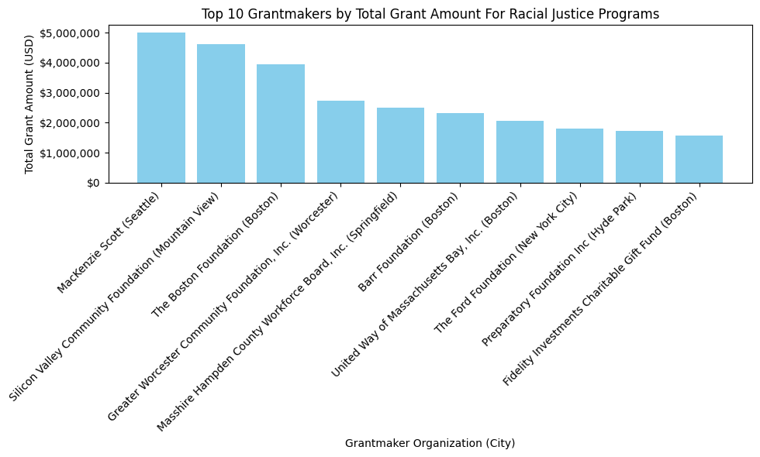
Extension Question #1
Grantmaker Analysis
again, we define ‘Racial Justice Program’ = any organization whose pcs_population contains the Black/LatinX community
Note
During our previous slides, we showed a version of this graph that had a mistake in its methodology - we looked at grants for ALL populations instead of just the filtered grants
Top 10 Grantmakers for Racial Justice Programs
Source: filtered ‘Grants’ Bundle
Columns used: ‘gm_name’, ‘amount_usd’
Notes:
$9,047,457 increase overall from 2019-2020

Slide 6
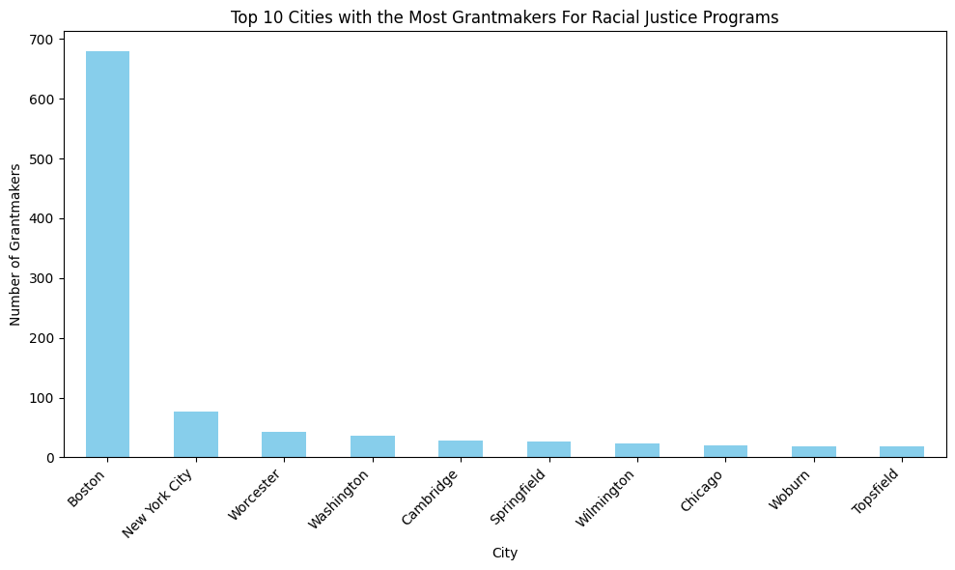
Extension Question #1
Grantmaker Analysis
Top 10 Cities with Grantmakers for Racial Justice Programs
Source: filtered ‘Grants’ Bundle
Columns used: ‘gm_name’, ‘gm_city’
Notes:
$9,047,457 increase overall from 2019-2020

Slide 7
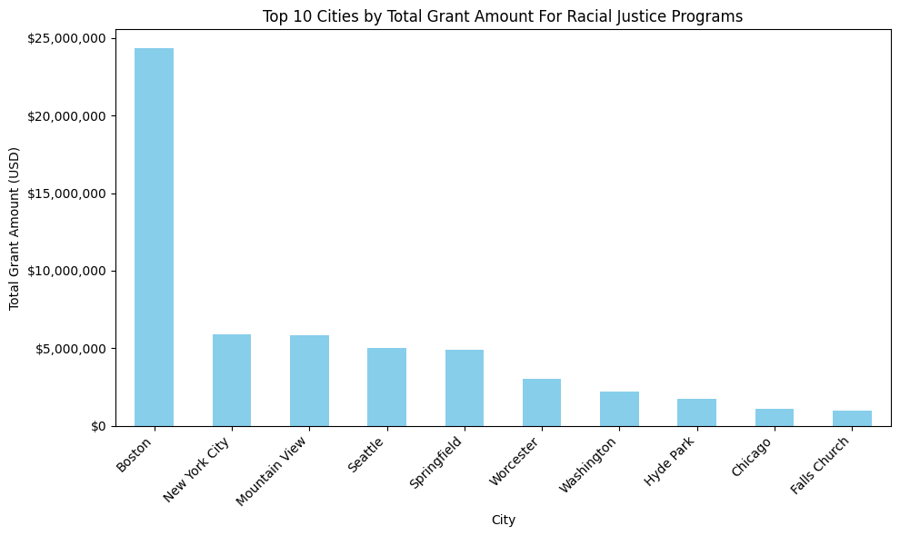
Extension Question #1
Grantmaker Analysis
Top 10 GM Cities by Grant Amount for Racial Justice Programs
Source: filtered ‘Grants’ Bundle
Columns used: ‘amount_usd’, ‘gm_city’
Notes:
$9,047,457 increase overall from 2019-2020

Slide 8
Extension Question #2
Propose a methodology for using and filtering by NTEE codes to extract more meaningful insights from organization mission. Why did you make the decisions that you did?
We can utilize filters based on NTEE codes starting with R20, as these codes are associated with Civil Rights, Social Action, and Advocacy specifically aimed at the Black community.
While R20 is tailored for Black causes, R40 is designated for Latinx causes, so ideally looking into both would be what we want to include both black and brown communities.
However, within our dataset, only R20 and R99 codes are present, with R99 representing Civil Rights, Social Action, and Advocacy activities that are not classified under more specific categories (Not Elsewhere Classified).
Therefore, narrowing down to only the Black NTEE social justice codes indicates a broader involvement in social advocacy initiatives supporting the Black community, beyond organizations explicitly focused solely on Black causes.
Notes:
$9,047,457 increase overall from 2019-2020

Slide 9
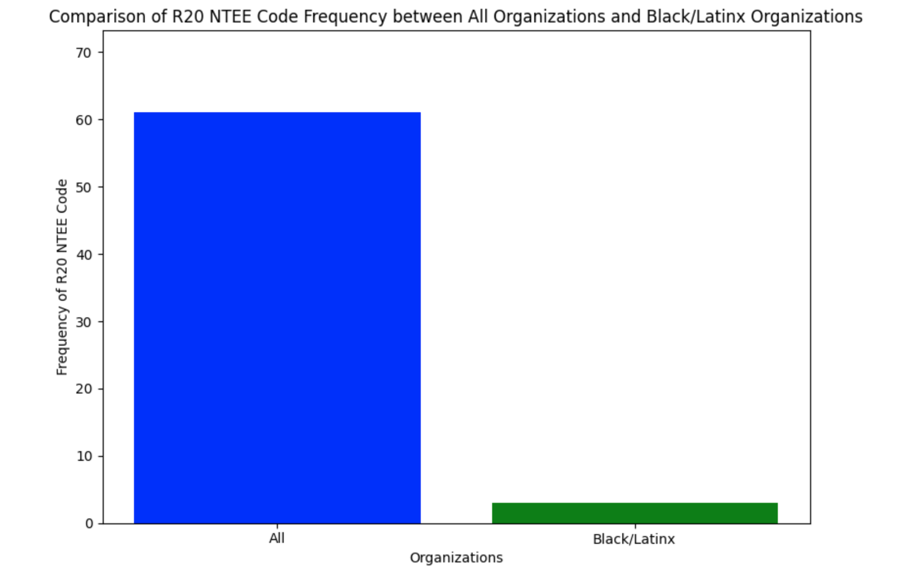
Extension Question #2
Propose a methodology for using and filtering by NTEE codes to extract more meaningful insights from organization mission. Why did you make the decisions that you did?
Looking at the graph, there are a lot more organizations indicating they support civil rights and racial justice issues affecting the Black community than just the ones with pcs_codes for Black/Latinx organizations.
Some useful analysis we could do in the future is compare the organizations with pcs supporting black/brown and NTEE codes supporting those causes.
Source: filtered ‘Organizations’ Bundle
Columns used: ‘NTEE’ column for both entire bundle and filtered bundle
Notes:
$9,047,457 increase overall from 2019-2020

Slide 10
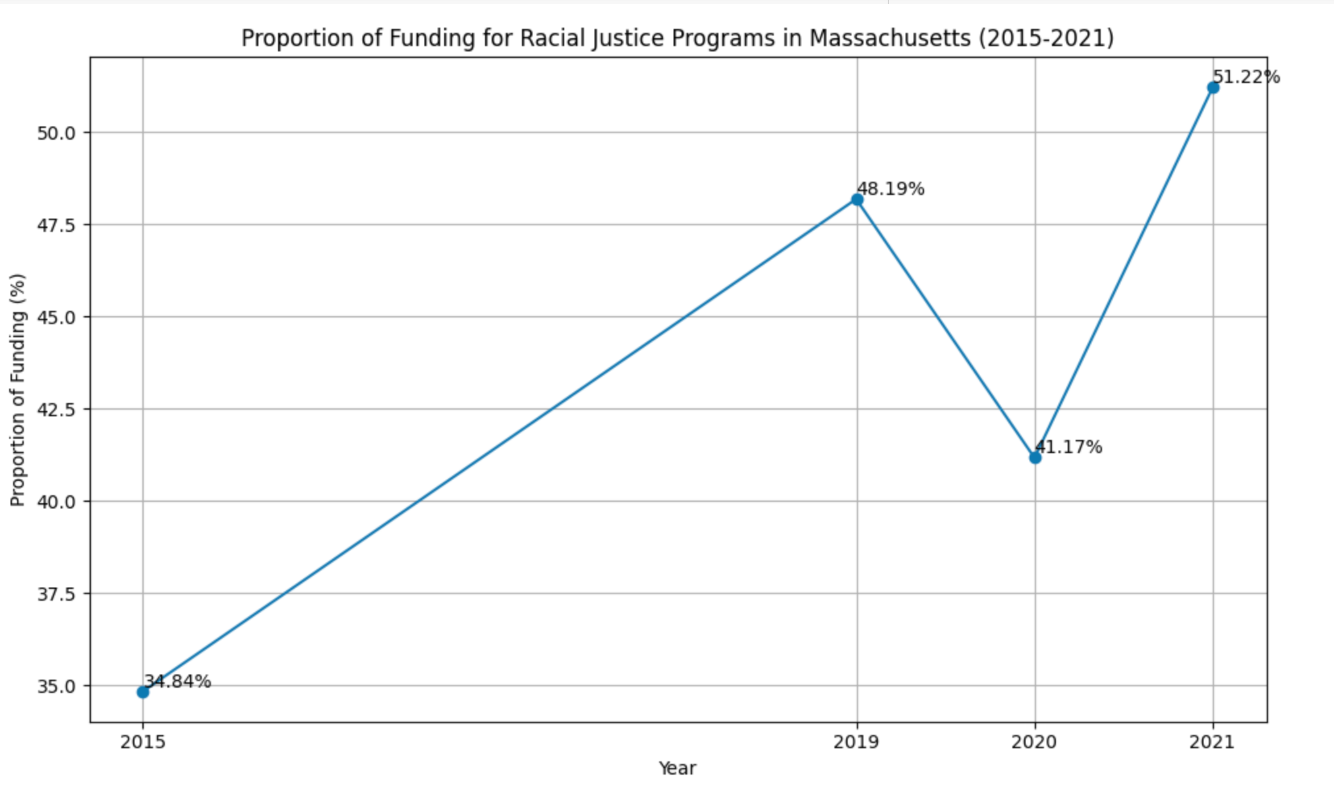
Extension Question #3
What is the proportion of contributions to Black/brown communities compared to all grants?:
How has this share of contributions changed between 2015 and 2020?
Notes:
$9,047,457 increase overall from 2019-2020

Slide 11
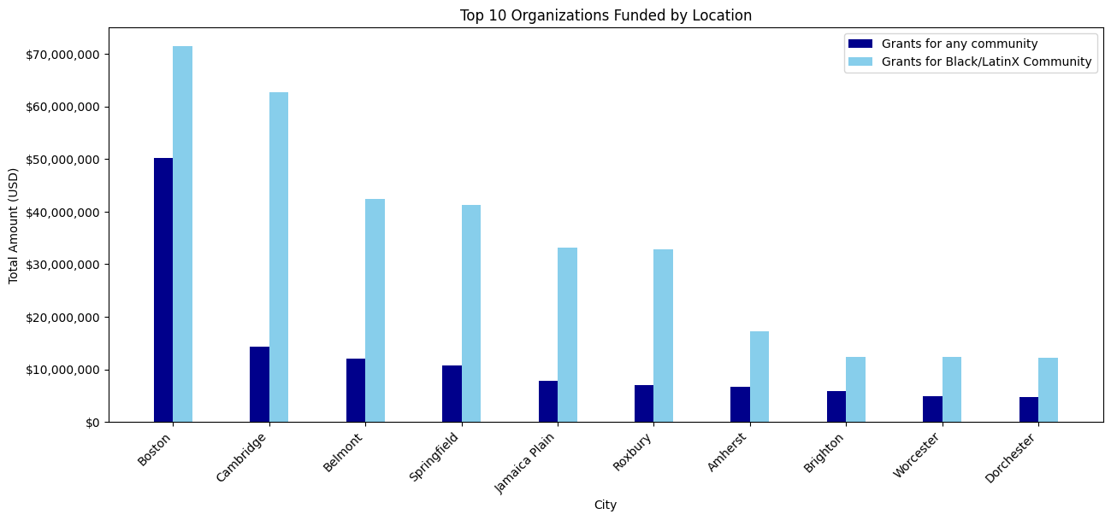
Extension Question #3
What is the proportion of contributions to Black/brown communities compared to all grants?:
Where are the recipient organizations located?
Top 10 Organizations Funded by Location
Source: filtered ‘Grants’ Bundle
Columns used: ‘recip_city, ‘amount_usd’
Notes:
$9,047,457 increase overall from 2019-2020

Slide 12
Next Steps
Preliminary
Analysis
Create More Visualizations + Find Trends
Mid-Semester Report
Extension Questions Answered
Final Report
Wrap up project by completing 3-page final report containing visualizations, key findings, and summary.
Initial analysis of data to become more familiar with the structure of our dataset and how we can best work with it.
In this phase, we answered 2 key questions.
Further analysis of datasets and all key questions answered.

Slide 13
Thank you!
CS506
Team C: Sharon, Fiona, Justin, Tyler, Esther
26 April, 2024

Slide 14
Key Question #2
2. How much funding is going toward nonprofits led by Black or LatinX individuals (president, executive director, board chair, etc.) in Massachusetts?
24% of funding is going towards nonprofits led by Black or LatinX individuals in MA
Source: ‘Grants’ Bundle, ‘Organizations’ Bundle
Columns used: ‘amount_usd’, ‘recip_name’, ‘org_name’, ‘race_leader’
new, updated chart!
Limitations
10.26% of organizations do not have race_leader data
Note: only 89% of organizations has race_leader data included.

