Slide 1

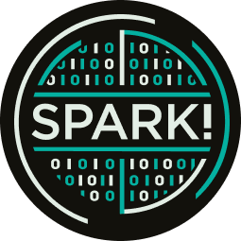


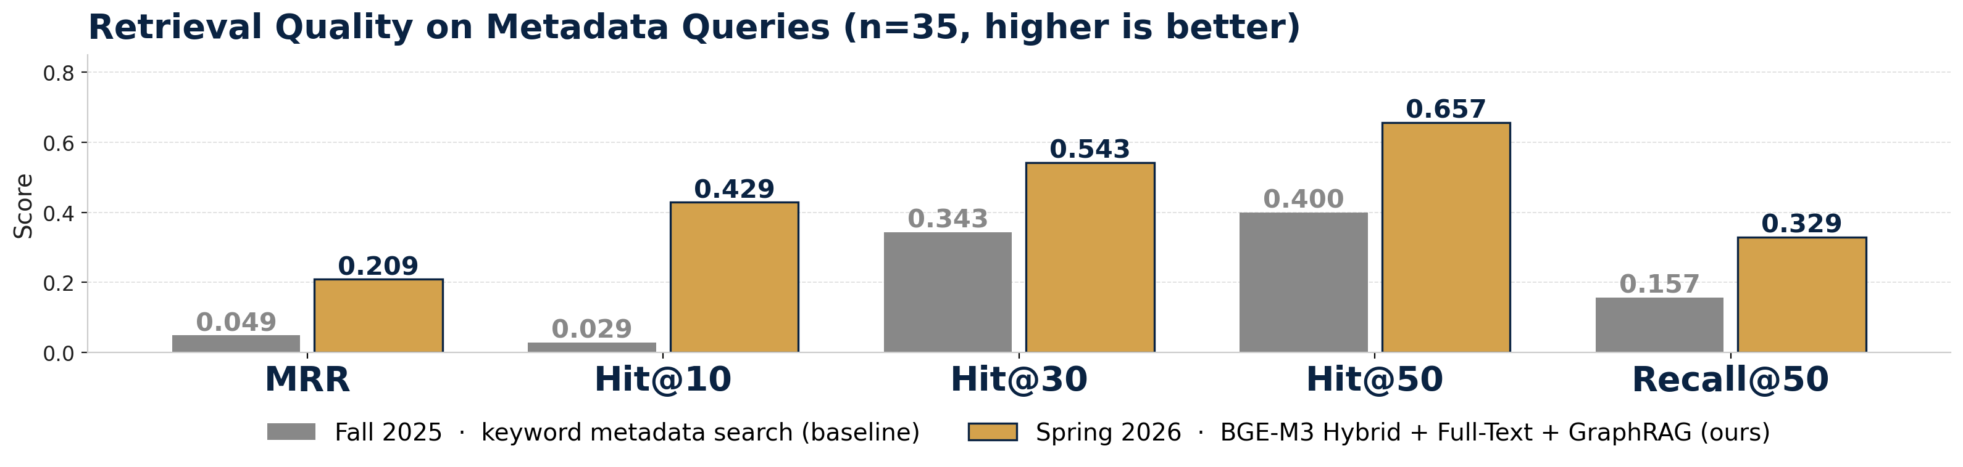


BPL-LIBRAG: Natural Language Search over a 15-Year Digital Archive
BU SPARK!
Page 1 · Project Overview & Results
SUMMARY
RESULTS
The Boston Public Library has spent 15 years digitizing historical photographs, newspapers, maps, and manuscripts via Digital Commonwealth. Today, users can only search by rigid keyword tags.
The Problem
If an item was never explicitly tagged with the right keyword, it can't be found — even if the answer is right there in the document text.
Our Goal
Build a natural-language search system that lets researchers, students, and the public ask plain-English questions and get back relevant historical documents with cited, source-grounded answers.
What We Built
An end-to-end Hybrid + GraphRAG pipeline with cited GPT-4o answers, deployed as a multi-page Streamlit app on Hugging Face — see Page 2 for system architecture.
Retrieval performance vs. Fall 2025 keyword baseline · n = 35 metadata queries from a held-out gold-standard set
Metadata Hit@10
Metadata Hit@50
Metadata MRR
0.029 → 0.429
0.400 → 0.657
0.049 → 0.209
≈ 15× improvement
+64% lift
≈ 4× improvement
CLIENT AND MENTORS
CONCLUSION & NEXT STEPS
Client
Eben English
Boston Public Library · Digital Commonwealth
Project Managers
Ryan Rodriguez (PM) · Shinu Shibu (TPM)
Team — BU Spark! Spring 2026
Hanna S. Tadesse · Vivinia Cai
Manaswi Yadamreddy · Haozhe (Jimmy) Jia
Partner: BU Spark! · Boston University
KEY INSIGHT Hybrid + Full-Text + GraphRAG retrieves the gold-standard document in 57% of all queries (Hit@50, n=51) — vs. 39% for the Fall 2025 metadata baseline.
First full-text search integration in project history — OCR newspaper content now indexed and searchable.
End-to-end Hybrid + GraphRAG pipeline with cited GPT-4o answers and structured query logs.
Multi-page Streamlit app deployed on Hugging Face — search, document detail, and query history.
Next: scale corpus from current subset to the full 1.5M-page collection, add a cross-encoder reranker, and extend to images via CLIP / SigLIP.

Slide 2

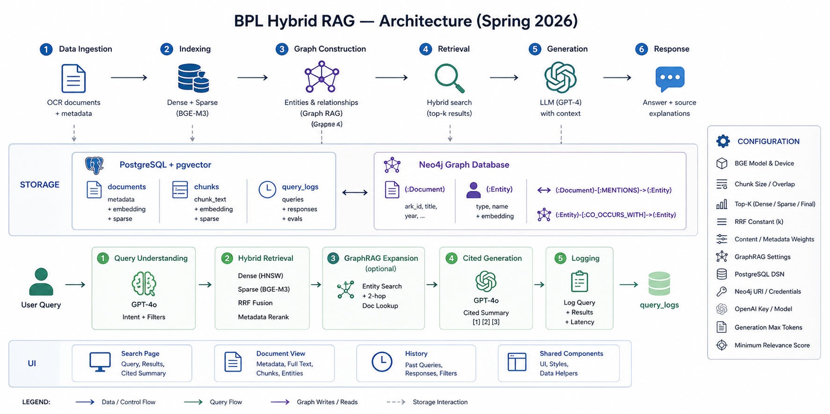


BPL-LIBRAG: Natural Language Search over a 15-Year Digital Archive
BU SPARK!
Page 2 · System Architecture, Methods & Reflections
SYSTEM ARCHITECTURE · HOW BPL-LIBRAG WORKS
HOW TO READ THIS DIAGRAM
OFFLINE PIPELINE (top row, 1–6)
OCR documents → Dense + Sparse indexing (BGE-M3) → Entity graph construction → Hybrid retrieval → Cited GPT-4o generation → Response with sources.
STORAGE LAYER (middle band)
PostgreSQL + pgvector holds documents, chunks, and query logs (with embeddings + sparse vectors). Neo4j holds the entity graph linked back to documents via MENTIONS / CO_OCCURS_WITH edges.
ONLINE QUERY FLOW (lower row, 1–5)
User query → GPT-4o intent + filter extraction → Hybrid retrieval (Dense + Sparse fused via RRF, then metadata-reranked) → optional GraphRAG entity expansion → cited summary → log every step for evaluation.
METHODS / TECH STACK
REFLECTIONS — WHAT WE LEARNED
Embeddings BGE-M3 dense + sparse (1024-d, single forward pass)
Vector Store PostgreSQL + pgvector (HNSW ANN over dense + sparse)
Hybrid Retrieval Dense ANN + Sparse lexical, fused via Reciprocal Rank Fusion + metadata rerank
Graph RAG Neo4j · spaCy NER · 2-hop CO_OCCURS_WITH traversal for entity expansion
Query & Generation GPT-4o intent classifier + cited summary writer with [1][2][3] inline source markers
Interface Multi-page Streamlit app · deployed on Hugging Face Spaces
Evaluation 51 gold-standard queries · MRR / Hit@K / Recall@K / Precision@K (K = 10, 30, 50)
A RAG pipeline is a chain — every model swap meant rebuilding indexes, retuning fusion weights, and re-running the full evaluation from scratch. Plan for re-runs, not one-shots.
Historical OCR is hard for embedding models — sparse output, broken tokens, and 19th-century vocabulary all hurt dense recall. Sparse retrieval is what saved us on noisy text.
Hybrid > either alone — dense + sparse fusion materially outperformed either component, especially on metadata-heavy queries: Hit@50 jumped 0.400 → 0.657.
Evaluation comes first, not last — without a real test set and a harness, every change is a guess. The harness is now the single source of truth for the team.
Citations build trust — librarians and researchers won't accept ungrounded LLM output. Inline [1][2][3] markers + source links were table-stakes for adoption.

