Slide 1
交通安全分析
交通大数据分析
2021年春季
马晓磊
Notes:
So the first example of transportation data analysis is the safety analysis

Slide 2
交通安全分析
安全分析似乎是交通领域的一个非常传统的话题，但在今天仍然非常重要。
与许多发达国家相比，美国的交通事故率仍然很高。
交通事故是美国15-24岁儿童死亡的首要原因。
道路交通事故给我们的社会带来了沉重的经济负担，无论是直接成本还是拥堵、污染和治安/医疗成本。因此，安全分析和改进是一项不错的投资。
Notes:
Traffic safety analysis might seem like a very conventional topic, but still very important in today’s transportation.
In general, traffic accident rate in the US is still high compared with many developed countries.
Crashes are the leading cause of death for young people, and the cost of traffic accidents is passed on to everyone due to the resulting congestion, pollution, and policing/medical costs.
There is really no doubt that the money spent to remediate this issue can be a good investment, and that is why we do accident analysis, to make sure that we maximize the return on that investment.

Slide 3
交通事故影响
在世界范围内：
每年有1,250,000人
死于道路交通事故
在美国：
2013年有32000多人死于交通事故；
230万人因交通事故受伤；
总损失：在美国2675亿美元；
事故成本是拥堵成本的2.2倍。
来源:
世界卫生组织WHO. http://www.who.int/violence_injury_prevention/road_safety_status/2015/en/
美国高速公路安全管理局NHTSA. https://www-fars.nhtsa.dot.gov/Main/index.aspx
Notes:
Let’s start with some numbers.
According to the world health organization, there were 1.25 million traffic related deaths worldwide in 2013.
In the US, there was more than 32,000 people died in traffic accidents. An additional 2.3 million people were injured, with a total monetary loss of more than 200 billion dollars.
We know that a very large percentage of congestion is caused by accidents, but the accidents themselves are much more expensive than the secondary costs. Cost of accidents is 2.2 times higher than congestion cost.

Slide 4
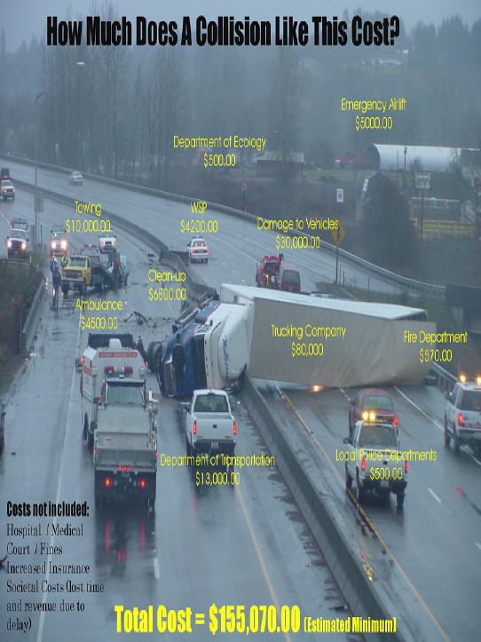
一次冲突要花费多少？
来源：
2004年国家公路碰撞数据汇总，美国华盛顿州交通部，2006年
Notes:
Here is a infographic made by WSDOT a few years ago, which might help to give an indication of how expensive a traffic accident can be.
Obviously, this is a pretty severe accident. The largest portion of cost comes from the truck itself. The damaged truck as well as destroyed load will cost around 80 grand. Besides the truck, there are several small vehicles involved, and each can worth 30~40 thousand dollars.
The DOT, local police and fire department will commit staff, vehicles, and other resources to the incident clearance work. In addition, this will also involve costs in towing, emergency medical services, and state patrol.
After all of that, now you can start thinking about how much time was wasted by commuters, as well as the additional pollution and fuel consumption generated.
The point is, transportation agencies and researchers still take the issue of safety to be central, and not just because we don’t want to see accidents on the roadways, but because of the huge cost as well.

Slide 5
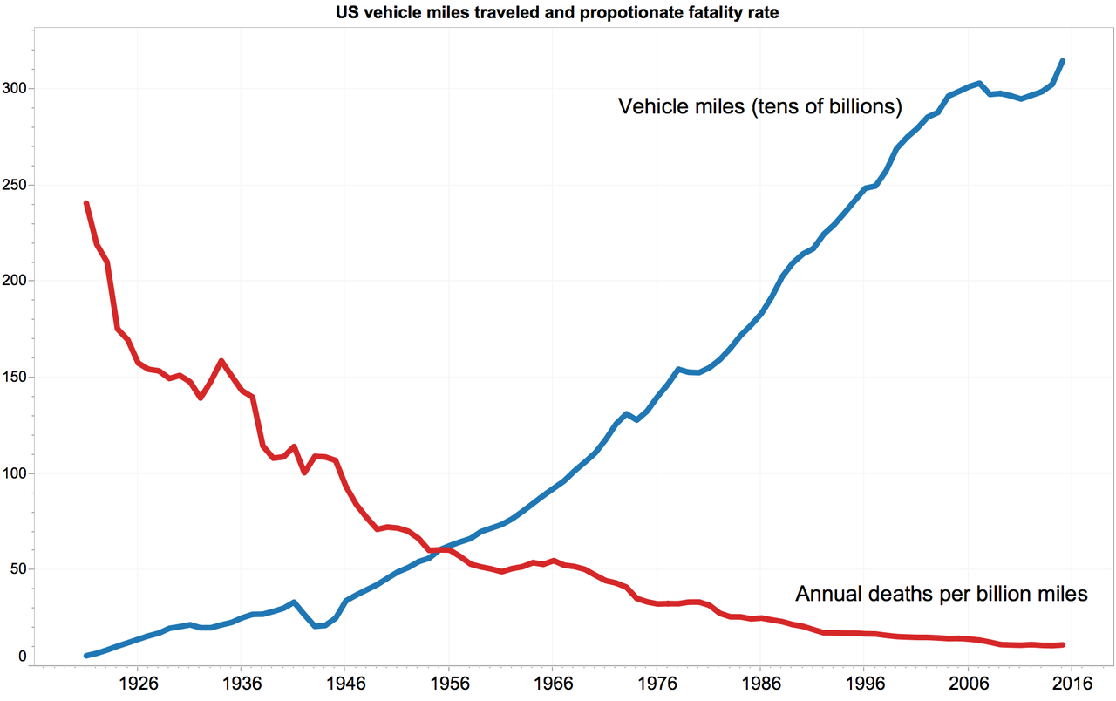
美国车辆行驶里程和死亡率
车辆里程数（百亿）
第一部汽车设计立法
联邦安全带法和公路安全法
每年每十亿英里的死亡人数
来源：外文学术资源整合服务系统，美国高速公路安全管理局https://upload.wikimedia.org/wikipedia/commons/d/d8/USA_VMT_vs_death_per_VMT.png
Notes:
This plot shows the change in VMT and fatality rate in the United States over the past 100 years.
If we just look at the curve of fatality rate (red curve), it might be a little deceiving as it looks like we are doing pretty good in improving the traffic safety and reducing accidents.
I am sure much of it can be explained by better vehicle technology. But from the policy perspective as a point of reference, the first auto design legislation was passed in the 1940s, the federal seat belt law and the highway safety act was initialized sometime around 1970.
However, if we look at the total vehicle mile traveled, in 2014 the number was around 3.2 trillion. This is almost 100 times compared to 100 years ago.
What it generally means is that today we do have a better driving environment, but traffic safety remains as an important issue because of the significant increase in vehicle use.

Slide 6
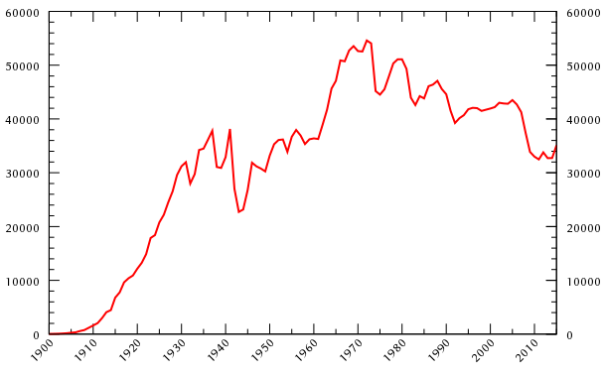
美国每年的车祸死亡人数
零事故愿景
“Vision Zero”
来源：外文学术资源整合服务系统，美国高速公路安全管理局https://upload.wikimedia.org/wikipedia/commons/d/d1/Motor_vehicle_death_in_the_US.svg
Notes:
Maybe a more informative chart is this one, which combines the two curves from the previous picture and shows the annual crash fatalities in the US.
In general, we do see a decrease in the total number of fatalities from 1970s. But there are still plenty of room of improvement.
I included a label here, vision zero is an international safety project initiated in Europe around 20 years ago. The aim of the project is to achieve no fatalities or serious injuries in the highway system. In recent years the project has been introduced to US and many states and cities has developed plans to achieve the target.
In Seattle, the goal is to end traffic deaths and serious injuries by 2030.

Slide 7
交通安全分析
常见话题：
基于不同因素的风险分析（如：天气、驾驶员等）
影响分析（如：事故引起的延误、清理时间等）
安全处理的热点识别（HSID）
碰撞热点通常定义为事故风险较高的位置，应优先考虑未来的安全处理。
怎么做？
观察到的事故数、频率、财产损失等
地理空间分析：核密度估计、聚类分析等
建模：经验贝叶斯、改进潜力等
Notes:
Through safety analysis, we can answer a lot of questions about the safety of transportation facilities.
Some common topics in traffic safety analysis are:
Risk analysis which predict how much likely an accident is to occur based on a number of factors, including weather, roadway geometrics, and driver behaviors.
Impact analysis which targets to predict the broader impact of accidents in the traffic system. Topics include accident induced delay estimation, as well as clearance time prediction.
Another important topic which is also what we will be focusing here is Hotspot Identification (HSID).
A crash hotspot is generally defined as a location that has elevated risk of accidents, and should receive priority consideration for future safety treatments.
One of the most important questions DOTs have is how to prioritize limited resources to make the best possible improvement.
Hotspot Identification is able to help us find those locations on a road network that have poor safety conditions and could potentially benefit the most from some safety treatments.
There are a lot of analysis methods for this.
For example, we can just look at the accident count and frequency, as well as the property damage to decide without too much quantitative analysis.
There are also some geospatial methods that use the spatial patterns of accidents to identify problem areas.
Probably the most used methods are statistical models that look for individual segments of a road that have a high crash risk.
This is basically what we are going to talk about today, and I am going to go over a particular method that is generally considered to be quite adequate and is widely used in practice.

Slide 8
事故热点识别
为什么要给事故建模，而不是仅仅修复那些事故率高的地点？
车祸是随机事件，不能对风险进行稳定的估计。
某些设施类别本身就具有较高的风险（较高的交通量、较长的路段长度等）。
我们可以使用统计模型来比较同一级别的设施。
尽管已经提出了更先进/更精确的方法，经验贝叶斯（EB）通常被认为是标准。
Notes:
This brings up the question, why do we want to model accidents, rather than just fix those locations with high accident counts?
One of the reasons is that crashes are random event, and there are a lot of cases where a high accident count is just due to random fluctuations.
The other thing is that some facilities are just inherently high risk. For example, facilities with higher traffic volumes and longer road segment lengths will generally has more accidents, but this does not really indicate high accident risk.
We can develop statistical models to make sure we are comparing facilities on the same level.
In particular, we will introduce the Empirical Bayes method, which is recommended in the highway safety manual and generally considered as standard in accident hotspot identification studies. There are variations of this method, and even many more sophisticated methods out there, but any new method developed is typically compared to the Empirical Bayes method, as it is quite consistent and interpretable.

Slide 9
泊松过程
泊松过程是排队论中最重要的模型之一。
基于时间的，基于事件的计数数据（例如，一个时间段内到达的客户数量）
非并行时间段中的计数是独立的
分布
一个时间段内的事件计数服从泊松分布
两个连续事件之间的时间间隔服从指数分布
Notes:
Let us start by briefly covering the statistics involved.
Poisson process is one of the most important models used in queueing theory.
A Poisson process describes the time-dependent event-based count data, for example, number of customers arrived in a time period.
Another feature of the process is that counts in non-concurrent time periods are independent. Which means that the process has no memory and what happens before has no influence on what will happen next.
With these natures, the event count in a given time period will follow a Poisson distribution, while the time between events has an exponential distribution.

Slide 10
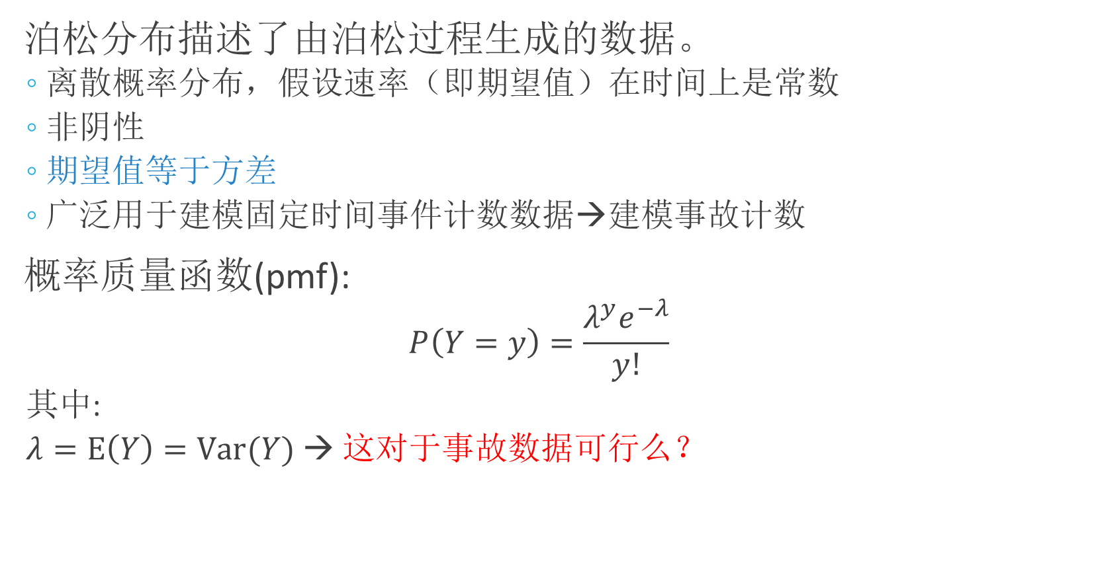
泊松分布
Notes:
The Poisson distribution describes the data that is generated from a Poisson process.
This is a discrete probability distribution, and assumes the rate or expected value is constant in time.
Also, the data must be non-negative, which is obvious for count data.
The most well-known characteristic is that the mean of the event counts is equal to the variance.
It is popular for used to model fixed time event count data, which makes it intuitive for use in accident counts.
This is the probability mass function, where y is the count value we want to model.
You will note here that there is only one parameter, lambda, in the function. This is because in a Poisson process, mean and variance are equal and thus only one parameter is needed.
So here is a question, the core assumption that the mean is equal to the variance, how realistic is this for accident data?
It kind of makes sense, in that we might expect the variance to increase with the mean, generally this is a very strict assumption and in fact it is seldom found to be true.
There are something we can do to solve this. But for now let’s just keep this going.
The e is the Euler’s number which is the basis for natural logarithm.
Factorial of y

Slide 11
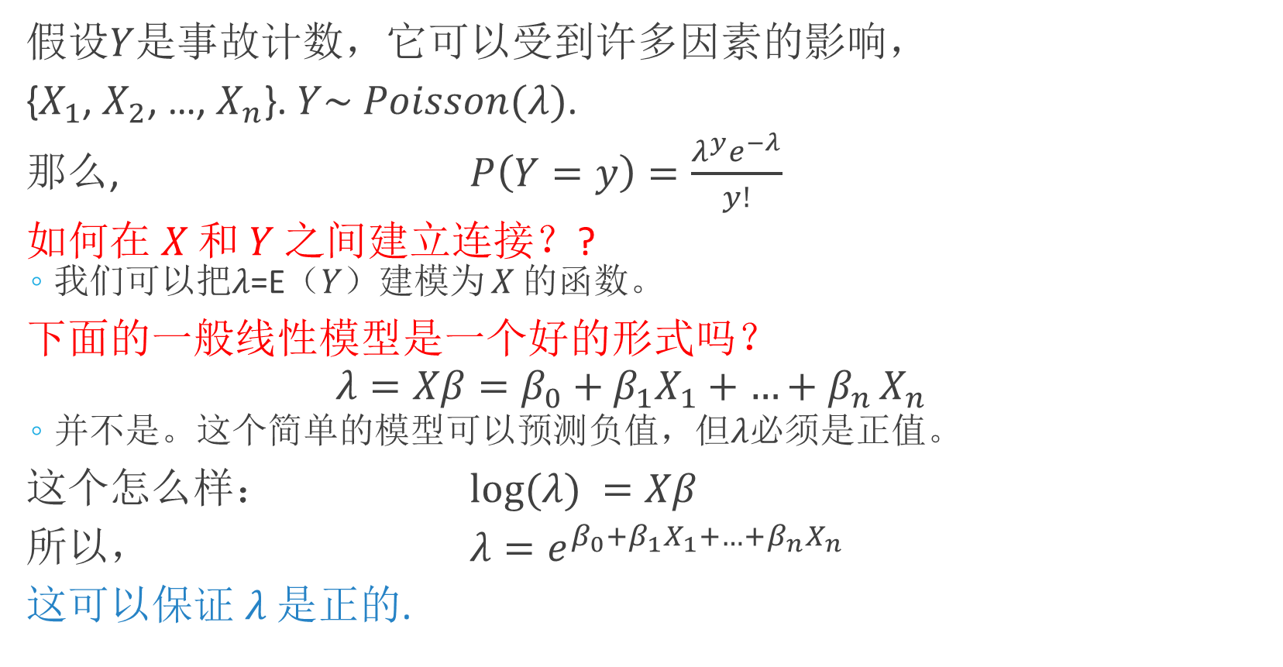
事故计数的泊松回归
Notes:
Okay, let’s look at Poisson regression for accident count data.
Suppose 𝑌 is the accident count, which can be influenced by a number of factors, {𝑋_1, 𝑋_2, …, 𝑋_𝑛}. And 𝑌 follows a Poisson distribution with the parameter 𝜆.
How to build a connection between X and Y? Because we have fixed the model form (Poisson), the distribution of Y is fixed to some extent. But what we can do is to model the distribution parameter 𝜆. From definition we know this equals to the mean of Y.
Then how to model? The first thing I would think of is to use some kind of linear model, like this here.
𝜆 is the response variable, and then some regression coefficients beta 1 through beta n with predictors X1 through Xn. These could be things like speed limit, traffic volume, or weather.
Is this a good model form? Probably not. The issue with this model is that it can predict negative values.
So, what if I take the natural log of 𝜆, and make this the response variable?
You can see that in such model form, 𝜆 is actually the exponent of e, which is guaranteed to be positive.

Slide 12
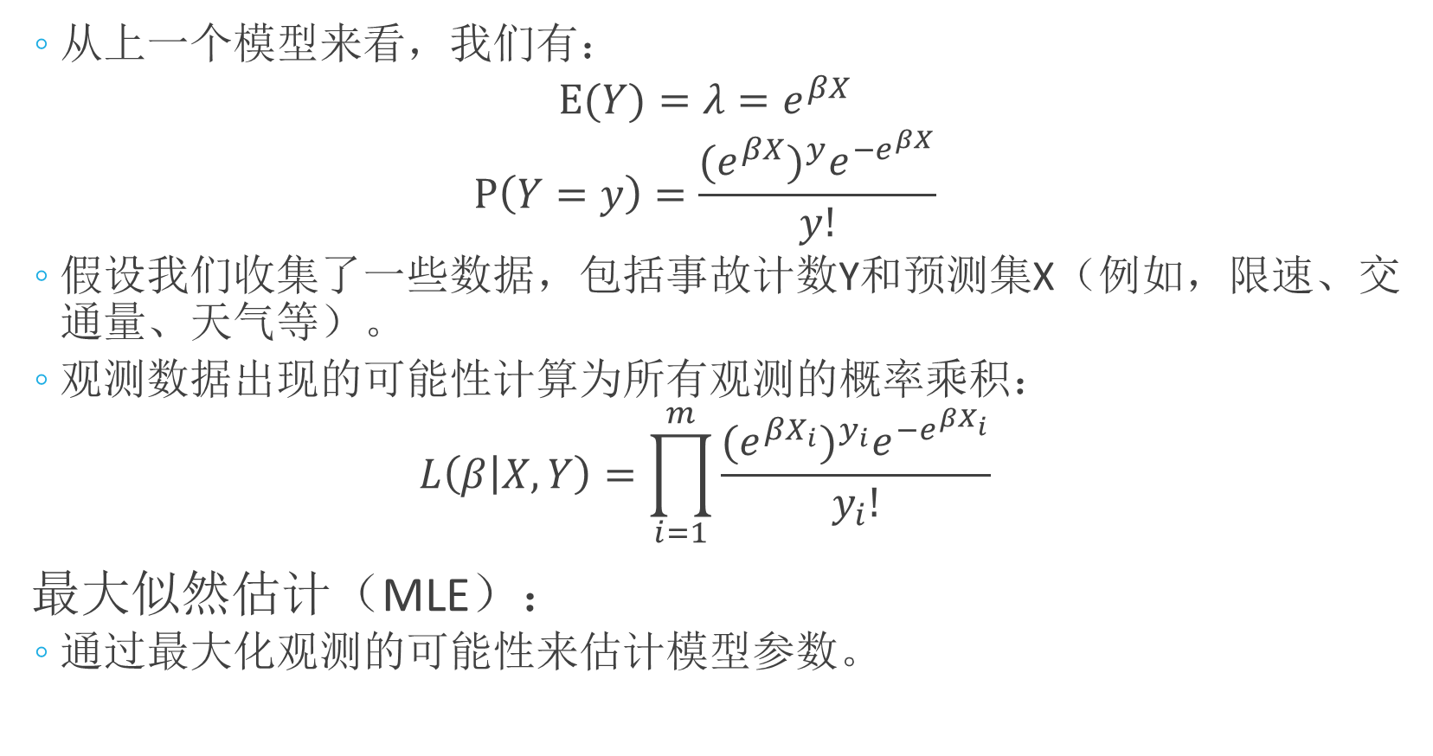
极大似然估计
Notes:
From the previous model we just developed, we can represent the probability for each accident count number by putting the formulation into the Poisson distribution probability mass function.
So assuming you have collected some data, including the accident count Y and predictor set X (e.g., speed limit, traffic volume, weather, etc.).
The likelihood that the observed data will occur is calculated as the product of probabilities for all observations:
Here we introduce the concept of Maximum Likelihood Estimation (MLE). This is a very popular statistical method for estimating model parameters, and the idea behind it is that what we observed in reality must be something that are likely to occur, and thus we want to choose the model parameter that maximize the probability of our observations.

Slide 13
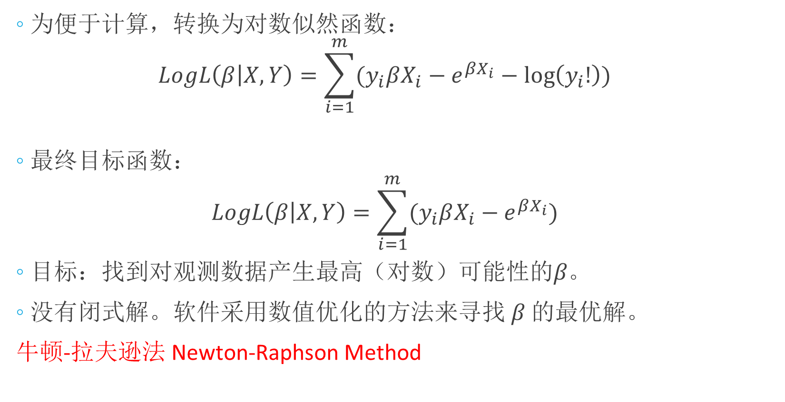
极大似然估计
这个项是一个常数，可以去掉。
Notes:
We typically take the logarithm of likelihood function to make it for computational convenience.
You can see there is a term on the end that does not have any beta in it, which is not of interest because it is a fixed quantity.
After dropping the fixed term, I have this as my final objective function.
My goal is to find beta that that results in the highest (log) likelihood for observed data.
One would think I could take the derivative of this and find the maximum value, but there is actually no closed form solution. So the software that does this uses numerical methods to estimate the parameters.

Slide 14
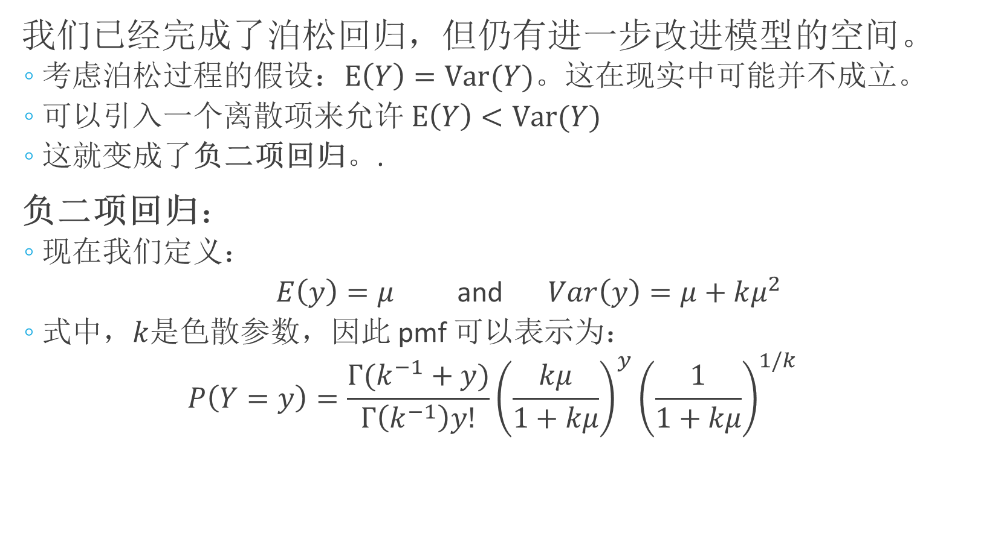
负二项回归
Notes:
Now we have finished the Poisson regression, but there is still room to further improve the model.
Consider the assumption of a Poisson process, which requires the mean to be equal to the variance. This may not hold true in reality. This can be solved by introducing a dispersion term into the model to allow variance greater than the mean.
This model form is called Negative Binomial regression (Poisson gamma distribution).
So let us define another variable, miu, that will represent the mean, and the variance as the mean plus some added quantity multiplied by the mean.
Without going through the tedious derivation, this is the probability mass function you end up with.
You can see this symbol here, this is the gamma function.
It is defined as the factorial of a number minus one, and has some other interpretations for non-integers, but that is not really important for what we are doing.
Let us look at what this means.

Slide 15
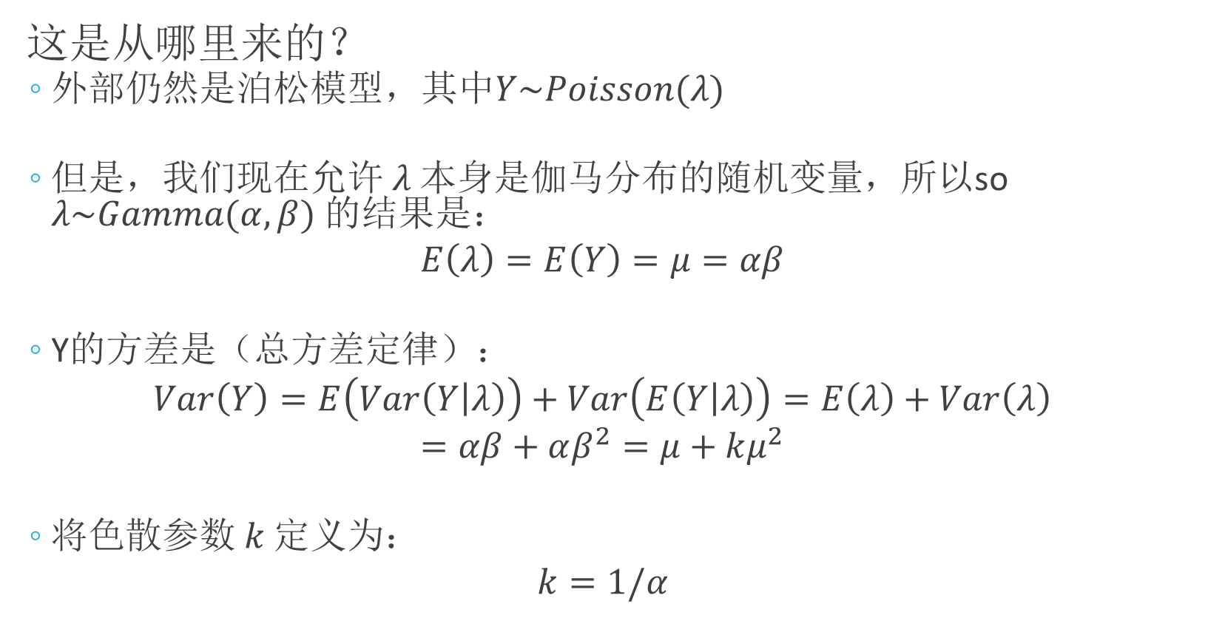
负二项回归
Notes:
So in the Poisson model, if a variable is Poisson distributed, we use this notation to say it is Poisson distributed with mean and variance equal to lambda.
In the negative binomial model, the mean itself is a random variable which is gamma distributed with parameters alpha and beta, hence the name Poisson gamma distribution.
The result is that the mean is a product of alpha and beta, and the variance cam be calculated through decomposition following law of total variance.
Thus, we have two parameters in the negative binomial model, the mean, miu, and the dispersion parameter, k.

Slide 16
全方差律的证明
总期望定律

Slide 17

负二项回归
Notes:
Now we need to find both regression parameters (the coefficient vector 𝛽) and the dispersion parameter, 𝑘. Again, this is solved with the maximum likelihood estimation.
I did not write out the log likelihood function, but it is derived similar to the Poisson distribution.
Some notes about the negative binomial regression:
As one could imagine, as k goes to zero, the model tends toward the Poisson distribution. This can be interpreted as the variance reducing to the mean.
Also, it is worth mentioning that there are still limitations to this model.
For one, it does not handle under dispersion, when the variance is less than the mean.
Also, it does not work well when there are a large number of zero counts in the dataset. But, it tends to work quite well for accident data so it is used extensively.

Slide 18
经验贝叶斯方法（EB Method）
标准统计推断是基于似然函数，目的是获得参数和标准误差的最大似然估计。
贝叶斯方法：在考虑任何数据之前，有一个描述参数知识的先验分布。
需要定义超参数，描述模型参数的先验分布。
在经验贝叶斯（EB）方法中，超参数是从观测数据中估计出来的。
在层次贝叶斯方法中，超参数本身被赋予一个先验分布（超先验）。
Notes:
Let’s move on. You have probably encountered Bayes theorem and general field of Bayesian statistics, we will not go into much detail on the general subject.
But, just as a simple introduction to the Bayes approach, consider that standard statistical inference is based on the likelihood function, with the goal of obtaining maximum likelihood estimates for parameters and standard errors.
The Bayesian program says that, we have some prior distributions about the parameters, maybe from some experiments or knowledge we already have, prior to considering any data.
A simple example is coin flipping.
How would we estimate the probability of getting a head if we only flip the coin once and get a head?
Using MLE, your estimation would be 100%, no matter you believe it or not.
However, using Bayesian approach, you might have some prior belief that the probabilities for head and tail are 50% each. Then with the observation, you gradually adjust your belief and generate some new estimation.
Thus, we need to define hyperparameters, which describe the prior distribution of model parameters.
In the Empirical Bayes method, at least in the context of accident analysis, we estimate the hyper parameters using observed data.
While in the hierarchical method the hyperparameters are themselves given a prior distributions or hyper-priors. This is sort of like a multi-level prior distribution, hence the name “hierarchical”.
I am not going to discuss the full Bayes method, but you will find the EB method to be both intuitive and simpler than you might assume, once you have access to the data.

Slide 19
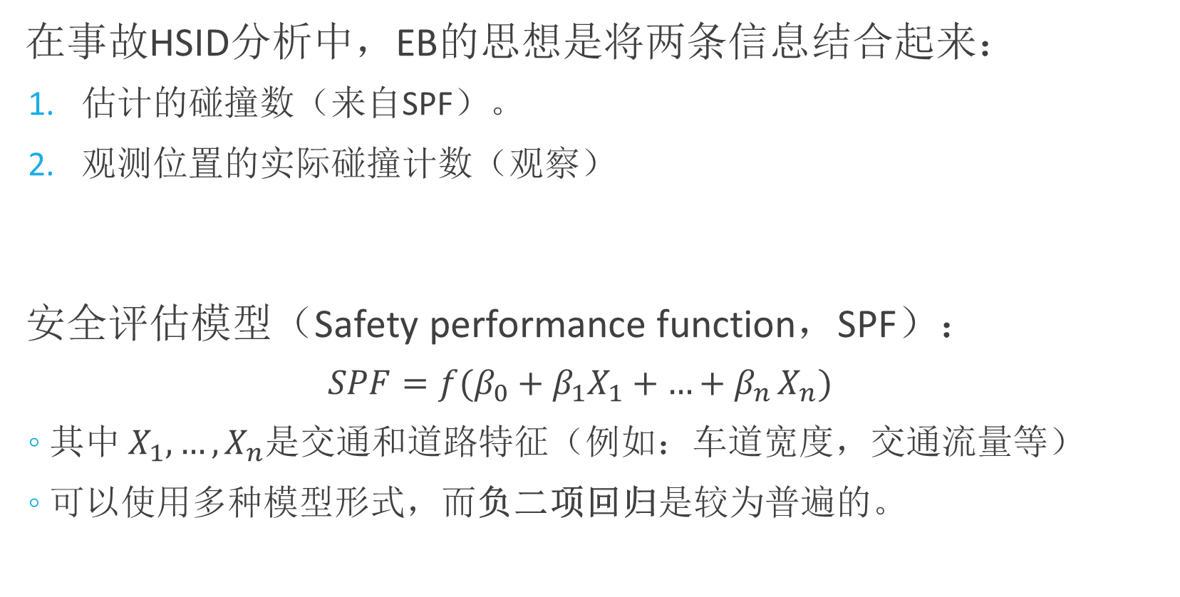
经验贝叶斯方法（EB Method）
Notes:
In the accident hotspot identification analysis, the idea of empirical Bayes method is to combine two pieces of information.
Prior knowledge about the facility safety level, this is represented by the estimated crash count from a model; and
The observed data at the site of interest.
The estimated crash count comes from the Safety Performance function, which is the accident count regression we have just talked about. Note that the function can take a number of forms. But the negative binomial regression is pretty much universal.

Slide 20
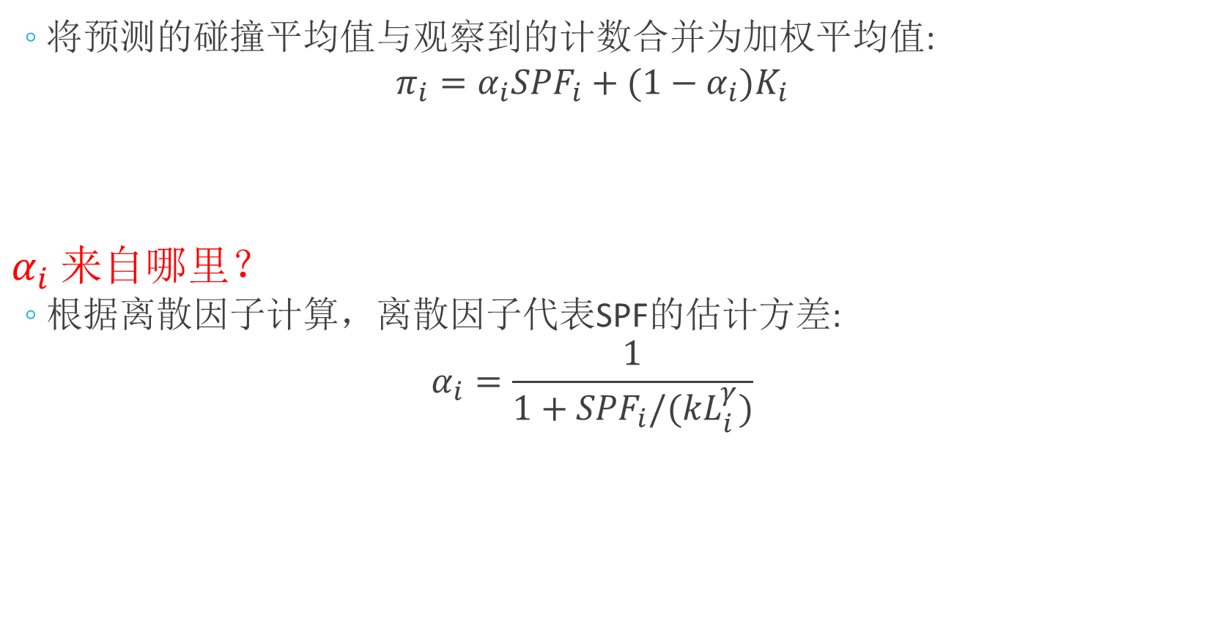

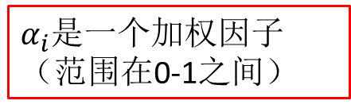
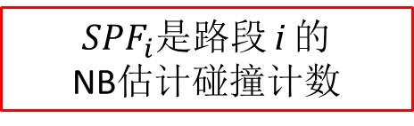
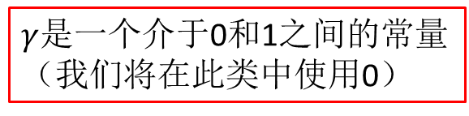


经验贝叶斯方法（EB Method）
地点 i 的预期安全性
详细推导过程可见：卢杨，基于经验贝叶斯法的高速公路事故黑点识别研究[D]. 长安大学硕士论文
Notes:
This top equation here is fundamental to the EB method.
Let us define the terms. Pi_i is the EB estimated crash count, or safety at a location i. it is a weighted average of the estimated crash mean from the SPF and the observed crash count. Alpha, then, is the weight parameter. Ki is the observed count at road segment i.
This alpha value, is then computed from the dispersion parameter, k, of the negative binomial model. The function is shown below.
So if you think about it, the over dispersion represents the variance of the model estimate in some sense, and so we can think of it as a measure of confidence that we have in the model. In general, higher dispersion of the data, we tend to rely more on our model estimations rather than observations.
You can also see that segment length makes its way into the alpha equation, under the notion that longer segments will have higher crash counts and thus higher variance.
However, this length term has a gamma as the exponent, and we have not defined this yet. There are a couple perspectives on what that gamma value should be, most people just use either 1 or 0. Zero of course means that length has not effect on variance. We will use 0 in this class, according to recommendations from HSM.

Slide 21
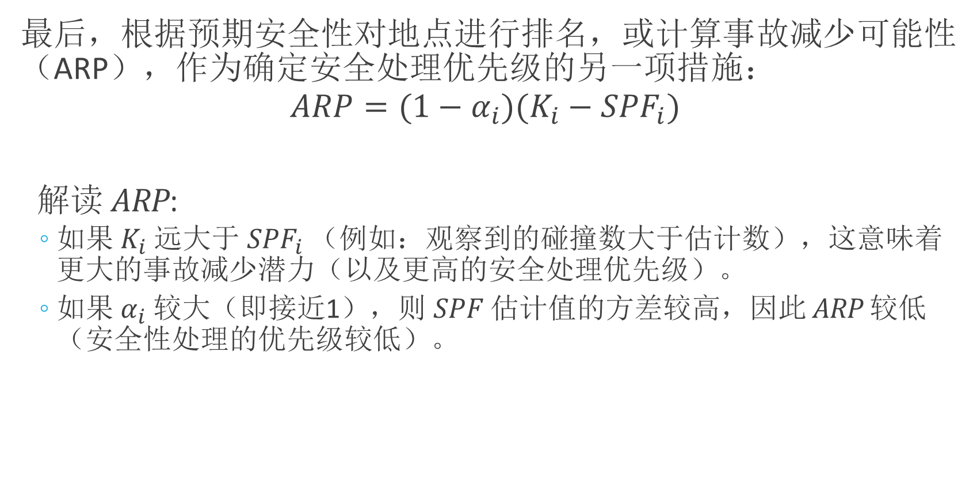
经验贝叶斯方法（EB Method）
Notes:
One additional measure we use to rank and prioritize road segments for safety treatments is the accident reduction potential, or ARP.
It just uses the information we got from using the EB method, including the SPF estimated crash count, the observed crash count, and the weight factor computed from the dispersion parameter.
This is quite an intuitive measure of accident safety, as an observed count much larger than expected based on the SPF will result in a higher ARP.
Likewise, a large alpha value, which is a measure of the variance of the SPF estimate and in a sense is the indicator of the confidence we have in the SPF estimate, will result in a smaller ARP.
This makes sense, because if my observed accident count is way higher than my SPF estimate, I might think this is a high priority location. But, the less confidence I have in the SPF estimate, the less worked up I will be when a particular location has a higher than expected value.

Slide 22
EB Method的考虑因素
你需要至少2-3年的事故数据。
我们将多年数据视为一个时间间隔，需要其他方法来考虑更长（可能是随时间变化）的周期。
通常需要分别考虑事故类型和/或严重程度（此处未涵盖）。
考虑到地点之间的异质性，我们定义“相似”路段的方式可能会出现问题。
如果有大量零事故路段，我们可能需要使用零膨胀负二项模型。
Source:
Powers, M., and J. Carson. Before-After Crash Analysis: A Primer for Using the Empirical Bayes Method. Tutorial. No. FHWA/MT-04-002-8117-21,. 2004.
Notes:
Okay, what I want you to keep in mind is, this brief lecture and the exercise is all the treatment of the EB method you will get from this class.
To close this, I want to leave you with some considerations in using the method:
First, you need at minimum 2-3 years of accident data. Now, we often say that too many years of accident data is a bad thing, because it increases the likelihood that we are no longer dealing with a stationary process, i.e. there maybe longer term changes over time.
There is some other methods that allows you to consider year to year changes, and you should look it up if you plan to do longer term analysis.
时间周期太短，可能没有一个稳定的安全状况，时间太长，道路条件又开始有所变化。
Often, we want to model different accident types and severity separately, and it is not too hard to do once you get this down. Here we took a pretty simple approach of just predicting accident count.
Also, the way we define “similar” road segments could break down considering between-site heterogeneity. And there are actually a broad range of other modeling methodologies to deal with this.
Last, if the data is under dispersed rather than over dispersed, or if there are a large number of segments with zero accidents, we might want to consider a zero inflated negative binomial model or something else.

Slide 23
在SQL中创建数据表
假设我们有一个至少包含事故表和道路表的数据库
使用SQL语句为HSID分析创建一个数据表：
SELECT将用作预测值的所有道路和事故属性；
使用COUNT（）聚合函数计算与每个预测变量组合相关的事故数；
按预测变量GROUP BY （通常是描述路段特征的字段）。
Notes:
Let’s talk about how to do this analysis in SQL and R.
Assume that we have a accident database, somewhat similar to what you created in project 1.
At minimum, I have a table describing road segments and a table describing accidents, as well as some relationship I can use to join them together.
To create a data table that I can use for the modeling task, namely accident hot spot analysis, you will start by constructing a sql query selecting the predictor variables.
Generally the predictors are somehow descriptive of the road segments.
We use the count aggregation function to count the accidents that occurred on each road segments. Then group by the predictor variables and possibly the identifying information about road segments. Let us look at this.

Slide 24
在SQL中创建数据表
结果表：
预测因素/自变量
响应/因变量
RouteNo | BeginMP | EndMP | AADT | Length | SpeedLMT | TruckRate | AccCnt
5 | 0.00 | 0.27 | 123000 | 0.27 | 50 | 9 | 14
5 | 0.27 | 0.28 | 123000 | 0.01 | 50 | 0 | 1
5 | 0.28 | 0.29 | 123000 | 0.01 | 50 | 0 | 3
5 | 0.29 | 0.32 | 123000 | 0.03 | 50 | 0 | 1
5 | 0.32 | 0.39 | 123000 | 0.07 | 50 | 0 | 6
5 | 0.39 | 0.50 | 123000 | 0.11 | 50 | 0 | 3
5 | 0.50 | 0.59 | 123000 | 0.09 | 50 | 0 | 2
5 | 0.59 | 0.60 | 123000 | 0.01 | 50 | 0 | 0
5 | 0.60 | 0.68 | 123000 | 0.08 | 50 | 0 | 1
… | … | … | … | … | … | … | …
Notes:
The result table is something like this.
Given the accident and road table, you should know how to write a SQL code to return some table like this.
This is really similar to what you would hopefully obtain for any regression analysis. A table containing predictors and a response.
I included the roadway identifying information, because once I identify the safety or ARP ranking, I want to be able to join this back to the physical road segments.
AADT = Annual average daily traffic
SpeedLMT = Speed limit
TruckRate = Percent truck volume
AccCnt = Accident count

Slide 25
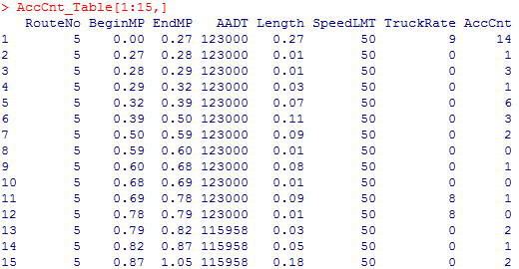
在R中建立模型
在R中，连接到 SQL 数据库并将以dataframe形式获取表（下面显示了前15行）：
每一行代表一个具有一定AADT、速度限制（SpeedLMT）和大车车比例（TrunkRate）的路段。事故计数（AccCnt）是指该路段上发生的事故数。
Notes:
Now in R, connect to the SQL database and get the table as a dataframe.
Below shows the top 15 rows of the dataframe.
The attributes are the same as the previous slide.

Slide 26
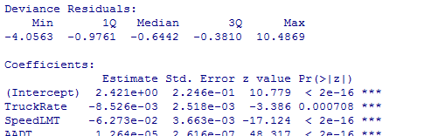
在R中建立模型
拟合泊松回归模型：
以泊松回归模型为例进行了拟合。用于拟合负二项模型的函数在“MASS”包中提供。
解读模型：
> model.pois = glm(AccCnt~TruckRate+SpeedLMT+AADT, family="poisson", data=AccCnt_Table)
拟合广义线性模型的函数
模型形式
模型类型
数据表
> summary(model.pois)
Notes:
Here is how you build that model in R.
Here is a model fitting function, which creates and fits a Poisson regression model.
I used the glm function, which means generalize linear model. The first input in the function is the model form, where I put the response or independent variable at first, followed by a tilde sign, and then all of the predictors are entered and separated by plus signs.
Following the model form I specify the model family, and then the name of the dataframe we are using. By entering the name of the dataframe in this way, I can reference the columns by name without specifying the full path to the columns.
Here we used the Poisson regression as an example. We can also fit a negative binomial regression but that function is available in another package named “MASS”. We will try that in our exercise this week.
The glm function will return me an object that stores all information about my model fitting procedure and result.
I can summarize the modeling result using the summary function.
This will print out a bunch of information about the model fit, including the residuals and coefficient estimates.

Slide 27
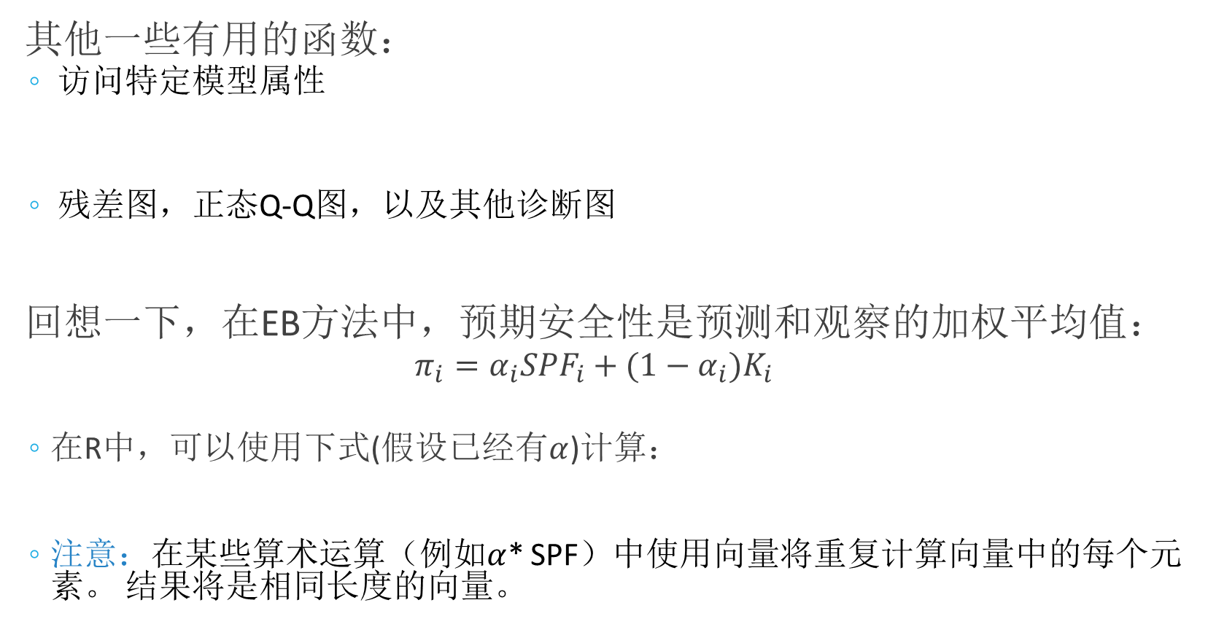
在R中建立模型
其他一些有用的函数：
访问特定模型属性
残差图，正态Q-Q图，以及其他诊断图
回想一下，在EB方法中，预期安全性是预测和观察的加权平均值：
$$π_{i}=α_{i}{SPF}_{i}+(1−α_{i})K_{i}$$
在R中，可以使用下式(假设已经有$α$)计算：
注意：在某些算术运算（例如$α$* SPF）中使用向量将重复计算向量中的每个元素。 结果将是相同长度的向量。
> SPF = model.pois$fitted.values # model predictions (fitted values)
> AIC = model.pois#aic # AIC (Akaike Information Criterion) of the model
> plot(model.pois)
> pi = alpha*SPF + (1-alpha)*AccCnt_Table$AccCnt
Notes:
Within the model result object, there are a number of things you can reference by name, by writing the name of the model result followed by the dollar sign and then the name of the information you want to look at.
Here I am extracting the model predictions (fitted values) and the AIC (Alkai information criterion). Note that in accident analysis, the model predictions are actually the Safety performance functions (SPF) we mentioned earlier.
In addition, we can plot model residuals and other stuff using the plot function.
One last thing I want to show is that in R if you use a vector in some arithmetic operation, the calculation will be repeated for each element in the vector.
Recall that in EB method, expected safety is a weighted average of prediction and observation. You can see here that I typed weighted value times the model prediction (which is a vector). The result will just be a vector of the same length where each row has been calculated separately.

