Slide 1
道路通行能力分析
交通大数据分析
2021年春季
马晓磊
Notes:
We then move to our next topic today, road capacity analysis.
Note that EB method we just introduced is very general and can be used in a large number of fields, but the HCM methods are really just a recipe for traffic capacity analysis and not at all applicable to anything else.

Slide 2

通行能力概念
交通通行能力分析解决了以下问题：
给定设施能容纳多少交通量？
通行能力如何随运行条件变化？
通行能力分析详细定义了通行能力概念，适用于几乎所有的出行模式。
汽车
行人
自行车
公交
Notes:
Traffic capacity analysis covers the issues shown here: how much traffic can a given facility accommodate, and how does capacity change with operating conditions.
These questions are of interest for nearly all travel modes, including cars, pedestrian, bicycle, and transit.
And for each mode, there is a very specific definition of capacity, but in general terms it can be thought of as the maximum of something that can be accommodated.
The picture here shows the subway train in Tokyo during rush hour. You might have known this, but there is a man here whose job is to push as many people onto the train as possible before the door closes. So in this case the capacity of this train may be the maximum number of people that can be physically pushed onto the train.
However, this may be very hard to measure and may not make too much sense in traffic study as well.
In general, we want a better way to measure capacity, such there is some relationship between capacity and traveler comfort.
So how is traffic capacity analysis currently conducted?

Slide 3
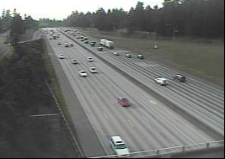

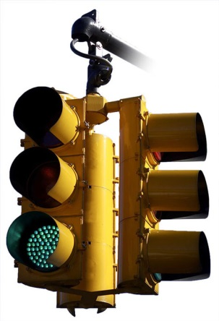
通行能力概念
几何特征
流量水平
服务质量
控制
目前如何进行通行能力分析？
使用一套与流量水平、几何特征和控制相关的分析模型，衡量最终运行质量
Notes:
Well, the typical engineering approach would be to define a set of analytical models that relate measurable quantities like flow levels, geometric characteristics, and control mechanisms to some indicator of traveler comfort.
This is exactly what we do.
We use this term quality of service to indicate how comfortable users are, and then capacity can be defined in terms of comfort by setting some threshold for quality of service.

Slide 4

道路通行能力手册（HCM）
通行能力分析使用哪本参考书？
在美国，HCM是通行能力分析程序的标准参考。
HCM由美国交通研究委员会（TRB）发布。
TRB的道路通行能力和服务质量（HCQSC）委员会负责HCM。
Notes:
The capacity analysis models are described in a publication called the Highway Capacity Manual, which is the standard reference for capacity analysis procedures.
HCM is published by the Transportation Research Board (TRB). If you still remember, the reason that we have one class off in the first week is because of the TRB annual meeting.
TRB has a number of committees on a wide range of transportation related topics, but the Highway Capacity and Quality of Service Committee is the one that is responsible for the HCM development.
If not, TRB is one of six major divisions of the National Research Council— a private, nonprofit institution. The National Research Council is jointly administered by the National Academy of Sciences, the National Academy of Engineering, and the Institute of Medicine.
TRB was established in 1920 as the National Advisory Board on Highway Research to provide a mechanism for the exchange of information and research results about highway technology. Now, its mission includes managing research programs on nearly all modes of transportation.

Slide 5

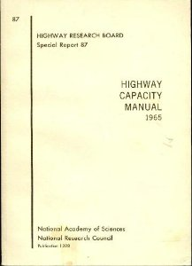
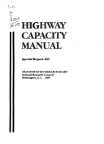

道路通行能力手册（HCM）
从1950年的147页，到现在的1650页，共四卷。
HCM 2010是自2000版本以来，完成超过500万美元研究的结果
1950
1965
1985
2000
当前版本：HCM 2010
资料来源：
“2010年道路通行能力手册”TRB出版物小专题。
Notes:
Up to now, there are in total five versions of HCM.
The earliest versions were based on volunteering efforts of committee members. And after that, a number of research projects have been initiated to expand the contents of the document.
The first version produced in 1950 had 147 pages, now we have four volumes with a total of over 1600 pages. It seems they have now given up on the idea of creating a printable volume, given the ponderous size of the thing.
Right now the most recent document is the fifth version published in 2010. They have a plan to publish a new version in 2016 but is delayed for some reason.
Both the 1st and 2nd versions of the HCM were based on efforts of volunteer committee members.
1950 by Bureau of Public Roads
The first edition was published by the Bureau of Public Roads in 1950 (post-WWII).
design guide
design consistency
based on scant data
1965 by TRB
The second edition of the HCM was published in 1965.
based on improved database
the concept of LOS was introduced
for both design and analysis of operations
1985 by TRB (w/ Highway Capacity Software) NCHRP + FHWA
The third edition was published in 1985.
based on FHWA and NCHRP funded research
represented a significant move towards operational analysis as the primary use of the procedures.
software package for complex computations
1994 update 1997 update
2000 by TRB FHWA, NCHRP and TCRP (Federal Transit Administration, Transit Development Corporation, the American Public Transportation Association)
based on research sponsored by FHWA, NCHRP, and TCRP
simulation application
CD-Rom version is also available
New chapters on interchange ramp terminals, etc.
2001 update
5th and current version: HCM 2010
In the 5th version, they made more of an effort to make the manual multimodal, and included information about the proper application of microsimulation models. They actually had a lot in the 2000 version about non-motorized and transit, but they were really focused on single driver vehicle centric concepts like capacity and delay.
Source: Paul Ryus, mark Vandehey, Lily Elefteriadou, Richard G. Dowling, and Barbara K. Otrom. “Highway capacity Manual 2010” TRB Publication Mini-feature.

Slide 6
道路通行能力手册（HCM）
第2卷：连续流
高速公路设施
高速公路合流/分流和交织区
多车道公路
双车道公路
第3卷：间断流
城市街道设施
交叉口：停车控制、信号控制、环形交叉口
街道外行人和自行车设施
立交匝道终端
Notes:
Here are the two facility oriented volumes.
Out of four volumes, the first is oriented toward concepts, the second is oriented toward uninterrupted flow such as freeways and highways, and the third is oriented toward interrupted flow such as intersections and control systems.
I provided chapter 11 which introduces procedures for basic freeway segments as a reading. In general, what is contained in the chapter is relatively simple step by step instructions that are not hard to follow. Because of this, you would be able to follow the procedures to complete the next assignment. My following slides will also summarize the procedure.
I should stress that, like any engineering analysis, some domain knowledge and math skills are required to apply most of these methods.

Slide 7
通行能力定义
HCM将设施的通行能力定义为
“在当前道路、环境、交通和控制条件下，在给定的时间段内，人或车辆能够合理地在预期下穿过某个地点或车道/道路的均匀截面的最大可持续小时流率。”
是否可以观察到流率高于通行能力？
答案是肯定的，因为实际的交通流量是不断变化的，所以交通流会有高峰和低谷。
Notes:
Here is the capacity definition given in the HCM.
I will not read through this but there are some key points. The capacity definition is based on the reasonable expectation for some given time period. In HCM usually 15 minutes is used as the time period.
Does this mean that the capacity is the greatest observable flow rate, in other words, can we ever see flow rates higher than our definition of capacity?
The answer is yes, and it happens all the time. In fact, because the actual flow rate is constantly in flux, for any time period, there will be peaks and valleys in traffic flow.

Slide 8
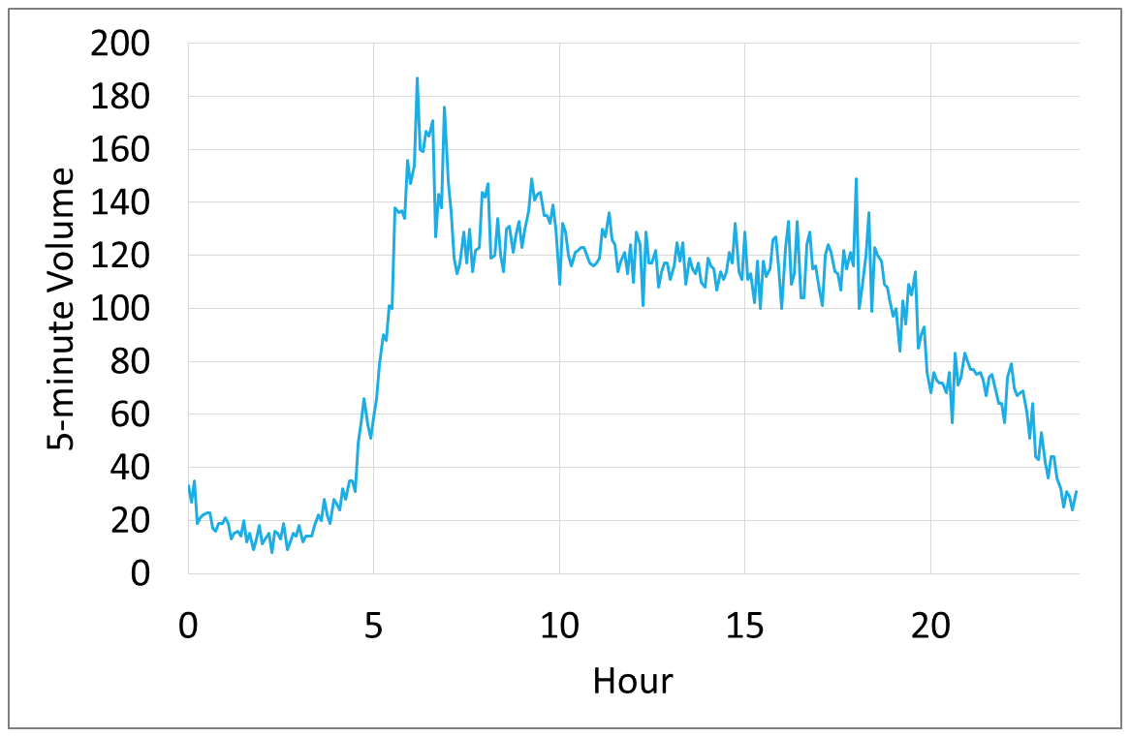
通行能力定义
最大每小时流率通常被定义为最高15分钟内的交通流率。
必须小于最高5分钟流率，因为该流量无法维持。
通过这种方式获得的通行能力不能保证为一小时内可容纳的最大车辆数。
最高5分钟流率
Notes:
This illustrates how traffic volumes can change with time during a day.
The red arrow in the graph represent the peak hour volume in the day.
Usually the maximum hourly flow rate is determined by the traffic flow rate within the highest 15 minutes.
Note that this must be smaller than the highest 5-minute flow rate, as that volume can not sustain,
If looking at more details about the graph, you may notice that traffic volume drops sharply after the peak flow rate, and cannot achieve the same level again. This is because traffic become congested after the peak traffic volume.
As a result of this, though the maximum hourly rate is often defined in terms of what is observed in the peak 15 minutes, we know that this volume will almost never be achieved for an entire hour.
So what are the factors that determines capacity?

Slide 9
通行能力定义
设施的容量取决于当时的条件。
当时的条件是指什么？
交通条件：车辆数量（PC、卡车、公共汽车和休闲车）、高峰特性、转向行为等；
道路条件：几何特性（例如车道和路肩宽度、线形）；
控制条件：信号、标记和控制标志。
通常，描述当时的条件需要你定义设施类型以及几何结构、交通流和控制条件的描述。
Notes:
The capacity of a facility depends on prevailing conditions at the site.
For our analysis, we define three basic groups of contributing factors.
Traffic conditions, including vehicle populations, driver behavior, turning volumes, and peaking characteristics.
Roadway conditions including lane width, alignment which includes the grade, and shoulder width.
Control facilities, including traffic signals, signs, and road markings.
So describing prevailing conditions would require you to define the facility type and as well as a description of the geometry, traffic stream, and control conditions.

Slide 10
通行能力定义
关于通行能力定义的其他注释：
通行能力是指在相同通行条件下对单点或统一路段的测量。
通行能力可根据所涉及设施的类型，以人/小时或车辆/小时的形式进行定义，以及分析的目的
什么时候使用vehicles/hour ，什么时候我们需要使用persons/hour ？
公共交通和行人设施： persons/hour。
设施： vehicles/hour 。
Notes:
Here are couple other things to note from the HCM definition of capacity.
Capacity is a measurement of a single point or uniform road section. Uniform refers to the same prevailing conditions, we need to limit our analysis to a homogenous section of roadway. If any prevailing condition changes, we need to analyze the capacity as another road section.
The units of capacity may be defined in terms of persons/hour or vehicles/hour, depending on the type of facility involved, and the purpose of the analysis.
But, when we are talking about transit, bicycles, and pedestrians, we are using units of people per hour.

Slide 11
设施类型
我们将简要讨论三种基本类型的设施：
高速公路基本路段
双车道公路
间断流
还有很多要考虑的…
Notes:
I am going to briefly go over these three basic analysis types, though we will focus on basic freeway segments.
There are a lot more to consider in capacity analysis such as ramp/weaving sections and multi-modal capacity. But we will focus on these types in the scope of this class.

Slide 12
基本条件
大多数通行能力分析模型包括确定基本或理想道路、交通和控制条件下的通行能力。
这并不表示典型的实际情况。相反，这是一种在典型设计标准下接近最佳可能条件的情况。
然后对基本同行能力进行调整，以反映当前条件的影响。
Notes:
In general, we start with defining a base or ideal condition, and the capacity for such condition.
Note that this does not indicate typical real world conditions. Rather, this is something close to the best possible conditions under typical design standards.
That way we can consider the reduction in capacity that is due to any differences between the ideal conditions and the given conditions.
So let’s take a look at how the HCM defines ideal conditions.

Slide 13
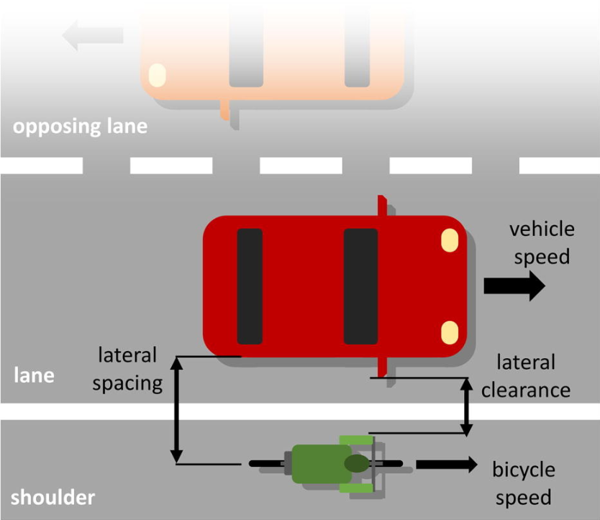
基本条件
高速公路基本路段的基本条件包括：
12英尺最小车道宽度
6英尺最小横向净空
仅在车流中使用
驾驶员熟悉该设施
没有恶劣天气或事故
我们是否知道处于理想状态的设施的通行能力？
否。通行能力取决于自由流速度（FFS）。
FFS是在中低流量（最高1,000 pc / h / ln）期间测得的小客车平均速度。
FFS可以被测量，但也可以使用标准HCM方法进行估算。
Notes:
Here is a list of base conditions for basic freeway segments, including…
It should be clear that there is almost no case when the case conditions will exist.
For example, we assume there are no heavy vehicles in the traffic stream, no ramps, and all drivers are familiar with the facilities.
The term itself is self explanatory. It can be defined as the clearance between the body of the vehicle (moving on the outermost lane) to any of the way side installations (like sign posts, signal tree etc).侧向净空
But given these ideal conditions, can we get some standard capacity?
The answer is no, we also need to know free flow speed.
FFS is the average speed of passenger cars measured during periods of low to moderate flow (up to 1,000 pc/h/ln). That is, the speed when vehicles are free from the influence of other vehicles.
In general, FFS should be measured, but can also be estimated using the standard HCM methodology.

Slide 14
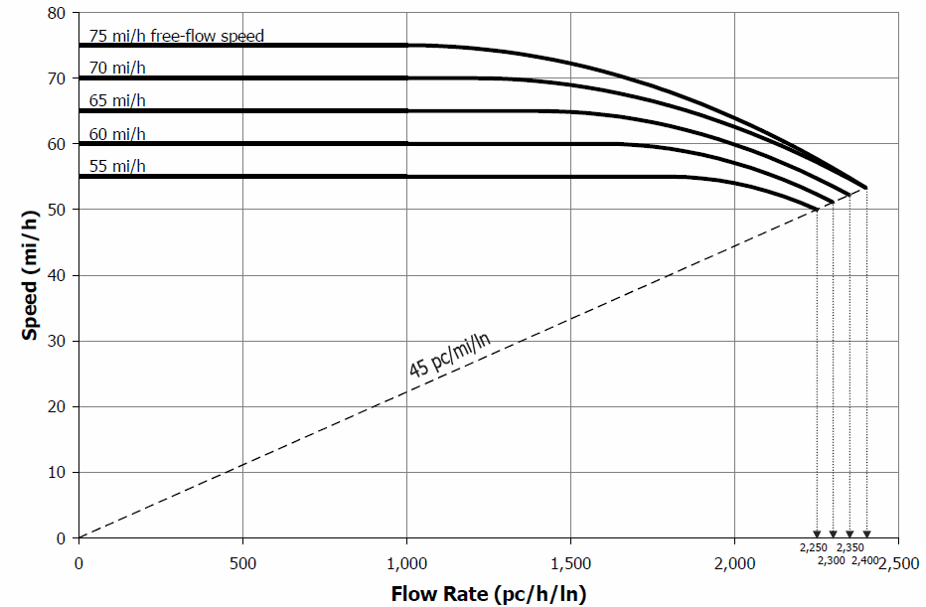
高速公路基本路段
基本条件下高速公路基本路段通行能力随自由流速度变化：
FFS (mi/h) | Capacity (pc/h/ln)
70-75 | 2400
65 | 2350
60 | 2300
55 | 2250
Notes:
This chart illustrates what is generally true about the relationship between average vehicle speed and flow rate. Each o the lines here represent a different freeflow speed.
Note that, at nearly any freeflow speed, the density does not cause the average speed to reduce until volume exceeds around 1300 passenger cars per lane per hour.
Also note that the ratio between flow rate and speed is density with increases as you move to the right side.
When reaching some critical density value, traffic will break down and the corresponding flow rate is your capacity

Slide 15
双车道公路
双车道公路的通行能力分析方法不同于多车道公路。
双车道公路具有超车影响。
双车道公路的理想条件包括：
平坦地形
无“禁止超车”区域
沿道路无直接入口
50/50双向交通配流
Notes:
A special case of uninterrupted flow facilities is the two lane highway, which has one lane in each direction.
The capacity analysis approach for a two lane highway is different from a multilane highway. Why?
It is because of the passing impacts. In a multilane highway, if you are unhappy with the speed of the vehicle that is in front of you, you can simply pass them at any time under low to relatively high traffic density.
On a two lane road, the slowest vehicle determines the speed of many vehicles until there is an opportunity to pass. And, opportunities to pass become lower as the volume on the opposing direction increases.
Because of this, we have some special conditions for the ideal case in two lane highway operation.
We assume level terrain, no “no passing” zones, no direct access points along the highway, and an even volume split between the two directions.

Slide 16
双车道公路
在理想条件下，双车道乡村公路双向通行能力为3200 pc/h，单向通行能力为1700 pc/h。
双车道公路上很少观察到通行能力条件。因为大多数双车道公路都是在需求接近通行能力之前进行升级的。
为什么在理想条件下指定“平坦地形”？
它会影响双车道乡村公路上的通过行为。
实际通行能力，当根据当时条件进行调整时，通常远低于此处引用的理想值。
Notes:
The capacity for a two lane highway under ideal conditions is 3200 passenger cars per vehicle per hour in both directions, or 1700 in one direction.
Note that, due to the limitations on passing caused by traffic in the opposing direction, the 1700 per hour is only considered possible if the opposing traffic volumes are lower, hence the 3200 per hour capacity for the two directions combined.
Capacity conditions, however, are rarely observed on two lane highways. Because most two‐lane highways are upgraded before demand approaches capacity.
Why do we specify level terrain?
Again, this is due to passing restrictions. It is assumed that it will take more time to pass someone on an up-hill section, and that in general elevation changes are an impediment to passing.

Slide 17
间断流
交叉口代表了最严格的通行能力限制。
在信号交叉口，信号配时显著影响给定车道或进口道的通行能力。
信号交叉口的基本通行能力是根据饱和流率来定义的，即假设信号灯始终为绿色，车道或进口道的通行能力。
Notes:
Interrupted flow facilities have the most severe capacity restrictions. This is intuitive given that you have conflicts between separate traffic streams.
For example, the performance of a signalized intersection is greatly impacted by the signal timing.
In fact, the capacity of the road itself is not really that important, because the signal determines how many vehicles can pass through.
One of the basic parameters for signalized intersections is the saturation flow, which is essentially the capacity of the road assuming the signals always showed green to the traffic movement of interest.

Slide 18
间断流
信号交叉口进口道的理想条件包括：
交通流中没有左/右车辆
在停车线250英尺范围内没有靠近行车道的停车场
位于非CBD区域的交叉口
在理想条件下，信号交叉口的饱和流率为1900 pc/hg/ln（每车道每绿灯小时小客车当量）。
Notes:
The base or ideal conditions for a signalized intersection include these measures:
No turning movements, no parking adjacent to the travel lane near the intersections, and that the facility is not located in the central business district.
Under ideal conditions, the saturation flow rate is assumed to be 1900 vehicles per hour of green per lane.
So now we have the capacity values under ideal conditions. For any factors that would reduce capacity, they will be considered as a reduction in the ideal capacity.

Slide 19
服务水平（ Level of Service ，LOS）
服务水平（LOS）：HCM对交通设施的交通运行条件定性排序
从A级到F级，服务水平从最好变为最差：
A级：代表最好的服务水平；
B级：自由流，但明显能看到其他车辆的存在。
C级：交通密度对驾驶操作的影响变得明显。
D级：由于高交通密度，机动能力受到严重限制。
E级：表示在通行能力或接近通行能力的情况下行驶，并且车流非常不稳定。
F级：表示交通阻塞或崩溃。
Notes:
I mentioned in the beginning that we need a better measure of system performance than simply use the capacity as the maximum number of vehicles that can be served.
In the HCM, we do have a performance measurement called “Level of Service (LOS)” which is a qualitative ranking of traffic operational conditions for transportation facilities.
LOS can take a range from level A to level F, representing from the best service level to the worst level.
On a highway facility, for example,
LOS A indicates excellent service, freeflow speeds and very little interaction between vehicles in the traffic stream.
As a contrast, LOS E represents operation at near capacity, which means that the traffic flow will be unstable and close to break down.
The divide between E and F, when traffic goes from unstable to total breakdown, represents the capacity that we will calculate.
In real-world design practice, when designing a facility, we most often start by picking a LOS for the facility, and then design a facility to serve the required traffic at that LOS.

Slide 20
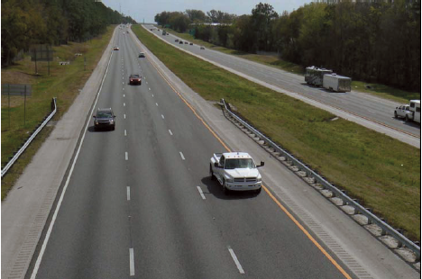
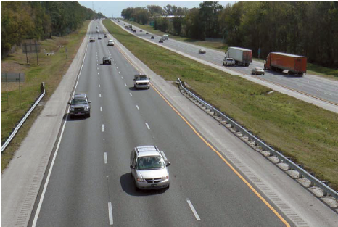
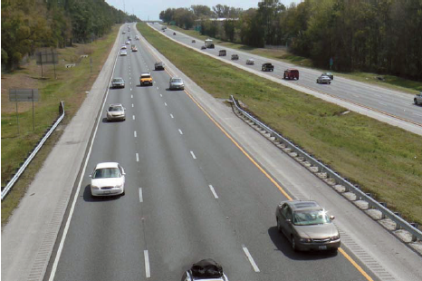
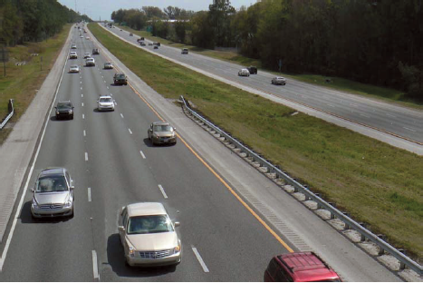
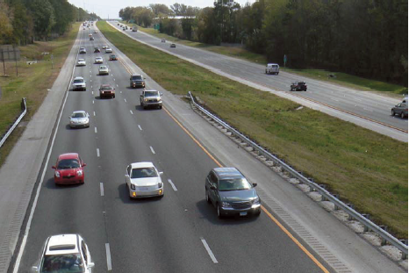
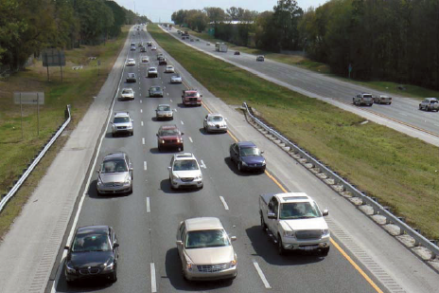
服务水平（LOS）
服务水平A
服务水平B
服务水平C
服务水平D
服务水平E
服务水平F
是什么决定了服务水平？
Notes:
These are some widely used pictures that describe different LOS scores.
If you consider the I-5 in Seattle, probably the daytime condition looks more like D and E, and even Level F during rush hours.
My question here is that, what measurement determines the LOS? Or what factor can serve as the LOS indicator?
For freeway segment, the indicator is Density.

Slide 21
有效性度量（MOE）
连续流 | Fwy: 基础路段 | 密度 (pc/mi/ln)
 | Fwy: 交织区 | 密度 (pc/mi/ln)
 | Fwy: 匝道(与普通公路)连接处 | 密度 (pc/mi/ln)
 | 多车道公路 | 密度 (pc/mi/ln)
 | 双车道公路 | 跟驰时间百分数
间断流 | 信号交叉口 | 延误 (sec/veh)
 | 无信号交叉口 | 延误(sec/veh)
 | 主干道 | 平均行驶速度
 | 公交 | LOS 分数
 | 行人 | LOS 分数
资料来源：TRB绩效评估委员会（ABC30）
Notes:
This tables shows the measures of effectiveness (MOE), or LOS indicators for different facility types.
You may have found from the previous graph, freeway LOS is determined by the traffic density.
Actually, for other travel modes and facility types, a number of different indicators are used.
Note in particular that the LOS for transit and pedestrians (and bikes, for that matter) are determined by something called the “LOS Score”, which is a numerical value computed from a number of factors that impact users’ perception of the quality of service.
This is part of the improvements in the 2010 version of the HCM, as the previous version had only very rudimentary calculation process.
For most of what we will be doing, we will stick to density.
Percent Time Spent Following (PTSF) is the average percent of total travel time that vehicles must travel in platoons behind slower vehicles due to inability to pass on a two-lane highway. It therefore represents the freedom to maneuver and convenience of travel.

Slide 22
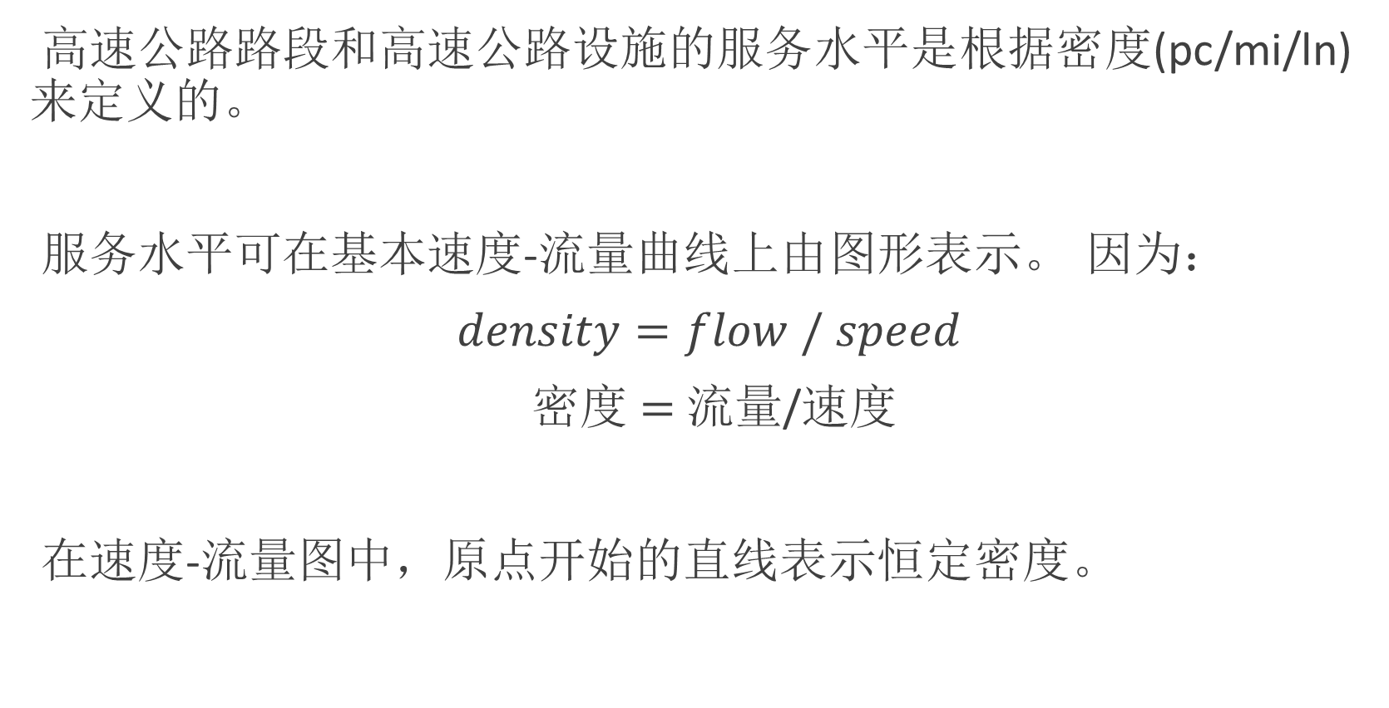
服务水平（LOS）
高速公路路段和高速公路设施的服务水平是根据密度(pc/mi/ln)来定义的。
服务水平可在基本速度-流量曲线上由图形表示。 因为：
$density=flow / speed$
密度 $=$ 流量/速度
在速度-流量图中，原点开始的直线表示恒定密度。
Notes:
As I said, freeway LOS is based on density.
So I may use a speed flow plot to illustrate the different levels of service.
Also note that density equals flow divided by speed. As you might expect, if I create a plot of speed vs. flow rate, then a straight line beginning at the origin will represent a constant density.
Let’s take a look.

Slide 23
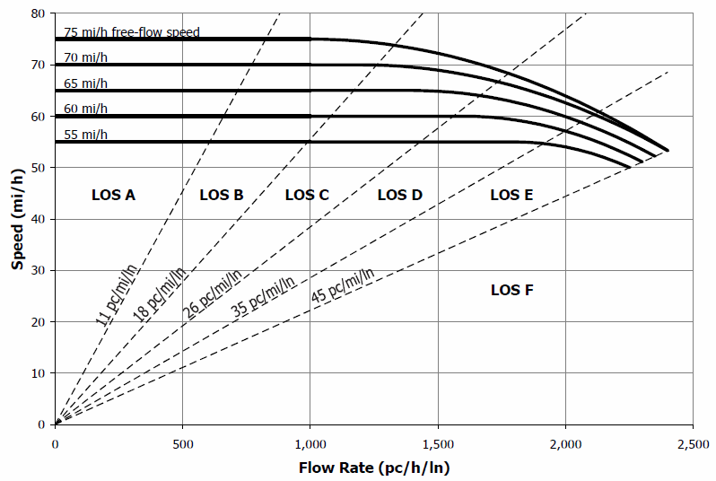
Notes:
This is similar to the speed flow plot I showed you earlier, except that now I have constant density lines delimiting the various levels of service.
What we will do in the freeway LOS analysis, is to first figure out which of these speed lines we will use, then determine the analysis flow rate, and then it is really easy to figure out what the level of service is.
The HCM also gives you equations to define these lines analytically, so you can do everything without looking up values on a chart like this.

Slide 24
高速公路服务水平分析
在实践中，如何确定高速公路基本路段的服务水平？
高速公路或多车道路段的服务水平预测通常包括四个步骤：
确定自由流速度
调整需求流量
估计运行速度和密度，
确定服务水平。
Notes:
So here is generally the procedure of LOS analysis for a freeway or a multilane highway segment.
You can see in my list that the primary goals are to get free flow speed, adjusted volume, and then operating speed.
As we will find, once we have FFS and adjusted volume, the rest is simple.

Slide 25
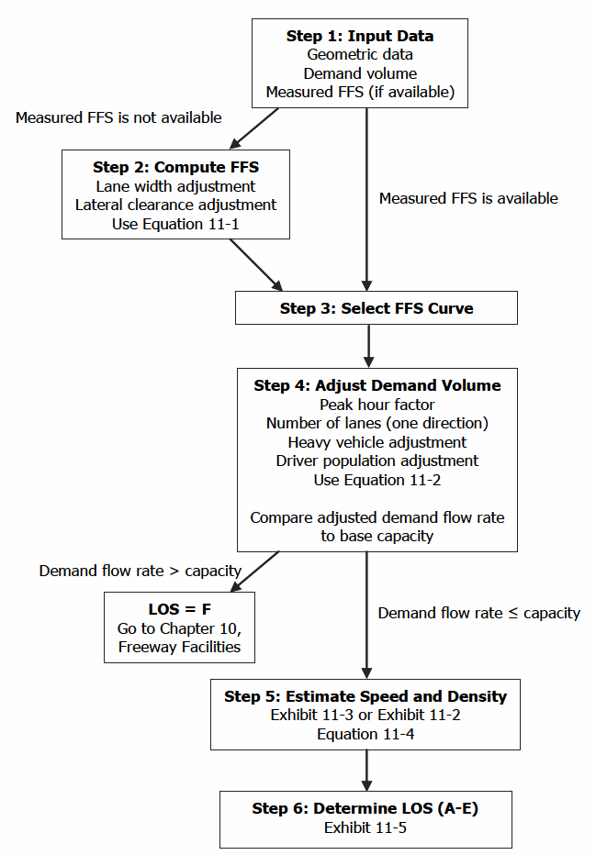
高速公路服务水平分析
更详细的步骤
Step 1: 输入数据
Step 2: 计算 FFS
Step 3: 选择FFS曲线
Step 4:调整需求流量
Step 5:估算车速和密度
Step 6: 确定服务水平（LOS）
Notes:
Here is a more detailed layout of the steps. You can also find the flowchart in the reading I provided.
Step one, get input data. There is a specific list of input data elements.
Step two: compute FFS. This step is only performed if you do not have the ability to measure FFS.
Step 3: select the free-flow speed curve that shows the relationship between speed and flowrate.
Step 4: adjust demand volume. For the purpose of our analysis, everything must be converted into units of passenger car equivalent per lane per hour. We use knowledge about the traffic stream and roadway characteristics to convert vehicles per hour to passenger cars per hour.
Step 5: estimate speed and density. With the FFS curve and demand volume, this is trivial.
Step 6: determine level of service. This is really as simple as looking it up in a table or chart.

Slide 26
高速公路服务水平分析
步骤1：输入数据
几何数据：
车道数和车道宽度、右侧净空、匝道密度和地形
需求量：
需求流量、重型车百分比（卡车、公共汽车和RVs）、PHF和驾驶员总体因素
测量的自由流速度（如果可用）
Notes:
So let me go through the steps, and show examples where applicable.
Here is a list of the information I need for the analysis.
Geometric data, demand data, and measured FFS if possible. As you will find, we can estimate it if need be.
I am not going to go through each of these, you will see them in my examples.

Slide 27
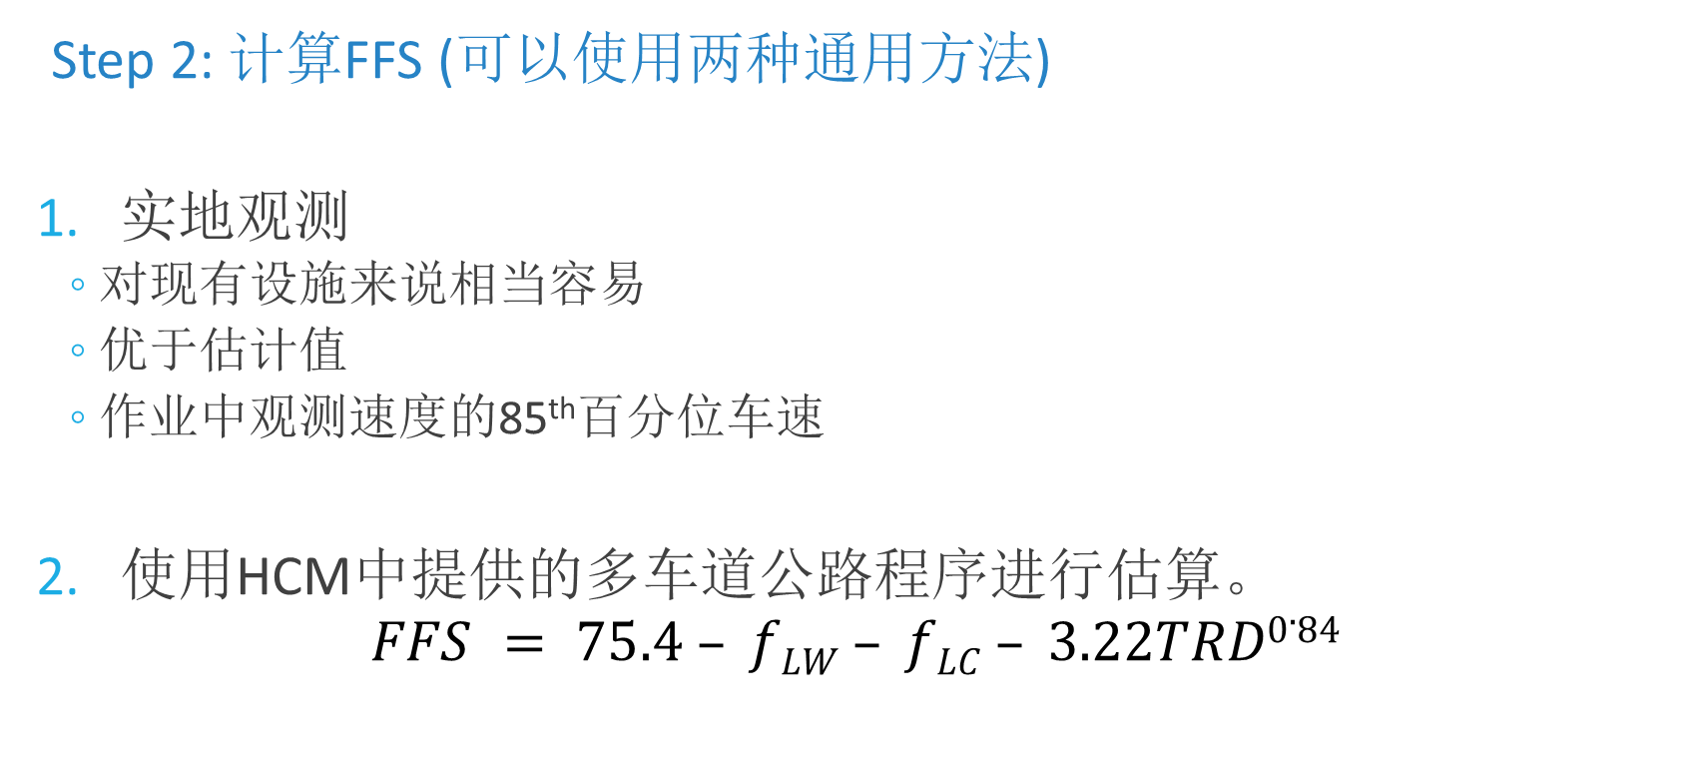
高速公路服务水平分析
Step 2: 计算FFS (可以使用两种通用方法)
实地观测
对现有设施来说相当容易
优于估计值
作业中观测速度的85th百分位车速
使用HCM中提供的多车道公路程序进行估算。
$$FFS = 75.4 – fLW – fLC – 3.22TRD0.84$$
总匝道密度
基本FFS
车道宽度和侧向净空的调整
Notes:
In step 2, I need to compute FFS. Generally there are two methods.
The first method is directly measure the FFS. This is fairly easy if you are considering an existing facility equipped with traffic detectors. In the homework, you will use the 85th percentile of speeds from loop detector measurements as the FFS.
Can we use the average speed under low traffic volume?
You need to be careful because low traffic volumes might actually indicate highly congested conditions.
If you do not have field measurement, you can use this equation to estimate the FFS.
Note that this equation is different for different facility types, though this is the one you can use for basic freeway segments.
You start with a base FFS given by the HCM, then, based on the lane width and lateral clearance, you look up the adjustments in HCM tables. The Total ramp density is just the number of ramps per mile, which can reasonably be expected to reduce FFS.

Slide 28
计算FFS-示例
四车道高速公路基本路段，自由流速度是多少？
车道宽度：11 ft
右侧净空：4 ft
每英里匝道：2.9
高峰小时流量：1900辆/小时
交通组成：13%卡车，2%RVs
PHF=0.90
熟悉设施的驾驶员
注意：在HCM 2010中，FFS四舍五入到最接近的5 mi/h
Notes:
So let’s look at an example of how to compute FFS.
I have a scenario here with 65mph design speed, and the geometry you see here.
What I will do is grab the relevant geometric characteristics, look up the required adjustment factors, and get to an estimate of the FFS using the equation on the previous slide.

Slide 29
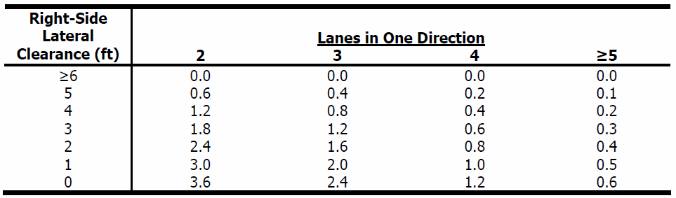
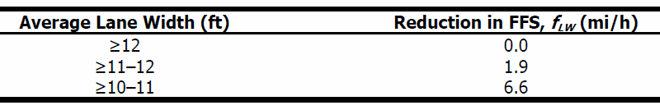
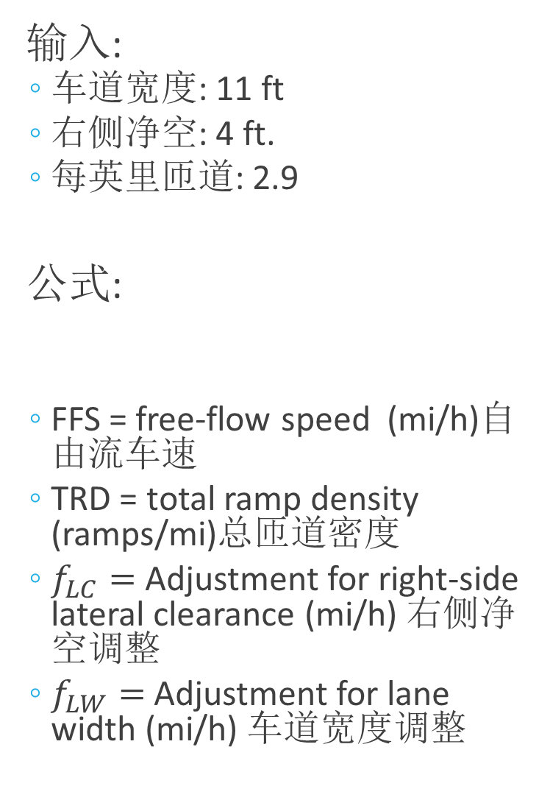
输入:
车道宽度: 11 ft
右侧净空: 4 ft.
每英里匝道: 2.9
公式:
FFS = free-flow speed (mi/h)自由流车速
TRD = total ramp density (ramps/mi)总匝道密度
$f_{LC}=$ Adjustment for right-side lateral clearance (mi/h) 右侧净空调整
$f_{LW}=$ Adjustment for lane width (mi/h) 车道宽度调整
$$FFS = 75.4 – flw – flc – 3.22TRD0.84$$
HCM 2010图表11-8
（HCM 2010方程式11-1）
HCM 2010图表11-9
Notes:
Here are the look up tables that the HCM provides for adjusting FFS. So it really is just looking up the values in these tables and putting them into the correct equation.
Okay, in the upper table, I can find the lateral clearance adjustment factor, which is actually also a function of the number of lanes. I said four lanes and 4 foot right side clearance, so the adjustment factor is 0.4 miles per hour.
In the lower table I can find the adjustment factor for lane width, I said 11 feet so the adjustement factor is 1.9 miles per hour.
Finally, the Total ramp density is 2.9, no factor needed here. At the bottom of the slide you can see the solution, just put the factors into the equation and compute the result. This is important, whether you measure or estimate it, FFS is always rounded to the nearest 5 miles per hour, in this case 65 mph.

Slide 30
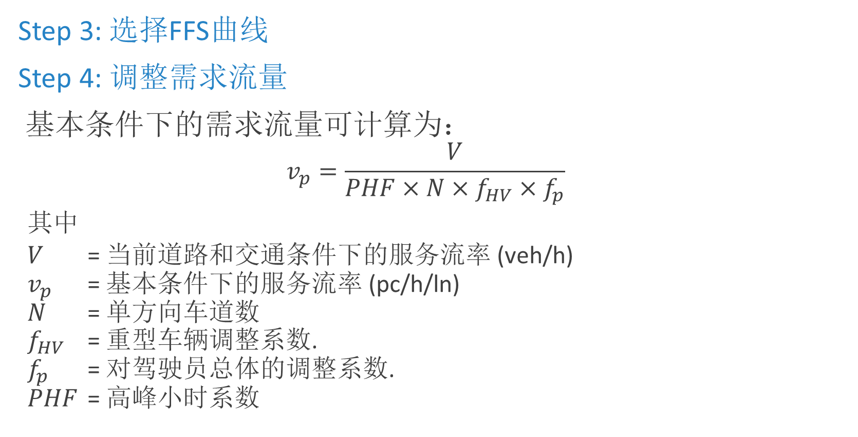
高速公路服务水平分析
Step 3: 选择FFS曲线
Step 4: 调整需求流量
基本条件下的需求流量可计算为：
$$v_{p}=\frac{V}{PHF×N×f_{HV}×f_{p}}$$
其中
$V$ = 当前道路和交通条件下的服务流率 (veh/h)
$v_{p}$ = 基本条件下的服务流率 (pc/h/ln)
$N$ = 单方向车道数
$f_{HV}$ = 重型车辆调整系数.
$f_{p}$ = 对驾驶员总体的调整系数.
$PHF$ = 高峰小时系数
（HCM 2010方程式11-2）
Notes:
The next step is to select a FFS curve, which is pretty simple as long as I have the FFS value.
Then the fourth step is to adjust demand volume.
Now, this assumes that I have an actual flow rate in vehicles per hour, and I want to find the adjusted demand flow rate to find LOS.
The function I need is shown here. On the top you see the observed volume in vehicles per hour.
On the bottom you see peak hour factor. N is the number of lanes in one direction. FHV is the heavy vehicle factor, which converts the volume that I have to units of passenger car equivalents.
The driver population factor is another thing we need here. This factor, almost always less than 1, reflects the influence of unfamiliar drivers in the traffic flow. This is something you can estimate from the data, or can be based on some local knowledge.

Slide 31
高速公路服务水平分析
思考等式11-2的两种方法：
给定流量和FFS，此设施的服务水平是多少？
从当前流量和FFS开始，使用公式11-2在基础条件下计算流率
使用图表11-3、公式11-4和图表11-5估算速度、密度和服务水平
使用公式11-2将基准条件下的最大流量换算为当前条件下的流量
从服务水平和自由流速度出发，计算基本条件下的最大交通量
给定所需的服务水平和FFS，该设施可容纳多少辆车？
Notes:
\\Note that the equation I showed on the previous slide can be thought of in a couple different ways.
For one, I started by some facility with traffic data, and I want to find the LOS of the facility.
The other way would be to design a facility to support some amount of traffic. I start with LOS I want, and estimate FFS. Then, I find the maximum volume by looking it up on the speed flow plot.
Then, I use the equation shown on the previous slide to compute the maximum service volume under prevailing conditions.
I could do something similar to select a number of lanes that would be needed to support a particular traffic volume at some level of service.

Slide 32
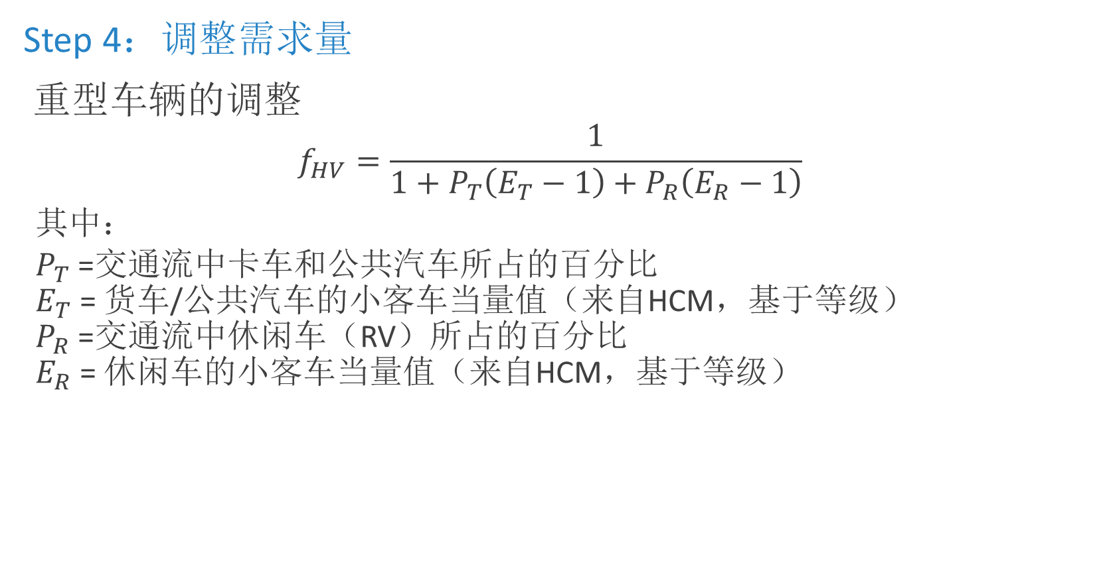
高速公路服务水平分析
Step 4：调整需求量
重型车辆的调整
$$f_{HV}=\frac{1}{1+P_{T}\left(E_{T}−1\right)+P_{R}\left(E_{R}−1\right)}$$
其中：
$P_{T}$ =交通流中卡车和公共汽车所占的百分比
$E_{T}$ = 货车/公共汽车的小客车当量值（来自HCM，基于等级）
$P_{R}$ =交通流中休闲车（RV）所占的百分比
$E_{R}$ = 休闲车的小客车当量值（来自HCM，基于等级）
（HCM 2010公式11-3）
Notes:
An important step in adjusting demand volume is to calculate heavy vehicle adjustments.
The general function is shown here.
HCM separates heavy vehicles into two classes, one containing trucks and busses and the other containing RVs.
For each class, we need two pieces of information to complete the heavy vehicle factor:
the percent of that type of vehicle in the traffic flow, and
the passenger car equivalent factor which is related to the grade of the roadway
Equivalent factors can be found in HCM lookup tables. You can imagine that these equivalency factors are greater than 1.

Slide 33
重型车辆调整
重型车辆的影响取决于高速公路位置的坡度条件。当量适用于两种地形条件：
一般地形:
在2％和3％之间的单个坡度不会超过1/2英里，或者
单个坡度超过3％的地方不超过1/4英里。
特定坡度
Notes:
Actually HCM has a quite complicate framework to determine the heavy vehicle equivalent factors.
Note that the impact of heavy vehicles depends on the grade conditions of the freeway location.
In general, Passenger car equivalents are specified for two terrain conditions: general terrain and specific grade.

Slide 34
重型车辆调整
一般地形
进一步将地形定义为以下类别之一：
水平地形
起伏地形
山地地形
然后从HCM 2010图表11-10中查找PC当量值：
Category | Level | Rolling | Mountainous
E_{T} for trucks/buses | 1.5 | 2.5 | 4.5
E_{R} for recreational vehicles | 1.2 | 2.0 | 4.0
Notes:
For general terrain, you need to further define your terrain as one of these categories.
Level terrain: heavy vehicles perform not too dissimilar to PCs. This generally includes short grades of no more than 2%.
Rolling terrain: causes heavy vehicles to reduce speeds substantially below those of PCs, but does not cause heavy vehicles to operate at crawl speeds for any significant length of time.
Mountainous terrain: heavy vehicles operate at crawl speeds for significant distances or at frequent intervals.
Then look up the PC equivalents.
In most cases your analysis segment will fall in some general terrain category, which make it pretty simple to find the adjustment.

Slide 35
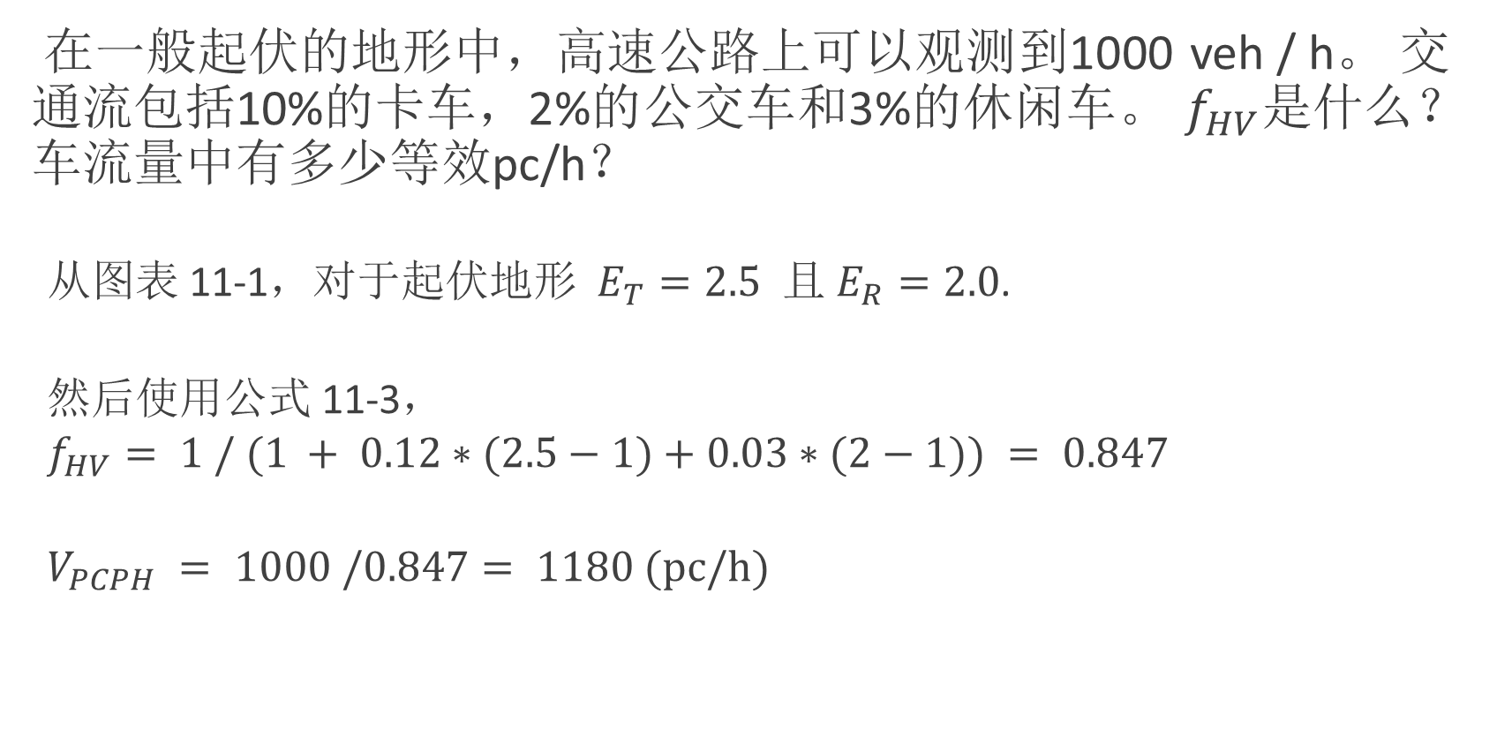
重型车辆调整
在一般起伏的地形中，高速公路上可以观测到1000 veh / h。 交通流包括10%的卡车，2%的公交车和3%的休闲车。 $f_{HV}$是什么？ 车流量中有多少等效pc/h？
从图表 11-1，对于$起伏地形{ E}_{T}=2.5$ 且 $E_{R}=2.0$.
然后使用公式 11-3，
$$f_{HV}= 1 / (1 + 0.12∗(2.5−1)+0.03∗(2−1)) = 0.847$$
$$V_{PCPH} = 1000 /0.847= 1180 (pc/h)$$

Slide 36

对驾驶员总体的调整
尽管研究表明周末的通行能力下降幅度可能高达10%至15%，但没有确定的算法可以进行这种调整。HCM建议:
$f_{p}$ = 1.00 ，通勤或常规驾驶员
$f_{p}$ = 0.85 – 1.00，休闲或临时驾驶员
确切值的选择必须基于对主体地点或相似地点的特征的直接观察
Notes:
The next thing we need to do is compute the driver population factor. We do not have an algorithm or table to look this up, you need to just take some general guidelines and knowledge of the traffic to get an estimate.
For example, research has shown that capacity can decline as much as 10 to 15 percent on weekends, when there is a higher percentage of non-routine drivers on the roadway. What the population factor is, then, is one minus the fractional loss in capacity due to unfamiliar drivers.
You can base this on observations of similar sites, for example the decline in maximum volume that is observed on the weekend vs. the weekday. In our problems, I will give you some guidance on for selecting this. For example, if the conditions are described as “weekend traffic with a high percentage of tourist traffic” you would select 0.85 for the population factor.

Slide 37
练习和作业
本周发布的练习：
R的简介及基本分析。
EB方法和HCM分析。
一些注意事项：
作业4将以练习的形式呈现。
Notes:
The assignment will be in the form of an exercise, which we will work on during lab time.
So make sure you come to the lab if you are not very familiar with R.

