Slide 1
R语言简介
交通大数据分析
2021年春季
马晓磊
Notes:
Okay, now we our discussion on SQL and move to the introduction of R.
I want to make you clear that in this class we are not going to introduce how to work with R as much as what we did with SQL.
Rather, we will focus on the database connection functions in R and see how it enables us to perform some statistical analysis on our data in the SQL database.

Slide 2
R简介
R是一种用于统计计算和图形的开源编程语言和软件环境。
R基于S语言，最初由John Chambers和at&T Bell labs的同事在20世纪70年代末和80年代初开发。
许多经典和现代统计技术已在基本环境或作为包在R中实现
志愿者继续创建和更新软件包。
Notes:
Some basic introduction.
R is an open source programming language and software environment for statistical computing and graphics.
It is based on the S language originally developed at AT&T Bell labs in the 1970s.
The good thing about R is that it has implemented many classical and modern statistical techniques, some in the base environment but a lot more are supplied as packages.
Volunteers continue to create and update the software packages.
A lot of statistics research makes its way into R packages, so you can get packages for what is really current in statistics research.

Slide 3
R的优点
免费！
丰富的Web资源和用户网络
支持多种应用程序的大量软件包
数据结构、操作和分析
统计建模
数据可视化
Notes:
Why do people love R so much?
The first reason is that it’s free. You can download the software anywhere on any computer.
And as a result, it has a large user community with a lot of free resources.
There are tons of packages, supporting a diverse range of applications.
There are some pretty good tools built in for data structures, data manipulation, and analysis.
And of course we can do statistical modeling and data visualization in R, and there are lots of packages that support more complex analysis such as machine learning and text analysis.

Slide 4
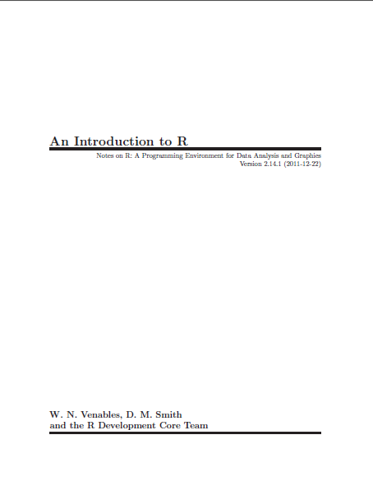
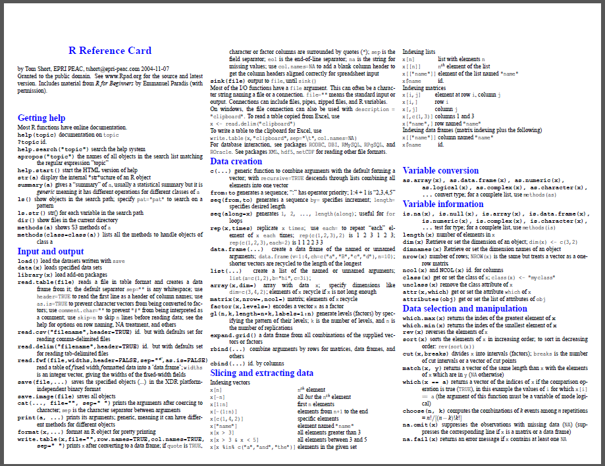
Web资源
R的简介
http://cran.r-project.org/doc/manuals/R-intro.pdf
R参考讲义（汤姆·肖特）
http://cran.r-project.org/doc/contrib/Short-refcard.pdf
Notes:
As I said, there are a lot of resources available to help you get started, here are a couple that I found useful.
Introduction to R is kind of a general reference, that will introduce you to the basic functionality of R and key functions and tools.
The reference card here on the right is like a cheat sheet that will point you to some very central functions and how to use them.
Do not have much explanation, just remind you of the correct function/syntax to use.

Slide 5


速查教材
R in a Nutshell, 2nd Edition
BY Joseph Adler
R Cookbook
BY Paul Teetor
Notes:
Here are a couple well-known text books.
I honestly never purchased a book for R. But if you really want some quick reference in a textbook format, these are for you.

Slide 6
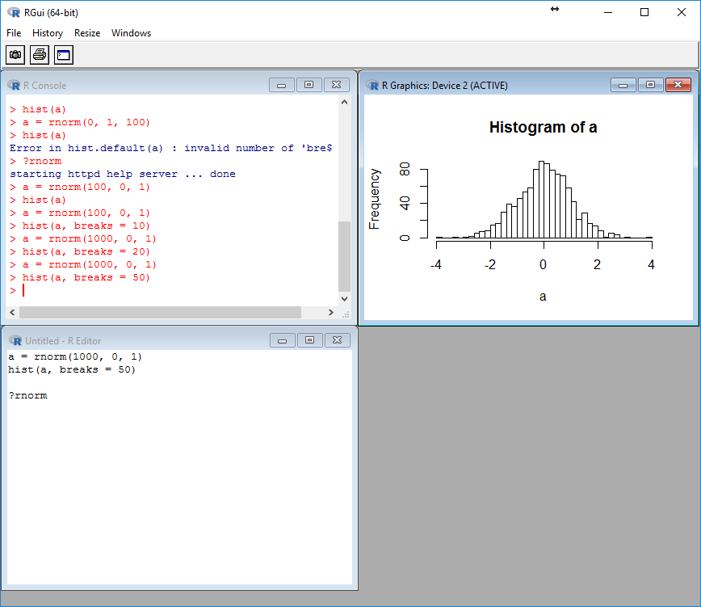
R环境
R
在编辑器窗口中创建和编写脚本。
Ctrl+R在控制台中执行命令。
可以移动和调整窗口大小以更改布局。
下载：http://cran.rstudio.com/
控制台窗口
图形窗口
编辑器窗口
Notes:
The picture here shows a general interface of R. This is where you can develop and execute R scripts, and view the output as well as generate graphs.
In the console window, you can type in your commends and execute them when you hit ENTER. You will see the output as well as error/warning messages.
Editor window is similar to the query window in SQL. You just write down you commands without running it. If you want to execute you command in the editor window, you can either copy/past them into the console or use keyboard shortcut.
A general procedure I will recommend is that:
Develop and edit scripts in Editor Window.
Ctrl + R to execute the command in the Console.
You can move and resize windows to change layout.
Note that you can move and resize the windows if you want a different layout.

Slide 7
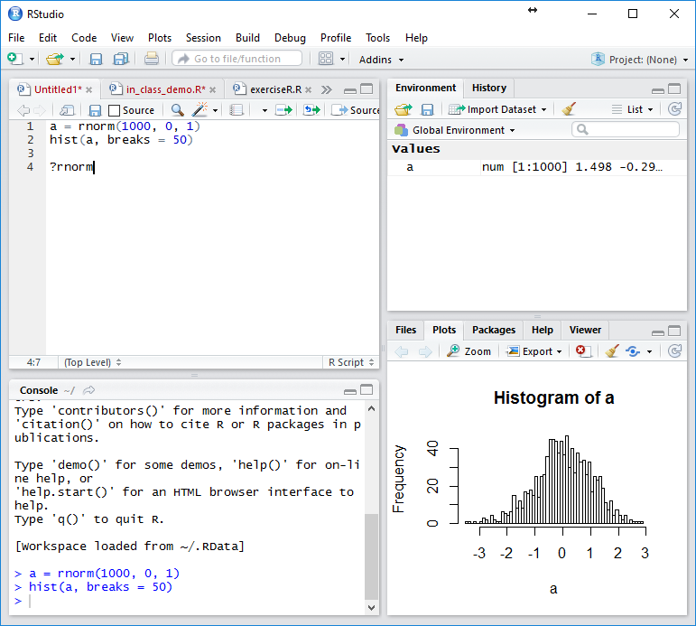
R环境
R Studio
R的IDE具有更好的编辑界面和更多的GUI选项
在Windows、Mac、Linux上运行，甚至在web浏览器中使用R Studio Server
要使用R Studio，还必须安装R.
免费下载：http://www.rstudio.com/products/rstudio/download/
编辑器窗口
控制台窗口
Notes:
Here I am going to introduce R studio.
This is an integrated development environment for R, which provide you with better editing interface and more GUI options.
It runs on a large range of systems, including Windows, Mac, Linux, and even in the web browser using R Studio Server.
One last thing maybe not worth to mention, R Studio is just an interface. To work with it you must have R running in the background.
It’s also free. And the download link is shown here.

Slide 8
在R中执行代码
在控制台窗口中键入命令，然后按enter键：
代码立即运行。
通过按键盘上的向上箭头，可以用以前输入的表达式填充行。
使用箭头键导航并键入内容，否则不进行编辑。
在编辑器窗口中编写脚本并执行（推荐）：
编辑代码并将其保存到R文件中。
选中要运行的部分并按Ctrl+R。。
R在代码编写方面的帮助很小（改用R studio）
Notes:
To execute a command in R, you can do one of two things.
In the Console Window, just type a line of code and hit enter.
The code you write will display, followed by the output of the code if any.
Though text editing is not really supported here, you can press the up arrow to call up previously entered commands.
The alternative, and what we will be doing for the most part, is editing code in the Editor Window.
You can also save your code into a R file.
Highlight the part you want to run and press Ctrl + R.
In R studio, there are some help in code writing, e.g., autocomplete variable names.

Slide 9
一些简单的R命令
>2+2
[1]4
> log(42)
结果
函数
括号内的参数

Slide 10
一些简单的R命令
> log(42)
[1] 3.737670
命令
结果
对自然底数e求log ln(x)

Slide 11
一些简单的R命令
> log(42, base = 10)
[1] 1.623249
结果
对数基数10

Slide 12
一些简单的R命令
> log(42
+ , base = 10)
[1] 1.623249
继续

Slide 13
面向对象语言
对象存储在你让R工作的目录中；
计算（例如:log(42))或分析（例如:ANOVA）的输出可以存储为稍后查看的对象，或用于以后的分析
>myObject<-log（42）
新建对象

Slide 14
管理对象
>ls（） 列出对象
[1]“myObject”
>rm（myObject） 删除对象

Slide 15
创建数据集：向量
c（）--连接
> Carbon <-c（8，54，534，1630，6611）
> Carbon
[1]1 5 14 15 6 8
> Carbon <-scan（）
赋值运算符,也可以使用=
使用scan（）手动输入值-完成后按enter键两次

Slide 16
索引向量
c（）--连接
> Carbon <-c（8，54，534，1630，6611）
> Carbon
[1]8 54 534 1630 6611
> Carbon[5]
[1]6611
提取Carbon的第五个元素

Slide 17
索引向量
c（）--连接
> Carbon <-c（8，54，534，1630，6611）
> Carbon
[1]8 54 534 1630 6611
> Carbon[c（2,5）]
[1]54 6611
提取Carbon的第二和第五个元素

Slide 18
索引向量
> Carbon
[1]8 54 534 1630 6611
> Carbon[c（3,4）]
[1]534 1630
> Carbon[-c（3,4）]
[1]8 54 6611
仅矢量的第3和第4个元素
除第3和第4以外的所有元素

Slide 19
索引向量
> Carbon
[1]8 54 534 1630 6611
> Carbon[2:4]
[1]54 534 1630
> Carbon[-（2:4）]
[1]8 6611
仅矢量的第二到第四个元素
除第2到第4个以外的所有元素

Slide 20
索引向量
c（）--连接
> Carbon <-c（8，54，534，1630，6611）
> Carbon
[1]8 54 534 1630 6611
>Carbon[Carbon >1000]
[1]1630 6611
提取Carbon大于1000的元素

Slide 21
逻辑运算符
==（等于，注意是双等号）
！=（不等于）
>（大于）
<（小于）
>=（大于或等于）
<=（小于或等于）
！（非）
& （和）
| （或）

Slide 22
逻辑运算符
大于
>Carbon>1000
[1] FALSE FALSE FALSE TRUE TRUE
> c(FALSE,FALSE,FALSE,TRUE,TRUE)
逻辑运算符返回TRUE或FALSE

Slide 23
索引向量
> Carbon[c（F，F，F，T，T）]
[1]1630 6611
可以使用TRUE&False提取元素——必须使用c()

Slide 24
逻辑运算符
> Carbon
[1] 8 54 534 1630 6611
> bool <- (Carbon>1000)|(Carbon<5000)
[1] FALSE FALSE FALSE TRUE FALSE
> Carbon[bool]
[1] 1630
注意[]和（）之间的差异

Slide 25
[]和（）之间的差异
>Carbon[（Carbon>1000）|（Carbon<5000）]
[1]1630
[]–方括号用于索引对象—提取不同的值
()–圆括号用于函数和运算符

Slide 26
索引向量
> Carbon
[1] 8 54 534 1630 6611
> Year
[1] 1800 1850 1900 1950 2000
> Carbon[Year>=1900]
[1] 534 1630 6611
根据一个向量的值索引另一个向量
两个向量的大小必须相同

Slide 27
模式化数据：seq（）
序列
> 1:5
[1] 1 2 3 4 5
> seq(from = 1, to = 5, by=1)
[1] 1 2 3 4 5
> seq(from = 1800, to = 2000, by=50)
[1] 1800 1850 1900 1950 2000

Slide 28
模式化数据：rep（）
重复
> rep (x = c(1,2,3), times = 2)
[1] 1 2 3 1 2 3

Slide 29

数据维度
> newData <- 1:20
[1] 1 2 3 4 5 6 7 8 9 [10] 10 11 12 13 14 15 16 17 18 [19] 19 20
> matrix(newData, 5,4, byrow = T)
[,1] [,2] [,3] [,4]
[1,] 1 6 11 16
[2,] 2 7 12 17
[3,] 3 8 13 18
[4,] 4 9 14 19
[5,] 5 10 15 20
五行×四列

Slide 30
添加行和列
> newData <- cbind(newData, 21:25)
> newData <- rbind(newData, 96:100)
[,1] [,2] [,3] [,4] [,5]
[1,] 1 6 11 16 21
[2,] 2 7 12 17 22
[3,] 3 8 13 18 23
[4,] 4 9 14 19 24
[5,] 5 10 15 20 25
[6,] 96 97 98 99 100
添加列
添加行

Slide 31
长度和维度
> dim(newData)
[1] 6 5
> length(newData)
[1] 30

Slide 32
索引矩阵
> newData[2:4,1:2]
[,1] [,2]
[1,] 2 7
[2,] 3 8
[3,] 4 9
> newData[c(1,3,5), c(1:2)]
[,1] [,2]
[1,] 1 6
[2,] 3 8
[3,] 5 10
[行，列]

Slide 33
数据结构Data Frames
一般来说，最好从电子表格程序（如Excel）中准备和创建的文本文件中导入数据结构
我们将学习如何做到这一点
不过，我首先想让大家学习如何在R中从头开始创建数据结构

Slide 34
Data Frames
> myDataFrame <-
+ data.frame(YearMeasured=Year,
+ CarbonOutput = Carbon)
列名
数据值

Slide 35
Data Frames
> myDataFrame
YearMeasured CarbonOutput
1 1800 8
2 1850 54
3 1900 534
4 1950 1630
5 2000 6611
列名
数据值
行名称

Slide 36
Data Frames ：添加列
> myDataFrame$otherValues <-
+ c(2,7,12,18,6)
$表示我们正在标识一个列名
因为该列不存在，因此将使用该名称创建一个新列

Slide 37
Data Frames ：添加列
> myDataFrame$otherValues <-
+ c(2,7,12,18,6,7)
YearMeasured CarbonOutput otherValues
1 1800 8 2
2 1850 54 7
3 1900 534 12
4 1950 1630 18
5 2000 6611 6

Slide 38
Data Frames ：添加行
> myDataFrame <-rbind(myDataFrame,
+ c(2050, 10000, 27))
YearMeasured CarbonOutput otherValues
1 1800 8 2
2 1850 54 7
3 1900 534 12
4 1950 1630 18
5 2000 6611 6
6 2050 10000 27

Slide 39
删除行
> myDataFrame <-
+ myDataFrame[-6,]
除了第六行，其余都保留

Slide 40
列名和行名
显示列和行名称
> colnames(myDataFrame)
> rownames(myDataFrame)
更改列和行名称
> rownames(myDataFrame)[1]<-
+ "new.row.name"

Slide 41
索引Data Frames
使用[rows，columns]索引：
> myDataFrame[1,2]
> myDataFrame[1:3, 1:2]
> myDataFrame[, 1:2]
> myDataFrame[,c(“YearMeasured”,“CarbonOutput")]
> myDataFrame[, -c(2,3)]
空索引表示所有值（行或列）

Slide 42
索引Data Frames
另外，索引使用$表示列：
> myDataFrame$CarbonOutput
[1] 8 54 534 1630 6611
> myDataFrame$CarbonOutput
+ [myDataFrame$YearMeasured >= 1900]

Slide 43
创建Data Frames子集方法综述
按照列名:
> myDataFrame$CarbonOutput
按照索引:
> myDataFrame[1:3, 1:2]
按照逻辑语句:
> myDataFrame$CarbonOutput
+ [myDataFrame$YearMeasured >= 1900

Slide 44
R vs. SQL
语法：
R区分大小写；SQL不区分大小写。
R对换行敏感；SQL对换行不敏感。
两者都对缩进不敏感（Python不同）。
数据结构：
在SQL中，关系中的元组是无序的。
在R中，数据结构中的行是有序的。
运算符和函数：
很多不同之处，下面是一些常见的：
 | R | SQL
比较运算符 | == | =
逻辑运算符 | !, &, | | NOT, AND, OR
函数 | mean() | AVG()
Notes:
I do want to put here a comparison between R and SQL. Actually these two languages are so different that people don’t really need to compare them.
The only reason why we do a comparison here is that I don’t want you to be confused when learning two kinds of languages in the same class.
Well on the Syntax level, we all know SQL is case insensitive, and it’s also insensitive to line feeds and indentation. The only thing that R is also insensitive to is the indentation.
For the data structure. In SQL, tuples in a relation are unordered, but in R, rows in a dataframe are stored with an order. That’s why you can get data from a specific row/column.
Last for the operators and functions, there are actually tons of differences because they are just two types of languages. In the table below I just show some common used ones to make sure you don’t use operators/functions from one language in the environment of another language.
R和SQL都对代码缩进不敏感

Slide 45
指定工作目录
R读取并写入工作目录中的文件，除非另有说明。
有两种方法可以指定工作目录。
运行setwd()函数：
所有文件路径名都需要使用正斜杠/而不是反斜杠\
R区分大小写。检查你的文件夹名。
> setwd("C:/Users/Wenbo Zhu/CEE412_599")
Notes:
Okay, let us get started in writing R code. One of the first things you want to do is specify the working directory.
This means the location where you are working, and any file paths you enter are relative to this location.
There are two ways to do this, one is to simply write and execute this code, setwd() and then the file path of the directory you want to work in enclosed in quotes and parenthesis.
Note that you need to use forward slashes when specifying file paths in R. This is kind of a pain because this backward slash is used in the windows file explorer.
Also note that because R is case sensitive, be careful about your folder names.

Slide 46
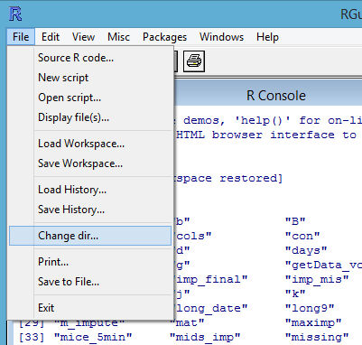
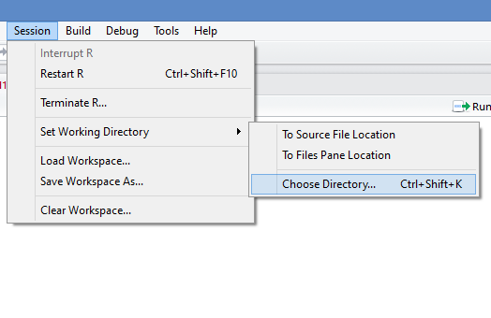
指定工作目录
在GUI中指定工作目录
R：
R Studio：
Notes:
The second way to do this is to specify the working directory in the GUI, which is possible both in R and R studio.
On the left you can see how to so in R, and the R studio interface on the right.

Slide 47
数据导入
R 中支持的数据文件类型：
文本文件（通常使用CSV）
Web URL
Excel、Minitab、SPSS等（由不同包中的函数支持）
数据库连接
使用read.csv()函数从CSV文件加载数据：
在这种情况下，CSV文件是我的工作目录，否则我需要指定相对于我的工作目录的文件路径。
accident = read.csv("wa11acc.csv")
Notes:
With your working directory set up, the next thing you probably want to do is load data into the R session.
R can take data files in a wide range of formats. Probably the most frequently used data source are CSV files.
Actually R has a number of packages to let you read files from pretty much any format, so just google what you are trying to do and you will likely find something that does what you want.
To load data from a CSV file, you can use the read.csv function with a file path specified.
To load data into R, we often use CSV. Files, though we will of course be using databases soon enough in this class. To grab a CSV file, you can use this command with a file path specified, read.CSV. The function will return a dataframe.
You may notice that here I just type in the file name. That’s because my file is just in my working directory. If not, you need to specify the file path relative to the working directory.

Slide 48
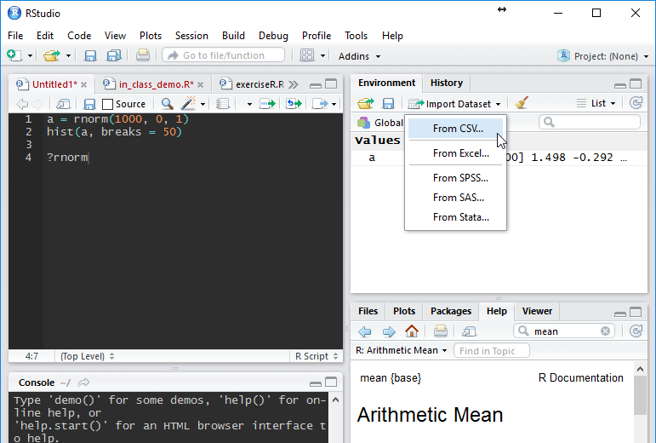
数据导入
使用R Studio GUI加载数据：
从CSV中导入数据集…
Notes:
In addition to the read.csv command, you can load data in the R studio graphical interface.
As shown here, click import dataset and then from the data format you want.

Slide 49
R中的包
所有R函数和数据集都存储在包中。
必须首先安装包，然后加载包以在任何给定的R会话中使用。
包含基本R函数的标准（基本）包在R安装中自动可用。
R软件包示例：
caret–回归和分类模型的工具
ggplot2–图形和绘图
data.table–处理大数据集的工具
randomForest–用于创建和训练随机森林模型的工具
Notes:
We have mentioned R packages several times, actually all R functions and datasets are stored in packages.
Packages must first be installed, and then loaded for use in any given R session.
The standard (base) packages that contain the basic R functions are automatically available in R installation.
Here are some examples of popular R packages.
ggplot2 is very popular for generating nice visuals
randomForest is probably the most utilized tree-based modeling package out there.

Slide 50
R中的包
安装包：
运行代码安装软件包时，系统将提示您选择镜像。通常，选择离您最近的一个。
然后，加载包：
每次重新打开R会话时，都需要加载包，但无需重新安装包。
> install.packages("ggplot2")
需要引号
> library(ggplot2)
引号可选
Notes:
Here is how to install and load a package.
To install, you can use the install.packages function with the name of the package enclosed in quotes and parenthesis.
In most cases R will be able to find the package through some centralized repositories and you don’t need to worry about where to find the package.
After a package is installed, you can load it into an R session with the library function and the name of the package in parenthesis.
Note that quotes are required when you are installing the package, but not when you are loading one.
Every time you reopen a R session, you need to load the packages, but no need to reinstall the package.

Slide 51
数据库连接
RODBC包
允许连接到数据库和各种数据库操作（查询、插入、更新等）
在R代码中嵌入查询
只是R中的另一个包
在结构上是通用的，可以连接到各种DBMSs
安装包：
> install.packages("RODBC")
Notes:
Okay here comes the most exiting part today.
You may feel that over the last half an hour or so my lecture sounds like from a different world. But start from here we are going to connect these two worlds together.
You can build database connection in R, and this is enabled by the package named RODBC. Open Database Connectivity
What’s good about this is that you can develop a database in SQL, manage it and set everything up, then write queries that return some data you want.
Then you can grab the result into R, perform some analysis.
Really, though, it is just a package in R like so many things.
Of course this is not included in the standard package and you need to install it. The command is shown below.

Slide 52
数据库连接
RODBC包中有两组函数：
低级别–不常用
SQL–高级，SQL功能
依赖于开放式数据库连接（ODBC）
用于访问DBMS的编程API
需要ODBC驱动程序，它是DBMS和软件之间的一个中间件
随着时间的推移，它变得不那么重要，一些较新的软件开发平台不需要它
Notes:
The RODBC package has two levels of functionality, but we are mostly interested in the high level SQL functions.
The functionality of RODBC relies on open database connectivity standards and interfaces.
To put it simple, this is a series of programing interfaces that allows interfacing with a database.
The ODBC driver is required, and this is a piece of middleware between the DBMS and the software.
Less important as time goes on, some newer software development platforms do not require it

Slide 53
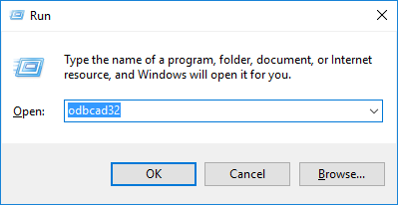
数据库连接
在windows中创建数据源名称（DSN）
这是一个定义连接特定数据库的文件
包括连接字符串：user、password、database Name
单击Start → Run或按Win+R并键入“odbcad32”
使用登录信息创建SQL server连接。
Notes:
To build the database connection, the first thing you need to do is to create a Data Source Name (DSN). This is a file that defines the connection to a particular database, which includes the connection string such as user, password and database name.
In windows, you can click Start → Run or press Win+R and type the string “odbcad32” to bring up the data source administrator window.
You will go through this process in the exercise next week and we will not introduce the details today. But what you need to do later is basically create a SQL server connection with your login information to be used in R.

Slide 54
数据库连接
现在，您可以从R连接到数据库并开始运行查询！
加载RODBC包：
创建到数据库的连接：
> library(RODBC)
> conn <- odbcConnect("CEE412_599", "Wenbo", “MyPassword")
DSN
SQL Server登录
Notes:
The next step is to get started querying data from the R environment.
First load your RODBC package. This makes all of the tools in the package available in the workspace.
The second thing is create a connection in R.
This is where you need to use the information from the DSN you created.
This odbcConection function is part of the RODBC package, and you must have an active connection before you have any interaction with a database.
It is simple to do though, just put the name of the DSN you created, your user name in SQL server, and your password in SQL server. Obviously, these must be the same log in credentials you entered when you created the DSN. When you run this, you have a connection object named conn, though you can name it whatever you want.
Now, whenever we write a query, we will need to specify that the connection is named con.

Slide 55
数据库连接
RODBC中的有用函数：
找出可用的表：
将表作为dataframe获取：
使用任意查询获取数据（返回dataframe）：
> sqlTables(conn)
> table = sqlFetch(conn, "table_name")
> table = sqlQuery(conn, "SELECT * FROM table_name")
Notes:
There are several useful functions in the RODBC package.
Sql tables will tell you how many table-like objects are available for you to query.
You can use the sqlFetch command to grab an entire table as a dataframe.
In my view, the most important is the sql Query, which allows you to run any kind of custom query.

Slide 56
数据库连接
RODBC中的有用函数：
将数据保存到SQL Server中的现有表或新表中：
如果为true，则值将插入现有表中。如果为false，将尝试创建新表，如果表已存在，则将失败。
>sqlSave（conn，dataframe，“表名”，append=TRUE）
R中的数据结构
SQL中的表名
Notes:
Another important one is the sqlSave command, which allows you to save a dataframe as a table or insert new rows into a SQL table from a dataframe.
I must specify the name of the connection, then the name of the R dataframe, and then the name of the SQL table I am putting data into.
If I say append is TRUE the SQL Save command will add rows to an existing table.
Otherwise, it will attempt to create the table and fail if the table already exists.

Slide 57
数据库连接
访问数据库作为数据源的过程如下：
安装并加载必需的包（在本例中为RODBC）
创建一个连接对象（在R中），其中包含连接名称、访问数据库的用户凭据和数据源的位置（ip地址等）
运行查询语句–更新、获取、保存，等等——使用connection
关闭连接
这个过程与其他编程语言非常相似：python、 C#等。
连接信息将保存在代码中，因此不要以允许他人访问您的凭据的形式共享它。
Notes:
Here is some notes about building a database connection in R.
The general procedure is that, first, you install and load necessary packages.
Next, inside your code, you create a connection to the database. This will include the name of the connection, the log in credentials, and the address or ip of data source.
The next step is to do whatever we want to do, run queries, make updates, whatever.
At the end, we close the connection to end the process.
This is what we do in R, but it is also very similar for other programing languages.
Last thing to emphasize, the connection information will be saved in your code, so don’t share it in a form that would allow someone to get access to your credentials.

