Slide 1
高级SQL函数
交通大数据分析
2021年春季
马晓磊

Slide 2
大纲
  窗口函数
  条件语句
  变量
  循环
  存储过程
2020年12月18日
交通大数据分析
2
Notes:
This is a good point to talk about some advanced SQL functions, especially when you have some solid knowledge with basic SQL queries after completing project 1 and the first midterm.
We are going to talk some advanced SQL today. First of all I want to make you clear that my test and homework will not heavily emphasize this, but these are big time savers and I want you to at least have knowledge of them.
Functions we will discuss today include window functions, named variables, loops and stored procedures.
Some of these (variables and loops) are quite often used in other programming languages, but as in SQL most of the things you do is querying data from database, you may not need to use those things very often. For some specific tasks they can be a life saver where no other solution exists.

Slide 3
窗口函数
窗口函数根据对查询结果的某些操作为每一行返回一个值。
  允许更复杂的数据分类和排序，包括难以捉摸的分位数函数
  这些特定于SQL Server，并非在所有平台上都能正常使用
基本语法：
SELECT ROW_NUMBER() OVER (PARTITION BY <attributes>
ORDER BY <attributes>) AS name
FROM relation
排名/聚合函数
窗口
2020年12月18日
交通大数据分析
三
Notes:
First let’s look at window functions. Window functions return a single value for each row based on some operations on the query result.
The value is that we can use window functions to sort data by various fields, find quantiles, and other things and store these information in a new column. We have mentioned several times that data tables in SQL are not ordered. But sometimes we do need to make use of the order of tuples in a relation, and that’s when window functions come into play.
The basic syntax is like this.
You can include a window function as an expression in your select list.
In the expression, first you have a ranking or aggregate function, in this case the rank is simply the row number in the result.
Followed by the word OVER, and then in parenthesis you put the window based on some set of attributes.
This may seem confusing at first. But we will talk about some examples later.

Slide 4
窗口函数
下面我们来看一个简单的例子，假如说我们希望将Employee表按照性别进行聚合，比如说我希望得到的结果是：“登录名，性别，该性别所有员工的总数”，如果我们使用传统的写法，那一定会涉及到子查询，如下所示。
使用窗口函数后，如下：
SELECT [LoginID],gender,
COUNT(*) OVER (Partition BY gender) AS GenderTotal
FROM [AdventureWorks2012].[HumanResources].[Employe]
SELECT [LoginID],gender,
(SELECT COUNT(*) FROM [AdventureWorks2012].[HumanResources].[Employee] a
WHERE a.Gender=b.Gender) AS GenderTotal
FROM [AdventureWorks2012].[HumanResources].[Employe] b
2020年12月18日
交通大数据分析
4

Slide 5
窗口函数
SQL Server支持的排名函数：
ROW_NUMBER():依据组显示每一条记录在该组中出现的位置，比如：若有两个第一名。则这两个第一名在一组内排名为1、2，下一组的排序仍从1 开始，依次类推。
RANK():在结果集中每一条记录所在的排名位置，但排名可能不连续，比如：若同一组内有两个第一名，则该组内下一个名次直接跳至第三名。
DENSE_RANK():功能与Rank相似。但排名的数值是连续的，比如：若同一组内有两个第一名，则该组内下一个名次为第二名。
NTILE():依据指定的分组数量将结果集分区，并记录其在组中的位置。
2020年12月18日
交通大数据分析
5
Notes:
Here are some ranking functions supported in SQL server
Talking about slides…
These functions could be essentially helpful if you want to
Rank rows based on some attribute value?
Find the row corresponding to the max or min value of some attribute?
Compute quantiles, rather than the simple aggregation functions?
Row_Number：依据组显示每一条记录在该组中出现的位置，比如：若有两个第一名。则这两个第一名在一组内排名为1、2，下一组的排序仍从1開始，依次类推
Rank：在结果集中每一条记录所在的排名位置，但排名可能不连续，比如：若同一组内有两个第一名，则该组内下一个名次直接跳至第三名
Dense_Rank：功能与Rank相似。但排名的数值是连续的，比如：若同一组内有两个第一名，则该组内下一个名次为第二名
NTILE：依据指定的分组数量将结果集分区，并记录其在组中的位置。

Slide 6
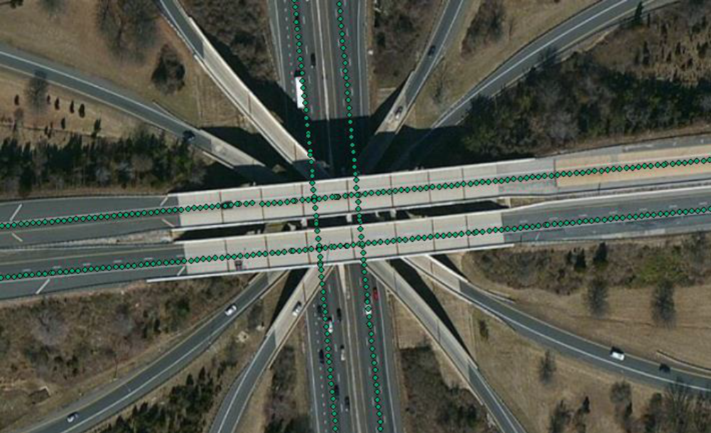
窗口函数–示例
Elevation
State | Route | Milepost | Elevation
WA | I-5 | 0 | 24.42
WA | I-5 | 0.001853 | 24.29
WA | I-5 | 0.003729 | 24.16
WA | I-90 | 0 | 15.52
WA | I-90 | 0.005632 | 15.48
WA | I-90 | 0.011288 | 13.79
如何根据道路上连续点的高程计算每个路段的坡度？
  对于每个点，找到同一条道路上的下一个点。
  计算高差，然后除以里程标差。
  分别对每条路线重复此过程
2020年12月18日
交通大数据分析
6
Notes:
Okay, here is my fist example. This is actually a research project I was working on, and in the process I benefited a lot from window functions.
Here in the table, each row corresponds to a single point on some route and has the elevation of that point. And my question is how could I calculate grade for each road segment (between each two adjacent points).
Very intuitively, my procedure should be something like this:
For each point, find the next point on the road.
Calculate the elevation difference, then divided by milepost difference.
Repeat the process for each route separately
Not sound very difficult right? Actually you can probably do this very fast in Excel by calculating differences between cells next to each other and drag/double click the cell to apply your function to one entire column.
However, this becomes a difficult task in SQL as data in SQL are not ordered, the system does not know which two points are next to each other. But the thing is, we have to develop some procedure in SQL, for the following reasons:
The dataset is too large to put into Excel.
Don’t want to transfer data between different applications, keep in SQL for further procedures.

Slide 7
窗口函数–示例
但是对于道路上的每个点，如何找到下一个点？
  没有窗口功能，可能会非常困难且效率低下。
  如果 A 是道路上的当前点，则下一个点 B 在所有里程点比 A 高的点中具有最小的里程点。
不使用窗口函数的解决方案:
计算坡度
SELECT a.*, (b.Elevation-a.Elevation)/(b.Milepost-a.Milepost)/5280 AS Grade
FROM Elevation AS a INNER JOIN Elevation AS b
ON a.Route = b.Route
AND b.Milepost = (SELECT MIN(c.Milepost)
FROM Elevation AS c
WHERE c.Route = a.Route
AND c.Milepost > a.Milepost)
2020年12月18日
交通大数据分析
7
Notes:
But for each point on the road, how to find the NEXT point?
Without a window function, it can be quite difficult and inefficient.
Well in our table, the only thing that can tell us some information about point locations is the milepost attribute. So this is the way:
If A is the current point on the road, the next point B has the minimum milepost among all points with higher milepost than A.
This at least sounds like something we can do. And below is my code to apply the procedure.
Talking about code
Correlated query needed.

Slide 8
窗口函数–示例
查询结果
这是我想要的结果。但这是一个好的解决方案吗？
  效率低下且缓慢
  对于每一点，我需要查看整个表格以找到下一个点。
State | Route | Milepost | Elevation | Grade
WA | I-5 | 0 | 24.42 | -0.01329
WA | I-5 | 0.001853 | 24.29 | -0.01312
WA | I-5 | 0.003729 | 24.16 | NULL
WA | I-90 | 0 | 15.52 | -0.00135
WA | I-90 | 0.005632 | 15.48 | -0.05659
WA | I-90 | 0.011288 | 13.79 | NULL
2020年12月18日
交通大数据分析
8
Notes:
The table here shows my result.
New column is the grade data, calculated by the elevation difference divided by milepost difference between each two adjacent points.
Note for the point at the end of the road segment, there is no NEXT point available so my grade will be NULL.
Well this query will give me what I want in terms of the result. But is that a good solution?
Inefficient and slow because for each point, I need to look into the entire table to find the NEXT point.
Actually when I first try this query it almost never finishes running as my table contains millions of rows.

Slide 9
窗口函数–示例
使用窗口函数的解决方法：
  创建一个新列来显示表格的行号，在每条道路内，这些行均按里程碑排序。
SELECT *, ROW_NUMBER() OVER (PARTITION BY Route
ORDER BY Milepost) AS PointOrder
INTO #Elev_Ordered
FROM Elevation
State | Route | Milepost | Elevation | PointOrder
WA | I-5 | 0 | 24.42 | 1
WA | I-5 | 0.001853 | 24.29 | 2
WA | I-5 | 0.003729 | 24.16 | 3
WA | I-90 | 0 | 15.52 | 1
WA | I-90 | 0.005632 | 15.48 | 2
WA | I-90 | 0.011288 | 13.79 | 3
2020年12月18日
交通大数据分析
9
Notes:
Then I switched to window function and my life becomes much easier.
Here I will introduce the query solution using the window function.
In the first step, I use the ROW_NUMBER() function to create a new column that shows row numbers of the table.
Of course I want my rows are ordered by milepost, and the order is repeated for each route.
This can be achieved by the query below.
Note that I also saved by data into a temporary table for future use.

Slide 10
窗口函数–示例
  对于每个点，找到同一条道路上的下一个点。
  计算高差，然后除以里程标差。
SELECT a.*, (b.Elevation-a.Elevation)/(b.Milepost-a.Milepost)/5280 AS Grade
FROM #Elev_Ordered AS a INNER JOIN #Elev_Ordered AS b
ON a.Route = b.Route
AND b.PointOrder = a.PointOrder + 1
State | Route | Milepost | Elevation | Grade
WA | I-5 | 0 | 24.42 | -0.01329
WA | I-5 | 0.001853 | 24.29 | -0.01312
WA | I-5 | 0.003729 | 24.16 | NULL
WA | I-90 | 0 | 15.52 | -0.00135
WA | I-90 | 0.005632 | 15.48 | -0.05659
WA | I-90 | 0.011288 | 13.79 | NULL
B is the next point of A
2020年12月18日
交通大数据分析
10
Notes:
Same as before, the next steps are:
For each point, find the next point on the same road.
Calculate the elevation difference, then divided by milepost difference.
This becomes much easier having the temporary table with the point order. The query below shows how I can do this.
The result is exactly the same.
Note that this is much faster than the previous solution. The thing is, SQL is very fast in finding something with an exact value in a huge data table, but in finding the max/min/average value it has no advantage in terms of speed or efficiency.

Slide 11
窗口函数
分位数函数: NTILE(n)
  将行平均分为n组。
  例如， NTILE(4)表示四分位数， NTILE(5)表示五分位等。
  这不会为你提供切点的值，它只是将每一行分配给特定的分位数组。
  对于每一行， NTILE(n)函数将返回该行所属的组（1〜n）的编号
  能够对结果集的数据排序后。依照指定的数量把结果集分成N组，并给予每组一个组编号，分组的方式非常easy，将结果集的总记录数除以N，若有余数M，则前M组都多增一条记录，因此，并不是全部的组都有同样的记录数。
2020年12月18日
交通大数据分析
11
Notes:
We have introduced an example using ROW_NUMBER() function, and RANK(), DENSE_RANK() are very similar if you look into the definition.
Here we will talk briefly about the quantile function. The function is Ntile, and what it basically do is to equally divide your rows in to n groups
This does not give you the value of the cut points, it just assigns each row to a particular quantile group.
For each row, NTILE(n) function will return the number of the group (1~n) to which the row belongs.

Slide 12
窗口函数–示例
创建CEOS的收入分位数：
SELECT *, NTILE(100) OVER (ORDER BY OneYrPay DESC) as Percentile
FROM CEOs
ORDER BY OneYrPay DESC
共有200位CEOS，每个百分位组中有两位
Name | Company | OneYrPay | FiveYrPay | Shares | Age | Percentile
John H Hammergren | McKesson | 131.19 | 285.02 | 51.9 | 53 | 1
Ralph Lauren | Ralph Lauren | 66.65 | 204.06 | 5010.4 | 72 | 1
Michael D Fascitelli | Vornado Realty | 64.405 | NULL | 171.7 | 55 | 2
Richard D Kinder | Kinder Morgan | 60.94 | 60.94 | 8582.3 | 67 | 2
David M Cote | Honeywell | 55.79 | 96.11 | 21.5 | 59 | 3
George Paz | Express Scripts | 51.525 | 100.21 | 47.3 | 57 | 3
Jeffery H Boyd | Priceline.com | 50.185 | 90.3 | 128.2 | 55 | 4
… | … | … | … | … | … | …
2020年12月18日
交通大数据分析
12
Notes:
Here is a quick example of this. I want to create the income percentile for my CEO table:
So what will this do? It will order the rows by the OneYrPay field.
Then the table will be divide into 100 groups of equal size, and assign each row with the group number.
Here I have 200 CEOs in the table and two CEOs will result in each percentile group.
Here the number one means these two CEOs are the top 1% in my table in terms of their one year payment.
In this case I happen to have 200 rows of data, so the data is easily evenly divided into 100 equal groups.
You would have differently sized groups if the total number of rows was not divisible by the number of groups. In this case, the larger groups will be assigned first.

Slide 13
窗口函数
可以在窗口上使用的常用:
  排名函数: ROW_NUMBER(), RANK(), DENSE_RANK(), NTILE(n), etc.
  聚合函数: AVG(), MIN(), MAX(), SUM(), COUNT(), etc.
在窗口上使用聚合函数时，在窗口中不使用ORDER BY （因为这没有意义）
2020年12月18日
交通大数据分析
13
Notes:
Here is kind of a summary for the window functions and one thing to note is that aside from ranking functions, you can also use common aggregate functions over a window.
Note that the ORDER BY statement does not make sense when you are applying an aggregation over a window, so it is not used.

Slide 14
条件语句
SQL中的CASE语句是在查询中返回条件值的一种方法。
与常规的基于集合的操作相比，它们可能较慢，但在某些情况下可能非常有用。 CASE语句的基本形式如下：
  解释为：当列为<condition 1>时，返回<value 1>，当列为<condition 2>时，然后返回<value 2>，…，否则，返回<<value x>。
SELECT CASE <column name>
WHEN <condition 1> THEN <value 1>
WHEN <condition 1> THEN <value 1>
...
ELSE <valune x>
END
2020年12月18日
交通大数据分析练习
14
Notes:
Let us move on.
I introduced case statements in the SQL exercise. Case statements are one way to return conditional values in a query.
The basic form of a CASE statement is shown here.
I put the case statement followed by the column I am applying it to. Then, I just write When followed by the condition, followed by Then and the conditional value that I want to have in my result.

Slide 15
条件语句
示例：
SELECT Name, Section,
Case Section
WHEN 'CEE 412' THEN 50
WHEN 'CEE 599' THEN 60
END AS TotalPoints
FROM Students
Students
Name | Section
Mary Brooks | CEE 412
Christina Parker | CEE 599
Craig Price | CEE 599
Elizabeth Howard | CEE 412
Lillian Cooper | CEE 599
Evelyn Bailey | CEE 412
… | …
Name | Section | TotalPoints
Mary Brooks | CEE 412 | 50
Christina Parker | CEE 599 | 60
Craig Price | CEE 599 | 60
Elizabeth Howard | CEE 412 | 50
Lillian Cooper | CEE 599 | 60
Evelyn Bailey | CEE 412 | 50
… | …
2020年12月18日
交通大数据分析
15
Notes:
Here is an example.
You can see I create a new column TotalPoint using the case statement, which is 50 for students enrolled in CEE 412 and 60 for students in CEE 599.
The structure is a little complicated. But I do want you to be able to make use of this. Actually if you just want to learn one function among all advanced functions that we are going to cover today, this is probably the one that are used most frequently.

Slide 16
SQL中的变量
在SQL中，局部变量是一个对象，可以保存特定类型的单个数据值。
声明变量的句法：:
或者:
DECLARE @variable_name <data type>
SET @variable_name = <some value>
DECLARE @variable_name <data type> = <some value>
2020年12月18日
交通大数据分析
16
Notes:
Next we will introduce variables in SQL. Here we will just focus on local variables. You can use a local variable to hold some single data value.
The syntax to declare a variable is presented below:

Slide 17
SQL中的变量—示例
Player (Name, Salary, Height, Weight, Team)
问题:找到薪水最高的球员的名字.
  使用子查询的解决方案:
  Solution using a local variable:
SELECT name, salary
FROM player
WHERE salary = (SELECT MAX(salary) FROM player)
DECLARE @max_salary INT = (SELECT MAX(salary) FROM player)
SELECT name, salary
FROM player
WHERE salary = @max_salary
name | salary
Peyton Manning | 15000000.00
2020年12月18日
交通大数据分析
17
Notes:
Here we look at an example. I have a table of players and my question is how to find the player with the highest salary.
Here is an example of how to set the value of a named variable. I can set it directly, or I can set it from a query as I am doing here. I just have to make sure that my query is returning only a single value instead of a list of values.
Next I just use it as a value in a query, and note that the constraints associated with the data type I declared at the start will be present when I am using it. For example, if I try to test the equality of a named variable of type integer with a column of type varchar, it will not work.

Slide 18
SQL中的循环语句
SQL中有几种循环类型，我们将介绍WHILE循环
SQL不是一种常规的编程语言，实际上似乎可以用循环解决的大多数事情都可以使用SQL“基于集合”的方法来解决。
当常规查询可以执行时，请不要使用循环（速度慢且占用大量资源）
2020年12月18日
交通大数据分析
18
Notes:
Okay, let us move on to loops.
Several notes about the loop functions:
We have a few options in SQL for loops, and in this class we are going to focus on the WHILE loops.
I also want to emphasize that, though it feels like loops can be used to solve a lot of the challenges if you are familiar with conventional programming languages, we do not actually use loops a lot in SQL.
Using loops when they are not needed is likely make your queries slow and use up a lot of memory and processing resources.
And you are not actually taking advantage of SQL.

Slide 19
SQL中的循环语句
创建一个包含十行随机数的表。
  创建一个空表和一个计数变量：
  在WHILE循环中将值插入表中：
CREATE TABLE #temp(ID INT, RandNum DECIMAL(5,4))
DECLARE @counter INT = 1
Random number (0~1) generator
WHILE @counter <= 10
BEGIN
INSERT INTO #temp VALUES(@counter, RAND())
SET @counter = @counter + 1
END
2020年12月18日
交通大数据分析
19
Notes:
Here is a pretty standard loop in SQL. I don’t really have a practical example, and my goal here is to create a table with ten rows of random numbers.
In the first step, I create an empty temporary table and declare a local variable to help me count the number of rows.
In the next step I start a WHILE loop to insert values in my table. Talking about the codes…

Slide 20
IF/BREAK循环
当随机数总和超过3时停止循环
CREATE TABLE #temp(ID INT, RandNum DECIMAL(5,4))
DECLARE @counter INT = 1
WHILE @counter <= 10
BEGIN
INSERT INTO #temp VALUES(@counter, RAND())
SET @counter = @counter + 1
IF (SELECT SUM(RandNum) FROM #temp) > 3.0 BREAK
ELSE CONTINUE
END
2020年12月18日
交通大数据分析
20
Notes:
Similar to other programing languages, I can use if/else and break statements in SQL.
The codes here is exactly like the previous one, except that in each loop I use an if statement to check if the sum of my random numbers is above 3, and breaking the loop if it is.
You can see that, should the if statement evaluate to true, we break out of the loop.
Otherwise, we execute the continue command to go to the next loop.

Slide 21
IF/BREAK循环
前两个查询的结果：
ID | RandNum
1 | 0.9953
2 | 0.8091
3 | 0.9167
4 | 0.2714
5 | 0.1149
6 | 0.9743
7 | 0.7772
8 | 0.8559
9 | 0.7972
10 | 0.4414
ID | RandNum
1 | 0.2238
2 | 0.7479
3 | 0.4861
4 | 0.9626
5 | 0.5082
6 | 0.1083
对比。
2020年12月18日
交通大数据分析
21
Notes:
This slide just shows the difference between the first loop and the second loop I showed you. The first one will be guaranteed to complete 10 iterations of the loop, but the second one will break if column rand1 sums to over 3.0.
That is really the extent of what I want to talk about in terms of loops, hopefully you can refer to this slide show if you have a need to do something like this.

Slide 22
存储过程
一组在SQL中保存的命令，可以随时轻松执行，甚至可以输入参数值（例如函数）
Why?
  提高性能（存储过程是预编译的）
  降低网络开销（只需提供存储过程名及参数）
  便于进行代码移植（仅对存储过程修改）
  更强的安全性（权限限制，无法看到表内容）
  Why Not?
  存储过程需要专门的数据库开发人员进行维护
  设计逻辑变更，修改存储过程没有SQL灵活
2020年12月18日
交通大数据分析
22
Notes:
The last advanced SQL function we are going to talk today is stored procedures.
First, what is a stored procedure?
A stored procedure is a set of saved commands in SQL that can be simply executed at any time and even input parameter values like a function.
So why would we want this?
One reason is that, if I am writing a program to interact with a database, I can save a set of SQL statements as a single procedure to reduce the amount of code I have to write.
Another reason is to manage access. Consider that in some cases I might want to give my users access to a particular procedure but not general query access to the database.
Another thing that might make this useful is that I can isolate my SQL code from any other code I might be using. Consider that, if I was writing a program in Java that needed to interact with a database, I would want to first debug my SQL code in SQL Server, and then execute it from the Java code. Keeping these two types of code separate makes it easier to debug and maintain the two different types of code.
We might not want to use stored procedures for a couple reasons.
Well, in the current generation SQL Server, stored procedures can give you little performance benefits. It used to be more efficient in the old days but in recent years the performance difference is just negligible.
Also, when working on different interfaces, some programmers might prefer to keep all SQL code in the same interface so that once they want to change something, they don’t need to switch between interfaces.
In general, stored procedures are great for larger or more complex SQL operations.
But for simple updates and inserts operations, you may probably just use simple queries.

Slide 23
存储过程–示例
给学生额外的学分：
执行以下步骤：
CREATE PROCEDURE ExtraCredit
@student_name VARCHAR(10),
@extra_credit FLOAT
AS
UPDATE #student
SET Grade = Grade + @extra_credit
WHERE name = @student_name
RETURN(1)
程序名称
输入参数
过程命令
返回值（可选）
EXEC ExtraCredit @student_name = 'Peter', @extra_credit = 5.0
2020年12月18日
交通大数据分析
23
Notes:
Here is the basic structure of a stored procedure. In this example I create a procedure that can give extra credit to students.
First I write CREATE PROCEDURE and the procedure name, followed by any parameters that I want to pass to the procedure.
Here I want to know the student name and the amount of extra credit.
Next, I write the word AS and then the body of the procedure. Here is a simple UPDATE query which add the extra credit to the grade of the specific student.
Add the end of the procedure, you can return something, this is optional.
After the procedure is built. I can execute the procedure and specify the student name and extra credit.
This can be very convenient imaging I have a very complicated commands that I want to run multiple times with different inputs.

Slide 24
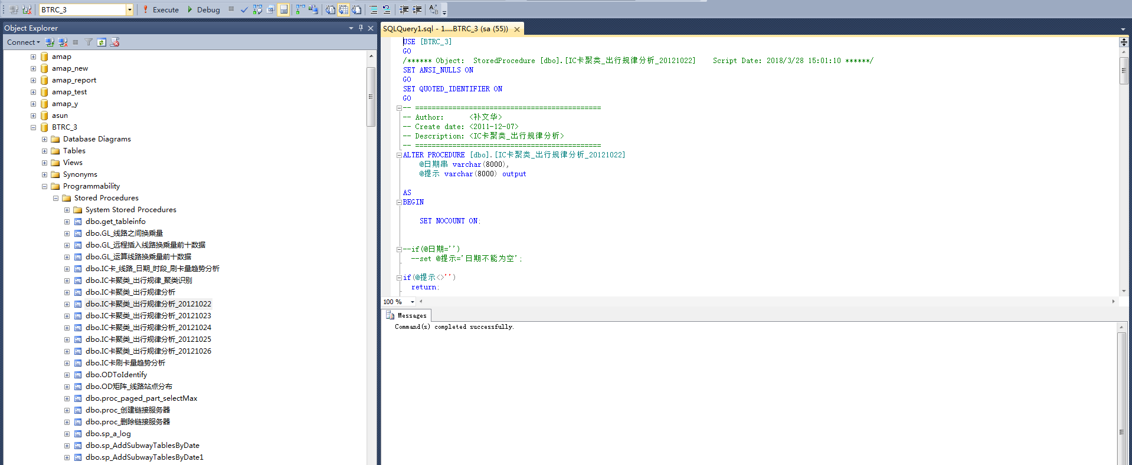
存储过程–示例
2020年12月18日
交通大数据分析
24

