Slide 1

The PAC Framework
《机器学习》课件

Slide 2
Ch5 Computational Learning Theory
Introduction
Probably Learning
Sample Complexity for Finite Hypothesis Spaces
Sample Complexity for Infinite Hypothesis Spaces
Mistake Bound Model, only for interested reader

Slide 3
Introduction
Problem setting:
  Inductively learning an unknown target function, given training examples and a hypothesis space
Focus on:
  How many training examples are sufficient?
  How many mistakes will the learner make before succeeding?

Slide 4
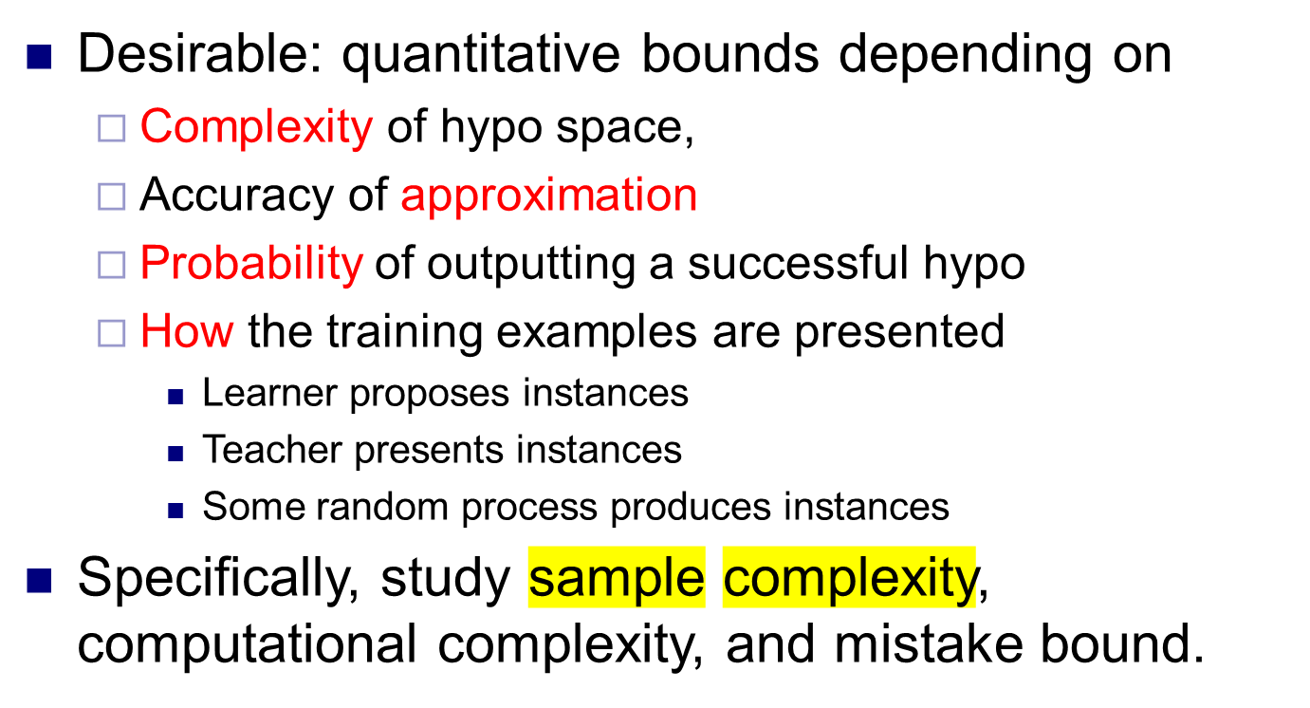
Introduction (2)
Notes:
Focus on broad class of algorithms rather than individual ones

Slide 5
Ch5 Computational Learning Theory
Introduction
PAC Learning model
Sample Complexity for Finite Hypothesis Spaces
Sample Complexity for Infinite Hypothesis Spaces
Mistake Bound Model

Slide 6
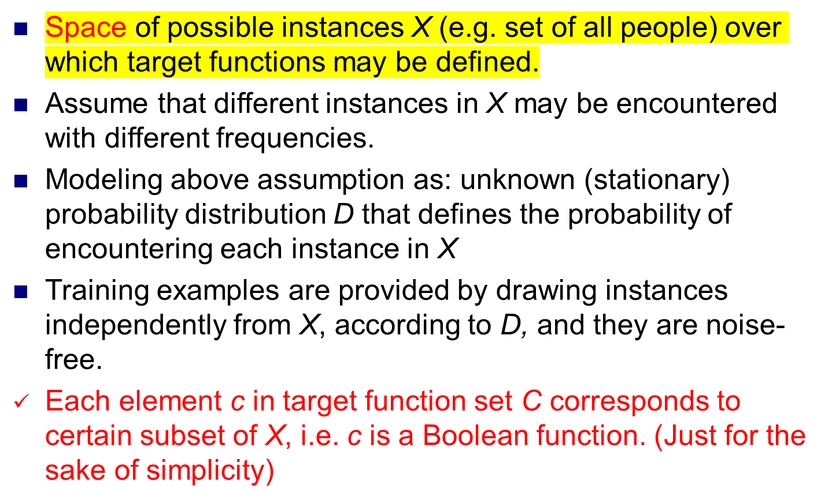
Problem Setting
Notes:
Worst case analysis

Slide 7
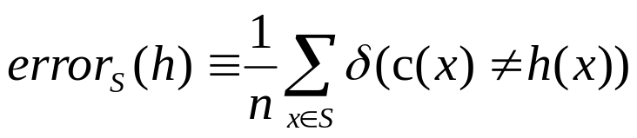
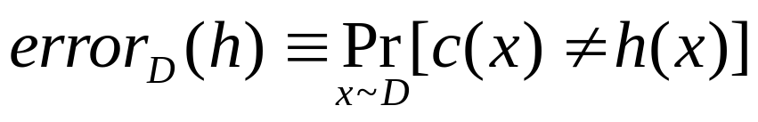
Error of a Hypothesis
Training error of hypo h w.r.t. target function c and training data set S of n sample is
True error of hypo h w.r.t. target function c and distribution D is
error_{D}(h) is not observable, so how probable is it that error_{S}(h) gives a misleading estimates of error_{D}(h)?
  Different from problem setting, where samples are drawn independently from h, here h depends on training samples.
Notes:
H should be discrete-valued

Slide 8
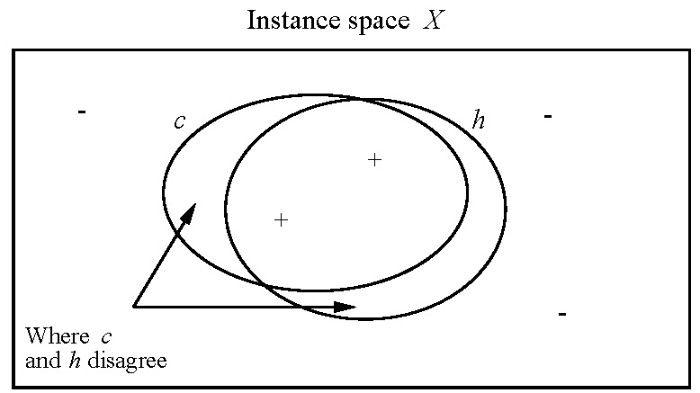
An Illustration of True Error

Slide 9
PAC Learnability
PAC refers to Probably Approximately Correct
It is desirable that error_{D}(h) to be zero, however, to be realistic, we weaken our demand in two ways:
  error_{D}(h) is to be bounded by a small number ε
  Learner is not required to success on every training sample, rather that its probability of failure is to be bounded by a constant δ.
Hence we come up with the idea of “Probably Approximately Correct”

Slide 10
PAC-Learnable
Def. Consider concept class C defined over instance space X of cardinality n and a learner L using hypo space H. C is PAC-learnable by L using H if for all c in C, distribution D over X, and ε & δ in (0,0.5), L will with probability at least 1-δ output a hypo h s.t. error_{D}(h)≤ ε, in time that is polynomial in 1/ε, 1/δ, n, and size(c), the coding length of c in C.
Notes:
PAC-learnable: first learn from poly number of examples, then per-example processing time…
Arbitrarily small?

Slide 11
Ch5 Computational Learning Theory
Introduction
Probably Learning
Sample Complexity for Finite Hypothesis Spaces
Sample Complexity for Infinite Hypothesis Spaces
Mistake Bound Model

Slide 12
Sample Complexity for Finite Hypothesis Spaces
Start from a good class of learner—consistent learner, defined as one that outputs a hypo which perfectly fits the training data set, whenever possible.
Recall: Version space VS_{H,D} is defined to be the set of all hypo h∈H that correctly classify all training examples of D.
Property. Every consistent learner outputs a hypo belonging to version space.
Notes:
Why say “whenever possible”?

Slide 13
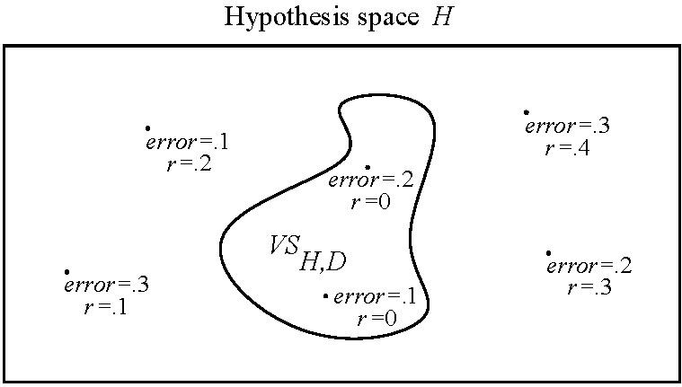
ε-exhausted
Correctly classify all training examples
Def. VS_{H,D} is said to be ε-exhausted w.r.t. c and D if for any h in VS_{H,D}, error_{D}(h)<ε.

Slide 14
ε-exhausting the Version Space
Theorem. If hypo space H is finite, and D is a sequence of m independent randomly drawn examples of some target concept c, then for any 0≤ε≤1, the probability that VS_{H,D} is not ε-exhausted w.r.t. c is no more than |H|e ^{-εm}.
Basic idea behind the proof: Since H is finite, we can enumerate hypotheses in VS_{H,D} by h₁, h₂, …h_{k}. VS_{H,D} is not ε-exhausted iff at least one of these h_{i} satisfies error_{D}(h)≥ε, however, such h_{i} perfectly fits the m number of training examples …

Slide 15
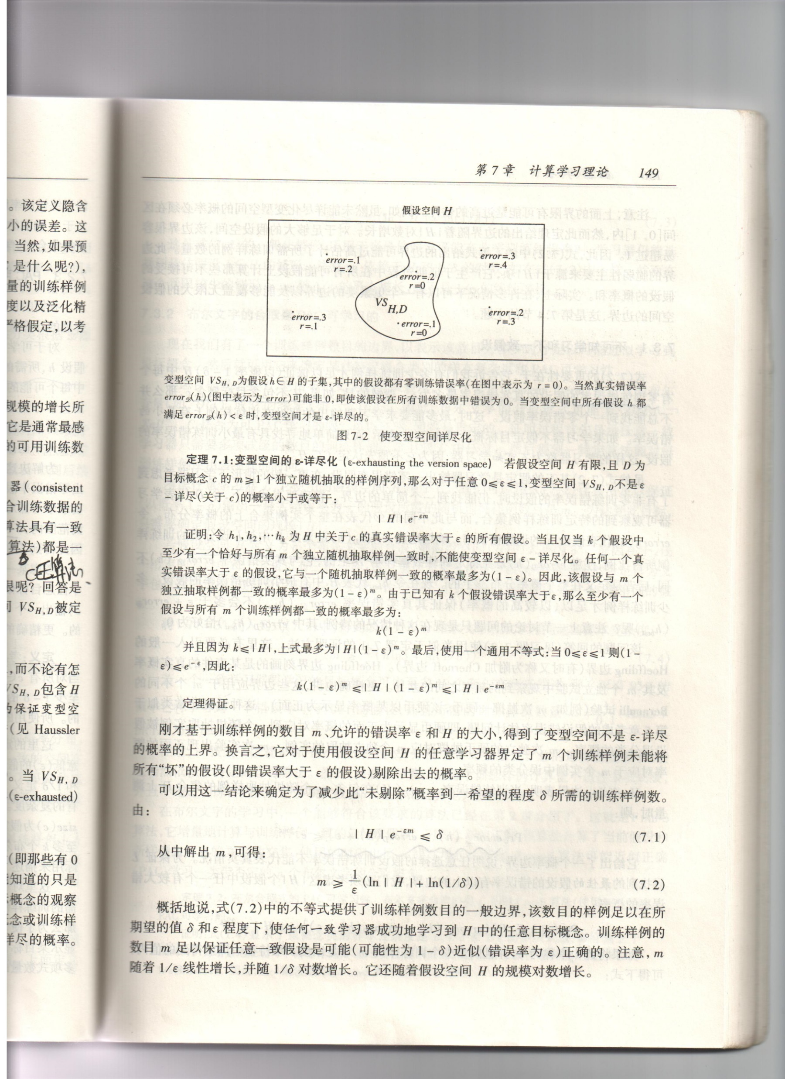
ε-exhausting the Version Space
Theorem 5.1 If hypo space H is finite, and D is a sequence of m independent randomly drawn examples of some target concept c, then for any 0≤ε≤1, the probability that VS_{H,D} is not ε-exhausted w.r.t. c is no more than |H|e ^{-εm}.
Basic idea behind the proof: Since H is finite, we can enumerate hypotheses in VS_{H,D} by h₁, h₂, …h_{k}. VS_{H,D} is not ε-exhausted iff at least one of these h_{i} satisfies error_{D}(h)≥ε, however, such h_{i} perfectly fits the m number of training examples …

Slide 16
Contd
The Theorem bounds the probability that m number of training examples fail to eliminate all “bad” hypotheses.
If we want the upper bound to be no more than δ, and we solve the resulting inequality for m, it follows that m≥(1/ε)(ln|H|+ln(1/δ)).
Such m number of training examples are sufficient to guarantee that any consistent hypo will be probably (with probability 1-δ) approximately correct (with error less than ε).
Notes:
m increases linearly …
The bound could be significantly over-estimated!

Slide 17
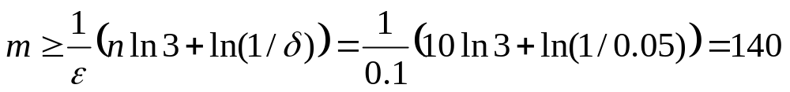
布尔文字的合取是PAC可学习的
我们已经有了一个训练样例数目的边界，表示样本数目为多少时才足以可能近似学习到目标概念，现在用它来确定某些特定概念类别的样本复杂度和PAC可学习性
考虑目标概念类C，它由布尔文字的合取表示。布尔文字是任意的布尔变量，或它的否定。问题：C是可PAC学习的吗？
若假设空间H定义为n个布尔文字的合取，则假设空间|H|的大小为3^{n}，得到关于n布尔文字合取学习问题的样本复杂度

Slide 18
布尔文字的合取是PAC可学习的（2）
定理7.2：布尔合取式的PAC可学习性
  布尔文字合取的类C是用Find-S算法PAC可学习的
证明：
  式7.4显示了该概念类的样本复杂度是n、1/δ和1/ε的多项式级，而且独立于size(c)。为增量地处理每个训练样例，Find-S算法要求的运算量根据n线性增长，并独立于1/δ、1/ε和size(c)。因此这一概念类别是Find-S算法PAC可学习的。

Slide 19
A PAC-Learnable Example
Consider class C of conjunction of boolean literals.
  A boolean literal is any boolean variable or its negation
Q: Is such C PAC-learnable?
A: Yes, by going through the following two steps:
  Show that any consistent learner will require only a polynomial number of training examples to learn any element of C
  Suggest a specific algorithm that use polynomial time per training example.

Slide 20
Contd
Step1:
Let H consists of conjunction of literals based on n boolean variables.
Now take a look at m≥(1/ε)(ln|H|+ln(1/δ)), observe that |H|=3^{n}, then the inequality becomes m≥(1/ε)(nln3+ln(1/δ)).
Step2:
FIND-S algorithm satisfies the requirement
  For each new positive training example, the algorithm computes intersection of literals shared by current hypothesis and the example, using time linear in n

Slide 21
Example:
Number of Instances Needed
  Assume
  F = 100 binary features
  H = all (pure) conjuncts
  [3^{F} possibilities (∀i, use f_{i}, use ¬f_{i}, or ignore f_{i})
  so lg|H| = F * lg 3 ≈ F]
  ε = 0.01
  δ = 0.01
  N = [ln(1/δ)+ln(|H|)] / ε = 100 * [ln(100) + 100] ≈ 10⁴
  But how many real-world concepts are pure conjuncts
  with noise-free training data?

Slide 22
Contd
Conclusion: Conjunctions of boolean literals are PAC-learnable.

Slide 23
Computational Learning Theory
Introduction
Probably Learning
Sample Complexity for Finite Hypothesis Spaces
Sample Complexity for Infinite Hypothesis Spaces
Mistake Bound Model
Notes:
First, go back to the example of using FIND-S to show that “conjunctions of boolean literals are PAC-learnable”.

Slide 24
Limitation of Theorem
Quite weak bound (can easily be greater than 1 if cardinality of H is large enough!)
H must be finite
Introduce a new measure—Vapnik Chervonenkis dimension of H, or VC dimension.
Rough idea of VC: it measures complexity of H by the number of distinct instances from X that can be completely discriminated using H

Slide 25
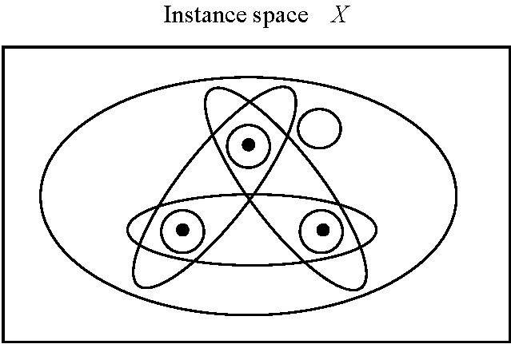
Shattering a Set of Instances
Def. A dichotomy of a set S is a partition of S into two disjoint subsets
Def. A set of instances S is shattered by hypo space H iff for every dichotomy of S, there exists some hypo in H consistent with this dichotomy.
3 instances shattered

Slide 26
VC Dimension
Motivation: What if H can’t shatter X? Try finite subsets of X.
Def. VC dimension of hypo space H defined over instance space X is the size of largest finite subset of X shattered by H. If any arbitrarily large finite subsets of X can be shattered by H, then VC(H)≡∞
Roughly speaking, VC dimension measures how many (training) points can be separated for all possible labeling using functions of a given class.

Slide 27
An Example: Linear Decision Surface
Line case: X=real number set, and H=set of all open intervals, then VC(H)=2.
Plane case: X=xy-plane, and H=set of all linear decision surface of the plane, then VC(H)=3.
General case: For n-dim real-number space, let H be its linear decision surface, then VC(H)=n+1.

Slide 28
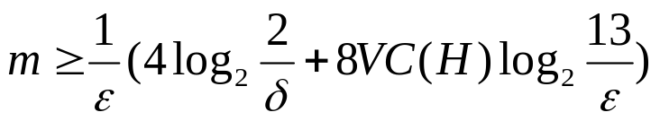
Sample Complexity from VC Dimension
How many randomly drawn examples suffice to ε-exhaust VS_{H,D} with probability at least 1-δ?
(Blumer et al. 1989)
Furthermore, it is possible to obtain a lower bound on sample complexity (i.e. minimum number of required training samples)

Slide 29
Lower Bound on Sample Complexity
Theorem 5.2 (Ehrenfeucht et al. 1989) Consider any concept class C s.t. VC(C)≥2, any learner L, and any 0<ε<1/8, and 0<δ<1/100. Then there exists a distribution D and target concept in C s.t. if L observes fewer examples than
max[(1/ε)log(1/δ), (VC(C)-1)/(32ε)], then with probability at least δ, L outputs a hypo h having error_{D}(h)>ε.

Slide 30
神经网络的VC维
本节给出一般性的结论，以计算分层无环网络的VC维。这个VC维可用于界定训练样例的数量，该数达到多大才足以按照希望的ε和δ值近似可能正确地学习一个前馈网络
考虑一个由单元组成的网络G，它形成一个分层有向无环图
  分层有向无环图的特点：
    节点可划分成层，即所有第l层出来的有向边进入到第l+1层节点
    没有有向环，即有向弧形成的回路
  这样网络的VC维的界定可以基于其图的结构和构造该图的基本单元的VC维

Slide 31
神经网络的VC维（2）
定义一些术语
  G表示神经网络
  n是G的输入数目
  G只有1个输出节点
  G的每个内部单元Ni最多有r个输入，并实现一布尔函数c_{i}:R^{r}→{0,1}，形成函数类C
定义C的G-合成：网络G能实现的所有函数的类，即网络G表示的假设空间，表示成C_{G}

Slide 32
神经网络的VC维（3）
定理7.4分层有向无环网络的VC维（Kearns & Vazirani 1994）
  令G为一分层有向无环图，有n个输入节点和s≥2个内部节点，每个至少有r个输入，令C为VC维为d的R^{r}上的概念类，对应于可由每个内部节点s描述的函数集合，令C_{G}为C的G合成，对应于可由G表示的函数集合，则VC(C_{G})<=2dslog(es)

Slide 33
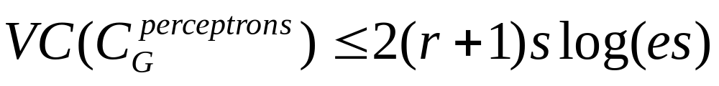
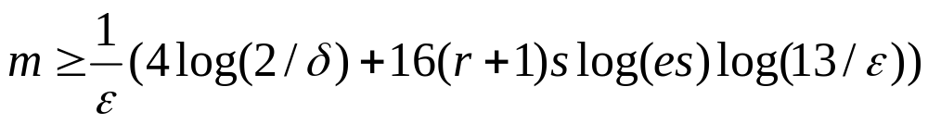
神经网络的VC维（4）
假定要考虑的分层有向无环网络中单个节点都是感知器，由于单独的r输入感知器VC维为r+1，得到
上面的结果不能直接应用于反向传播的网络，原因有两个：
  此结果应用于感知器网络，而不是sigmoid单元网络
  不能处理反向传播中的训练过程

Slide 34
Ch5 Computational Learning Theory
Introduction
Probably Learning
Sample Complexity for Finite Hypothesis Spaces
Sample Complexity for Infinite Hypothesis Spaces
Mistake Bound Model

Slide 35
Recall: Introduction of this Chapter
Problem setting in Ch5:
  Inductively learning an unknown target function, given training examples and a hypothesis space
Focus on:
  How many training examples are sufficient?
  How many mistakes will the learner make before succeeding?

Slide 36
Summary
Problem setting in Ch5:
  Inductively learning an unknown target function, given training examples and a hypothesis space
Focus on:
  How many training examples are sufficient?
    PAC-learning model (probably approximately), VC dimension for infinite hypo space
  How many mistakes will the learner make before succeeding?
    Mistake bound, optimal mistake bound

