Slide 1


Last-Mile Delivery Made Practical:
An Efficient Route Planning Framework with Theoretical Guarantees
Yuxiang Zeng ¹, Yongxin Tong ², Lei Chen ¹
¹ The Hong Kong University of Science and Technology
² Beihang University

Slide 2
Outline
Background
Problem Statement
Our Solution
Experiments
Conclusions

Slide 3
Last-Mile Delivery (LMD) Problem
LMD refers to the movement of goods from transportation origins to the final destinations [1].
  [1] Huaxia Xia et al., Is last-mile delivery a ’killer app’ for self-driving vehicles?, In Communications of the ACM 2018.

Slide 4
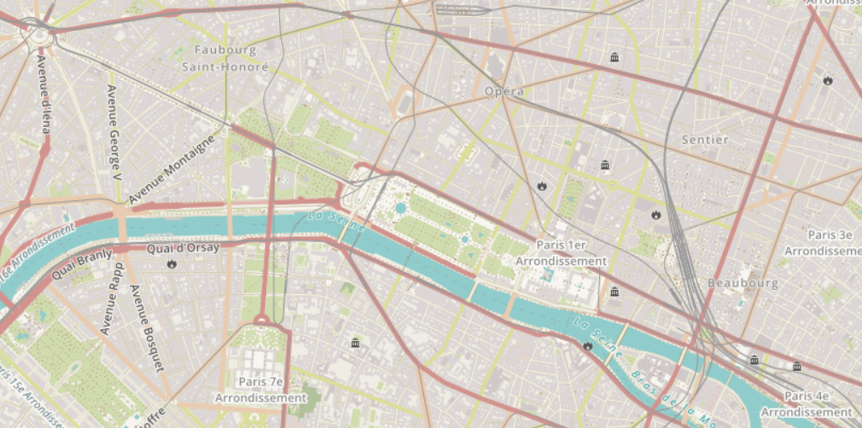


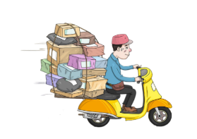


Last-Mile Delivery (LMD) Problem
LMD refers to the movement of goods from transportation origins to the final destinations [1].
seller
customer

Slide 5





Last-Mile Delivery (LMD) Problem
LMD refers to the movement of goods from transportation origins to the final destinations [1].
factory
warehouse

Slide 6





Last-Mile Delivery (LMD) Problem
LMD refers to the movement of goods from transportation origins to the final destinations [1].
restaurant
residence
  How to plan routes among the couriers and requests
  is a fundamental challenge in LMD.

Slide 7



Last-Mile Delivery (LMD) Problem
Route planning based on different objectives
  For couriers: minimize the travel time
  For requesters: minimize the waiting time (latency)
  However, these problems are often hard (NP/APX-hard).

Slide 8
Existing Work: Limitations
Existing work trades off between two goals
  Focus on one goal and neglect the other [1,2]
  Focus on a weighted combination of two goals [3]
Definition of ``Trade-off’’: a situation in which you accept something bad in order to have something good.
In Cambridge Dictionary
  [1] Y. Tong et al., A unified approach to route planning for shared mobility, In VLDB 2018.
  [2] H. A. Waisanen et al., A dynamic pickup and delivery problem in mobile networks under information constraints, In IEEE Trans. Autom. Control. 2006.
  [3] Timo Gschwind et al., Adaptive Large Neighborhood Search with a Constant-Time Feasibility Test for the Dial-a-Ride Problem. In Transportation Science 2019.

Slide 9


Existing Work: Limitations
Existing work trades off between two goals
  Focus on one goal and neglect the other [1,2]
  Focus on a weighted combination of two goals [3]
They have no theoretical guarantees and are not effective on either goal (see the results later.)
  Both requesters and couriers should be satisfied by one route plan.
  Thus, do we have to sacrifice one goal for the other goal?

Slide 10
Outline
Background
Problem Statement
Our Solution
Experiments
Conclusions

Slide 11
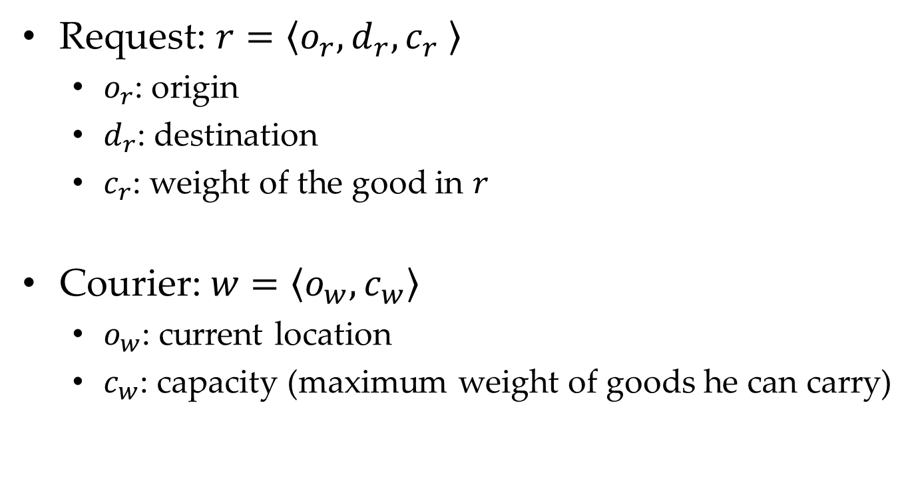
Basic Concepts: Request & Courier
Request: $r=\left\langle o_{r},d_{r}, c_{r} \right\rangle$
  $o_{r}$: origin
  $d_{r}$: destination
  $c_{r}$: weight of the good in $r$
Courier:$w=\left\langle o_{w},c_{w}\right\rangle$
  $o_{w}$: current location
  $c_{w}$: capacity (maximum weight of goods he can carry)

Slide 12

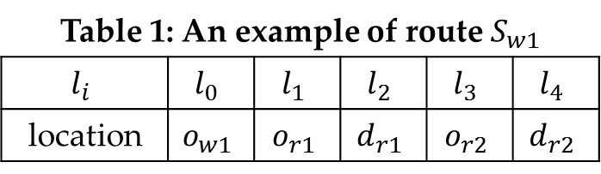
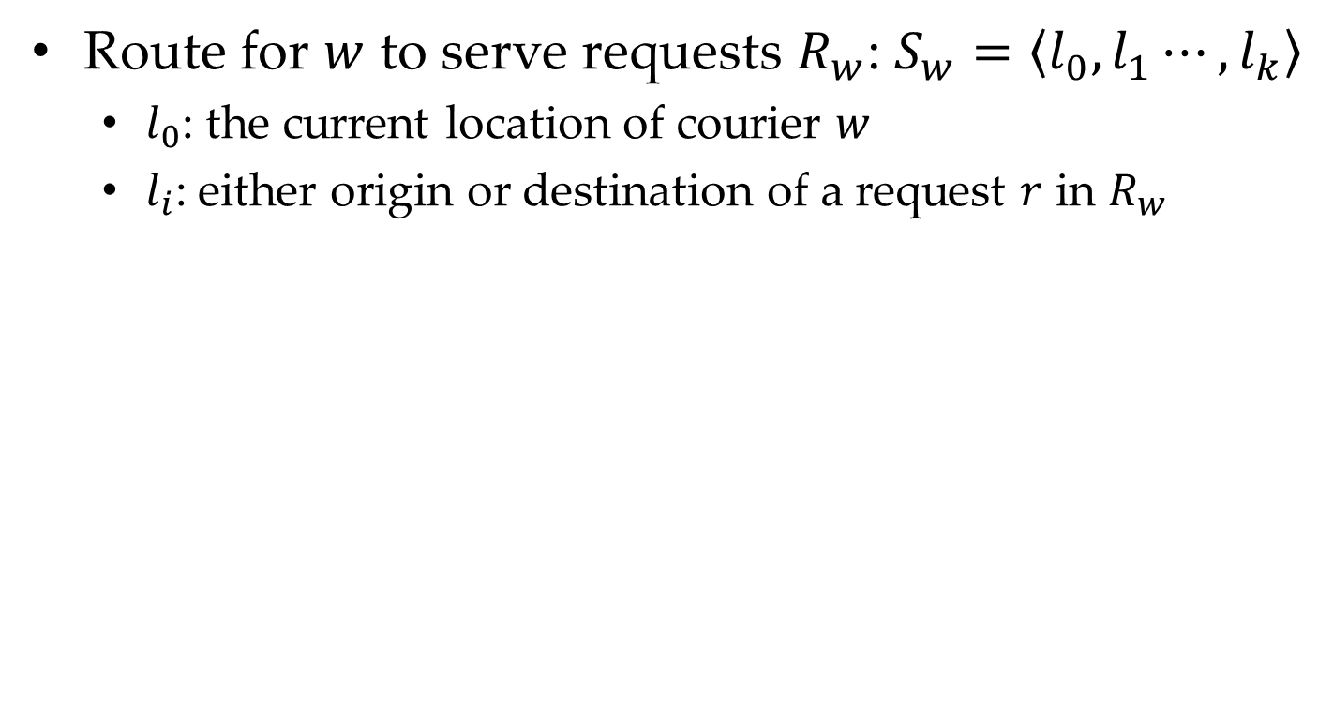








Basic Concepts: Route
1
r1’s origin
1
r1’s destination
1
w1’s location
Route for $w$ to serve requests $R_{w}$: $S_{w}=\left\langle l_{0},l_{1}⋯,l_{k}\right\rangle$
  $l_{0}\text{: }$the current location of courier $w$
  $l_{i}\text{:}$ either origin or destination of a request $r$ in $R_{w}$
$$Y$$
Table 1: An example of route $S_{w1}$
$$l_{i}$$ | $$l_{0}$$ | $$l_{1}$$ | $$l_{2}$$ | $$l_{3}$$ | $$l_{4}$$
location | $$o_{w1}$$ | $$o_{r1}$$ | $$d_{r1}$$ | $$o_{r2}$$ | $$d_{r2}$$
$$6$$
2
$$4$$
1
2
$$2$$
1
1
$$X$$
$$0$$
$$2$$
$$4$$
$$6$$

Slide 13
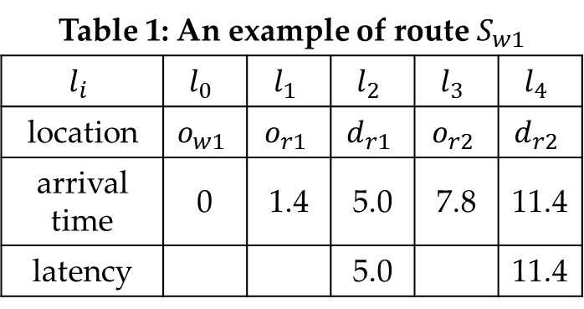
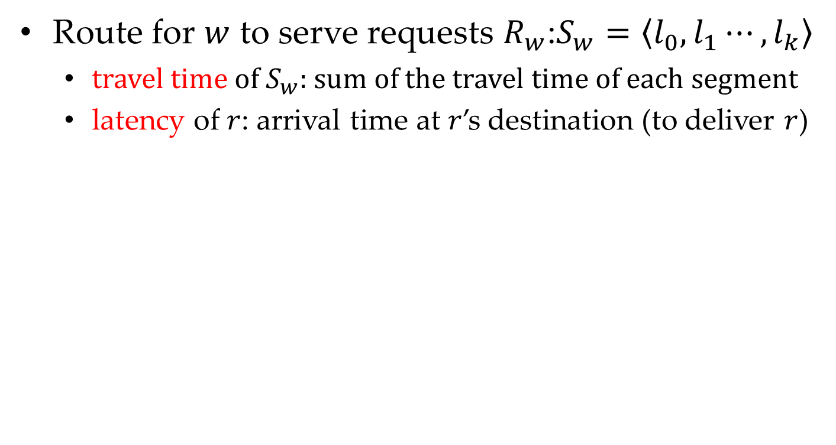
Basic Concepts: Route
1
r1’s origin
1
r1’s destination
1
w1’s location
Route for $w$ to serve requests $R_{w}$:$S_{w}=\left\langle l_{0},l_{1}⋯,l_{k}\right\rangle$
  travel time of $S_{w}$: sum of the travel time of each segment
  latency of $r$: arrival time at $r$’s destination (to deliver $r$)
$$Y$$
Table 1: An example of route $S_{w1}$
$$l_{i}$$ | $$l_{0}$$ | $$l_{1}$$ | $$l_{2}$$ | $$l_{3}$$ | $$l_{4}$$
location | $$o_{w1}$$ | $$o_{r1}$$ | $$d_{r1}$$ | $$o_{r2}$$ | $$d_{r2}$$
arrival time | 0 | 1.4 | 5.0 | 7.8 | 11.4
latency |  |  | 5.0 |  | 11.4
$$6$$
2
3.6
2.8
$$4$$
1
2
3.6
$$2$$
1.4
1
  Travel time of $S_{w1}$ is 11.4; latency of r1/r2 is 5.0/11.4
1
$$X$$
$$0$$
$$2$$
$$4$$
$$6$$

Slide 14




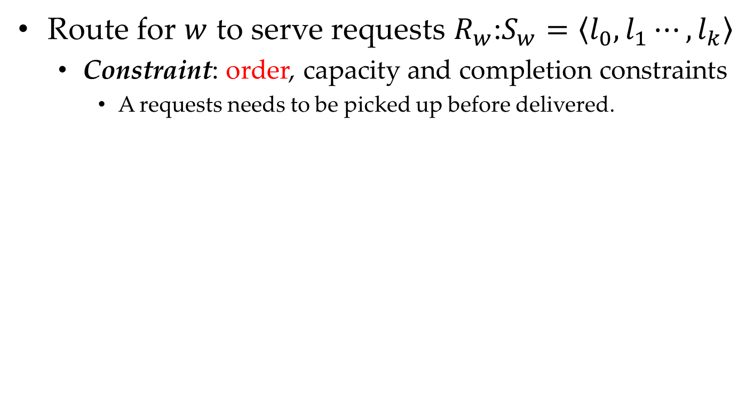







Basic Concepts: Route
1
r1’s origin
1
r1’s destination
1
w1’s location
Route for $w$ to serve requests $R_{w}$:$S_{w}=\left\langle l_{0},l_{1}⋯,l_{k}\right\rangle$
  Constraint: order, capacity and completion constraints
    A requests needs to be picked up before delivered.
a request origin
must lie ahead of
its destination
$$Y$$
$$Y$$
$$6$$
2
$$6$$
2
$$4$$
1
2
$$4$$
1
2
$$2$$
$$2$$
1
1
1
$$X$$
1
$$X$$
$$0$$
$$2$$
$$4$$
$$6$$
$$0$$
$$2$$
$$4$$
$$6$$

Slide 15

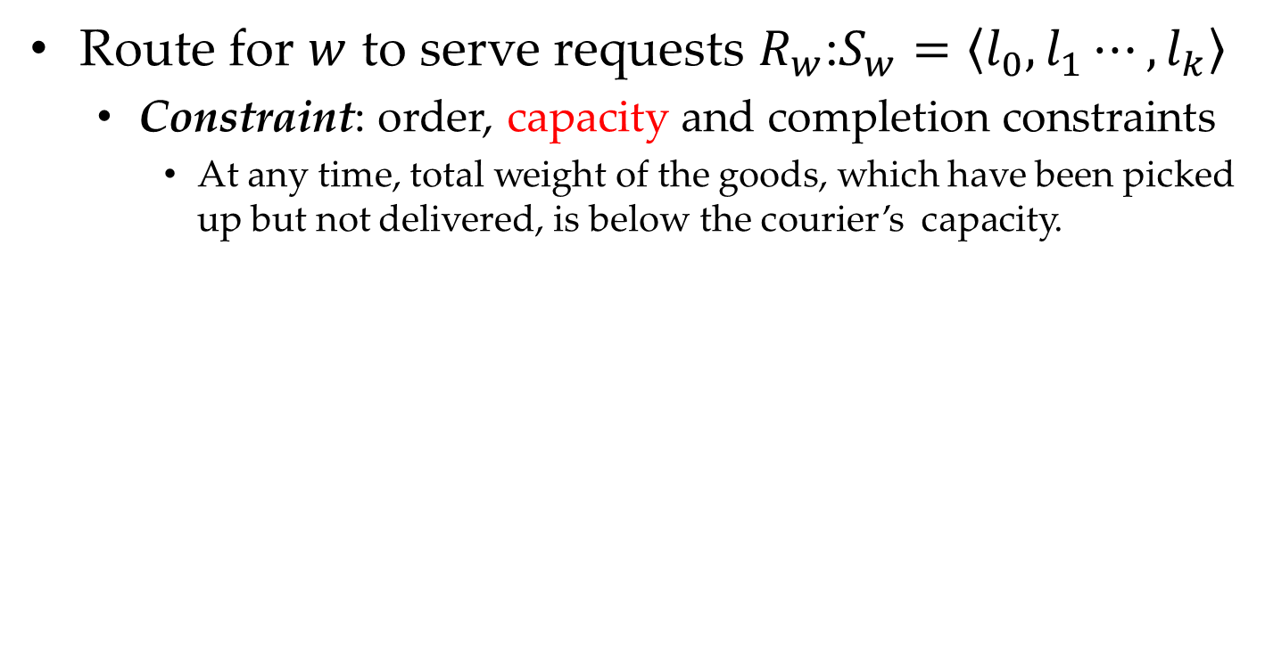








Basic Concepts: Route
1
r1’s origin
1
r1’s destination
1
w1’s location
Route for $w$ to serve requests $R_{w}$:$S_{w}=\left\langle l_{0},l_{1}⋯,l_{k}\right\rangle$
  Constraint: order, capacity and completion constraints
    At any time, total weight of the goods, which have been picked up but not delivered, is below the courier’s capacity.
$$Y$$
The total weight is 1.
$$Y$$
If w1’s capacity is 1,
the total weight (2) is
larger than the capacity.
$$6$$
2
$$6$$
2
$$4$$
1
2
$$4$$
1
2
the total weight is 0,
since r1 is delivered.
$$2$$
$$2$$
1
1
1
$$X$$
1
$$X$$
$$0$$
$$2$$
$$4$$
$$6$$
$$0$$
$$2$$
$$4$$
$$6$$

Slide 16
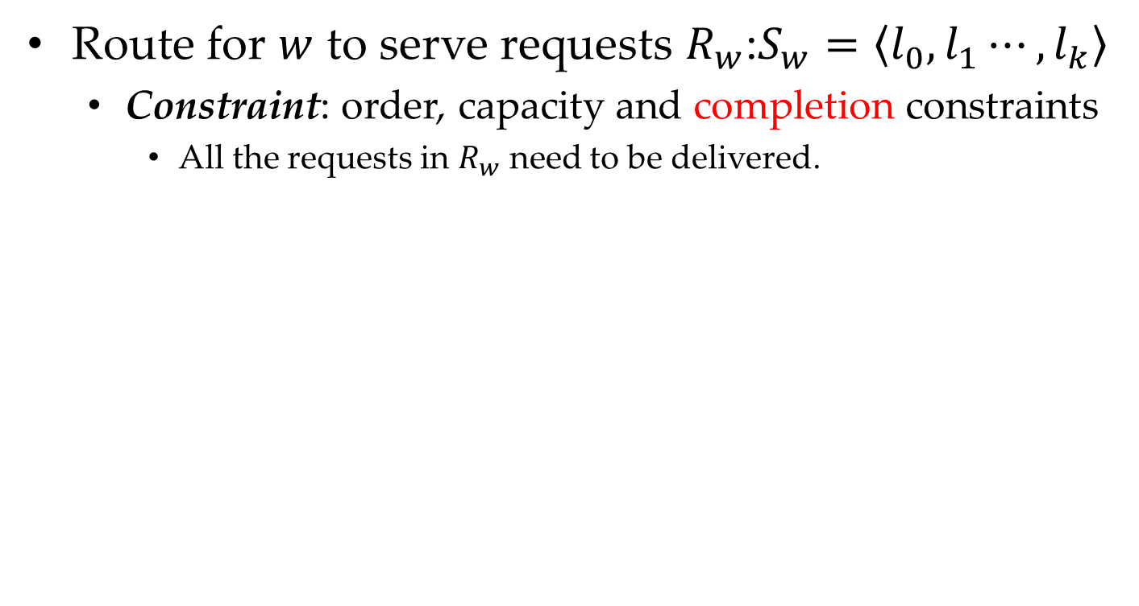
Basic Concepts: Route
1
r1’s origin
1
r1’s destination
1
w1’s location
Route for $w$ to serve requests $R_{w}$:$S_{w}=\left\langle l_{0},l_{1}⋯,l_{k}\right\rangle$
  Constraint: order, capacity and completion constraints
    All the requests in $R_{w}$ need to be delivered.
$$Y$$
$$Y$$
$$6$$
2
$$6$$
2
r2 is not delivered
$$4$$
1
2
$$4$$
1
2
$$2$$
$$2$$
1
1
1
$$X$$
1
$$X$$
$$0$$
$$2$$
$$4$$
$$6$$
$$0$$
$$2$$
$$4$$
$$6$$

Slide 17
Problem Definition: LMD problem
Given:
  Requests R and couriers W,
Goal: plan routes to simultaneously minimize
  Makespan (aka maximum travel time) of all couriers
  Total latency (aka waiting time) of all requesters
Constraints:
  Each route is feasible.
  All the requestes are delivered.
  Considering either goal, LMD is NP-hard and APX-hard.

Slide 18



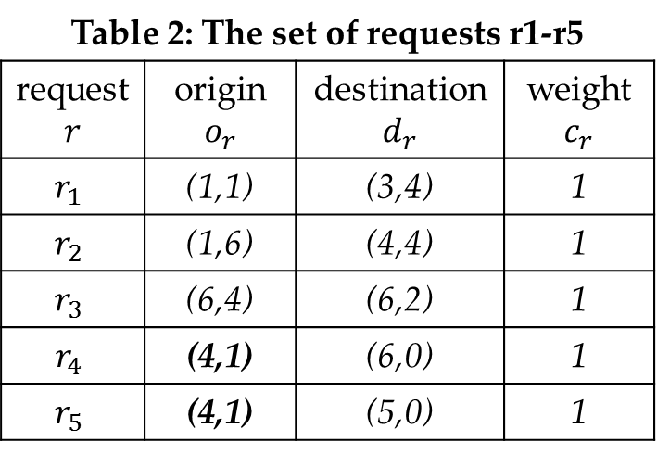






A Toy Example of LMD Problem
2 couriers (each with capacity 3) and 5 requests
1
r1’s origin
1
r1’s destination
$$Y$$
$$6$$
2
1
w1’s location
Table 2: The set of requests r1-r5
request $$r$$ | origin $$o_{r}$$ | destination $$d_{r}$$ | weight $$c_{r}$$
$$r_{1}$$ | (1,1) | (3,4) | 1
$$r_{2}$$ | (1,6) | (4,4) | 1
$$r_{3}$$ | (6,4) | (6,2) | 1
$$r_{4}$$ | (4,1) | (6,0) | 1
$$r_{5}$$ | (4,1) | (5,0) | 1
$$4$$
1
2
3
$$2$$
3
4
1
5
5
4
1
2
$$X$$
$$0$$
$$2$$
$$4$$
$$6$$

Slide 19
Outline
Background
Problem Statement
Our Solution
Experiments
Conclusions

Slide 20

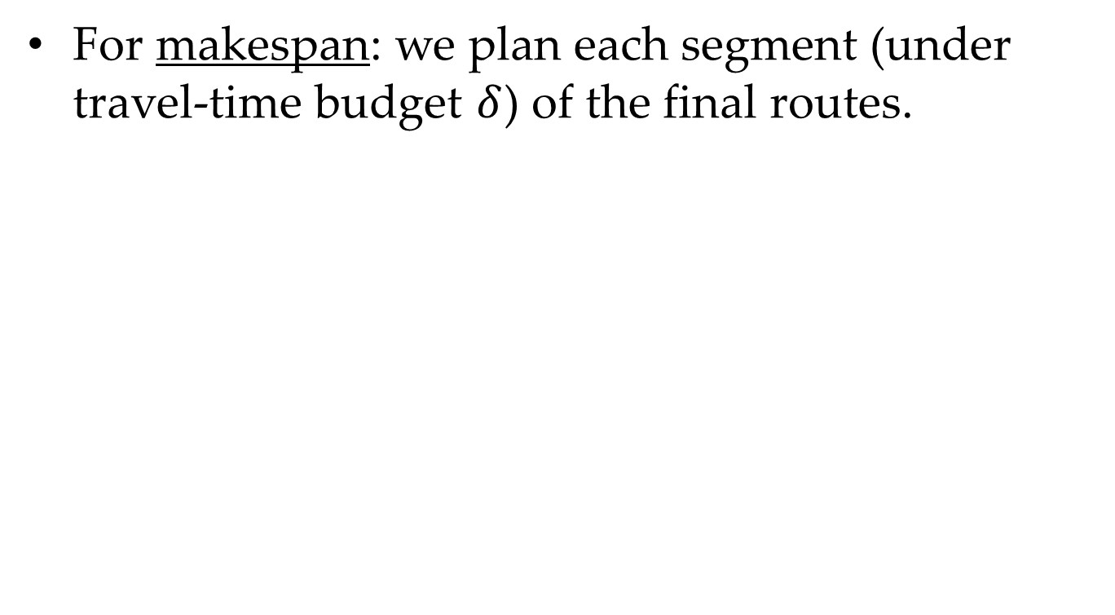


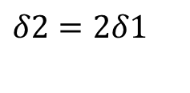

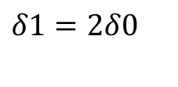



Framework: Main Idea
For makespan: we plan each segment (under travel-time budget $δ$) of the final routes.
1
w1’s location
a segment of route
$$δ0$$
$$δ1=2δ0$$
$$δ2=2δ1$$
1
$$δ0$$
$$δ1=2δ0$$
$$δ2=2δ1$$
2
$$δ0$$
$$δ1=2δ0$$
$$δ2=2δ1$$
3

Slide 21

Framework: Main Idea
For makespan: we plan each segment (under travel-time budget 𝛿) of the final routes.
For total latency: we deliver as many requests as possible in each segment.
under $δ$
1
2
3
4
1
1
2
3
1
2
4
1
3
4

Slide 22

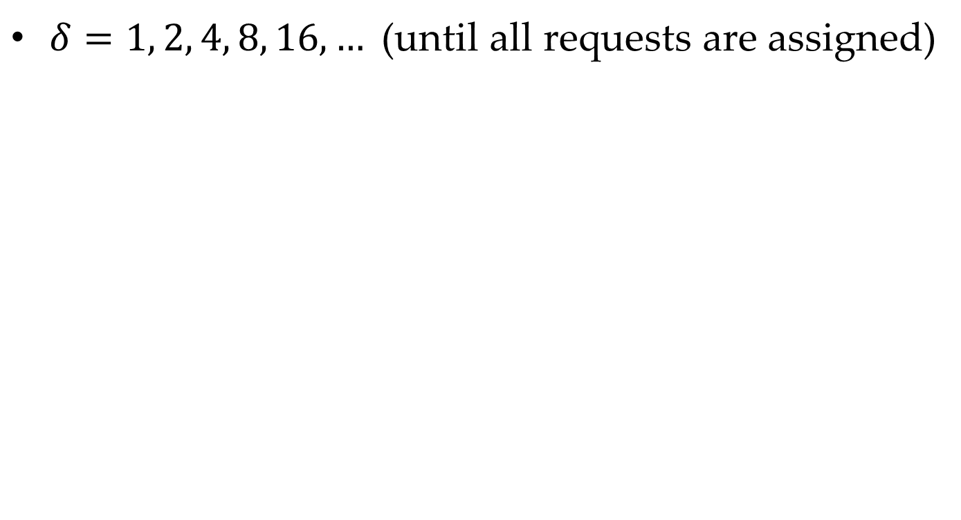
Framework: Illustrations
1
r1’s origin
1
r1’s destination
1
w1’s location
$δ=1, 2, 4, 8, 16, …$ (until all requests are assigned)
$$Y$$
$$6$$
2
$$4$$
1
2
3
3.6
$$2$$
3
4
1.4
1
3.2
5
1.4
5
4
1
2
$$X$$
$$0$$
$$2$$
$$4$$
$$6$$
  When $δ=1, 2, 4$, w1 and w2 cannot deliver any request,
  since they need longer time than $δ$ to deliver the nearest requests.

Slide 23


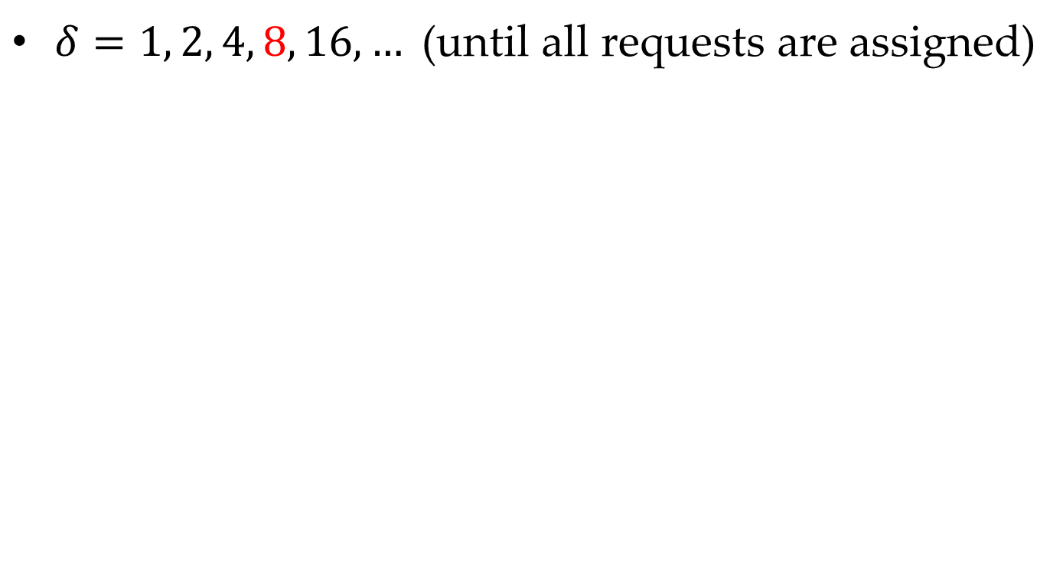








Framework: Illustrations
1
r1’s origin
1
r1’s destination
1
w1’s location
$δ=1, 2, 4, 8, 16, …$ (until all requests are assigned)
$$Y$$
$$6$$
2
$$4$$
1
2
3
1
1
1
3.6
$$2$$
3
4
4
2
5
5
4
1.4
1
3.2
5
1.4
1
$$X$$
1
2
5
4
$$0$$
$$2$$
$$4$$
$$6$$
  When $δ=8$, w1 can deliver r1 and w2 can deliver r4/r5.

Slide 24

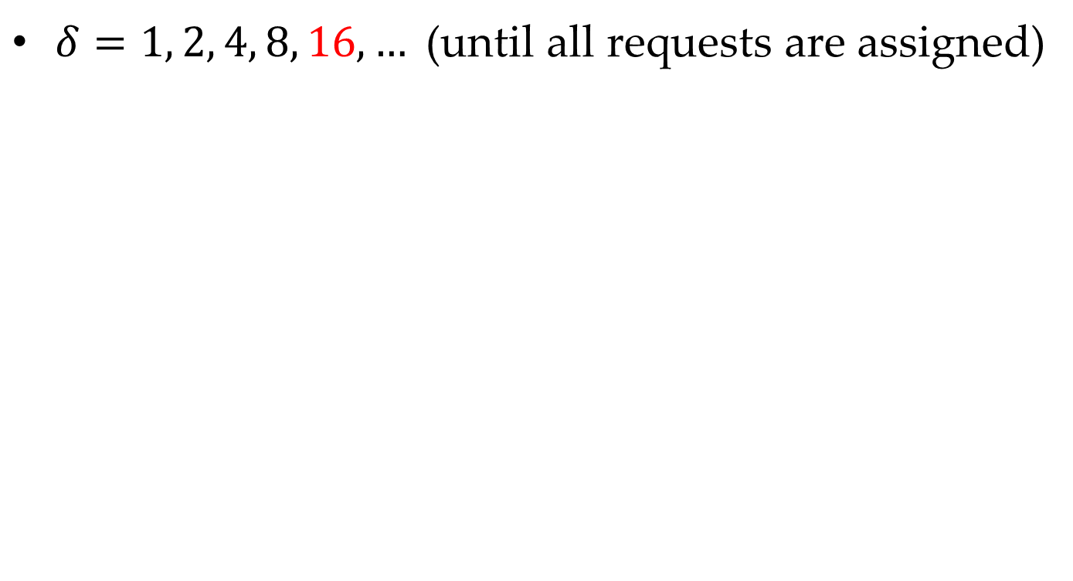
Framework: Illustrations
1
r1’s origin
1
r1’s destination
1
w1’s location
$δ=1, 2, 4, 8, 16, …$ (until all requests are assigned)
$$Y$$
$$6$$
2
3.6
$$4$$
2
2
3
6.1
2
1
2
2
3
3
$$2$$
3
5
$$X$$
1
2
4
$$0$$
$$2$$
$$4$$
$$6$$
  When $δ=16$, w1 can deliver r2/r3 (i.e., all the remaining requests).

Slide 25
Framework: Illustrations
1
r1’s origin
1
r1’s destination
1
w1’s location
$δ=1, 2, 4, 8, 16, …$ (until all requests are assigned)
$$Y$$
$$6$$
2
$$4$$
1
2
3
1
1
1
1
2
2
3
3
$$2$$
3
1
5
$$X$$
1
2
4
$$0$$
$$2$$
$$4$$
$$6$$
  To connect two segments, we use triangle inequality.

Slide 26
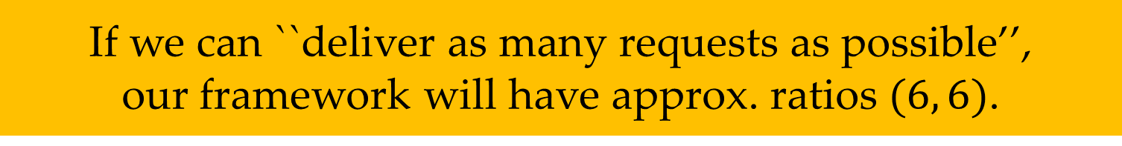
Framework: Illustrations
1
r1’s origin
1
r1’s destination
1
w1’s location
$δ=1, 2, 4, 8, 16, …$ (until all requests are assigned)
$$Y$$
$$6$$
2
$$4$$
1
2
3
1
1
1
2
2
3
3
$$2$$
3
4
4
2
5
5
4
1
5
5
$$X$$
5
4
1
2
4
$$0$$
$$2$$
$$4$$
$$6$$
  If we can ``deliver as many requests as possible’’,
  our framework will have approx. ratios $(6, 6)$.

Slide 27
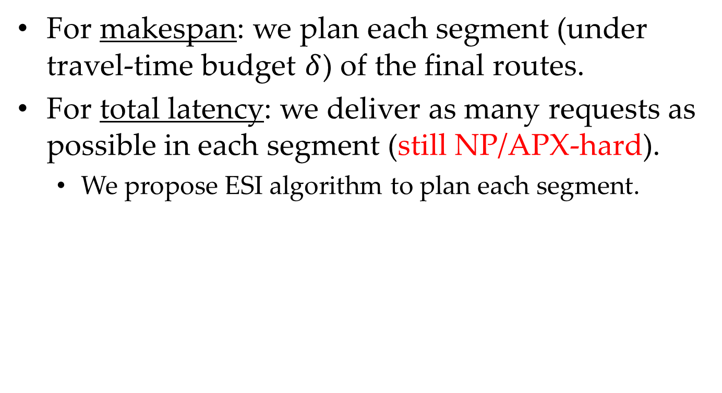
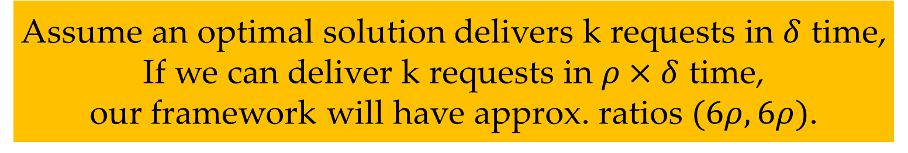
Framework: Main Idea
For makespan: we plan each segment (under travel-time budget $δ$) of the final routes.
For total latency: we deliver as many requests as possible in each segment (still NP/APX-hard).
  We propose ESI algorithm to plan each segment.
  Assume an optimal solution delivers k requests in $δ$ time,
  If we can deliver k requests in $ρ×δ$ time,
  our framework will have approx. ratios $(6ρ, 6ρ)$.

Slide 28
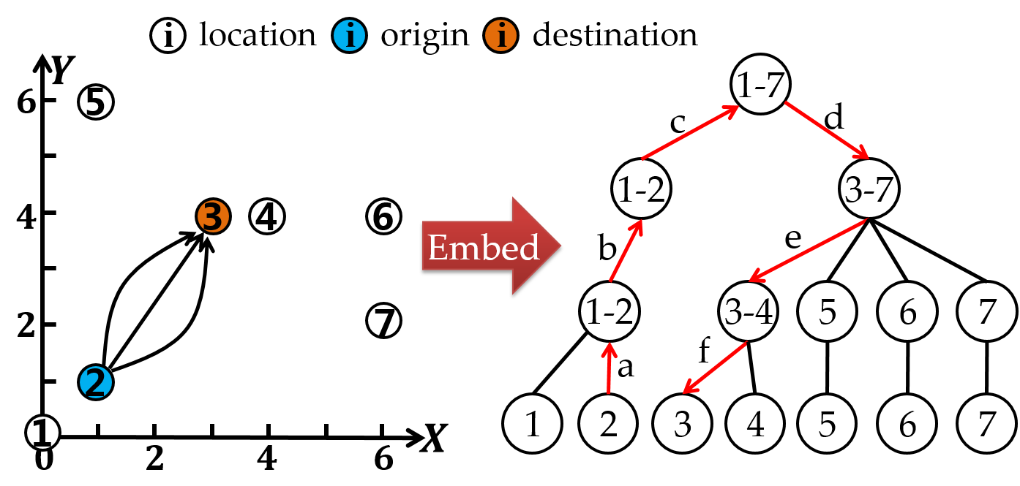
Plan Segments: Main Idea
ESI algorithm: Embed, Sort, Insertion
  Embed the locations into a tree-based metric HST and the (approx.) shortest paths into tree paths

Slide 29
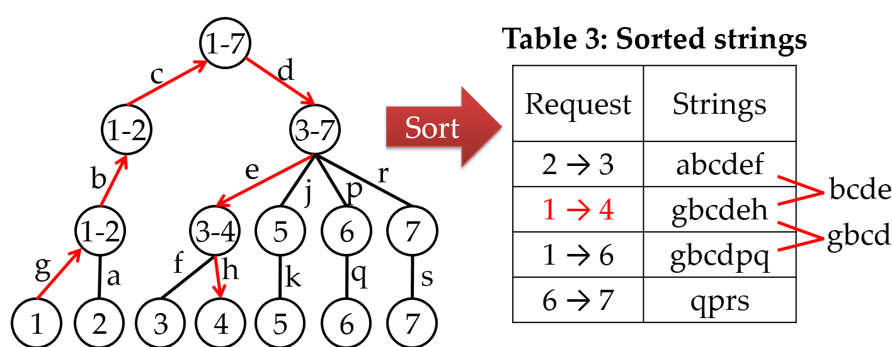
Plan Segments : Main Idea
ESI algorithm: Embed, Sort, Insertion
  Embed the locations into a tree-based metric HST and the (approx.) shortest paths into tree paths
  Sort the strings of the tree paths of each request

Slide 30
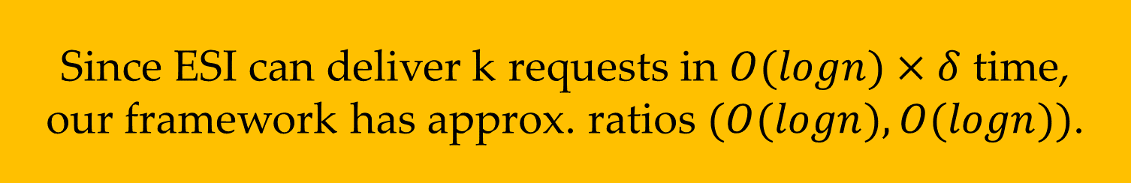
Plan Segments : Main Idea
ESI algorithm: Embed, Sort, Insertion
  Embed the locations into a tree-based metric HST and the (approx.) shortest paths into tree paths
  Sort the strings of the tree paths of each request
  Insert the requests based on the sorted order
  Since ESI can deliver k requests in $O(logn)×δ$ time,
  our framework has approx. ratios $(O(logn), O(logn))$.

Slide 31
Outline
Background
Problem Statement
Our Solution
Experiments
Conclusions

Slide 32


Experimental Setup
Datasets: synthetic and real datasets
  Real data 1: Cainiao, a logistic company in China, owned by Alibaba
  Real data 2: Olist, an online e-commerce company in Brazil
Table 4: Statistics of the real datasets
Real datasets | Number of requests | Number of couriers | Collected city
Cainiao | 238,636 | 1k~5k | Shanghai
Olist | 4,819 | 30~150 | Sao Paulo

Slide 33
Experimental Setup
Evaluation metrics:
  makespan: maximum travel time of the couriers
  total latency: total latency of the requests
  total travel time: total travel time of the couriers
  (total) running time and memory usage
Compared algorithms: 5 baselines
  GDP [1], TAC [2], eFOCS[3], ALNS[4], ALNS⁺[4]
  [1] Yongxin Tong et al., A unified approach to route planning for shared mobility, In VLDB 2018.
  [2] H. A. Waisanen et al., A dynamic pickup and delivery problem in mobile networks under information constraints, In IEEE Trans. Autom. Control. 2006.
  [3] Moses Charikar et al., The finite capacity dial-a-ride problem, In FOCS 1998.
  [4] Timo Gschwind et al., Adaptive Large Neighborhood Search with a Constant-Time Feasibility Test for the Dial-a-Ride Problem. In Transportation Science 2019.

Slide 34
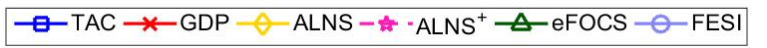
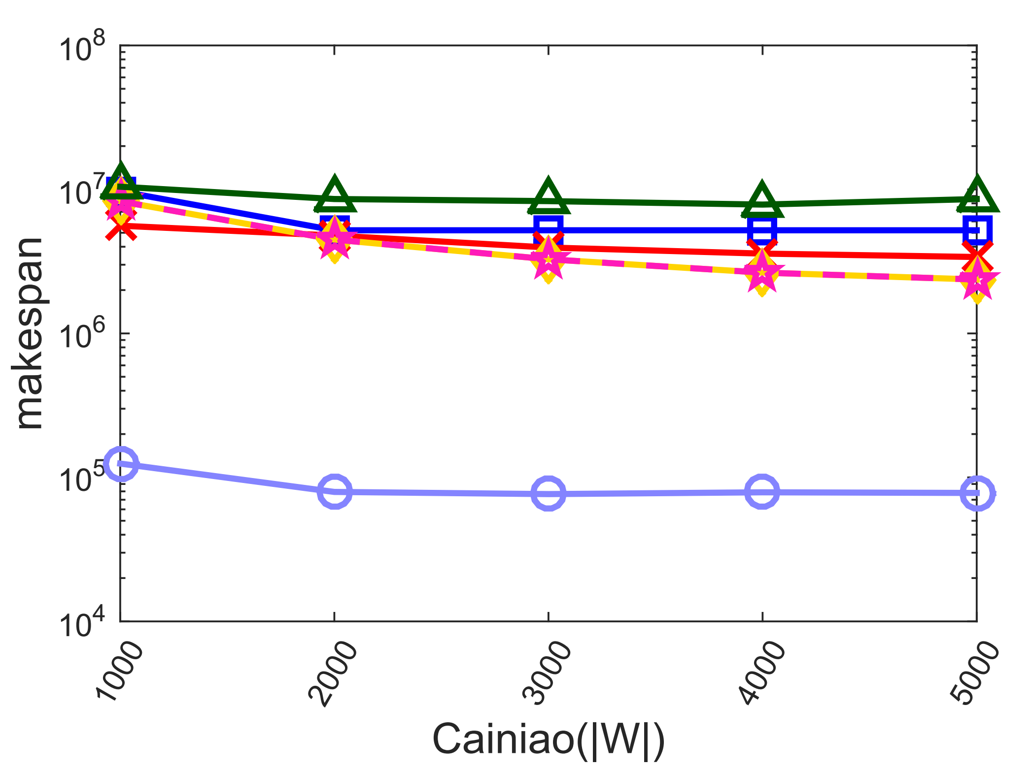
Experimental Results
Makespan in Cainiao (the lower, the better)
Baselines
60x~109x
Our method
  By our method FESI, makespan is reduced by 60x~109x.

Slide 35
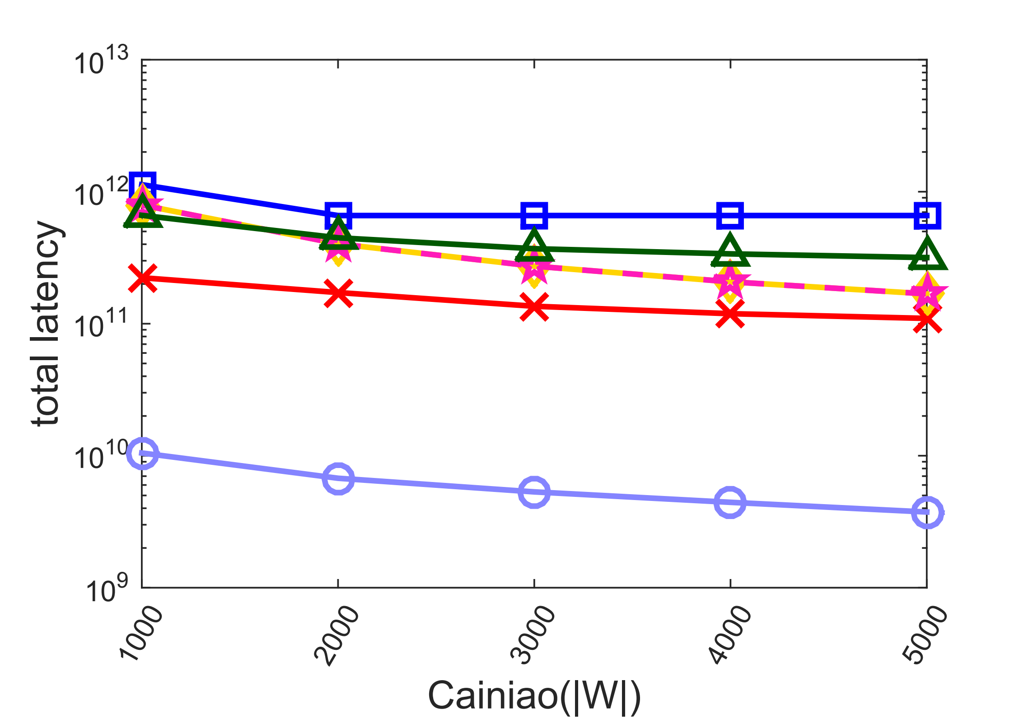
Experimental Results
Total latency in Cainiao (the lower, the better)
Baselines
29x~176x
Our method
  By our method FESI, total latency is reduced by 29x~176x.

Slide 36
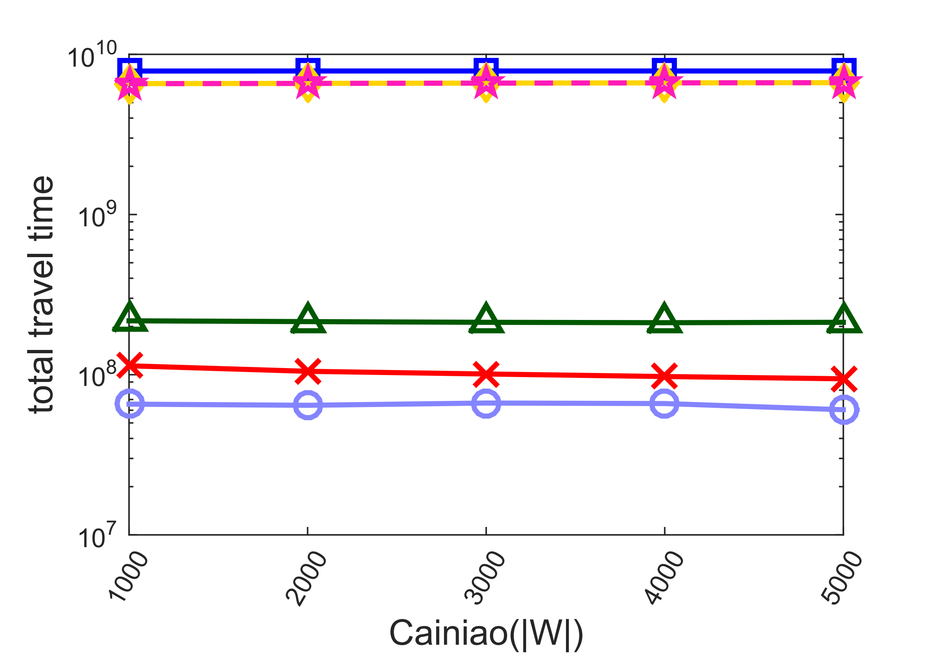
Experimental Results
Total travel time in Cainiao (the lower, the better)
1.7x~130x
Baselines
Our method
  By our method FESI, total travel time is reduced by 1.7x~130x.

Slide 37
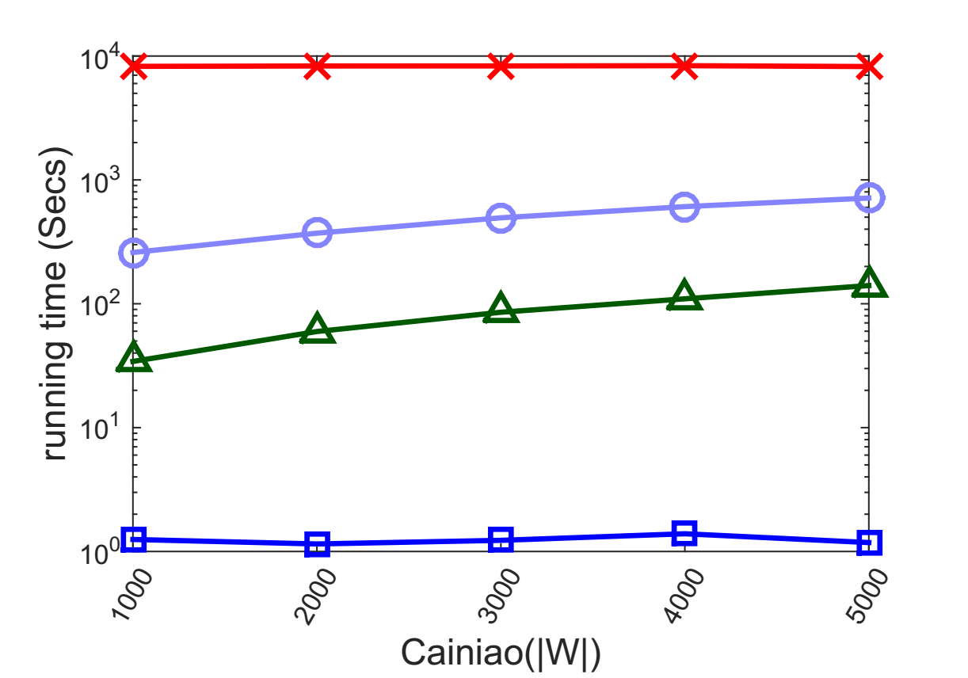
Experimental Results
Total Runtime in Cainiao (the lower, the better)
Our method
The running time of ALNS/ALNS⁺ is >10 hours.
  By our method FESI, each request can be processed in <3ms.

Slide 38
Outline
Background
Problem Statement
Our Solution
Experiments
Conclusions

Slide 39


Conclusions
FESI is an effective and efficient solution to Last-Mile Delivery problem, which has theoeretical guarantees in the objectives of both couriers and requesters (instead of sacrificing one for the other).
Our code, data, slides are available
github.com/BUAA-BDA/ridesharing-LMD

