Slide 1
Team 4 – Aspect Based Sentiment Analysis of Airline Tweets

Slide 2







The AI Canvas
What task/decision are you examining?
We are examining tweets and deciding how to analyze the aspect or topic of that tweet as well as the customer’s sentiment towards it.
We want to give the company an evaluation of the topic, so they can task out whether it requires remediation.
Prediction
Judgment
Action
Outcome
Predict whether a tweet towards an airline has positive or negative sentiment, and what aspect caused that.
Identifying a truly negative tweet can give the company insight on where their efforts should be placed and quickly resolved. Falsely identifying a negative tweet as positive could leave the company with more unsatisfied customers.
The airline can then identify the source of many of their negative tweets and work to resolve it, as well as improve their brand’s standing on social media (restart a service, address a delay, etc.)
When an airline acts on the aspect presented that was negative, we expect to see if in a different timeframe the negative sentiment towards the aspect go down. (example: 100 people hate the food during 2021, they change the food in 2022, then we only see 20 people hate the food)
Training
Input
Feedback
Our sentiment model will stay the same, but our aspect identifying model will stay trained on a historical record of the tweets before hand with generic clusters setup. As the prediction machine is deployed, we will receive more data from the newer tweets that come in, and have it adjusted to the whims of the public over time.
A steady stream of tweets about the airline will generate our aspects and sentiment analysis for the model to work from. Gaps in knowledge from the tweets can be supplemented with flight records and other public data relating to the time period. (holidays, other social media, etc.)
On a monthly cycle we will package all the tweets run through our model with their respective sentiment prediction and aspect identified and outsource the validity of models predictions. If we are happy with our positive rate we will let the model continue as is, if not we will have to retune our model with the new data
How will this AI impact on the overall workflow?
The goal of this AI is reducing the workload of social listening for a company. Customer service representatives will need to be retrained to identify the aspects and which ones require escalation or remediation. This AI will give airline companies a more efficient and effective method of finding the issues their company is causing for the customers. Usually customer surveys go unanswered, but tweets are more easily accessible making it a better identifier of a company’s standing on social media, and what issues need their attention.
© Agrawal, Gans, Goldfarb 2019

Slide 3

Our Data
Twitter is a social network where users can post “tweets”, tweets are short post of up 140 characters.
The data set that we used consistent of approximately 15,000 tweets from users that have an @airline in their text. Airlines consist of United, Southwest, Delta, US Airways, American, and Virgin America
Tweet
Datapoint
Airline | Tweet | Sentiment | Other Cols. But not used
United | @UnitedAirlines_Direct flight booked was changed no notification with lay over. I purchases seats, not honored. Now in the last seat on both legs. NOT what I purchased!! After an hour on hold a they fixed it, only to when I arrived they did’nt #frustrated #unitedsucks | Negative | ………
Example

Slide 4

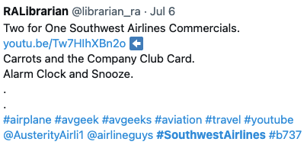
Data Scrubbing
Tweets contain portions of text that aren’t related to the sentiment or aspect and have to removed
Remove Tagged Users
HTML Decoding
Remove any links
Remove any characters that aren’t letters
Remove Stop Words
Pre
Two for One Southwest Airlines Commercials youtu.be/Tw7HlhXBn20 Carrots and the Company Club Card. Alarm Clock and Snooze… #airplane #avgeek #avgeeks #aviation#travel #youtube @AusterityAirli1 @airlineguys #SouthwestAirlines #b737
Post
Two One Southwest Airlines Commercials Carrots Company Club Card Alarm Clock Snooze airplane avgeek avgeeks aviation travel youtube SouthwestAirlines b

Slide 5
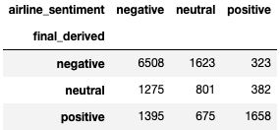
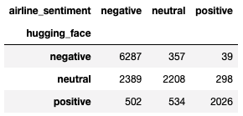
Model Training
Sentiment
Aspect
Sentiment portion is supervised
We compare our sentiment prediction to the sentiment given to us in our dataset
TextBlob and Naïve Bayes combined voting
These are general sentiment tools can be used on anything
Hugging Face
This was originally trained with over 50mm tweets
aspect portion is unsupervised we needed to create clusters from all our tweets
The number of clusters was decided with an elbow curve, six clusters was the best number
After six clusters were created we looked at the top 10 words to give each cluster an appropriate name
Add Elbow Curve Picture here
Accuracy – 61%
Positive Recall - 70% Neutral Recall - 26% Negative Recall - 71%
Positive Precision - 44% Neutral Precision - 33% Negative Precision - 77%
Accuracy – 72%
Positive Recall - 86% Neutral Recall - 71% Negative Recall - 69%
Positive Precision - 66% Neutral Precision - 45% Negative Precision - 94%

Slide 6
What else could we do
Each tweet being put to more than one cluster, multi-aspect analysis
When more data is added, incorporate a seasonality affect
Dynamic Clusters

