Slide 1
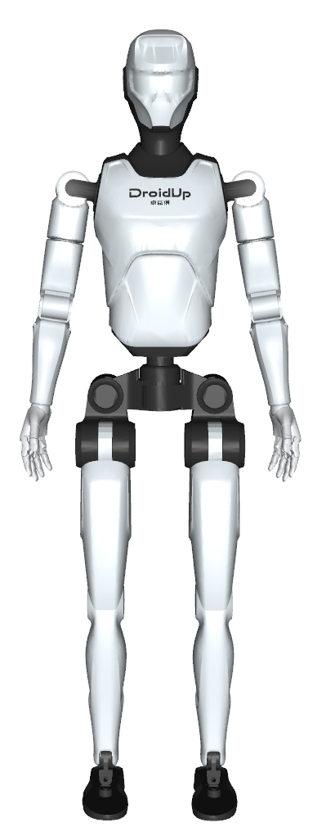
Yaw
Pitch
Roll
Joint rotation
Z
Y
X
Link frame

