Slide 1
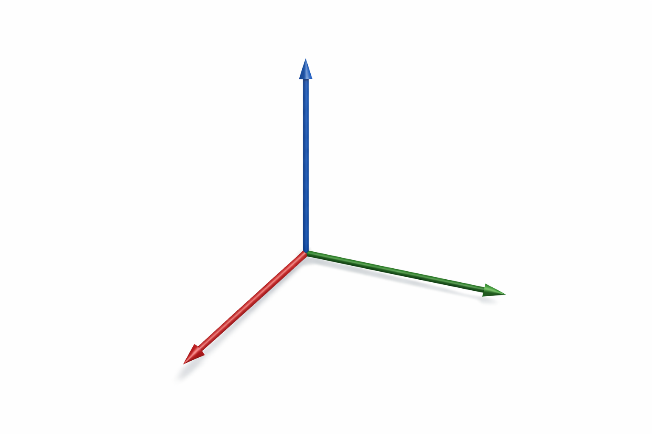
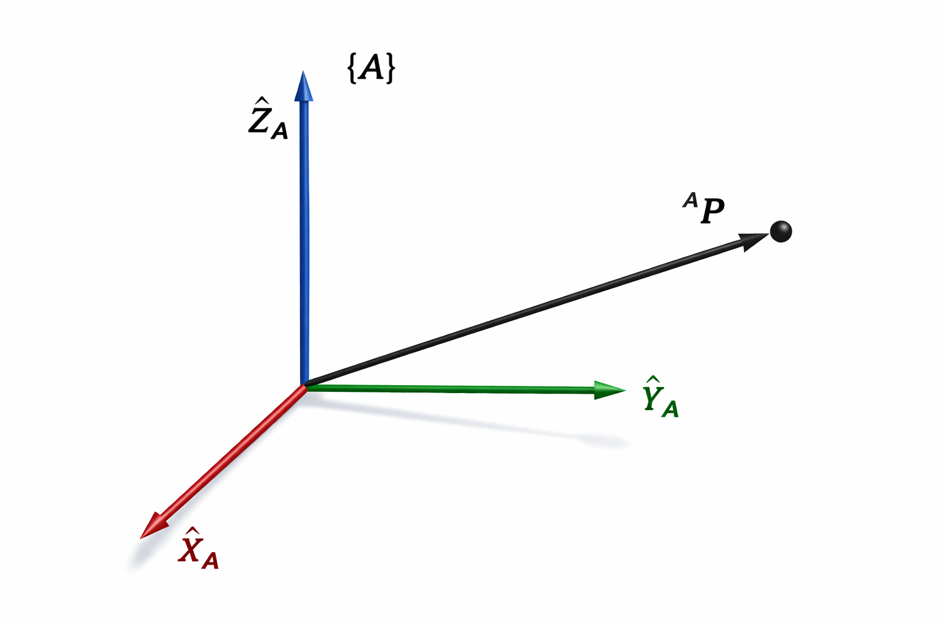



$$\{B\}$$
$${}_{}^{A}P$$
$${\hat{Y}}_{B}$$

