Slide 1
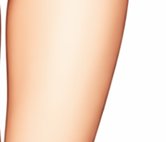
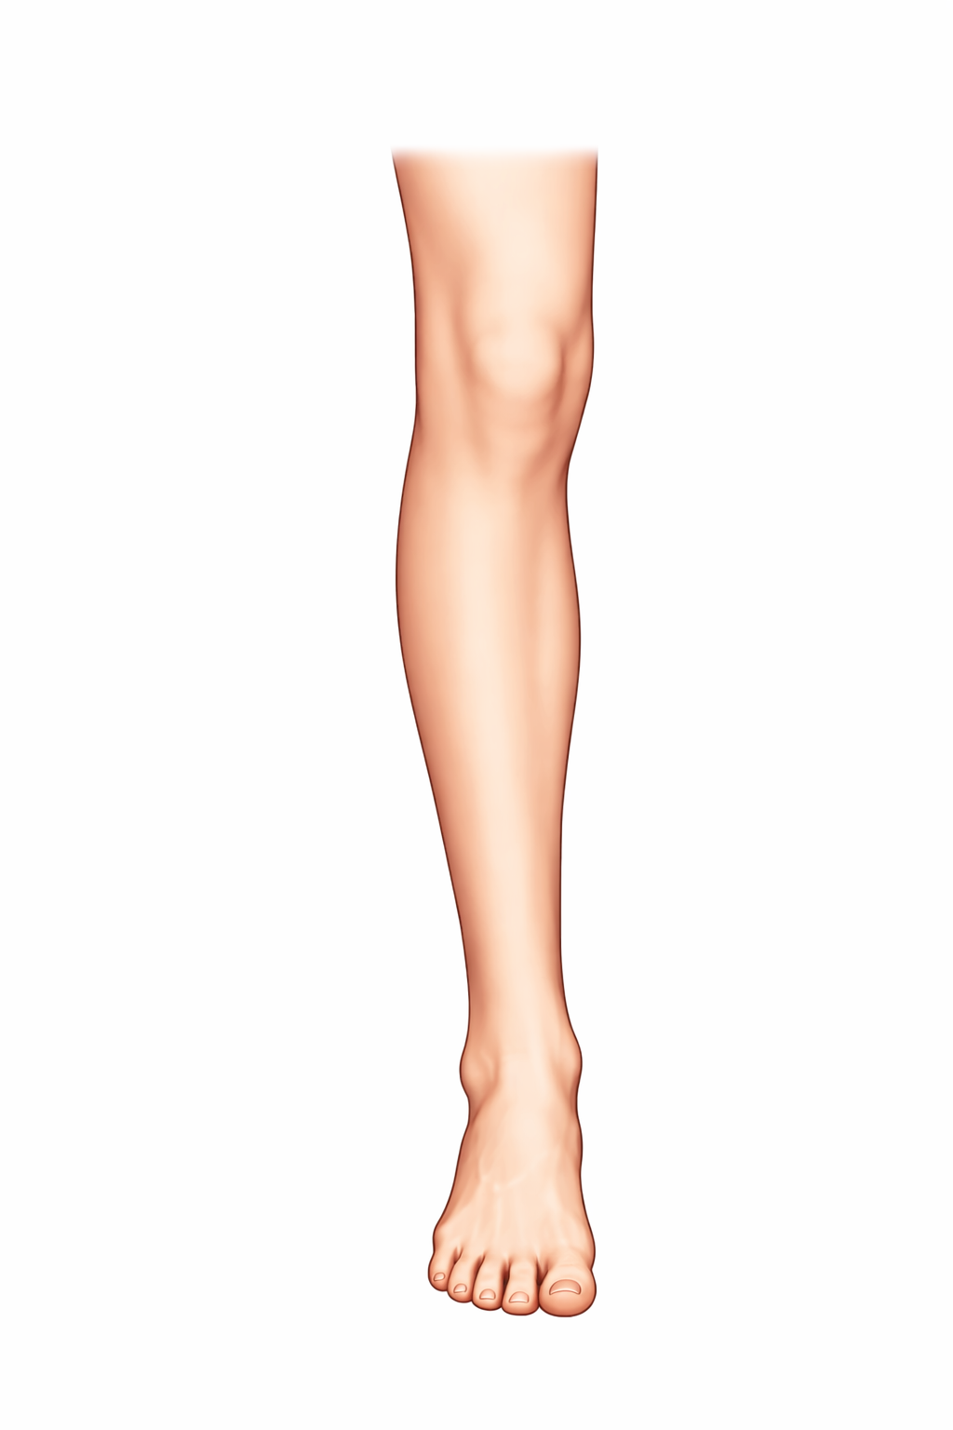
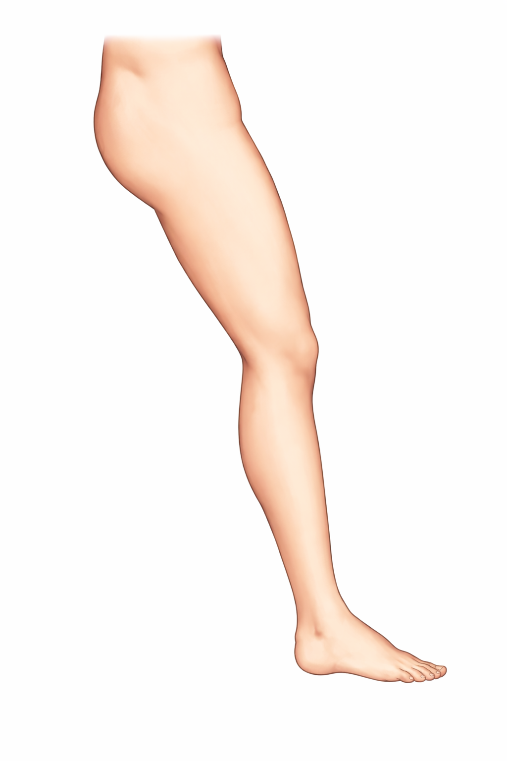
S
h
O
H
HS
Hk
K
KA
A

Slide 2







Z
H
$$r$$
Y
$$θ_{HR}$$
$$θ_{HP}$$
$$n_{HP}$$
X
$$v_{HK}$$
$$θ_{K}$$
K
$$v_{KA}$$
A

Slide 3
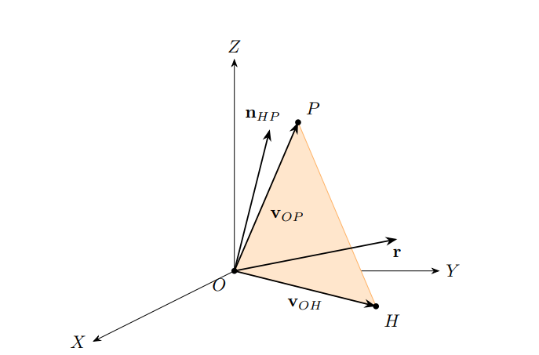

Slide 4
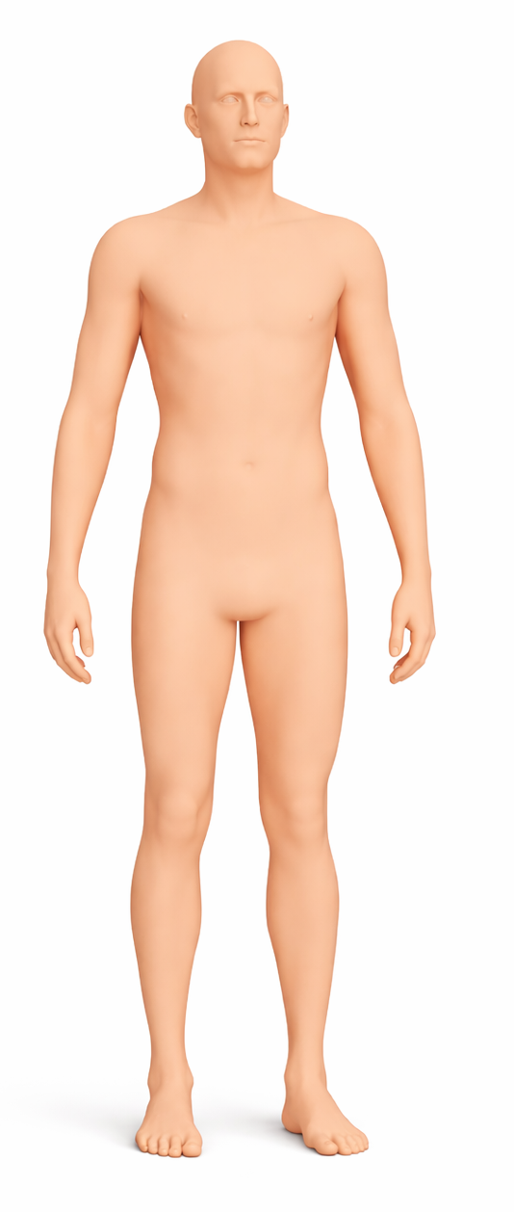
S
E
P
O
H
W
K
A

