Slide 1
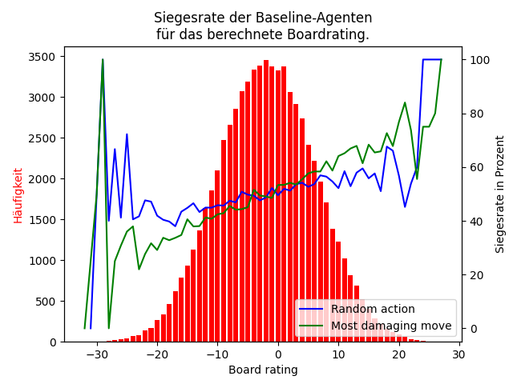
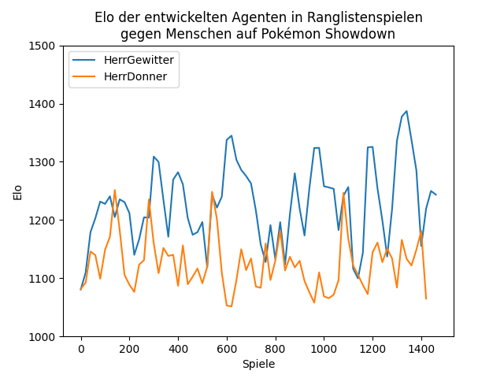
Design, Implementation and evaluation of different strategies for playing Pokémon battles
Bewertung eines gamestates
Evaluation gegen Menschen

