Slide 1
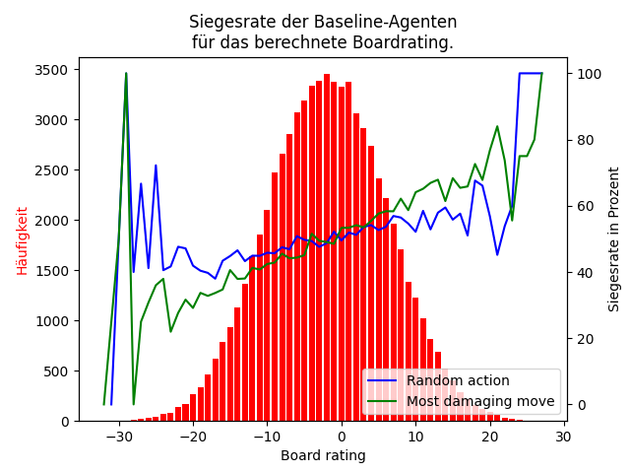
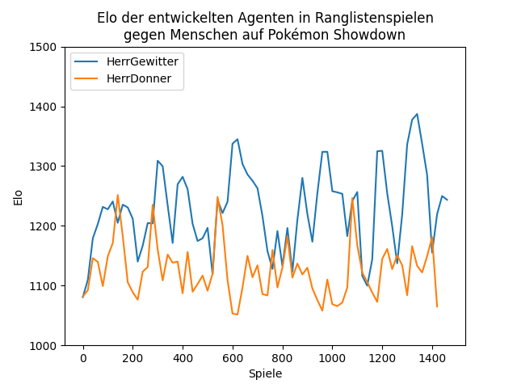
Design, Implementation and Evaluation of Different Strategies for Playing Pokémon Battles
Bewertung eines Gamestates
Evaluation gegen Menschen

