Slide 1
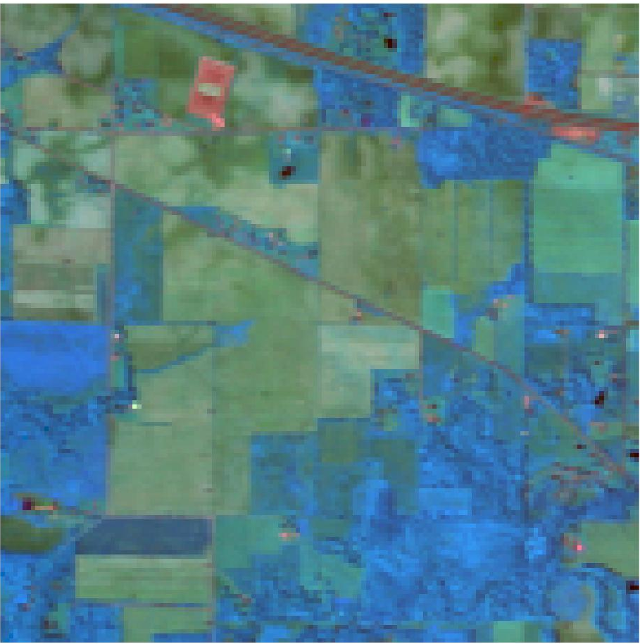
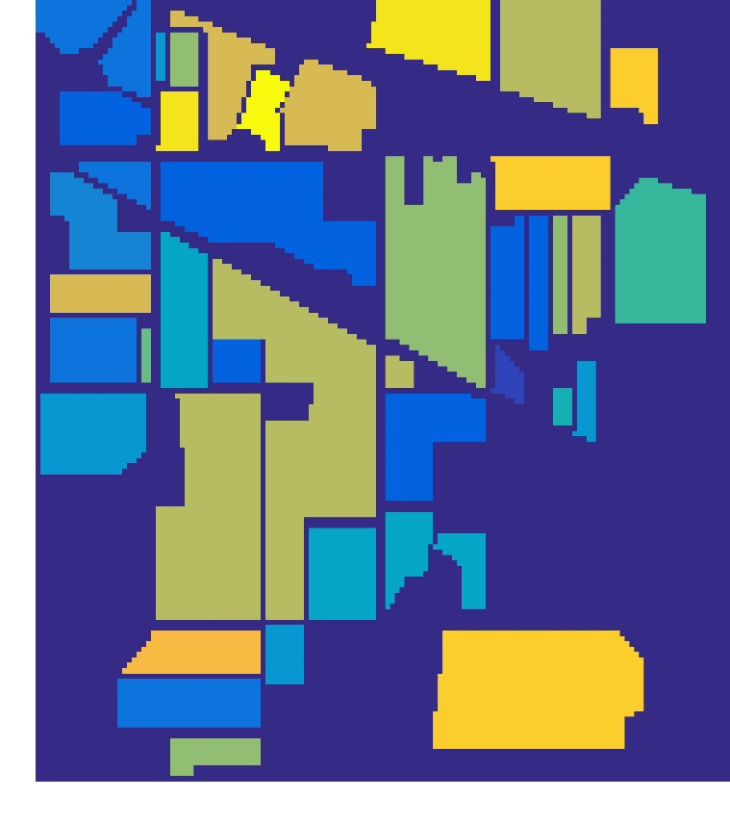
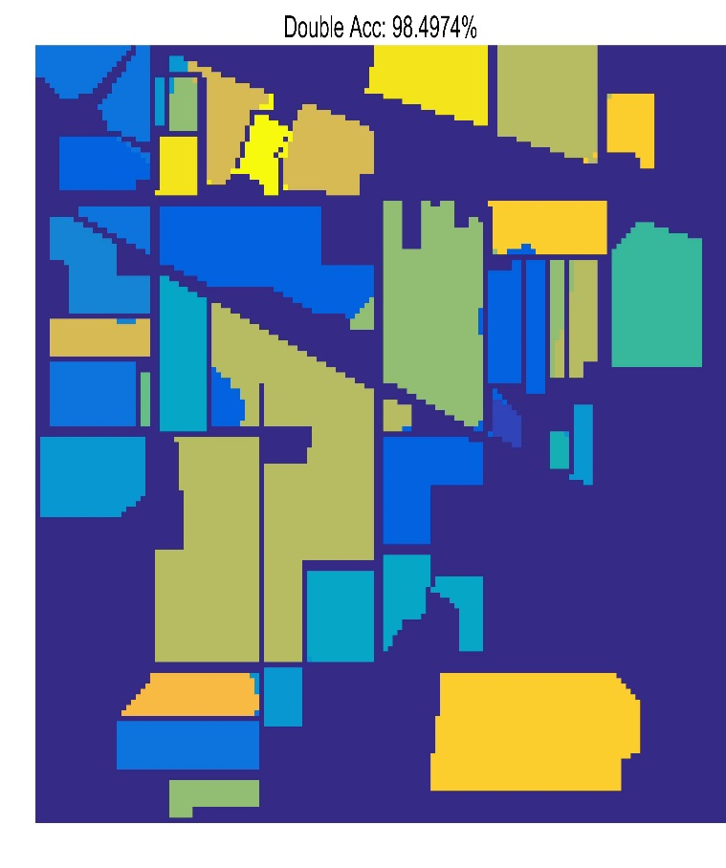
(a)
(b)
(c)
Corn-mintill
Corn
Grass-pasture
Grass-pasture-mowed
Hay-windrowed
Oats
Soybean-notill
Soybean-mintill
Wheat
Woods
Grass-tree
Soybean-clean
Corn-notill
Alfalfa
Ground
Stone-Steel-Drivers
Bulidings-Grass-Trees-Drivers

