Slide 1
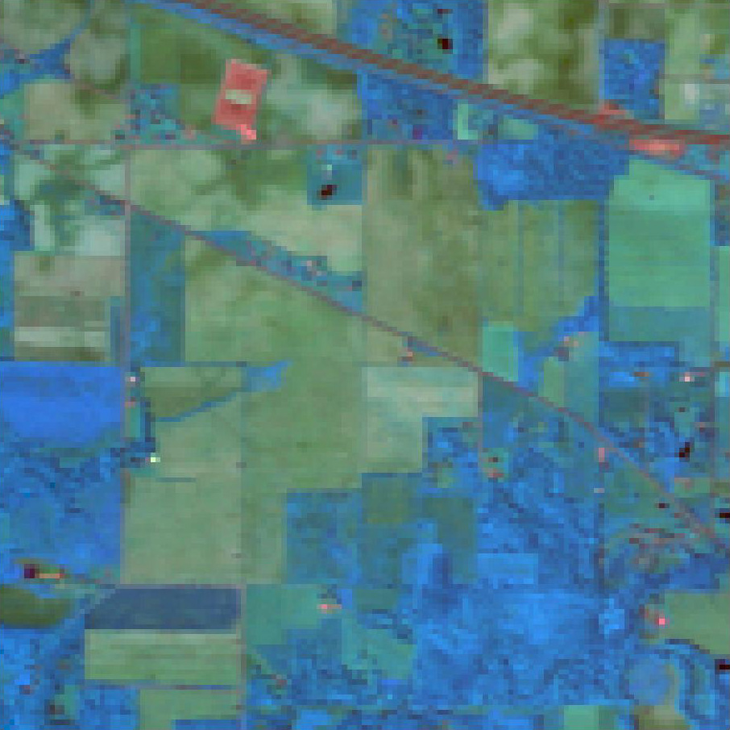

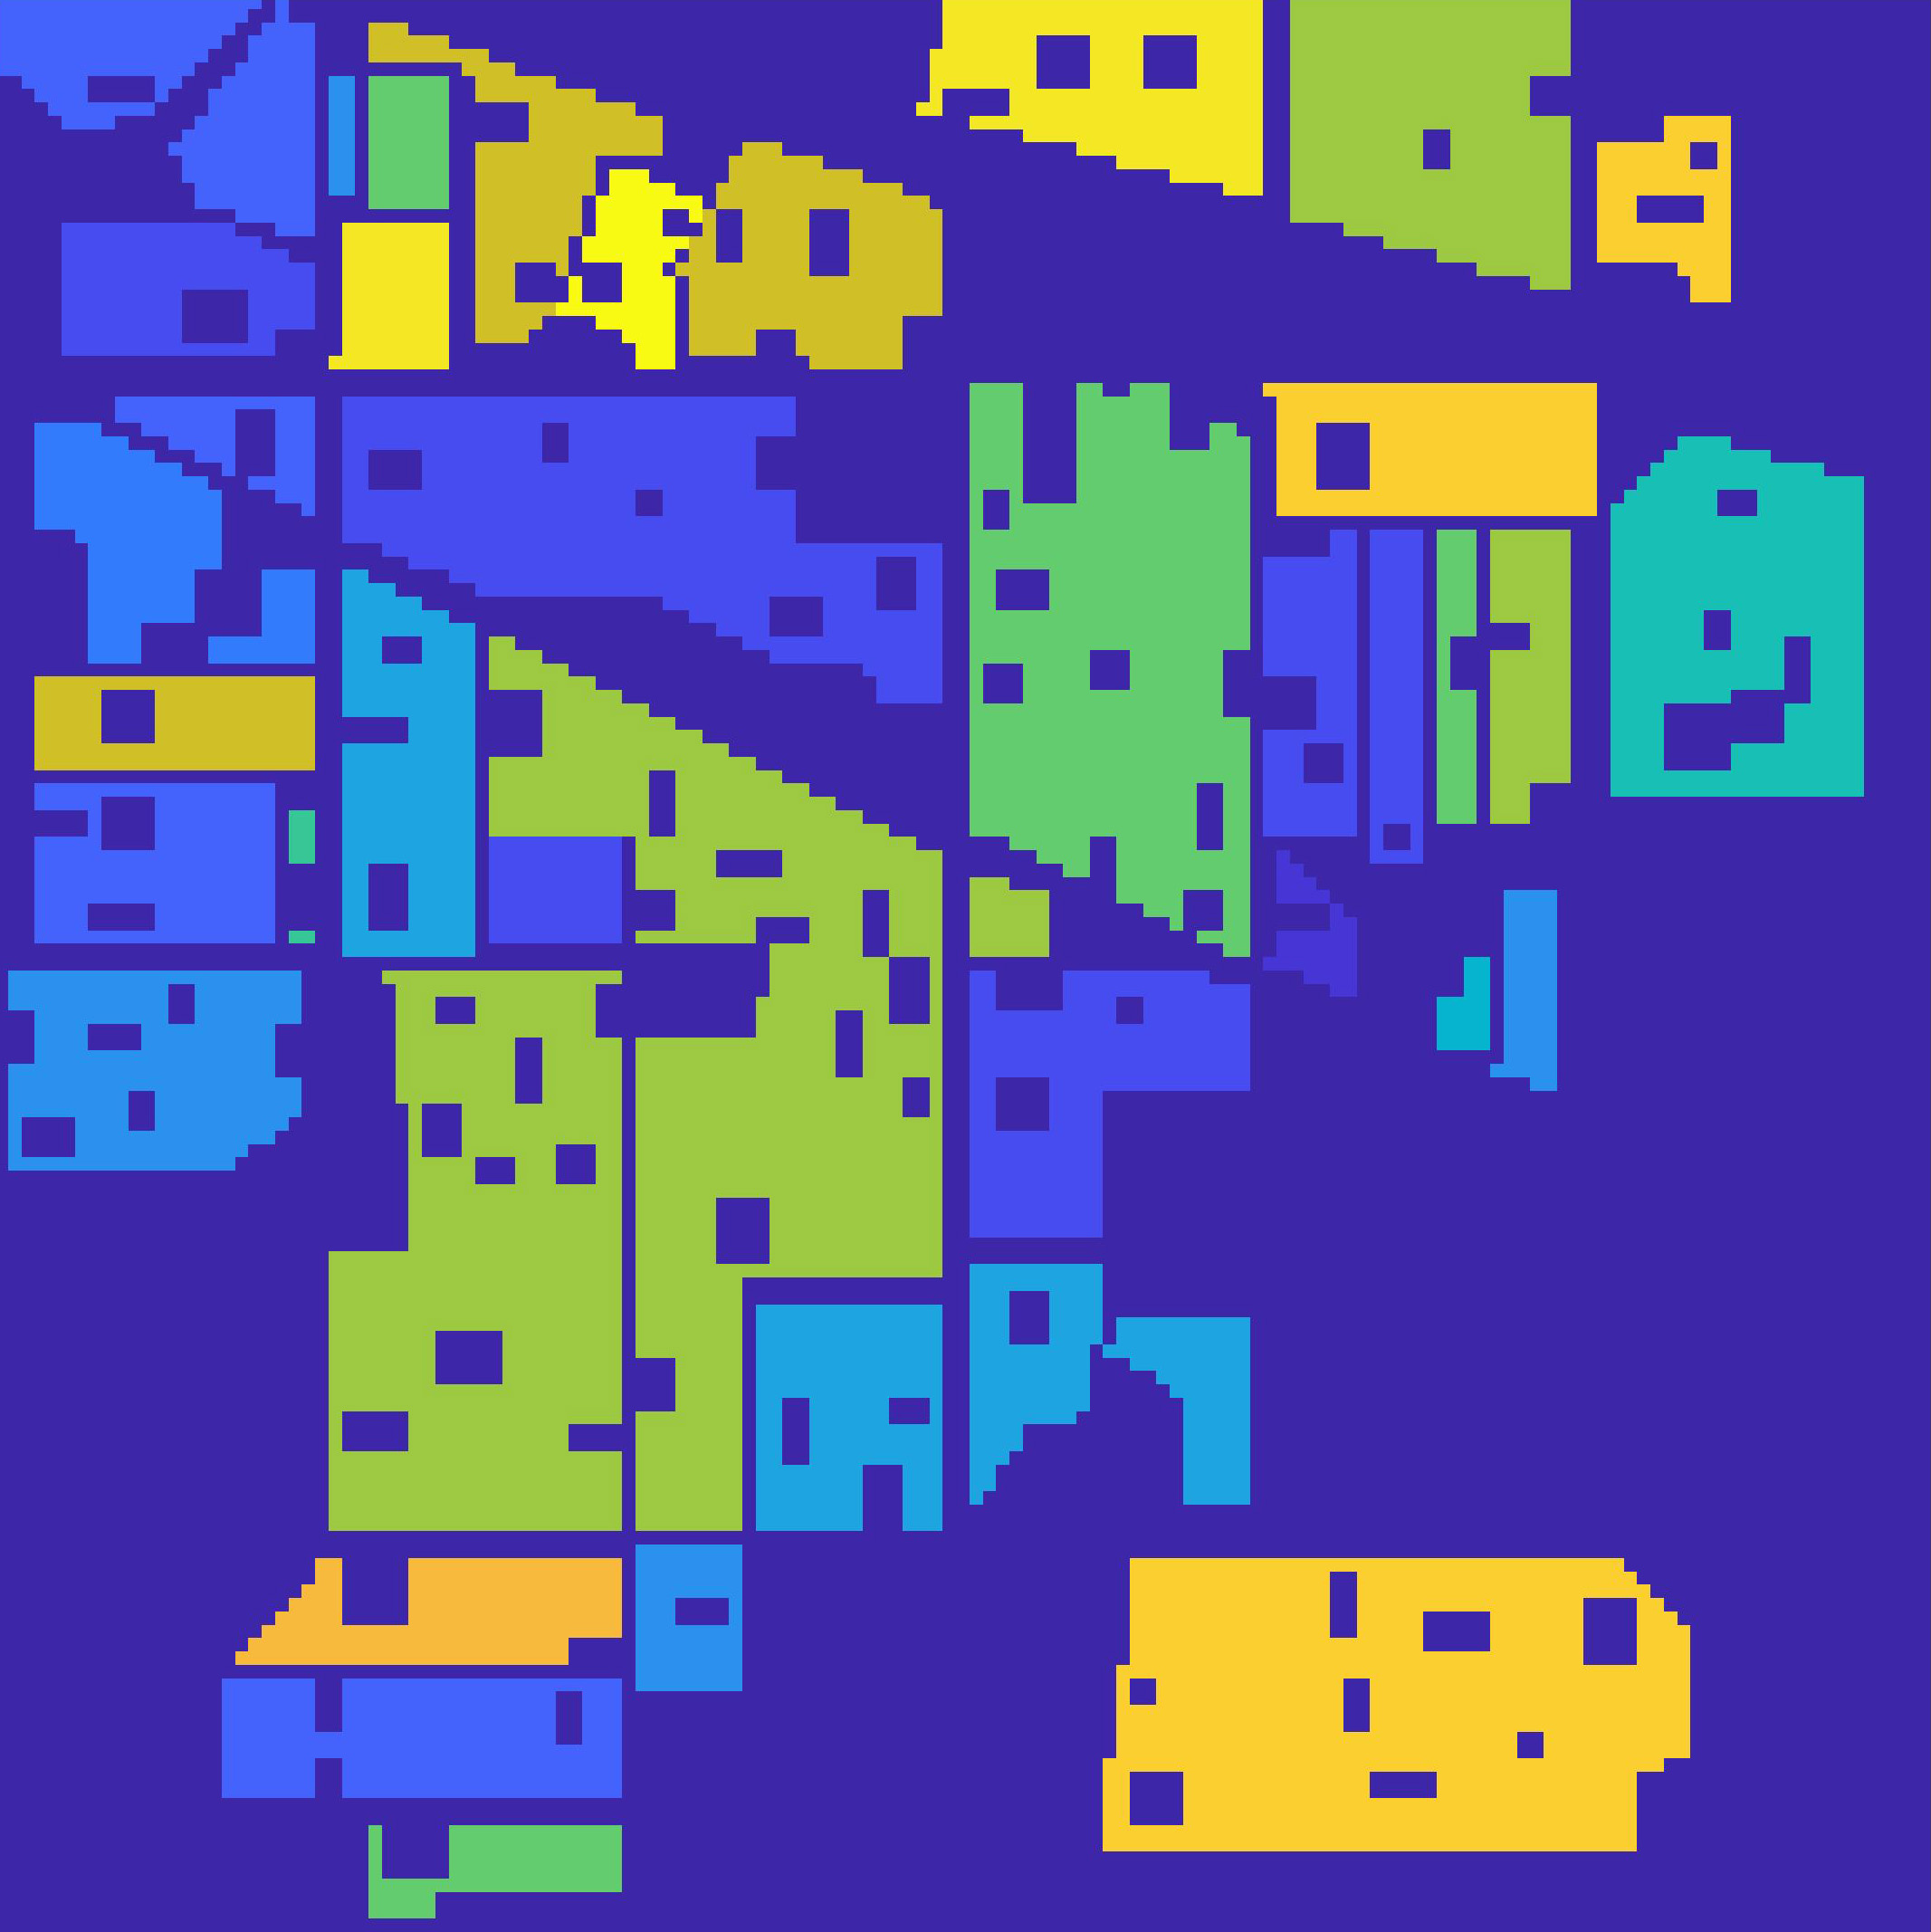
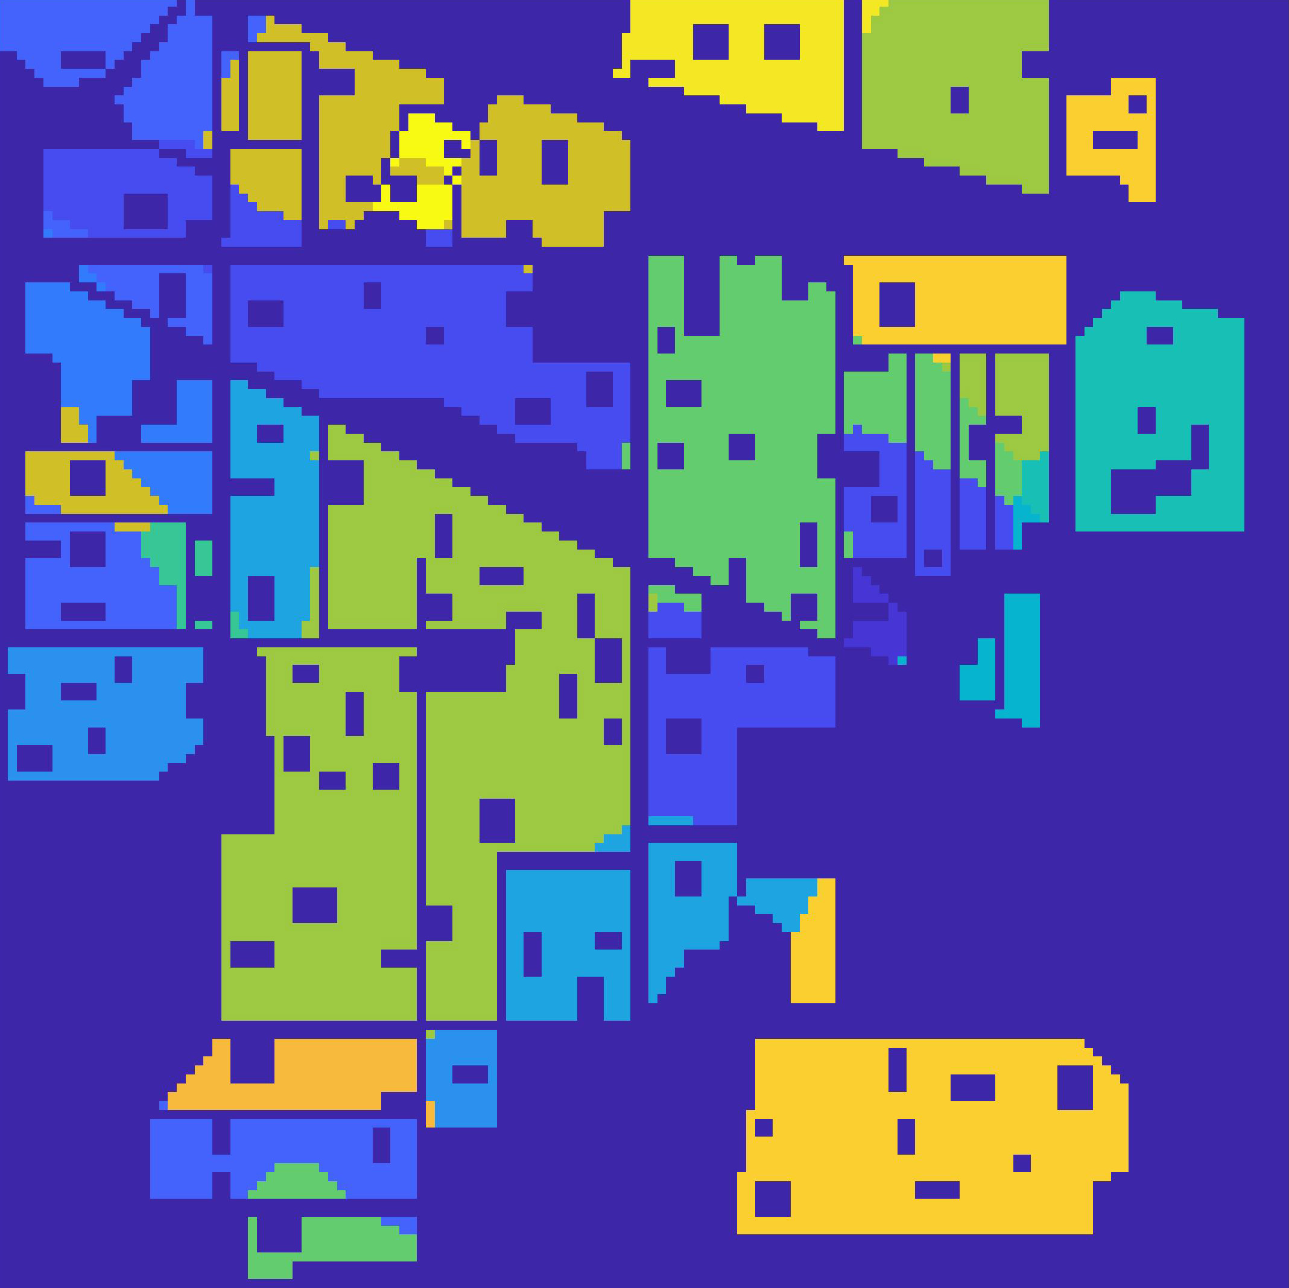
Corn-mintill
Corn-notill
Corn
Soybean-clean
Grass/pasture
Soybean-notill
Buildings-Grass
-Trees-Drives
(a)
(b)
Grass/trees
Soybean-mintill
Wheat
Stone-Steel-towers
Woods
Alfalfa
Grass/pasture-mowed
Hay-windrowed
Oats
(c)
(d)

