Slide 1

2B+3H₂SO₄(热浓)=2H₃BO₃+3SO₂ ↑
H₂SO₄（浓）+8HI=4I₂+H₂S+4H₂O
Sn+2NaOH+4H₂O=Na₂[Sn(OH)₆]+2H₂ ↑
3Br₂+6OH⁻=5Br⁻+BrO₃⁻+3H₂O (常温,I₂与Br₂类似)
NaH + H₂O = NaOH + H₂↑
2S₂O₃^{2–} + I₂ = S₄O₆^{2–} + 2I–
SbCl₃+H₂O→SbOCl ↓ +2HCl
BiCl₃+H₂O→BiOCl ↓ +2HCl
SnCl₂+H₂O→Sn(OH)Cl ↓ +HCl
PCl₃+3H₂O→H₃PO₃+3HCl PCl₅+4H₂O→H₃PO₄+5HCl BCl₃+3H₂O→H₃BO₃+3HCl
H₃BO₃ + H₂O
+ H⁺
[B(OH)₄]⁻

Slide 2
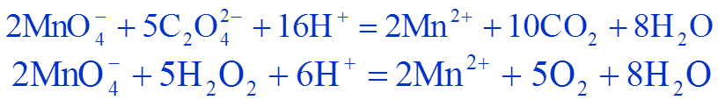
2[Cr(OH)₄]– + 3H₂O₂ + 2OH– = 2CrO₄^{2–} + 8H₂O
Δ
(NH₄)₂Cr₂O₇ Cr₂O₃ + N₂↑ + 4H₂O
Cr₂O₇^{2–} + 6I– + 14H⁺ 2Cr³⁺ + 3I₂ + 7H₂O
2Mn²⁺ + 5PbO₂ + 4H⁺ 2MnO₄– + 5Pb²⁺ + 2H₂O
2Mn²⁺ + 5NaBiO₃ + 14H⁺ 2MnO₄– + 5Bi³⁺ + 5Na⁺ + 7H₂O

Slide 3
Co₂O₃ + 6HCl 2CoCl₂ + Cl₂↑+ 3H₂O
Ni₂O₃ + 6HCl 2NiCl₂ + Cl₂↑+ 3H₂O
2Co₂O₃ + 4H₂SO₄ 4CoSO₄+ O₂↑ + 4H₂O
2Ni₂O₃ + 4H₂SO₄ 4NiSO₄+ O₂↑ + 4H₂O
2CoO(OH) + 6HCl 2CoCl₂+ Cl₂↑ + 4H₂O
2NiO(OH) + 6HCl 2NiCl₂+ Cl₂↑ + 4H₂O
4CoO(OH) + 4H₂SO₄ 4CoSO₄+ O₂↑ + 6H₂O
4NiO(OH) + 4H₂SO₄ 4NiSO₄+ O₂↑ + 6H₂O

Slide 4
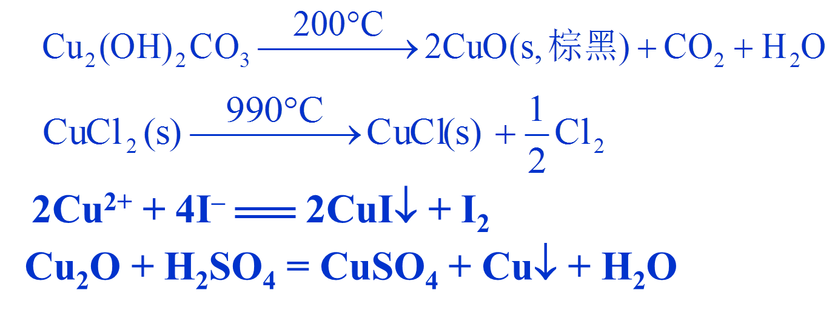
HgCl₂ + 2NH₃（稀） = Hg(NH₂)Cl↓(白) + NH₄Cl
NH₄Cl
HgCl₂ + 2NH₃ [HgCl₂(NH₃)₂]↓
(白)
Hg₂Cl₂ + 2NH₃ = Hg(NH₂)Cl↓(白) + Hg↓(黑) + NH₄Cl
Hg₂²⁺ + 2OH– = Hg↓ + HgO↓ + H₂O
Hg₂²⁺ + 4I– = Hg↓ + [HgI₄]^{2–}

