Slide 1
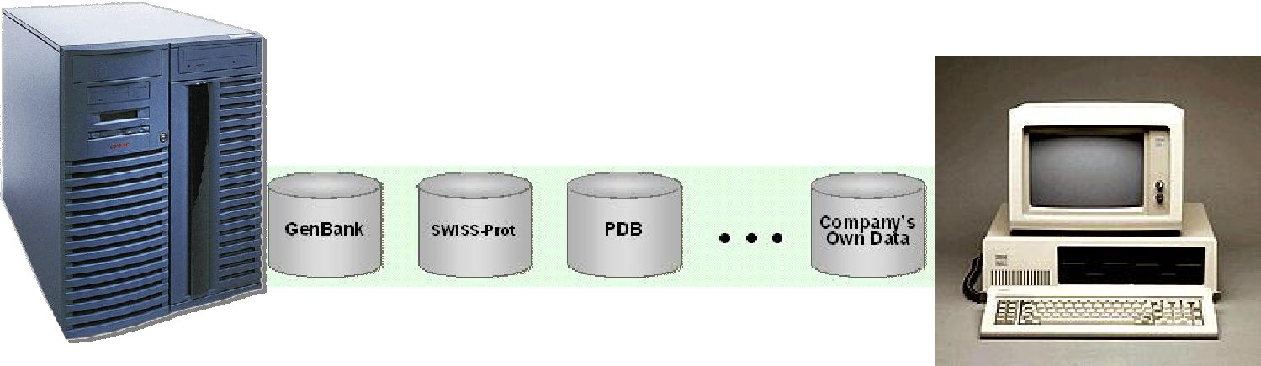
生物信息数据库
--检索实例
阎 爱 侠
E-mail: yanax@mail.buct.edu.cn

Slide 2
GenBank
http://www.ncbi.nlm.nih.gov/genbank/index.html
检索关键词： SARS coronavirus BJ01

Slide 3
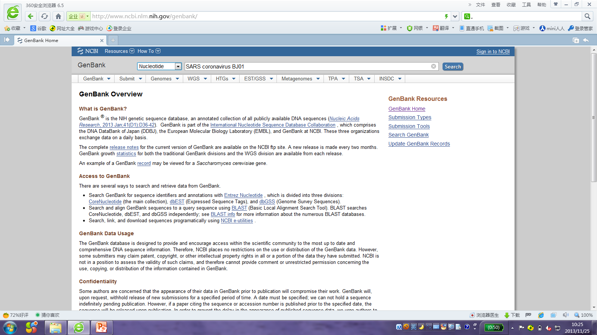

Slide 4
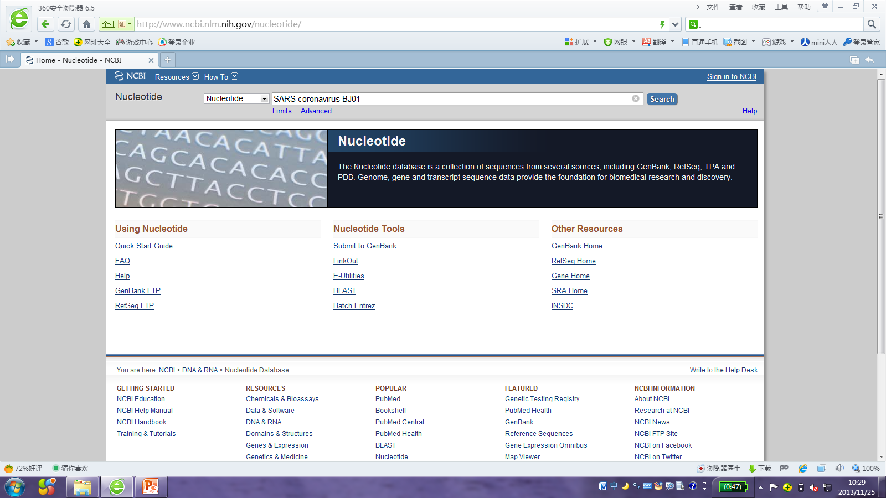

Slide 5
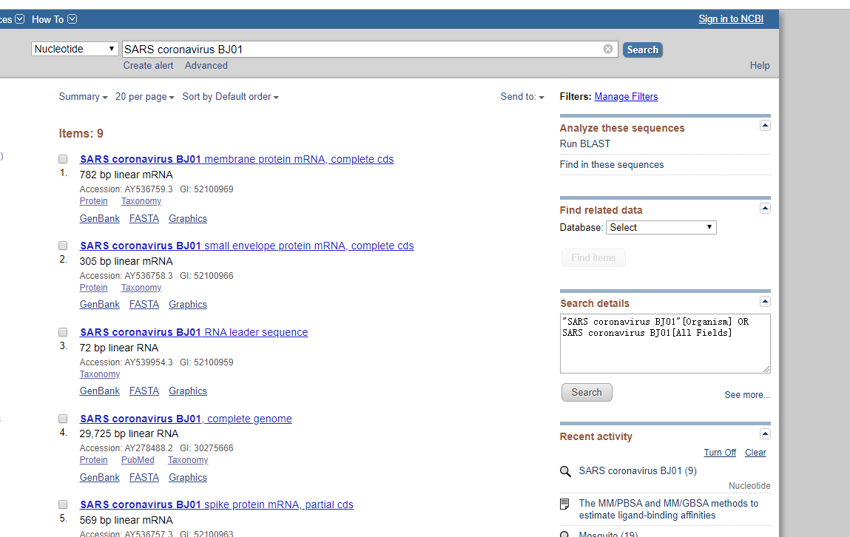

Slide 6
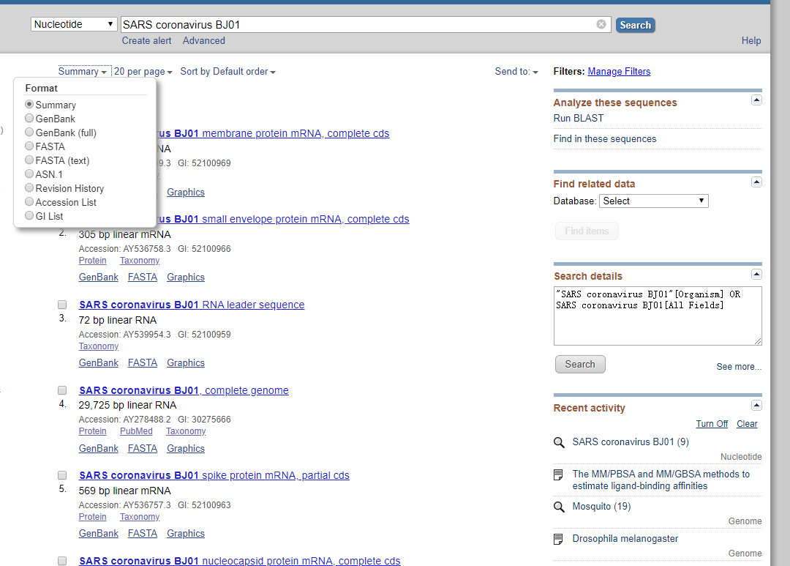
显示方式，选择GenBank

Slide 7
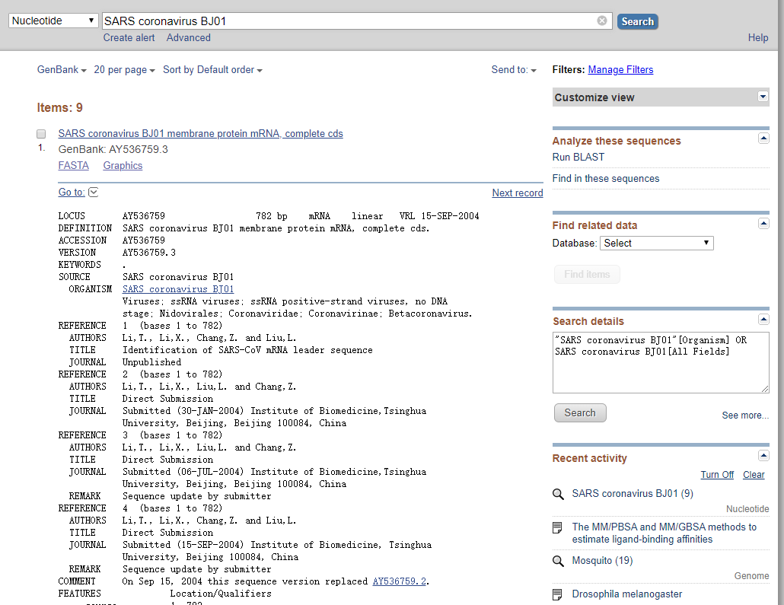

显示方式
序列号
物种信息
作者信息等

Slide 8
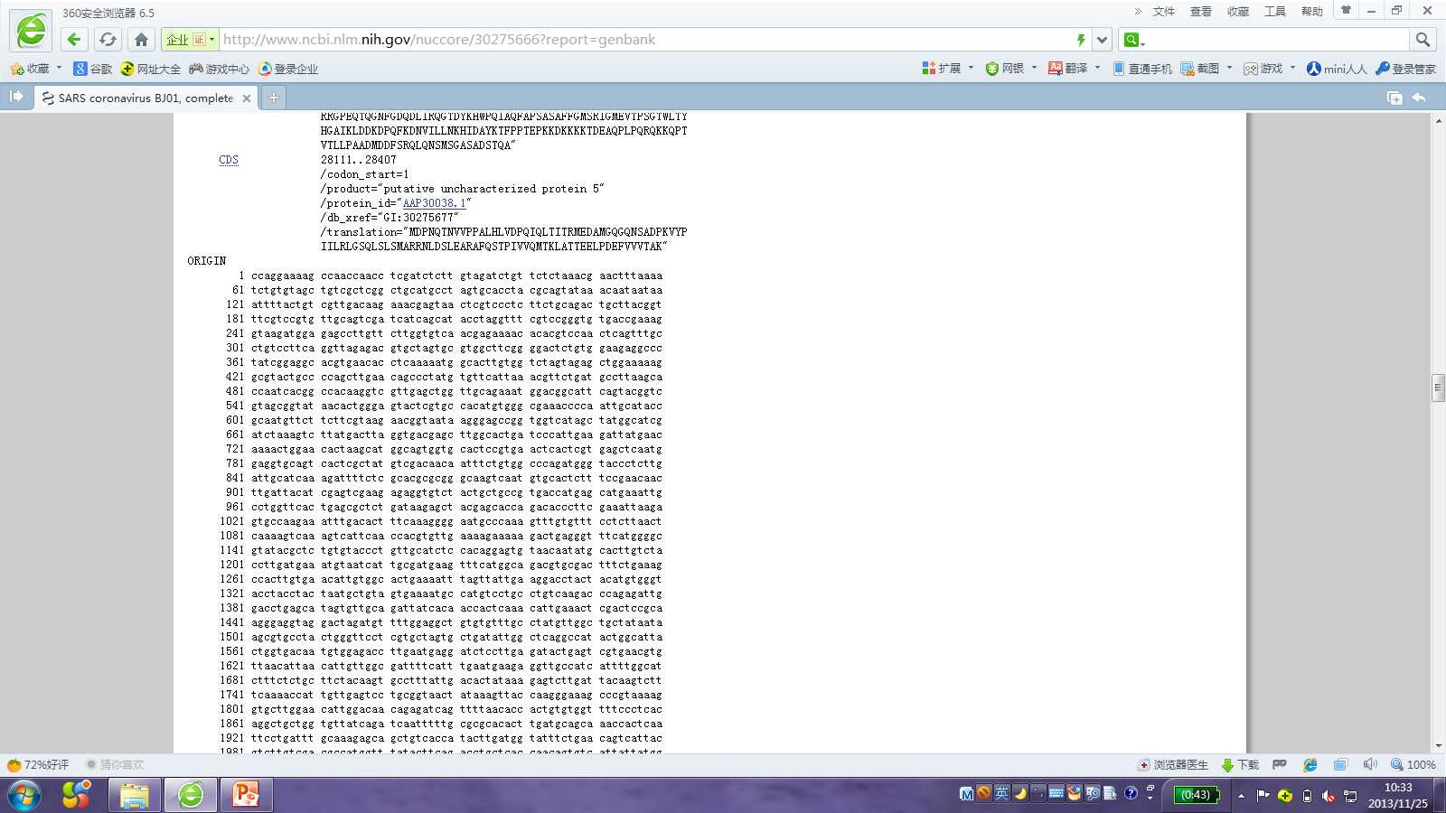
序列信息

Slide 9
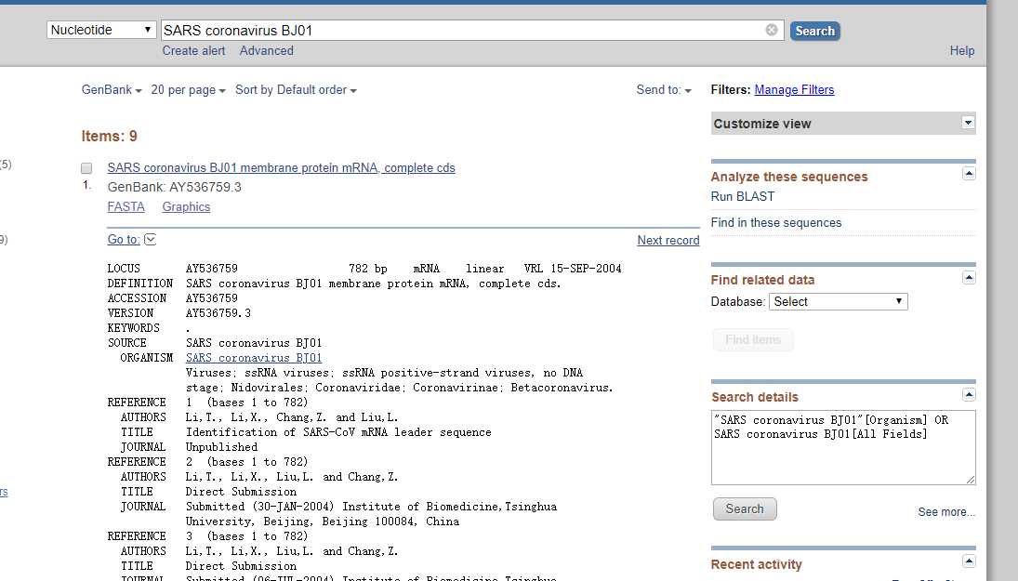

Slide 10
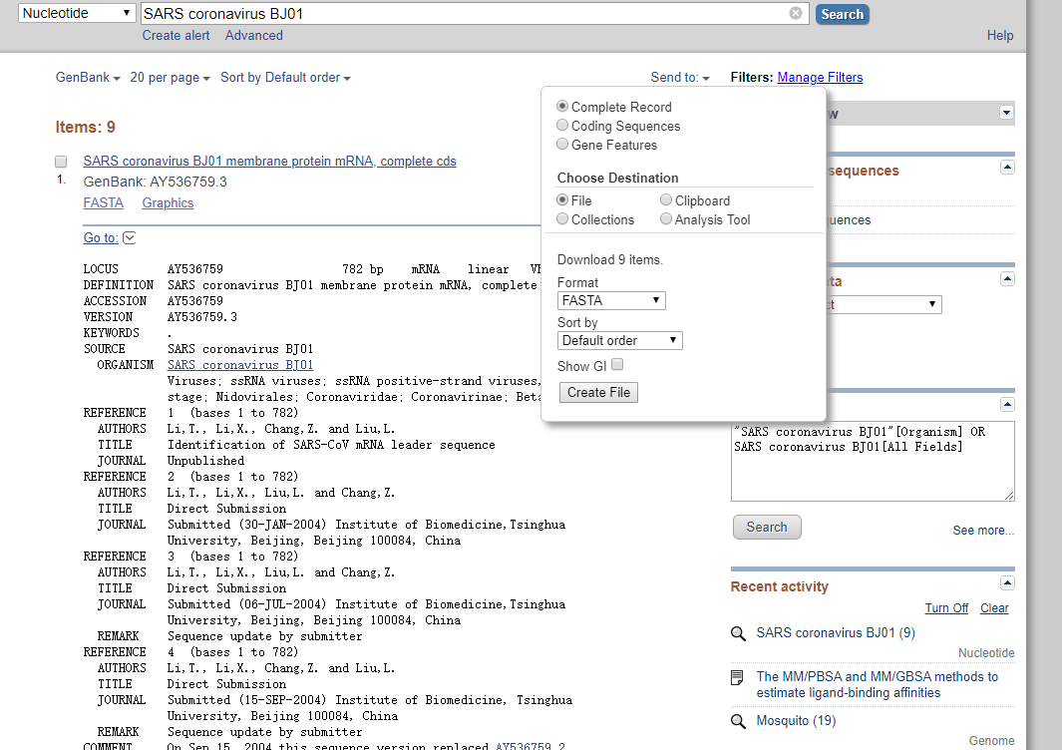
产生文件 sequence.gb

Slide 11
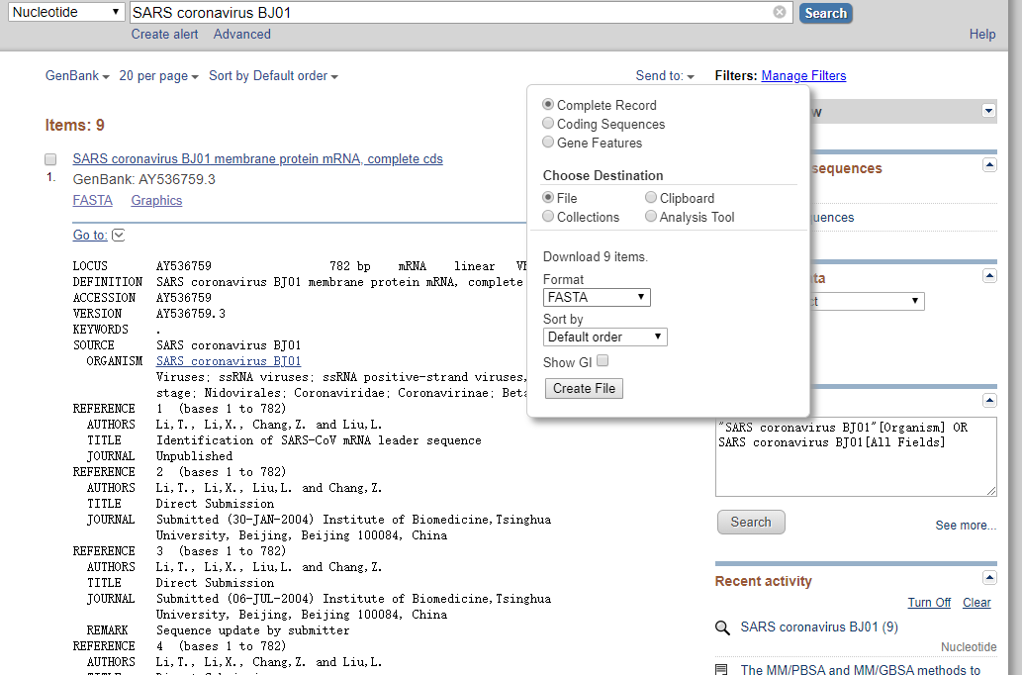
产生文件 sequence.fasta

Slide 12
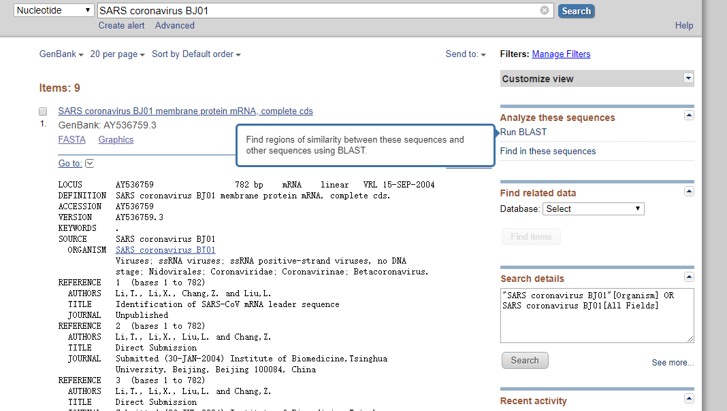

Slide 13
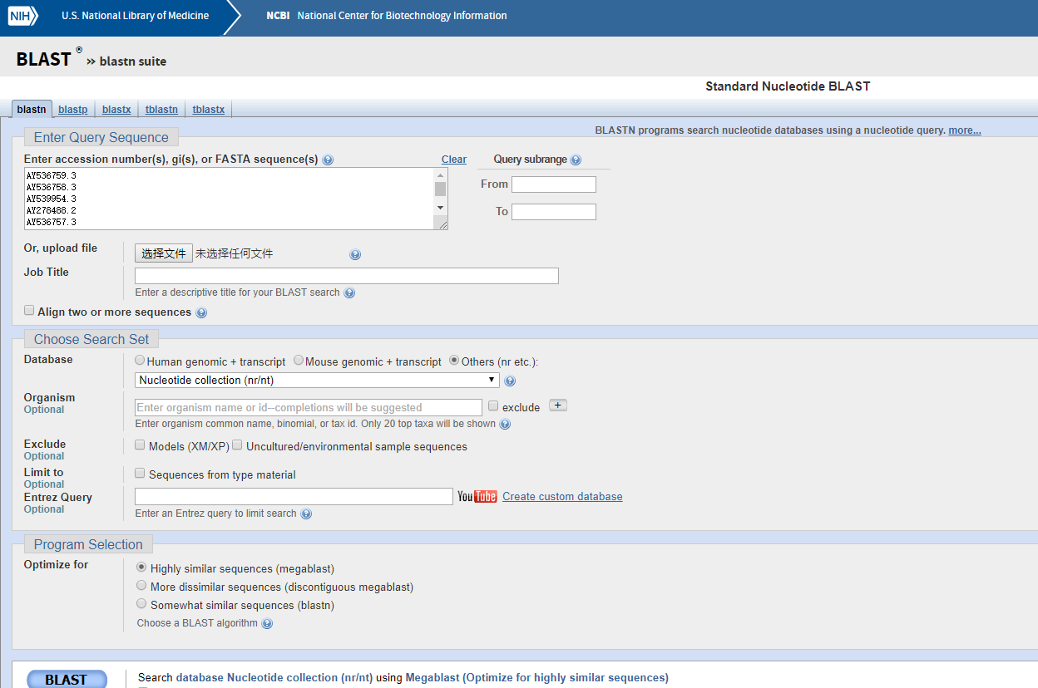

Slide 14
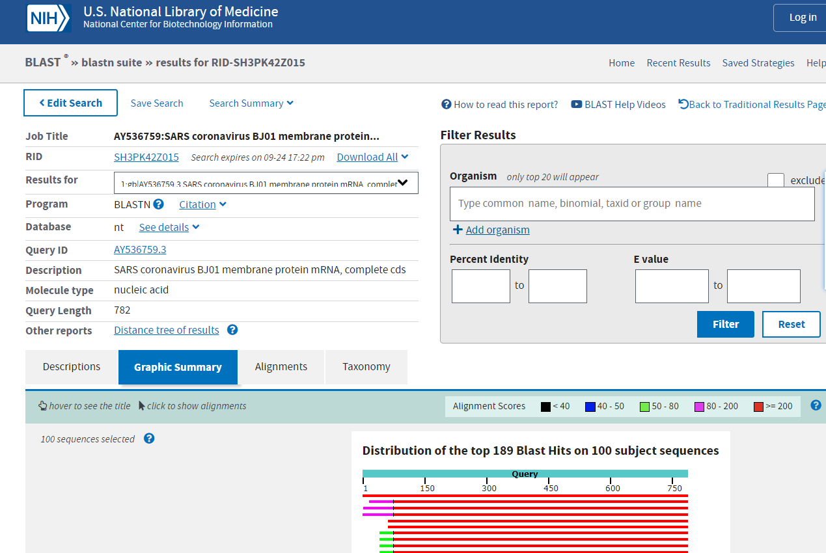

Slide 15
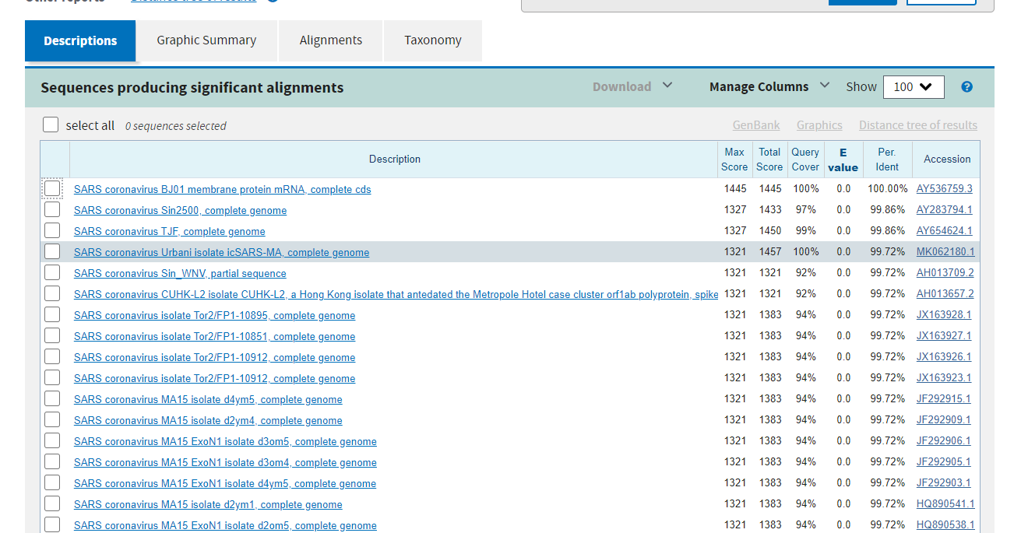

Slide 16
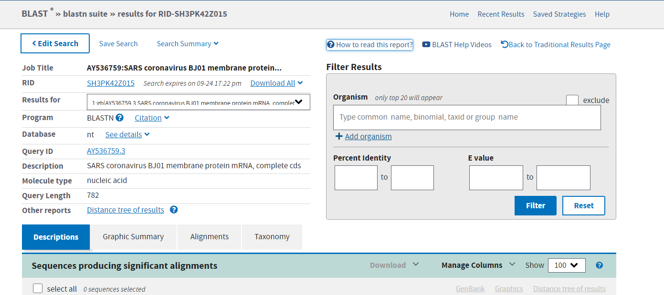
产生文件 HowTo_NewBLAST.pdf

Slide 17
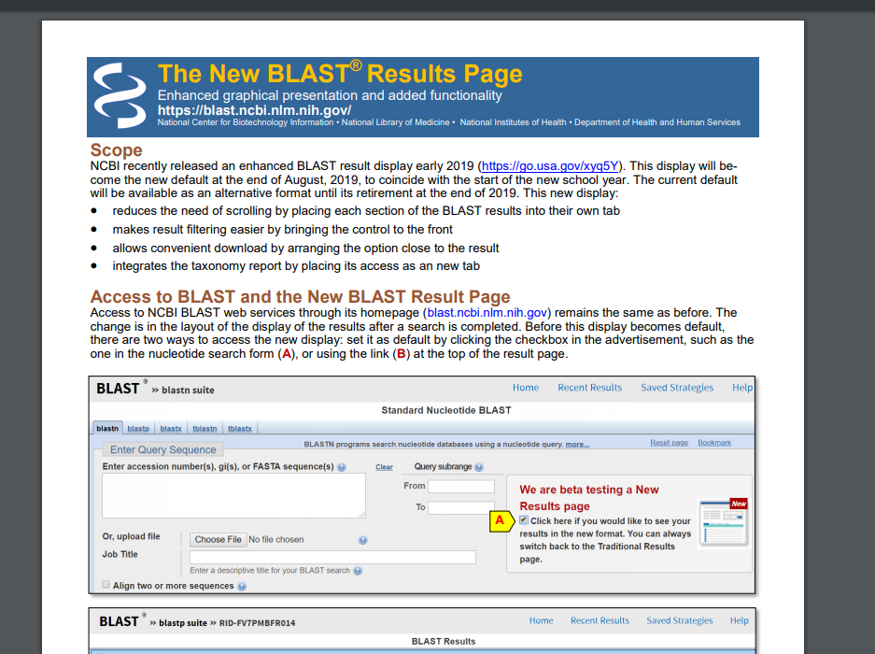

Slide 18
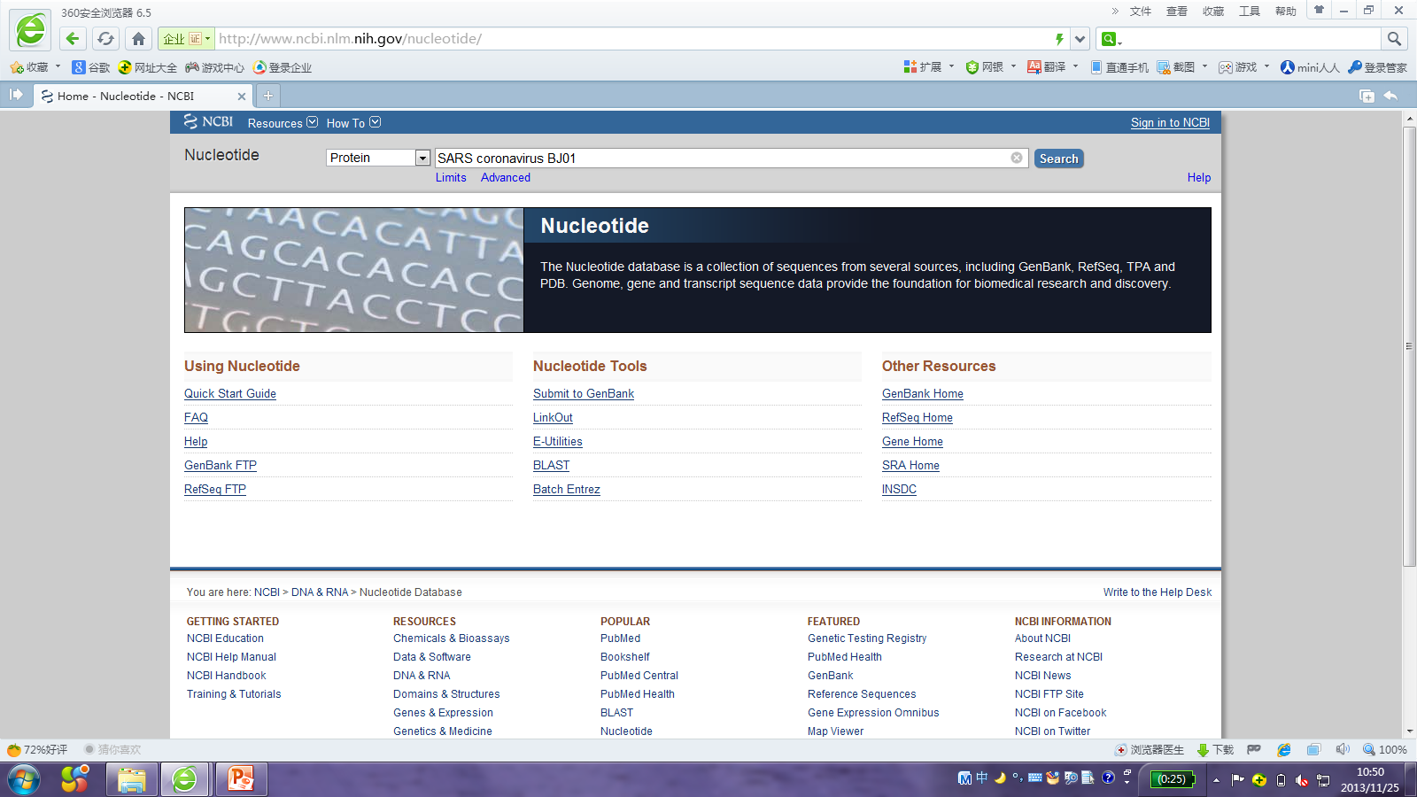

Slide 19
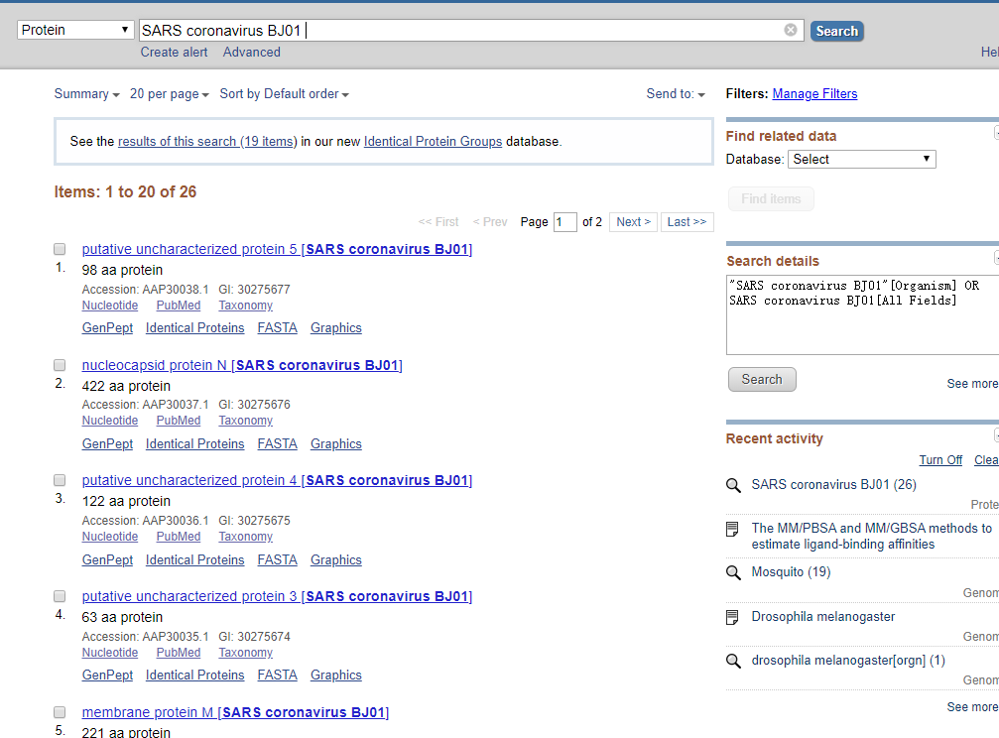

Slide 20
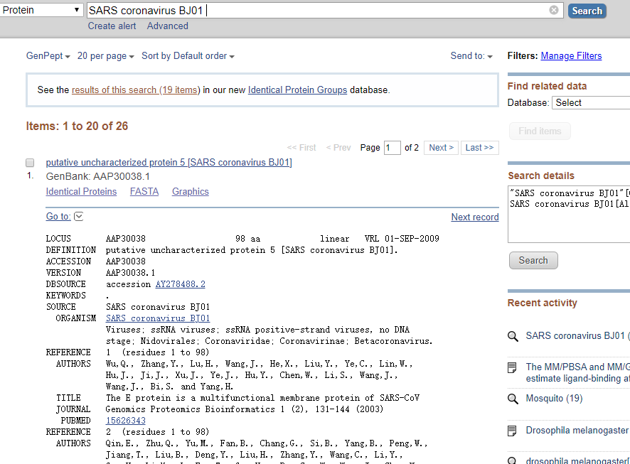

Slide 21
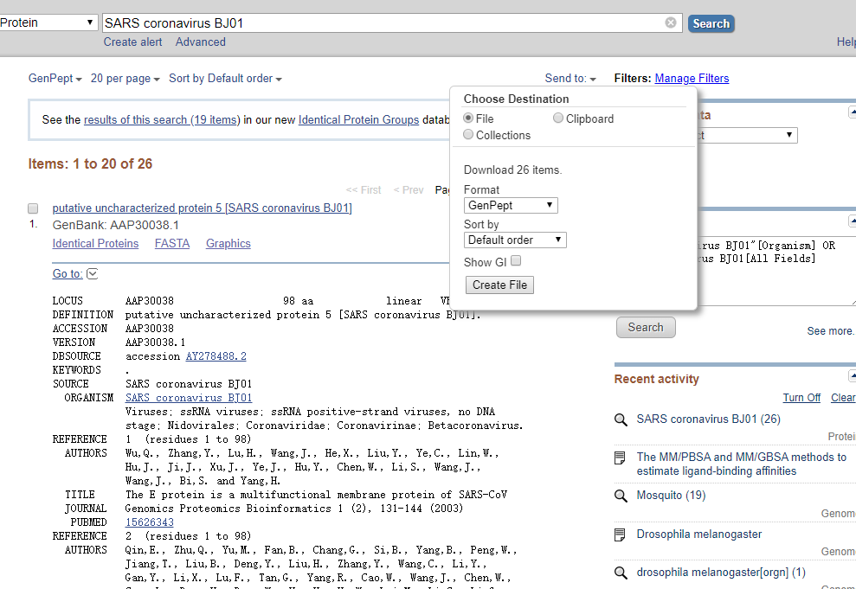
产生文件 sequence.gp

Slide 22
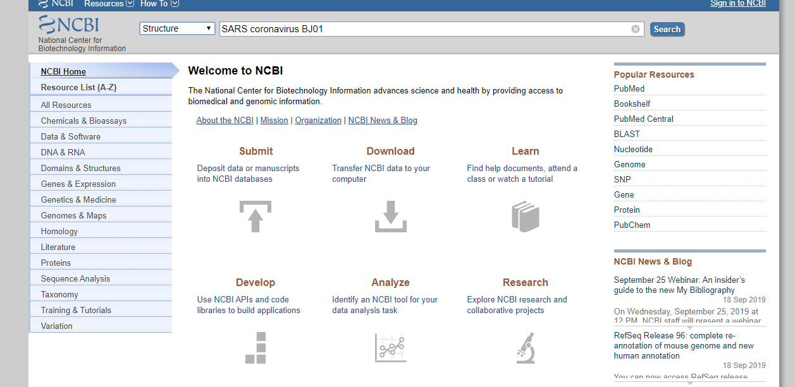

Slide 23
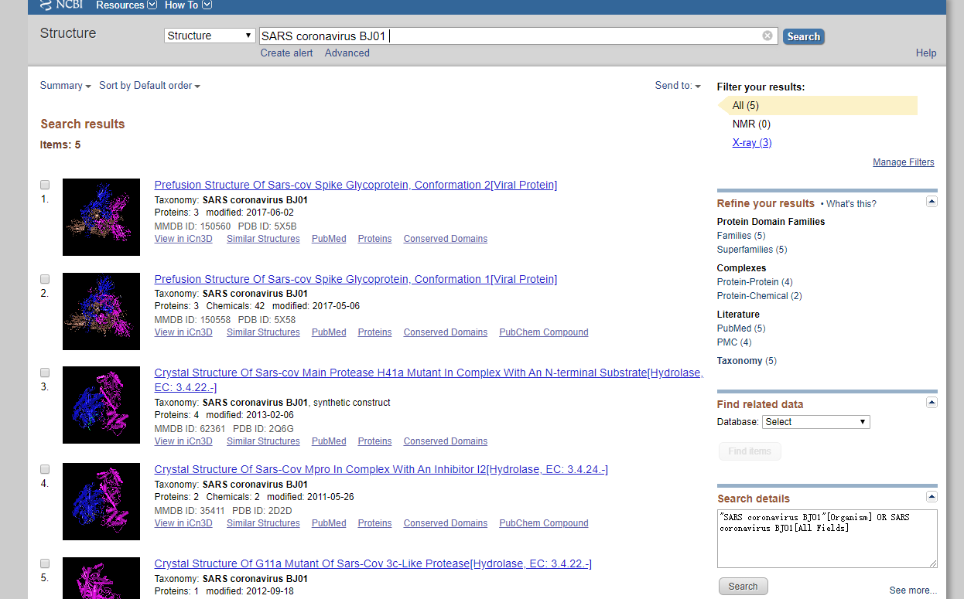

Slide 24
PDB (protein data bank)
http://www.rcsb.org/pdb/home/home.do
检索关键词： SARS coronavirus BJ01

Slide 25
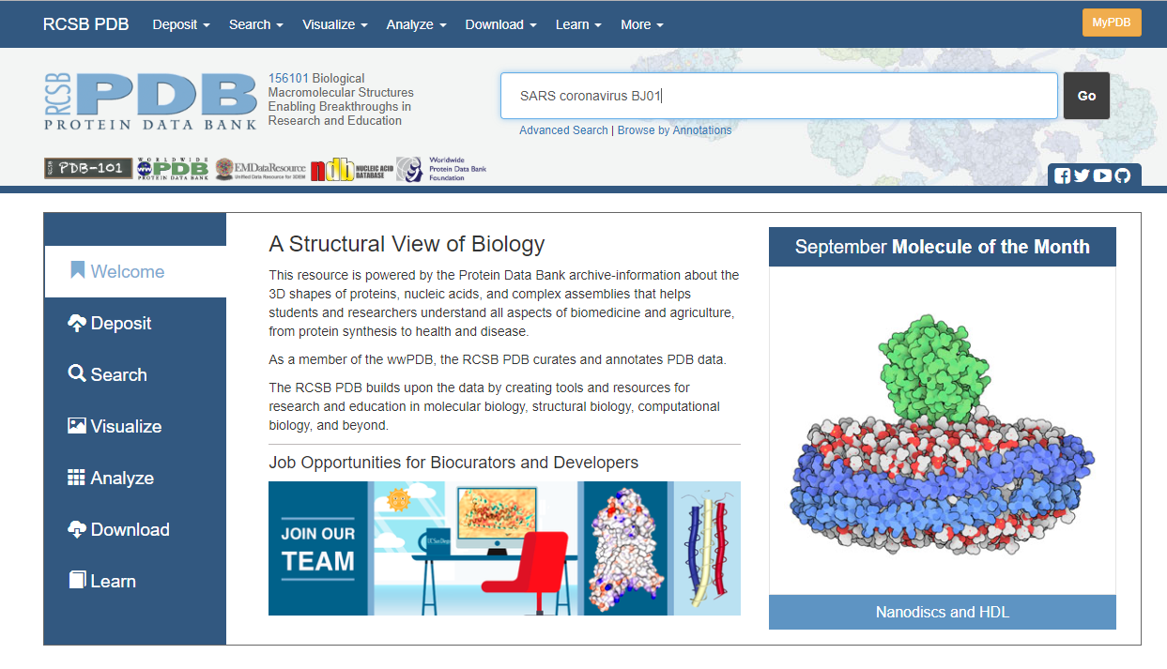

Slide 26
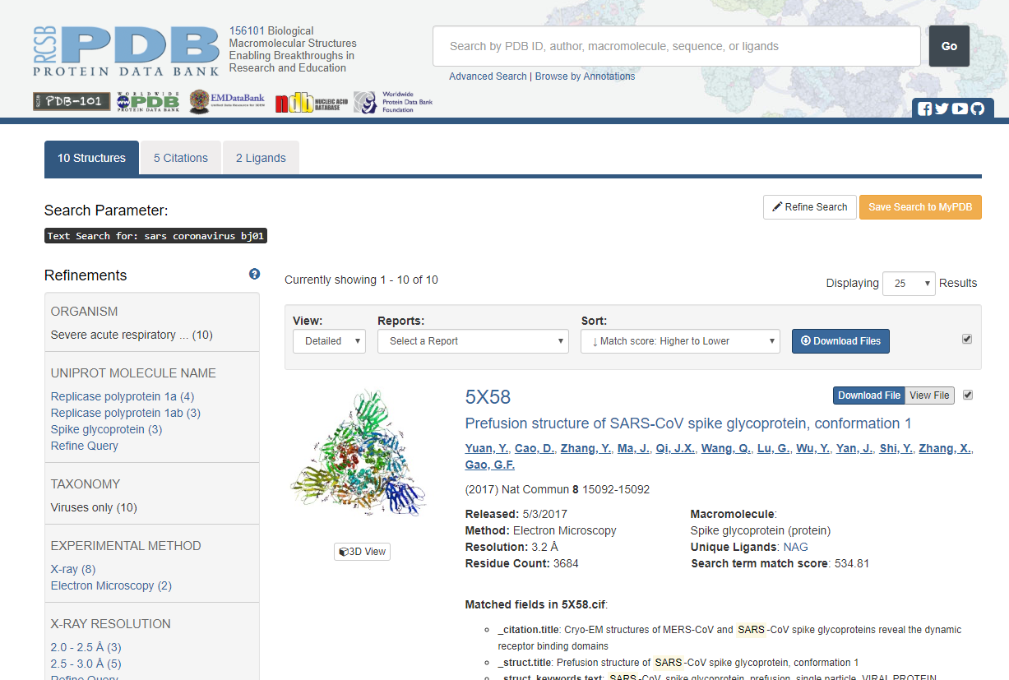

Slide 27
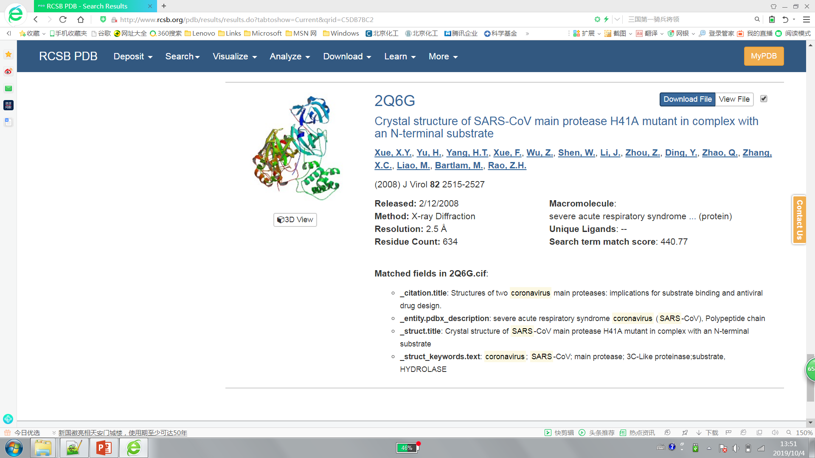
产生文件 PDB文件

Slide 28
蛋白质结构数据库
PDB的文件格式 PDB file name: 2Q6G.pdb
HEADER HYDROLASE 05-JUN-07 2Q6G
TITLE CRYSTAL STRUCTURE OF SARS-COV MAIN PROTEASE H41A MUTANT IN COMPLEX
TITLE 2 WITH AN N-TERMINAL SUBSTRATE
COMPND MOL_ID: 1;
COMPND 2 MOLECULE: SEVERE ACUTE RESPIRATORY SYNDROME CORONAVIRUS (SARS-COV);
COMPND 3 CHAIN: A, B;
COMPND 4 EC: 3.4.22.-;
COMPND 5 ENGINEERED: YES;
COMPND 6 MUTATION: YES;
COMPND 7 MOL_ID: 2;
COMPND 8 MOLECULE: POLYPEPTIDE CHAIN;
COMPND 9 CHAIN: C, D;
COMPND 10 ENGINEERED: YES
SOURCE MOL_ID: 1;
SOURCE 2 ORGANISM_SCIENTIFIC: SARS CORONAVIRUS;
SOURCE 3 ORGANISM_TAXID: 228407;
SOURCE 4 STRAIN: BJ01;
SOURCE 5 GENE: REP;
SOURCE 6 EXPRESSION_SYSTEM: ESCHERICHIA COLI BL21;
SOURCE 7 EXPRESSION_SYSTEM_TAXID: 511693;
SOURCE 8 EXPRESSION_SYSTEM_STRAIN: BL21;
SOURCE 9 EXPRESSION_SYSTEM_VECTOR_TYPE: PLASMID;
SOURCE 10 EXPRESSION_SYSTEM_PLASMID: PGEX-6P-1;
SOURCE 11 MOL_ID: 2;
SOURCE 12 SYNTHETIC: YES;
SOURCE 13 OTHER_DETAILS: CHEMICALLY SYNTHESIZED.
KEYWDS CORONAVIRUS; SARS-COV; MAIN PROTEASE; 3C-LIKE PROTEINASE;SUBSTRATE,
KEYWDS 2 HYDROLASE
EXPDTA X-RAY DIFFRACTION
AUTHOR X.Y.XUE,H.T.YANG,F.XUE,M.BARTLAM,Z.H.RAO
REVDAT 4 13-JUL-11 2Q6G 1 VERSN
REVDAT 3 24-FEB-09 2Q6G 1 VERSN
REVDAT 2 25-MAR-08 2Q6G 1 JRNL
REVDAT 1 12-FEB-08 2Q6G 0
JRNL AUTH X.XUE,H.YU,H.YANG,F.XUE,Z.WU,W.SHEN,J.LI,Z.ZHOU,Y.DING,
JRNL AUTH 2 Q.ZHAO,X.C.ZHANG,M.LIAO,M.BARTLAM,Z.RAO
JRNL TITL STRUCTURES OF TWO CORONAVIRUS MAIN PROTEASES: IMPLICATIONS
JRNL TITL 2 FOR SUBSTRATE BINDING AND ANTIVIRAL DRUG DESIGN.
JRNL REF J.VIROL. V. 82 2515 2008
JRNL REFN ISSN 0022-538X
JRNL PMID 18094151
JRNL DOI 10.1128/JVI.02114-07
物种来源、
测定方法、
提交者信息、

Slide 29
蛋白质结构数据库
PDB的文件格式 PDB file name: 2Q6G.pdb
SEQRES 1 A 306 SER GLY PHE ARG LYS MET ALA PHE PRO SER GLY LYS VAL
SEQRES 2 A 306 GLU GLY CYS MET VAL GLN VAL THR CYS GLY THR THR THR
SEQRES 3 A 306 LEU ASN GLY LEU TRP LEU ASP ASP THR VAL TYR CYS PRO
SEQRES 4 A 306 ARG ALA VAL ILE CYS THR ALA GLU ASP MET LEU ASN PRO
SEQRES 5 A 306 ASN TYR GLU ASP LEU LEU ILE ARG LYS SER ASN HIS SER
SEQRES 6 A 306 PHE LEU VAL GLN ALA GLY ASN VAL GLN LEU ARG VAL ILE
SEQRES 7 A 306 GLY HIS SER MET GLN ASN CYS LEU LEU ARG LEU LYS VAL
SEQRES 8 A 306 ASP THR SER ASN PRO LYS THR PRO LYS TYR LYS PHE VAL
SEQRES 9 A 306 ARG ILE GLN PRO GLY GLN THR PHE SER VAL LEU ALA CYS
SEQRES 10 A 306 TYR ASN GLY SER PRO SER GLY VAL TYR GLN CYS ALA MET
SEQRES 11 A 306 ARG PRO ASN HIS THR ILE LYS GLY SER PHE LEU ASN GLY
SEQRES 12 A 306 SER CYS GLY SER VAL GLY PHE ASN ILE ASP TYR ASP CYS
SEQRES 13 A 306 VAL SER PHE CYS TYR MET HIS HIS MET GLU LEU PRO THR
SEQRES 14 A 306 GLY VAL HIS ALA GLY THR ASP LEU GLU GLY LYS PHE TYR
SEQRES 15 A 306 GLY PRO PHE VAL ASP ARG GLN THR ALA GLN ALA ALA GLY
SEQRES 16 A 306 THR ASP THR THR ILE THR LEU ASN VAL LEU ALA TRP LEU
SEQRES 17 A 306 TYR ALA ALA VAL ILE ASN GLY ASP ARG TRP PHE LEU ASN
SEQRES 18 A 306 ARG PHE THR THR THR LEU ASN ASP PHE ASN LEU VAL ALA
SEQRES 19 A 306 MET LYS TYR ASN TYR GLU PRO LEU THR GLN ASP HIS VAL
SEQRES 20 A 306 ASP ILE LEU GLY PRO LEU SER ALA GLN THR GLY ILE ALA
SEQRES 21 A 306 VAL LEU ASP MET CYS ALA ALA LEU LYS GLU LEU LEU GLN
SEQRES 22 A 306 ASN GLY MET ASN GLY ARG THR ILE LEU GLY SER THR ILE
SEQRES 23 A 306 LEU GLU ASP GLU PHE THR PRO PHE ASP VAL VAL ARG GLN
SEQRES 24 A 306 CYS SER GLY VAL THR PHE GLN
SEQRES 1 B 306 SER GLY PHE ARG LYS MET ALA PHE PRO SER GLY LYS VAL
SEQRES 2 B 306 GLU GLY CYS MET VAL GLN VAL THR CYS GLY THR THR THR
SEQRES 3 B 306 LEU ASN GLY LEU TRP LEU ASP ASP THR VAL TYR CYS PRO
SEQRES 4 B 306 ARG ALA VAL ILE CYS THR ALA GLU ASP MET LEU ASN PRO
SEQRES 5 B 306 ASN TYR GLU ASP LEU LEU ILE ARG LYS SER ASN HIS SER
SEQRES 6 B 306 PHE LEU VAL GLN ALA GLY ASN VAL GLN LEU ARG VAL ILE
SEQRES 7 B 306 GLY HIS SER MET GLN ASN CYS LEU LEU ARG LEU LYS VAL
SEQRES 8 B 306 ASP THR SER ASN PRO LYS THR PRO LYS TYR LYS PHE VAL
SEQRES 9 B 306 ARG ILE GLN PRO GLY GLN THR PHE SER VAL LEU ALA CYS
SEQRES 10 B 306 TYR ASN GLY SER PRO SER GLY VAL TYR GLN CYS ALA MET
SEQRES 11 B 306 ARG PRO ASN HIS THR ILE LYS GLY SER PHE LEU ASN GLY
SEQRES 12 B 306 SER CYS GLY SER VAL GLY PHE ASN ILE ASP TYR ASP CYS
SEQRES 13 B 306 VAL SER PHE CYS TYR MET HIS HIS MET GLU LEU PRO THR
SEQRES 14 B 306 GLY VAL HIS ALA GLY THR ASP LEU GLU GLY LYS PHE TYR
SEQRES 15 B 306 GLY PRO PHE VAL ASP ARG GLN THR ALA GLN ALA ALA GLY
SEQRES 16 B 306 THR ASP THR THR ILE THR LEU ASN VAL LEU ALA TRP LEU
SEQRES 17 B 306 TYR ALA ALA VAL ILE ASN GLY ASP ARG TRP PHE LEU ASN
SEQRES 18 B 306 ARG PHE THR THR THR LEU ASN ASP PHE ASN LEU VAL ALA
SEQRES 19 B 306 MET LYS TYR ASN TYR GLU PRO LEU THR GLN ASP HIS VAL
SEQRES 20 B 306 ASP ILE LEU GLY PRO LEU SER ALA GLN THR GLY ILE ALA
SEQRES 21 B 306 VAL LEU ASP MET CYS ALA ALA LEU LYS GLU LEU LEU GLN
SEQRES 22 B 306 ASN GLY MET ASN GLY ARG THR ILE LEU GLY SER THR ILE
SEQRES 23 B 306 LEU GLU ASP GLU PHE THR PRO PHE ASP VAL VAL ARG GLN
SEQRES 24 B 306 CYS SER GLY VAL THR PHE GLN
SEQRES 1 C 11 THR SER ALA VAL LEU GLN SER GLY PHE ARG LYS
SEQRES 1 D 11 THR SER ALA VAL LEU GLN SER GLY PHE ARG LYS
蛋白质序列
一级结构

Slide 30
蛋白质结构数据库
PDB的文件格式 PDB file name: 2Q6G.pdb
HELIX 1 1 SER A 10 GLY A 15 1 6
HELIX 2 2 ALA A 41 CYS A 44 5 4
HELIX 3 3 ASN A 53 ARG A 60 1 8
HELIX 4 4 SER A 62 PHE A 66 5 5
HELIX 5 5 ILE A 200 ASN A 214 1 15
HELIX 6 6 THR A 226 TYR A 237 1 12
HELIX 7 7 THR A 243 LEU A 250 1 8
HELIX 8 8 LEU A 250 GLY A 258 1 9
HELIX 9 9 ALA A 260 ASN A 274 1 15
HELIX 10 10 THR A 292 SER A 301 1 10
HELIX 11 11 SER B 10 GLY B 15 1 6
HELIX 12 12 ALA B 41 CYS B 44 5 4
HELIX 13 13 ALA B 46 ASN B 51 5 6
HELIX 14 14 ASN B 53 ARG B 60 1 8
HELIX 15 15 SER B 62 PHE B 66 5 5
HELIX 16 16 ILE B 200 ASN B 214 1 15
HELIX 17 17 THR B 226 TYR B 237 1 12
HELIX 18 18 THR B 243 LEU B 250 1 8
HELIX 19 19 LEU B 250 GLN B 256 1 7
HELIX 20 20 THR B 257 ILE B 259 5 3
HELIX 21 21 ALA B 260 GLY B 275 1 16
HELIX 22 22 THR B 292 GLY B 302 1 11
SHEET 1 A 7 VAL A 73 LEU A 75 0
SHEET 2 A 7 LEU A 67 ALA A 70 -1 N VAL A 68 O LEU A 75
SHEET 3 A 7 MET A 17 CYS A 22 -1 N GLN A 19 O GLN A 69
SHEET 4 A 7 THR A 25 LEU A 32 -1 O GLY A 29 N VAL A 18
SHEET 5 A 7 THR A 35 PRO A 39 -1 O TYR A 37 N LEU A 30
SHEET 6 A 7 LEU A 86 VAL A 91 -1 O LEU A 87 N CYS A 38
SHEET 7 A 7 VAL A 77 GLN A 83 -1 N SER A 81 O ARG A 88
SHEET 1 B 5 VAL A 73 LEU A 75 0
SHEET 2 B 5 LEU A 67 ALA A 70 -1 N VAL A 68 O LEU A 75
SHEET 3 B 5 MET A 17 CYS A 22 -1 N GLN A 19 O GLN A 69
SHEET 4 B 5 THR A 25 LEU A 32 -1 O GLY A 29 N VAL A 18
SHEET 5 B 5 GLY C 8 PHE C 9 -1 O GLY C 8 N THR A 26
SHEET 1 C 3 TYR A 101 PHE A 103 0
SHEET 2 C 3 CYS A 156 GLU A 166 1 O VAL A 157 N LYS A 102
SHEET 3 C 3 HIS A 172 THR A 175 -1 O ALA A 173 N MET A 165
SHEET 1 D 5 SER A 121 ALA A 129 0
SHEET 2 D 5 THR A 111 TYR A 118 -1 N ALA A 116 O SER A 123
SHEET 3 D 5 VAL A 148 ASP A 153 -1 O PHE A 150 N SER A 113
SHEET 4 D 5 CYS A 156 GLU A 166 -1 O CYS A 156 N ASP A 153
SHEET 5 D 5 VAL C 4 LEU C 5 -1 O VAL C 4 N GLU A 166
SHEET 1 E 7 VAL B 73 LEU B 75 0
SHEET 2 E 7 LEU B 67 ALA B 70 -1 N VAL B 68 O LEU B 75
SHEET 3 E 7 MET B 17 CYS B 22 -1 N THR B 21 O LEU B 67
SHEET 4 E 7 THR B 25 LEU B 32 -1 O THR B 25 N CYS B 22
SHEET 5 E 7 THR B 35 PRO B 39 -1 O TYR B 37 N LEU B 30
SHEET 6 E 7 LEU B 86 VAL B 91 -1 O LEU B 89 N VAL B 36
SHEET 7 E 7 VAL B 77 GLN B 83 -1 N GLY B 79 O LYS B 90
SHEET 1 F 5 LYS B 100 PHE B 103 0
SHEET 2 F 5 CYS B 156 GLU B 166 1 O VAL B 157 N LYS B 100
SHEET 3 F 5 VAL B 148 ASP B 153 -1 N GLY B 149 O TYR B 161
SHEET 4 F 5 THR B 111 TYR B 118 -1 N SER B 113 O PHE B 150
SHEET 5 F 5 SER B 121 ALA B 129 -1 O TYR B 126 N VAL B 114
SHEET 1 G 3 LYS B 100 PHE B 103 0
SHEET 2 G 3 CYS B 156 GLU B 166 1 O VAL B 157 N LYS B 100
SHEET 3 G 3 HIS B 172 THR B 175 -1 O ALA B 173 N MET B 165
蛋白质二级结构

Slide 31
蛋白质结构数据库
PDB的文件格式 PDB file name: 2Q6G.pdb
ATOM 1 N SER A 1 85.864 -28.295 30.330 1.00 69.25 N
ATOM 2 CA SER A 1 86.458 -29.546 29.773 1.00 70.59 C
ATOM 3 C SER A 1 86.390 -29.591 28.243 1.00 70.71 C
ATOM 4 O SER A 1 86.159 -30.643 27.637 1.00 71.42 O
ATOM 5 CB SER A 1 85.759 -30.766 30.374 1.00 97.04 C
ATOM 6 OG SER A 1 85.975 -30.820 31.776 1.00 98.44 O
ATOM 7 N GLY A 2 86.593 -28.425 27.639 1.00 73.16 N
ATOM 8 CA GLY A 2 86.592 -28.288 26.195 1.00 72.03 C
ATOM 9 C GLY A 2 87.693 -27.288 25.916 1.00 71.40 C
ATOM 10 O GLY A 2 87.728 -26.229 26.544 1.00 72.18 O
ATOM 11 N PHE A 3 88.594 -27.600 24.989 1.00 54.76 N
ATOM 12 CA PHE A 3 89.702 -26.695 24.713 1.00 52.43 C
ATOM 13 C PHE A 3 89.438 -25.661 23.636 1.00 50.49 C
ATOM 14 O PHE A 3 89.620 -25.919 22.448 1.00 50.58 O
ATOM 15 CB PHE A 3 90.962 -27.481 24.356 1.00 46.09 C
ATOM 16 CG PHE A 3 92.212 -26.916 24.974 1.00 45.94 C
ATOM 17 CD1 PHE A 3 92.465 -27.084 26.336 1.00 44.45 C
ATOM 18 CD2 PHE A 3 93.119 -26.183 24.207 1.00 45.16 C
ATOM 19 CE1 PHE A 3 93.601 -26.530 26.927 1.00 44.49 C
ATOM 20 CE2 PHE A 3 94.262 -25.623 24.791 1.00 45.52 C
ATOM 21 CZ PHE A 3 94.502 -25.798 26.153 1.00 44.51 C
ATOM 22 N ARG A 4 89.031 -24.475 24.071 1.00 37.15 N
ATOM 23 CA ARG A 4 88.739 -23.378 23.160 1.00 34.92 C
ATOM 24 C ARG A 4 89.927 -22.416 23.066 1.00 32.86 C
ATOM 25 O ARG A 4 90.922 -22.567 23.772 1.00 31.89 O
ATOM 26 CB ARG A 4 87.503 -22.621 23.650 1.00 44.16 C
ATOM 27 CG ARG A 4 86.360 -23.515 24.072 1.00 44.10 C
ATOM 28 CD ARG A 4 85.133 -22.698 24.432 1.00 45.73 C
ATOM 29 NE ARG A 4 84.465 -22.152 23.254 1.00 46.08 N
ATOM 30 CZ ARG A 4 83.850 -22.895 22.339 1.00 46.40 C
构成蛋白质的氨基酸的每个原子的三维坐标

Slide 32
思考题
核酸序列的 *.gb （Genbank）文件包含核酸的哪些信息？蛋白质 *.pdb（protein data bank）文件包含蛋白质的哪些信息？

Slide 33
Thank you！

