Slide 1
Chapter 4
Differential Analysis:
The Key to Decision Making
管理会计的核心

Slide 2

迈克尔.波特：“竞争是企业成败的
关键。竞争优势归根到底来源于企业
为客户创造的超过其成本的价值。一
是创造价值，决定于产业内的竞争地
位；另一是低于对手的价格提供同值
服务。”
创造顾客是企业的首要
剩下的只是成本问题

Slide 3
管理的重心在于经营，经营的重心在于决策
“世界上每100家破产倒闭的大企业中，85%是因为企业管理者的决策不慎造成的。”—美国兰德公司
决策：管理会计的核心

Slide 4
CHAPTER OUTLINE
Cost Concepts for Decision Making
Adding and Dropping Product Lines and Other Segments
The Make or Buy Decision
Opportunity Cost
Special Orders
Utilization of a Constrained Resource
Joint Product Costs and the Contribution Approach

Slide 5
1 Cost Concepts for Decision Making
——Differential cost
Differential cost：
广义
A difference in costs between any two alternatives
狭义
通常是指产量增减变化而形成的成本差别。
incremental cost
在“相关范围”内，差别成本表现为变动成本，但是，当生产能力发生变动时，差别成本也可能包括固定成本。

Slide 6
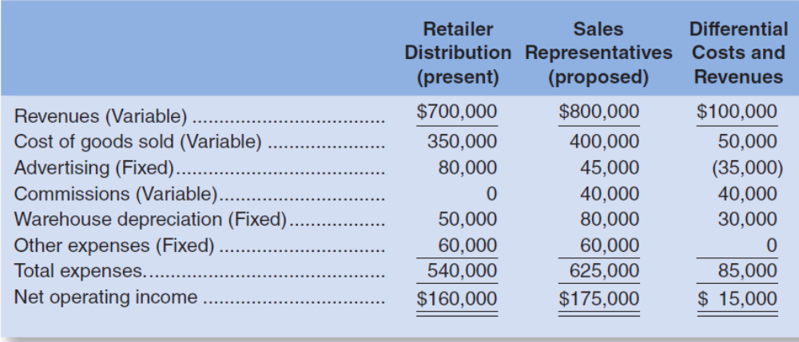
1 Cost Concepts for Decision Making
——Differential cost
每年15000美元的差额支持通过销售代表网络分销。

Slide 7

1 Cost Concepts for Decision Making
——Opportunity Cost
The potential benefit that is given up when one alternative is selected over another.
Example: If you were
not seeking further education,
you could be earning
$15,000 per year.
Your opportunity cost
of returning to school for one year is $15,000.

Slide 8
1 Cost Concepts for Decision Making
——Opportunity Cost
The potential benefit that is given up when one alternative is selected over another.
玛丽的备选方案：
留下做雇员 开办独立事务所 差额
收入 60000 200000 140000
实支成本 — 120000 120000
机会成本 80000
每年的收益结果 60000 80000 20000
考虑机会成本的收益 —20000 20000
60000
玛丽每年牺牲20000美元一避免独立执业的风险。

Slide 9
1 Cost Concepts for Decision Making
——Opportunity Cost
课外链接
梁武帝 《河中之水歌》：
河中之水向东流。洛阳女儿名莫愁。
莫愁十三能织绮。十四采桑南陌头。
十五嫁为卢家妇。十六生儿字阿侯。
卢家兰室桂为梁。中有郁金苏合香。
头上金钗十二行。足下丝履五文章。
珊瑚挂镜烂生光。平头奴子擎履箱。
人生富贵何所望。恨不早嫁东家王

Slide 10
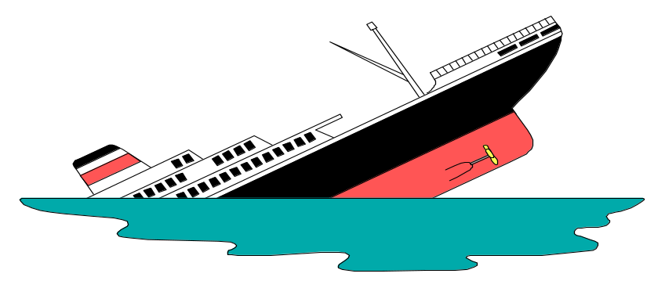
1 Cost Concepts for Decision Making
——Sunk Costs
Sunk costs have already been incurred and cannot be changed now or in the future. These costs should be ignored when making decisions.
［例］某企业在六年前购置一台机床，原价 18 000元，拟报废清理或修理后作价出售。
1、假定报废清理可得残值1200元；
2、进行修理则需花修理费 4 000元，修理后可作价8 000元出售。
究竟采用哪个方案较为合适？
沉没成本，决策无关成本

Slide 11
1 Cost Concepts for Decision Making
——avoidable cost
An avoidable cost is a cost that can be eliminated by choosing one alternative over another.

Slide 12
Cost Concepts for Decision Making
A relevant cost is a cost that differs between alternatives.
1
2
Two broad categories of costs are never relevant in any decision. They include:
  Sunk costs.沉没成本
  Future costs that do not differ between the
  alternatives.目前各备选方案相同的未来成本。
小结：
相关成本： 差别成本、机会成本、可避免成本
不相关成本：沉没成本、各备选方案相同的未来成本

Slide 13


Decision-Making Process
好，我已经汇集了与我们考虑的备选方案相关的所有成本。

Slide 14

Decision-Making Process
太好了！我们首先
需要做的是去除
所有沉没成本。

Slide 15

Decision-Making Process
我们既要除了沉没成本，
也要去除各备选方案
相同的成本。

Slide 16
Decision-Making Process
现在决策要容易些了,
所剩下的是可相关成本.

Slide 17
普通人常常不计算机会成本，而经济学家则往往忽略沉没成本，这是一种睿智。
--2001年诺贝尔经济学奖得主斯蒂格利茨。

Slide 18

我们来看一下
例子

Slide 19
例：是否采纳乘地铁上班这一项目。
开车上班的月费用：保险费用 120美元
公寓停车费 150美元
上班停车费 90美元
汽油等费用 110美元
总计 470美元
乘地铁上班月费用：保险费用（120）
公寓停车费（150）
车票（140美元）
总计 410美元
无关费用（成本）：公寓停车费和汽车保险费
相关费用（成本）：上班停车费和汽油等费用
相关费用总计为90+110=200美元，而地铁车票成本为140美元。

Slide 20
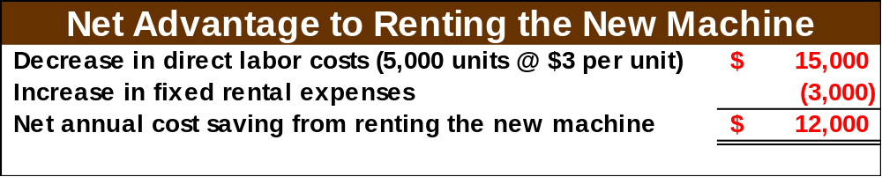
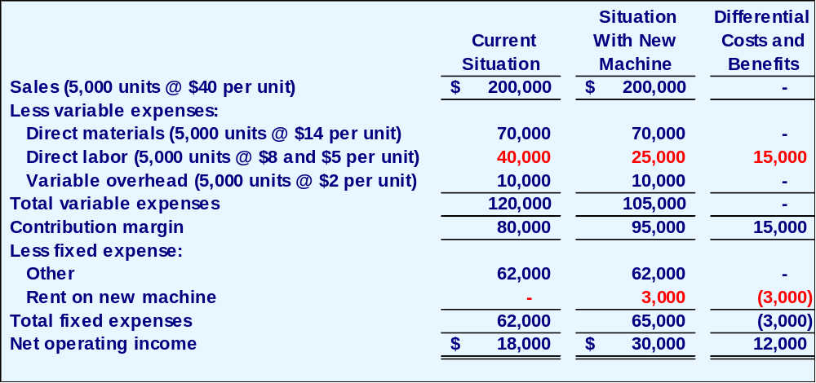
Total and Differential Cost Approaches
We can efficiently analyze the decision by
looking at the different costs and revenues
and arrive at the same solution.
The management of a company is considering a new labor saving machine that rents for $3,000 per year. Data about the company’s annual sales and costs with and without the new machine are:

Slide 21
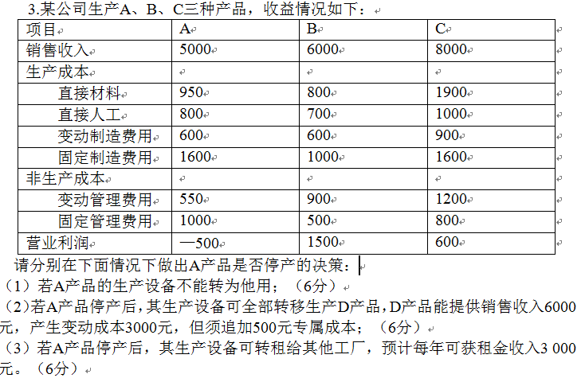

Slide 22
1.假设你在10月买了一张到A、售价450美元的不可退的机票，参加一个5天4夜的冬季滑雪团A的雪橇票价格为300美元，在A的旅馆住宿成本为每晚180美元。
你现在有机会可以买一张400美元的机票，是到B的5天4夜的冬季滑雪团，还包括一张免费的雪橇票B的旅馆住宿成本为每晚150美元。
在决定去B还是A的决策中，下列哪个是非相关的？
A.450美元 B.400美元 C. 300美元 D. 180美元
2.根据问题的信息，差量成本分析倾向于A 还是B？差异是多少？
A. B,470美元 B. B,20美元
C. A,70美元 D. A, 20美元

Slide 23
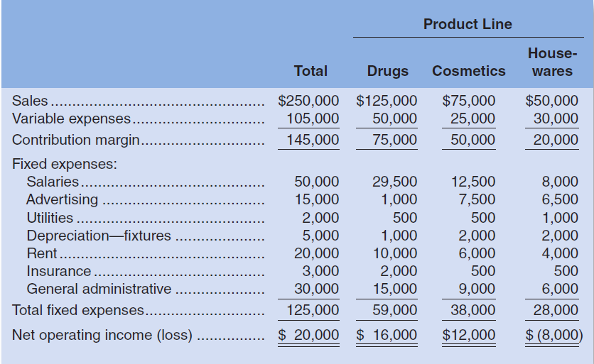
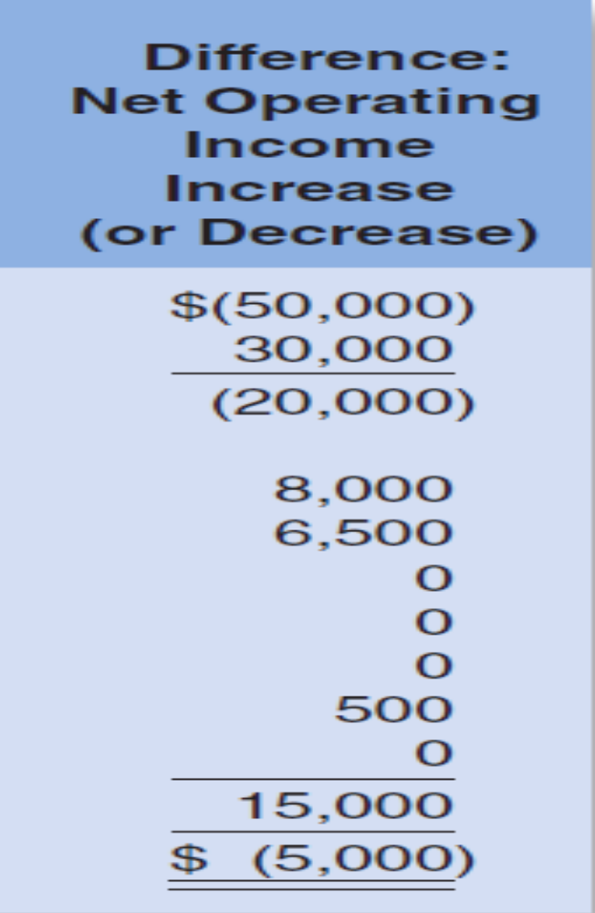
2 Adding/Dropping Segments 538
Should Lovell retain or drop
the housewares segment?
IRRELEVANT

Slide 24
2 Adding/Dropping Segments 538
relevant sales > relevant costs
or
Incremental net operating income >0

Slide 25
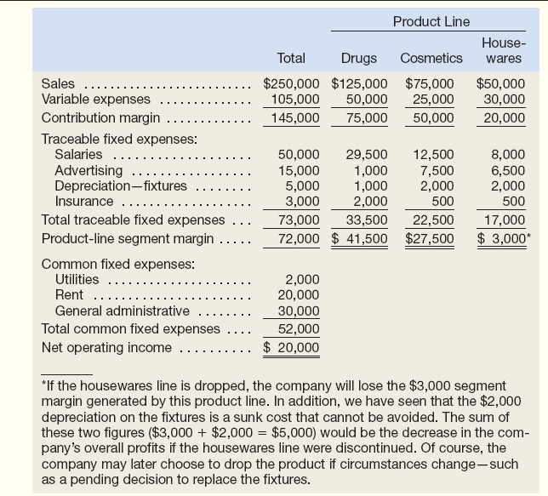
部门产品的盈利能力
评价部门经理业绩
1000
16000
24000
1000
4000
6000
评价部门业绩
如果停止日常用品线，公司将损失3000美元的部门边际贡献，注意固定资产的折旧费用2000美元是沉没成本，无法免除的。而这两个数字的加总（$3000+$2000=$5000）就是公司停止日常用品生产线所减少的利润。

Slide 26
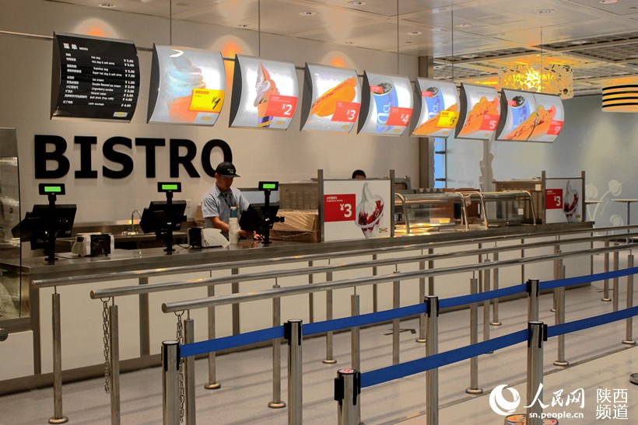
Managers may choose to retain an unprofitable product line if the line helps sell other products, or if it serves as a ―magnet‖ to attract customers.

Slide 27
IPM Co. is considering closing down one of its divisions. The division presently has a division contribution margin of €500,000. Overhead allocated to the division is €1,250,000, of which €125,000 cannot be eliminated. If this division were discontinued, by what amount would IPM’s pretax income decrease?
1) €625,000 2) €500,000
3) €125,000 4) €750,000

Slide 28

3 The Make or Buy Decision
Vertical Integration- Advantages
Smoother flow of parts and materials
Better quality control
Realize profits
Disadvantage
Companies may fail to take advantage of suppliers who can create economies of scale advantage by pooling demand from numerous companies.

Slide 29
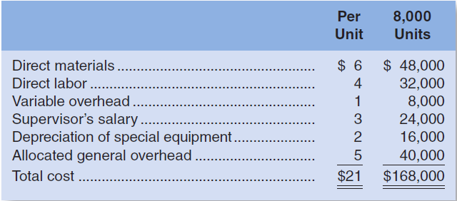
3 The Make or Buy Decision
登山自行车变速器成本：
IRRELEVANT

Slide 30
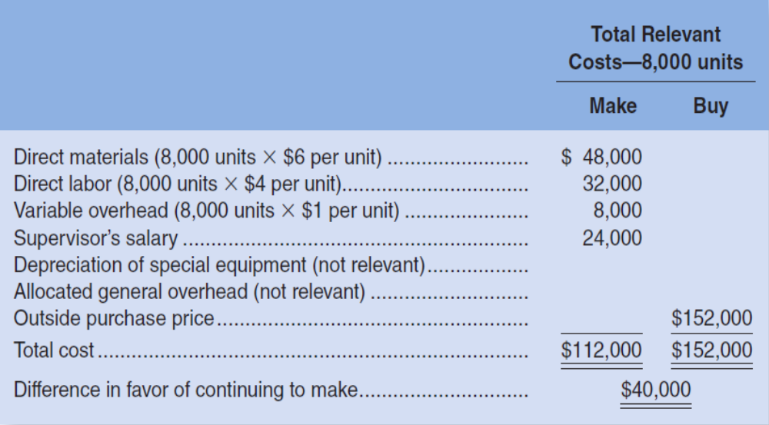
3 The Make or Buy Decision
Comparison of the relevant costs
Given that the total avoidable costs are less than the cost of buying the part, MGC should continue to make the part.

Slide 31
4 Opportunity Cost
假设生产变速器的厂房空间可以用来生产一种新型的越野单车，每年可因此获利60 000美元。
Opportunity cost—segment margin forgone
on a potential new product line
$60 000
$172 000
$20 000

Slide 32
Lindon Company produces 5,000 units of Part X each year as a component of its products. The company is presently producing Part X internally at a total cost as follows:
Direct materials $18,000
Direct labor 20,000
Variable manufacturing overhead 12,000
Fixed manufacturing overhead 30,000
Total costs $80,000
An outside supplier has offered to provide Part X at a price of $13 per unit. If Lindon Company stops producing the part internally, one-third of the fixed manufacturing overhead would be eliminated.
Required: What is the net total profit (loss) of purchasing the part rather than making it? SHOW YOUR COMPUTATIONS.

Slide 33
Relevant cost Analysis:
Make Buy
Outside purchase price $65,000
(5,000× $13)
Direct materials ............................... $ 18,000
Direct labor .........................................20,000
Variable manufacturing overhead .....12,000
Fixed manufacturing overhead 10,000
(1/3× $30,000)
Total
$60,000 $65,000
$60,000-$65,000=-$5,000(1marks)
The net total loss of purchasing the part rather than making it is $5,000.

Slide 34
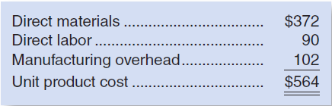
5 special order
A special order is a one-time order that is not considered part of the company’s normal ongoing business.
ORDERE : price : $558 each, 100
The normal selling price is $698
Should MGC accept the offer?

Slide 35
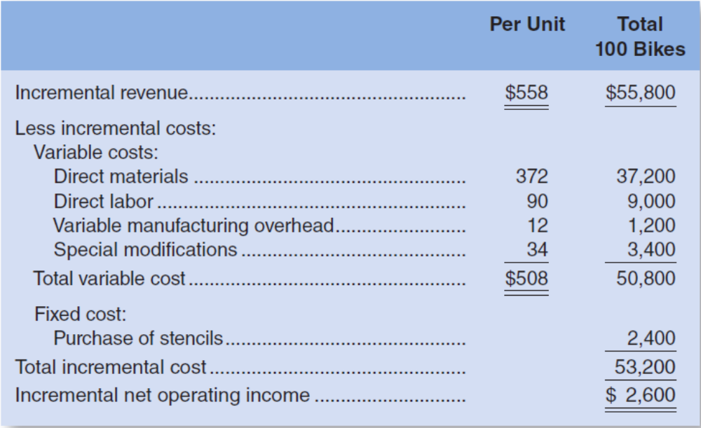
5 special order
支撑架焊接
警局标志模板

Slide 36
5 special order
relevant sales > relevant costs
or
Incremental net operating income >0
支撑架焊接
警局标志模板

Slide 37

Question :Adamyan Co. manufactures and sells medals of athletic and other events.Its manufacturing plant has the capacity to produce 90,000 medals each month; current monthly production is 80,000 medals. The company normally charges $11 per medal.
Cost data for the current level of production are shown below:
The company has just received a special one-time order for 10,000 medals at $7 each.
a. For this particular order, no variable selling and administrative costs would be incurred.
b. The special order has to be taken in its entirety.
Required: Should the company accept this special order?

Slide 38
Question :Adamyan Co. manufactures and sells medals of athletic and other events.Its manufacturing plant has the capacity to produce 90,000 medals each month; current monthly production is 80,000 medals. The company normally charges $11 per medal.
Cost data for the current level of production are shown below:
The company has just received a special one-time order for 12,000 medals at $7 each.
a.For this particular order, no variable selling and administrative costs would be incurred.
b.The special order has to be taken in its entirety.
Required: Should the company accept this special order?

Slide 39
Incremental revenue
（12,000 × $7 ）-（2,000 × $）=$62,000
Incremental costs
Variable production costs=10,000 × $4.6=$46,000
variable selling and administrative costs
= -2,000 × $1=-$2,000
Incremental costs net operating income=$18,000
The company should accept this special order.

Slide 40
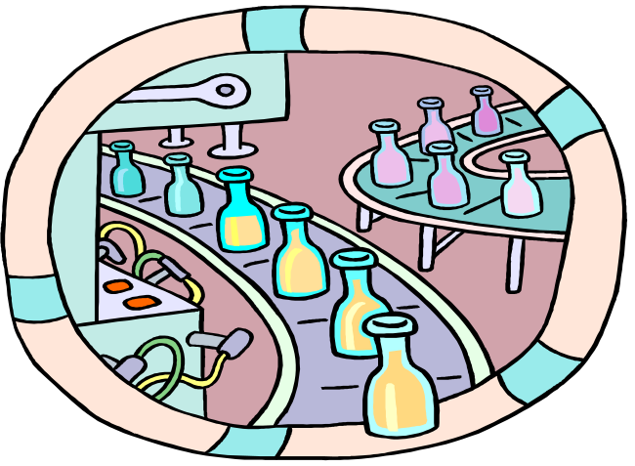
6 Utilization of a Constrained Resource
When a limited resource of some type restricts the company’s ability to satisfy demand, the company is said to have a constraint.
The machine or process that is limiting overall output is called the bottleneck – it is the constraint.

Slide 41
总收入中各种产品和劳务的数量组合关系：
低边际贡献和高边际贡献产品所占比例的变化
  增加高边际贡献产品的比例
  最佳生产决策：面对资源限制时最佳生产决策不是选择单位边际贡献最高的产品，而是使相对于有限的资源因素的单位边际贡献最高的产品。

Slide 42
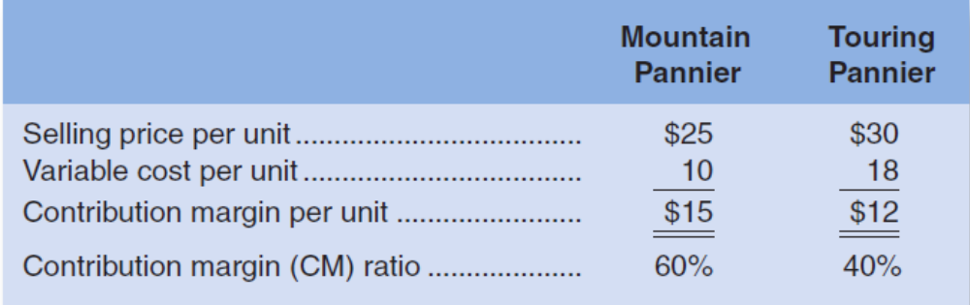
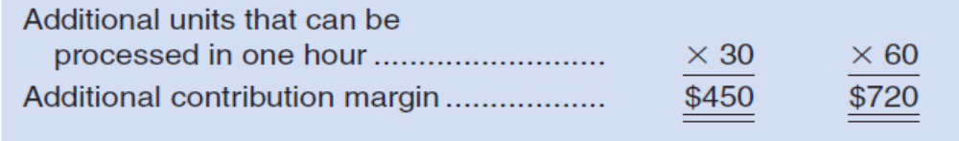
（a）

Slide 43

雪橇发动机 船用发动机
售价 800 1000
单位变动成本 560 625
单位边际贡献 240 375
边际贡献率 30% 37.5%
单位产品所需机时 2 5
（每天只有600个机时）
单位机时边际贡献 120 75
600机时总边际贡献 72000 45000

Slide 44
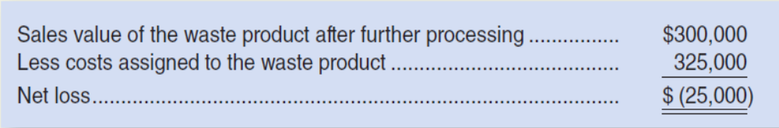
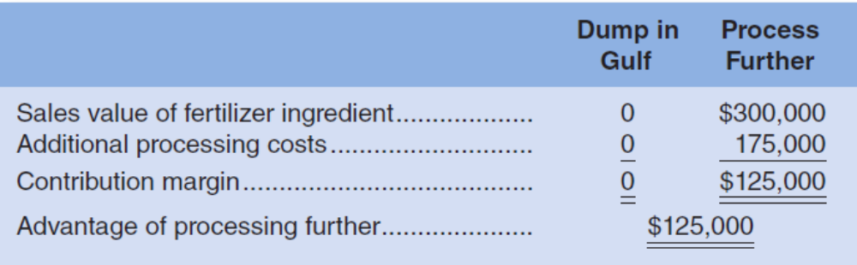
7 JOINT PRODUCT COSTS
AND THE CONTRIBUTION APPROACH

Slide 45
Joint Costs
In some industries, a number of end products are produced from a single raw material input.
Two or more products produced from a common input are called joint products.
The point in the manufacturing process where each joint product can be recognized as a separate product is called the split-off point.

Slide 46




Joint products and by-products
Joint products
forestry
By - product
Slide <number>

Slide 47
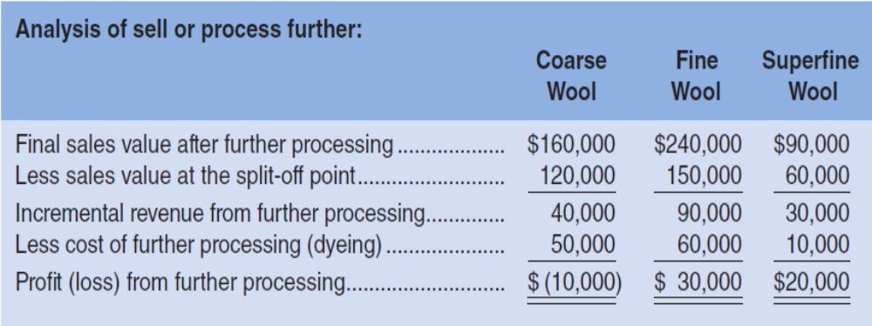

Slide 48
联产品是否进一步加工的决策分析
产品 | 产量（件） | 马上出售的单价 | 继续加工的单位成本 | 加工后出售的单价
甲 | 5 000 | 12 | 8 | 22
乙 | 3 000 | 20 | 12 | 25
√
产 品 项 目 | 甲产品 | 乙产品
差别收入 | 5 000 X （22-12）= 50 000 | 3 000 X （25-20）=15 000
差别成本 | 5 000 X 8 =40 000 | 3 000 X 12 =36 000
差别利润 | 10 000 | （21 000）

Slide 49
小结：
Cost Concepts for Decision Making
Adding and Dropping Product Lines and Other Segments
The Make or Buy Decision
Opportunity Cost
Special Orders
Utilization of a Constrained Resource
Joint Product Costs and the Contribution Approach

Slide 50

Next Lecture…
Profit Planning

