Slide 1
Let’s talk about cookies today

Slide 2
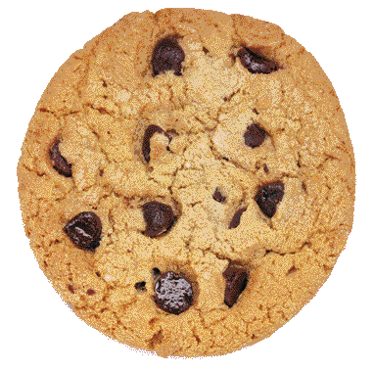
Nope!
Not this kind of cookie

Slide 3
1.
So, what are cookies?
Any Ideas?

Slide 4
The Internet is tracking my cookies?!
They’ll NEVER get my recipe!
Grandma

Slide 5
Also Known As
Web Cookie
Internet Cookie
Browser Cookie
A small piece of data sent from a site and stored on the user’s computer by the user’s web browser while the user is browsing.

Slide 6
Simply Put
A cookie is basically the same idea of getting a number at the DMV
Notes:
cookie is basically same idea of you getting a number at the DMV or at the deli counter.
the store gives you a number. you are now client 234241. everytime you talk to me, you'll tell me you're 234241. even if you leave the store, if u come back a day or two later, you'll still tell me you're 234241.
Different on each site

Slide 7

Different Kinds of Cookies
Persistent
Session
Chocolate Chip
Notes:
Session cookies - these are temporary and are erased when you close your browser at the end of your surfing session. The next time you visit that particular site it will not recognise you and will treat you as a completely new visitor as there is nothing in your browser to let the site know that you have visited before
Persistent cookies - these remain on your hard drive until you erase them or they expire. How long a cookie remains on your browser depends on how long the visited website has programmed the cookie to last. (preferences)
Can be both
Advertisig revenue, billboard example

Slide 8

COokies are completely SAFE
They can’t carry malware or viruses, so don’t worry about harm to your computer!

Slide 9
Potential Bad Sides
Forgery
What if someone gets ahold of your cookie?
Tracking
Remember talking about privacy?
Notes:
The worst possible scenario would be the interception or forgery of one of your cookies, which would allow another user to impersonate you on some website. This could result in them eavesdropping on your user data OR hijacking your account credentials.
A more prevalent issue is a specific type of cookie called the “tracking cookie.” Instead, they keep track of all of your actions on certain websites. These can be used to build browsing history profiles, which can be used to target specific ads to you. This is where “invasion of privacy” comes in. You can opt out!

Slide 10
Let’s see what they look like!
Notes:
Examples TBD

