Slide 1
Passwords and Hashing

Slide 2
Everything is stored somewhere
Say you run a website. When a user gives you their username and password, how do you know to let them in?
You probably have a file or database of usernames and passwords.
(This doesn’t only apply to websites - the same thing is true on any system you log into: computers (desktop/laptop/mobile), apps, websites, services…)

Slide 3
What are some problems with this password file?
Path to file: Desktop/PasswordsNOTStoredHere
Empoyee # | Employee Name | Employee Email | Employee Password
1 | Sarah Larbi | larbis@UNsecure.com | PASSWORDSSSS
2 | Shreeya Khadka | khadkas@UNsecure.com | Pa$$words
3 | JianYi Huang | huangj@UNsecure.com | a1234556788
4 | Nobody Cares | Caresn@UNsecure.com | icare
5 | Code Breaker | Breakerc@UNsecure.com | breakingCodes

Slide 4
Problems
File must not be stored in plaintext
File is stored in a standard location
File needs to be edited, added to, removed from a lot, possibly from a lot of different sources

Slide 5
Solutions?
File must not be stored in plaintext
Encryption?
Notes:
Problem: crypto relies on keys. You probably don’t want just one master key, because then so many different locations must know it. But then where do you store the keys? Now we have the same problem.

Slide 6
Solutions?
File must not be stored in plaintext
Encryption?
Hide the file?
Notes:
This is in general bad practice, because it only takes ONE misstep to lose the entire file!

Slide 7
Solutions?
File must not be stored in plaintext
Encryption?
Hide the file?
Something new!
Notes:
This is in general bad practice, because it only takes ONE misstep to lose the entire file! Also, it makes it harder to update from many different locations.

Slide 8
Hashing
In general, a hash function is a function from one space (say, “integers”) to another space with a fixed length (say, “integers mod 100”)
Examples:
Binary strings -> First two characters of the strings
Any amount of money ($17.61) -> Only the change ($0.61)
People -> Birthdays
Any color -> “ROYGBIV”
What is mod 100?

Slide 9
Pigeon Hole Principle
If you have N pigeons in K holes, and (N/K) is not an integer, then then some hole must have strictly more than (N/K) pigeons.
Notes:
So 16 pigeons occupying 5 holes means some hole has at least 4 pigeons.
This deals with 100% chance of a collision.

Slide 10
Birthday Paradox
What is the probability of finding a hash collision (two inputs with the same output) given n people and a hash function that maps to m outputs.
“Birthday problem”:
h(person) = person’s birthday n = number of people in this room m = 366 (every possible birthday)
Notes:
Birthday paradox!! Pigeon Hole principle.
Gets pretty complex, but there’s a difference between knowing there is a collision, and actually finding it!

Slide 11
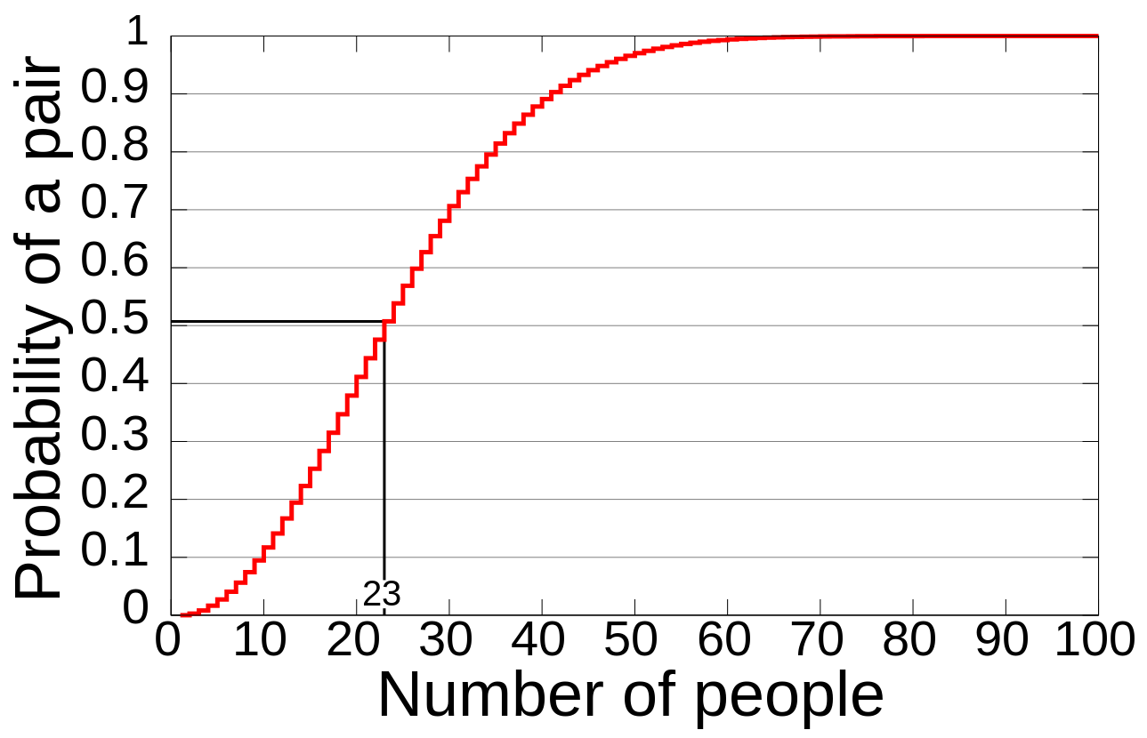
Hash functions
How many people need to be in a room for there to be a 50% chance at a birthday hash collision?
Notes:
Show the math!
Basic probability. Figuring out something happens, is the probability of 1-something happening. Easy example: p(I take a nap after codebreakers is 60%). What’s the probability that I don’t take a nap then? (*answer: 40%!)
Assume all days are equally likely!! Any two people. Not me + 1 other person (much lower!)
p(someone shares a bday?) = 1-p(no one shares a bday)
Second player doesn’t share with the 1st: 364/365
Third player: 363/365
4th player: 362/365
….
23rd player: 343/365 #allowed to have a birthday
When we combine the odds of multiple independent choices together, we multiply their probabilities. Multiplication rule P(a and b)
Multiplication = .49
1-.49 = ~50%

Slide 12
Back to storing the password file...
File must not be stored in plaintext
Encryption?
Hide the file?
Hashing?
Hash functions in cryptography are usually “easy” to do forward, and “hard” to do backward...
Notes:
.
MD5 was designed for a number of properties, one of the strongest being collision resistance. This means that it should take an enormous computational effort in order to find two files that have the same hash output.
This is an important property for a number of applications, most obviously digital signatures. For signatures, a file is usually hashed and then signed. So if two files -- one innocuous and one malicious -- can be prepared with the same hash values, a signature on the innocuous one will also be valid on the malicious one. This is how the Flame malware, for example, poses as a legitimate windows patch (using an MD5 collision not on Flame itself, but on the certificate used to sign it).

Slide 13
We can hash any string (or file, actually)
http://md5-hash-online.waraxe.us/
Remember, this is one-way. So we can’t easily plug the hash into a function and get the hash back. (That is, given h(x), it’s hard to find x.)

Slide 14
Problems with hashing
Given that it’s easy to get a hash of something, and hard to get that something given the hash, how can we crack hashed passwords?
Notes:
Could precompute a bunch of potential passwords
Can search for h(“1234”) easily and figure out who has simple passwords like that.

Slide 15
Hashing the same thing always yields the same result
A random string you attach to the thing you hash. You can store it in plaintext; the point is to prevent adversaries from using pre-computed lookup tables.
Username Password H(password) Mom trees 2d5563ed288ac5396add9b78fbca810b iceicebaby trees 2d5563ed288ac5396add9b78fbca810b oddbagel trees 2d5563ed288ac5396add9b78fbca810b nerdling mypassword 34819d7beeabb9260a5c854bc85b3e44

Slide 16
Problems with hashing
Try hashing both common passwords and random gibberish:
“Password” → “P455w0rd” → “A9ds8hwoiryuqkweaf098” →
Hash calculator: http://md5-hash-online.waraxe.us/
Then crack the hashes: https://crackstation.net/
342c5ccfe549f200a5596816e736bb27
092eec70def3fc115ff5c32a2cc1516f
ca4c87347da2261627bd9e0562b27c7e
Notes:
Could precompute a bunch of potential passwords
Can search for h(“1234”) easily and figure out who has simple passwords like that.

Slide 17
Back to storing the password file...
File must not be stored in plaintext
Encryption?
Hide the file?
Hashing?
Hashing with salt!

Slide 18
“Salt”
A random string you attach to the thing you hash. You can store it in plaintext; the point is to prevent adversaries from using pre-computed lookup tables.
Username Password Salt H(salt+pw) Mom trees 10zu2J 7504b19aa2b3b82d876fd115fc9cfd5a iceicebaby trees L0o48x 3644cad1ce06d38ce614ab0a44385e62 oddbagel trees Mh5mN8 4a73a422b51dfca118f40abd1daf6d47 Nerdling mypassword e9CY01 694bbd07a70a9f42491ded592e521477

Slide 19
Cracking passwords
stolenPasswordHash = “7c6a180b36896a0a8c02787eeafb0e4c”
potentialPasswords = [“password”, “password1”, “1234”, “123456”, “password1234”, “p455w0rd”, “Password”, “Password1”, “Password1234”, “P455W0RD”]
for pw in potentialPasswords: if hash(pw) == stolenPasswordHash: print(pw)

Slide 20
Exercise_hashing.py
Given a hash function, a bunch of hashes, and a bunch of words, can you crack the hashes with brute force attacks?

Slide 21
What does this say about individual passwords?
You should use different passwords on different websites - a hacker who gets your password on one website can use it to log in anywhere, and not every site protects your passwords equally. Don’t be afraid to contact websites that don’t salt your password hashes.
Be knowledgeable about how your passwords are stored, and what you should do in the case that the server is breached.
To prevent dictionary attacks, try not to use only dictionary words in passwords. If possible, insert numbers or symbols in the middle of the words or switch up uppercase/lowercase.

Slide 22
Salting your hash
https://www.youtube.com/watch?v=8ZtInClXe1Q

