Slide 1
Passwords

Slide 2
Brute force strength
What does it mean to brute force?

Slide 3
What does password strength depend on?
Length
How long the password is
Uniqueness
How unique the password is
Notes:
Ask what brute force is

Slide 4
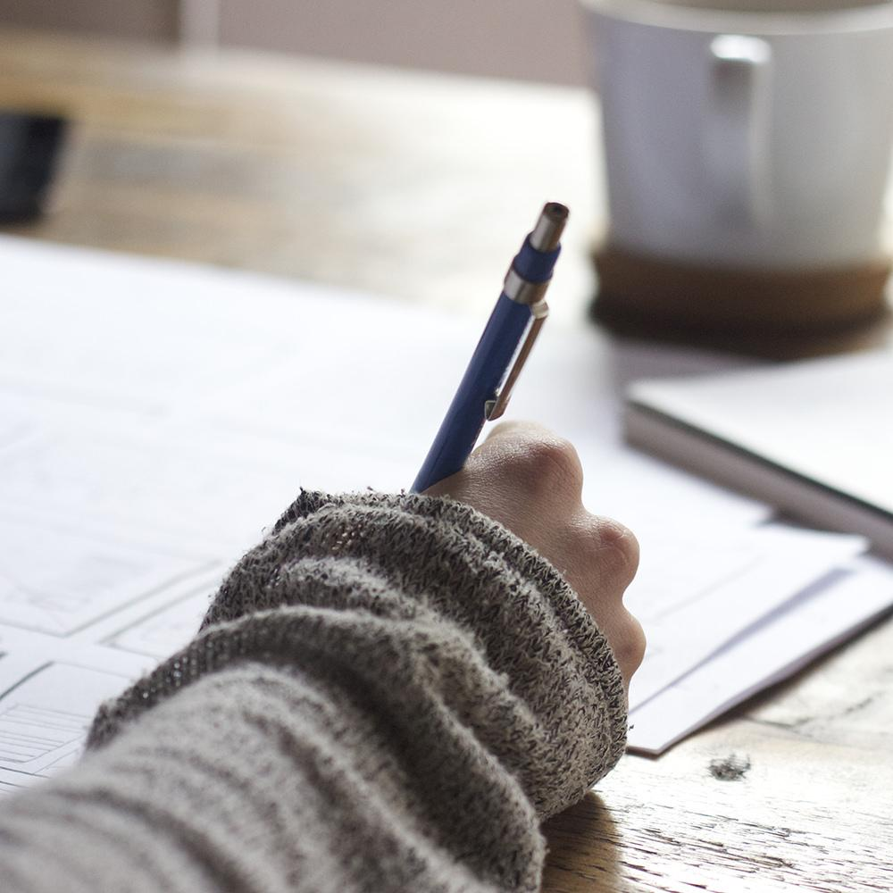
LET’S PLAY A GAME
How secure is THIS password?
Notes:
Take a couple minutes to think of a “hard passowrd” Check on kapersky labs

Slide 5
Can be brute forced in less than 1 second by a home computer!
SECURE OR UNSECURE?
Pa$$word

Slide 6
poiuytrewq
SECURE OR UNSECURE?
Can be brute forced in less than 1 second by a home computer!
Did you notice the pattern?

Slide 7
IAmNotarobot
SECURE OR UNSECURE
Brute forced by a home computer in > 10000 centuries. BUT a supercomputer can do it in < 2 years.

Slide 8
6=pa-wedun#wabrus-ud#5awr7+wu8ed
SECURE OR UNSECURE
10000+ centuries even for a super computer. But is this realistic?

Slide 9
“ I set my password to incorrect so that when i forget it my computer tells me ‘Your password is incorrect’ “

Slide 10
So How do we keep our passwords secure?
Let’s ask Ellen Degeneres.
https://www.youtube.com/watch?v=Srh_TV_J144
Notes:
Show computerphile video

Slide 11
No, but really - here’s how
Length not Complexity
Keep it Weird
Don’t Bunch Up
Don’t Change Them So Often
Don’t Double Dip
Don’t Panic
Notes:
Length not Complexity
A longer password is usually better than a more random password..
Keep it Weird
If longer passwords are based on simple patterns they will put you in just as much risk of having your identity stolen by hackers.
Don’t Bunch Up
Put digits, special characters, and punctuation throughout the middle of your password. Not just at the beginning and end.
Don’t Change Them So Often
Frequent password changes are largely a waste of time. .
Don’t Double Dip
Your passwords are only as secure as the sites you entrust them to.
Don’t Panic
Your bank isn’t going to give an attacker a million guesses

Slide 12
TakeAway Points
Don’t
Use names,
Personal information
Patterns
Reuse
Do
Make them long
Have a variety of characters
OBSCURE DOESN’T MEAN UNCRACKABLE
Notes:
https://www.youtube.com/watch?v=3NjQ9b3pgIg&t=312s

Slide 13
Multi Factor Authentication
A method of computer access control in which a user is granted access only after successfully presenting several pieces of evidence to an authentication mechanism -- typically at least two of the following categories: knowledge and possession.

Slide 14
Password Duel
Time for an activity!

Slide 15
A MORE FUN GAME!
Game Play
- take turns writing down 10 words on individual slips of paper. These will become your password.
- Pick a player to be ‘IT’ for each round.
- Team 1 picks a password from Team 2 and vice versa (or 3 from 4)
- Each team takes turns collaborating on a one-word clue to give the IT player so he can guess the password.
- Team that provides the best clue in the fewest # of turns so the IT guesses the password gets a point! Teams at the end win a prize! (after lunch though LOL)

Slide 16
A More Fun Game!
Notes:
game play
Before the game begins, players take turns writing 5 to 10 words on individual slips of paper. These words become the "passwords" used during game play. Each team selects a player to be It for each round, while teams pick a password from the opposite team's word bank. Itstands before his team as they share the password with each other. Then, each team takes turns collaborating on a one-word clue to give the It player so he can guess the password. The first team to provide the best clue in the fewest number of turns so that It guesses the password gets one point. Games can last as long as you want, provided you have enough passwords.
objective
Figure out great synonyms for the password to provide the best clues possible.
more rules
Make sure that you are choosing passwords that the It player did not write. Make sure you provide the other team passwords your team creates.

