Slide 1
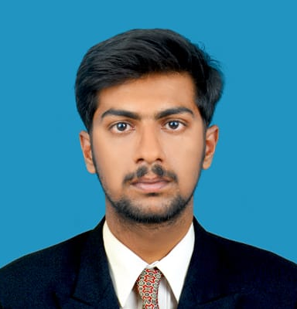



BHUMIREDDY UDAY SIMHA REDDY
Analyst/Software Engineer
Bachelor of Engineering
CIVIL : 2017 - 2021
Skills
Java | Java Basics, OOPS, Generics, Collections, Arrays, Lambda Exp, Junit, Mockito
Spring | Spring MVC, Spring boot Frame work.
Spring REST | REST controllers, Implementation of GET, POST, PUT & DELETE, Bean Validation & Exception Handling, Testing Services, Controller & Repository layer
Spring Cloud | Eureka
React | Components, Hooks, Event handling, Redux, Reducers, Testing using Jasmin
Database | MongoDB, Oracle
UI Tech | HTML 5 & CSS 3,JavaScript, ES6 & React
Tools | Git, Postman, IDE, Swagger, Visual Studio Code, STS
Certifications | CAF Certificate AWS level-1 Certified
Add On skills | Communications, Team management. Peer learning
Bangalore
bhumireddy.uday-simha-reddy@capgemini.com
+91 8309075532
A4
Full Stack Developer
Hands on experience on Java, Spring framework, oracle, spring MVC with WEB API.
Proficient in creating Single page Web Application in React with Authentication with routing
Hands on experience in developing web pages using HTML5, CSS, Object TypeScript, Good understanding of Document Object Model (DOM) and DOM Functions
Ready to learn new technologies and implement them for the Future Knowledge improvement
Agriculture Crop Deal System
Crop Deal is implemented to make farmers’ life easier by advertising their crops and selling them directly to the dealer, as it neglects all The commissions farmers pay to sell their crops. The main objective of the Crop deal is to act as a bridge between n farmer and the dealer by registering the famer and dealer. the farmer will list their crops and the dealer can make payment directly to the farmer’s account.
Degreed :Successfully completed the degreed training in git, Mongo Db, core java, spring boot.
Check out my work on GitHub & Video Profile

