Slide 1
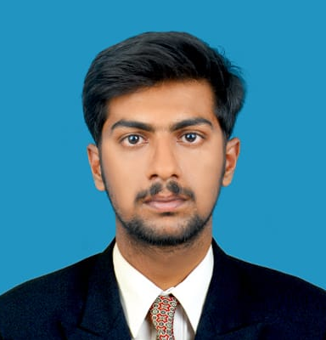



BHUMIREDDY UDAY SIMHA REDDY
Analyst/Software Engineer
Bachelor of Engineering
CIVIL : 2017 - 2021
Skills
Java 8 /J2EE | Java Basics, OOPS, Generics, Collections, Arrays, Loops, Lambda Exp, Stream API Junit, Mockito, Servlets
Spring core | IOC & Dependency Injection, Autowire
Spring REST | REST controllers, Implementation of GET, POST, PUT & DELETE, Bean Validation & Exception Handling, Testing Services, Controller & Repository layer
Spring Data JPA | Implement DAO layer using spring Data repositories, Transaction Management
Spring Boot Microservices | Spring Boot Starters, annotations, Messaging Service, Sync/Async comms, Swagger API documents
Spring Cloud | Eureka, Netflix Ribbon, Feign Client, Netflix Hystrix, Netflix Zuul & Config Server
React | Components, Hooks, Event handling, Redux, Reducers, Testing using Jasmin & Karma
Angular | Components, Services, Modules, Routing, Forms & Validation, Testing using Jasmine & Karma
Database | MongoDB No Sql Basics My SQL RDS Basics
UI Tech | HTML 5 & CSS 3,JavaScript, ES6 & TypeScript Reusable templates, Optimized UI Designed
Tools | Git, Postman, Maven, IDE
Devops | CI/CD, Jenkins configuration, Build Pipelines, notifications, quality gate understanding
Add On skills | Communications, Team management. Peer learning
Bangalore
bhumireddy.uday-simha-reddy@capgemini.com
+91 8309075532
A4
Full Stack Developer
Hands on experience on Java, Spring framework, oracle, spring MVC with WEB API.
Proficient in creating Single page Web Application in React with Authentication with routing
Hands on experience in developing web pages using HTML5, CSS, Object TypeScript, Good understanding of Document Object Model (DOM) and DOM Functions
Ready to learn new technologies and implement them for the Future Knowledge improvement
Movie Ticket Booking
Case study of Movie Ticket Booking along with API Gateway, Swagger, responsive UI with HTML5, CSS, Bootstrap and React used as User Interface.
Degreed :Successfully completed the degreed training in git, Mongo Db, core java, spring boot.
Check out my work on GitHub & Video Profile

