Slide 1

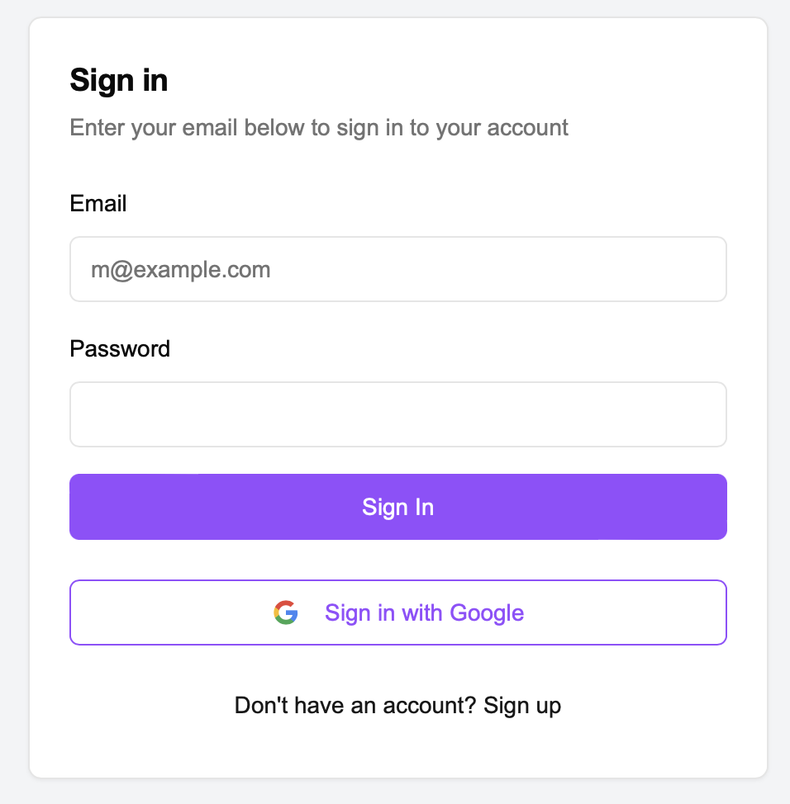
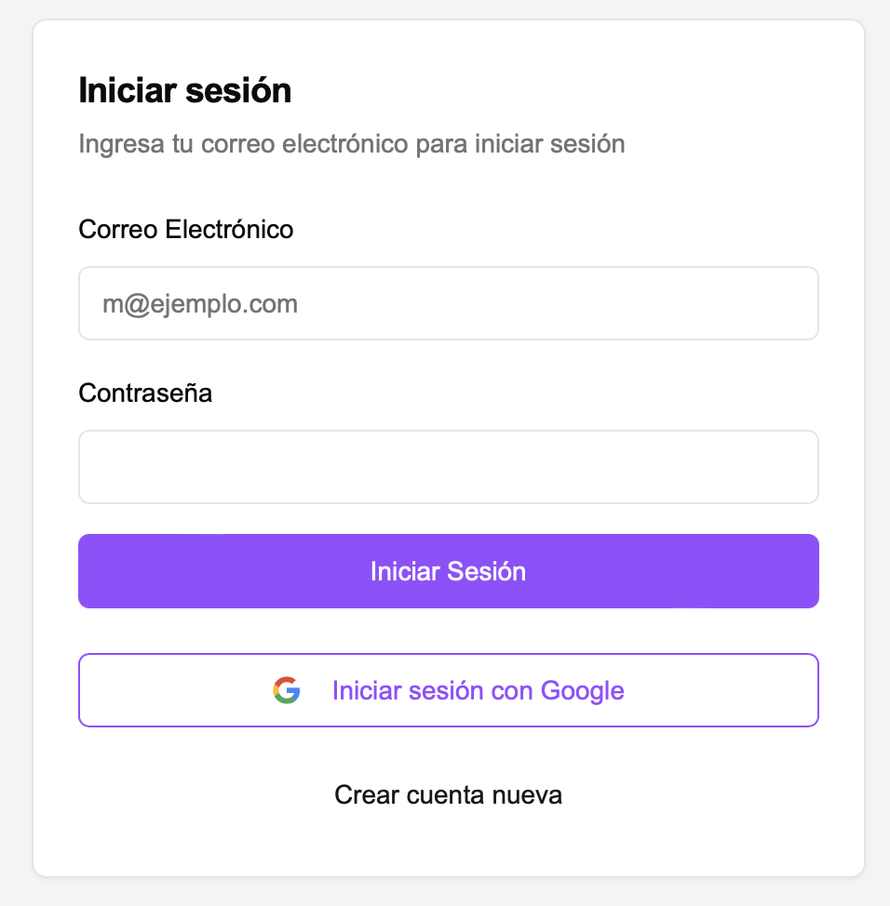
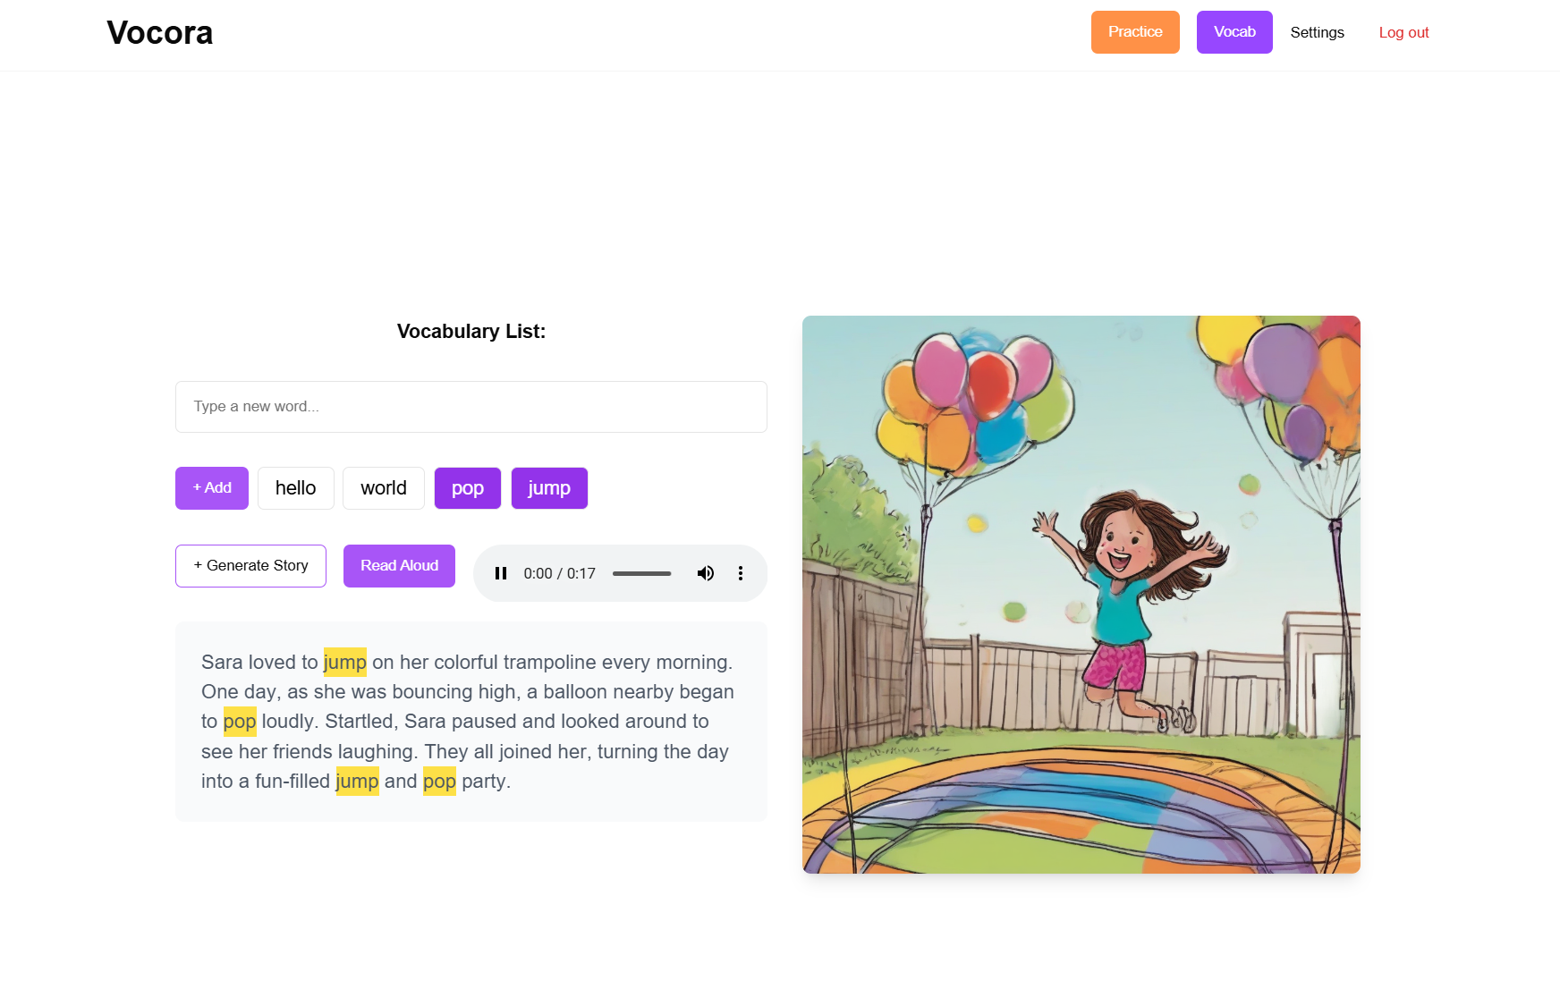


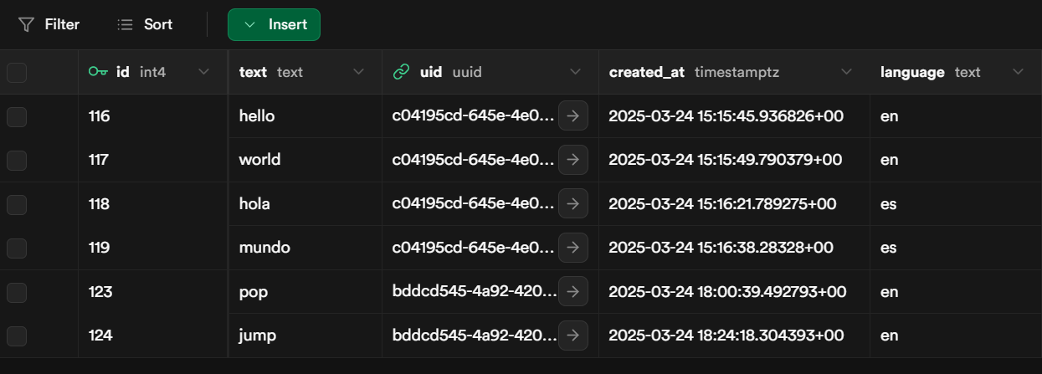



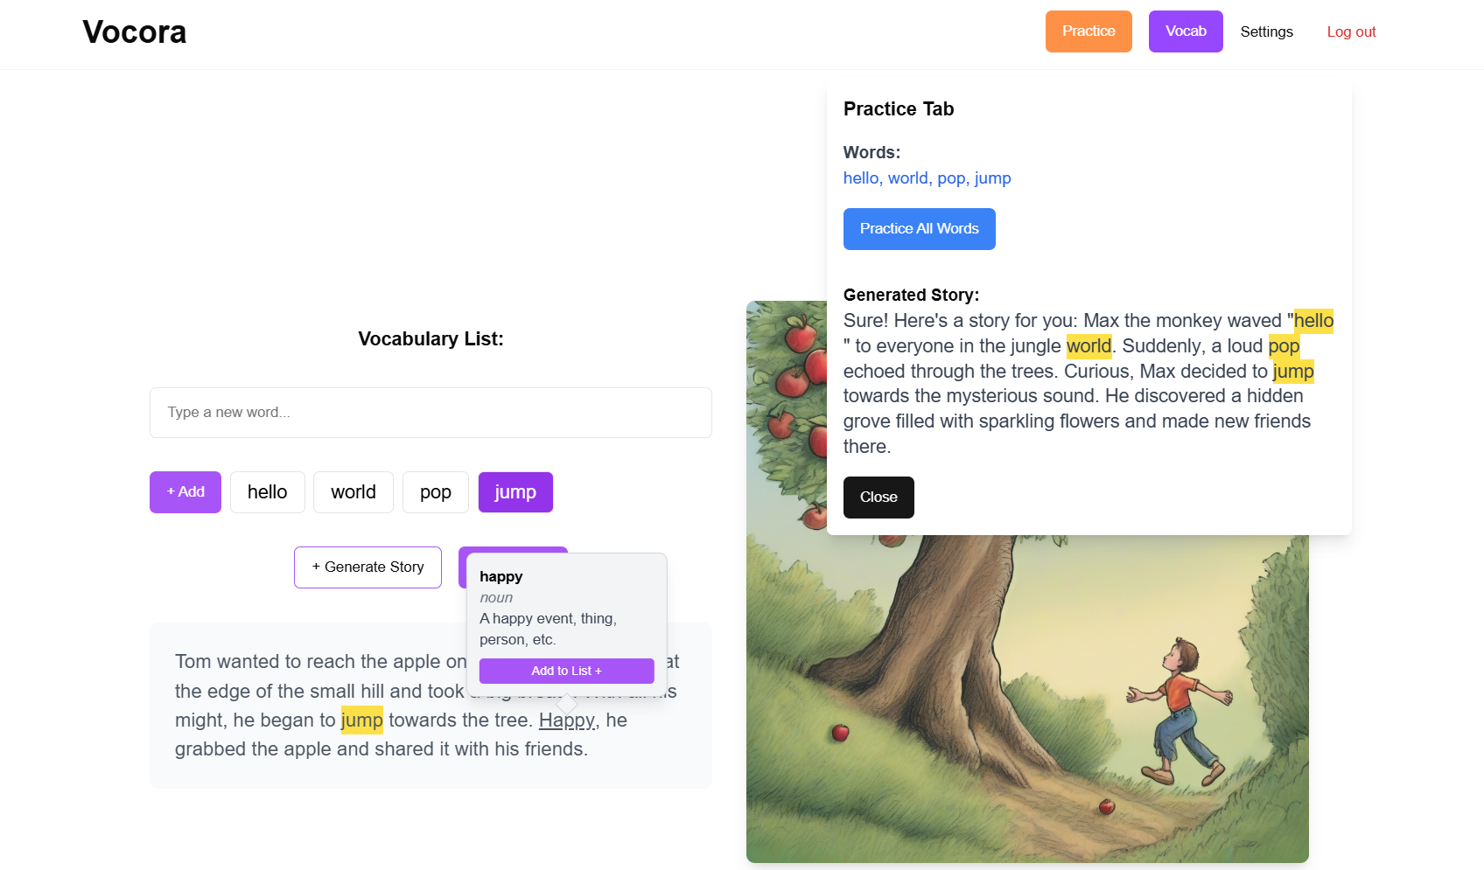
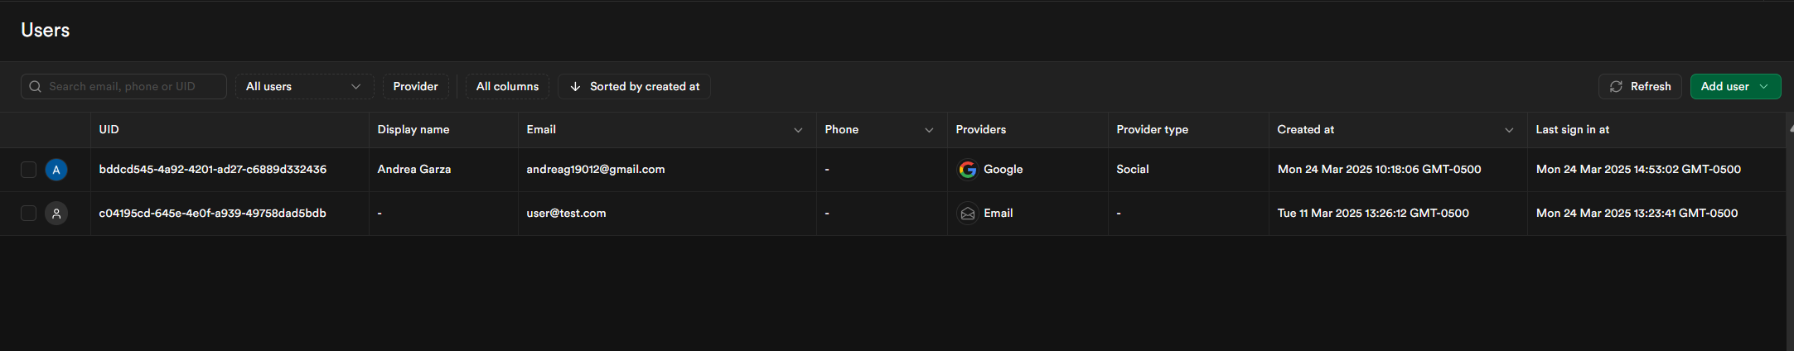
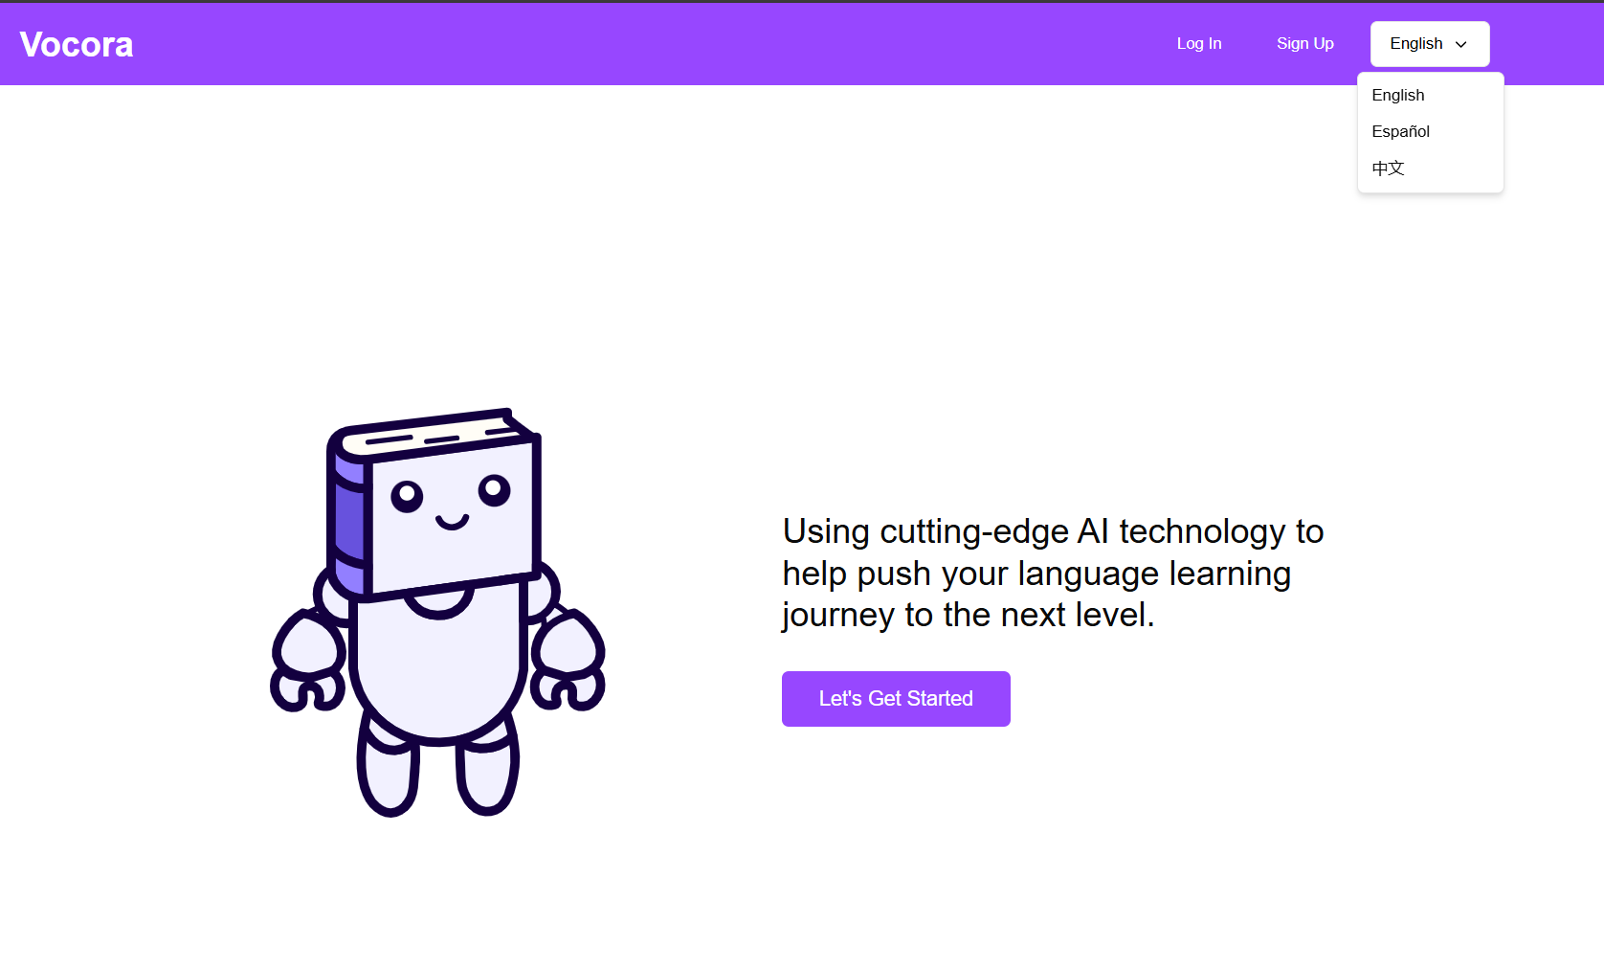



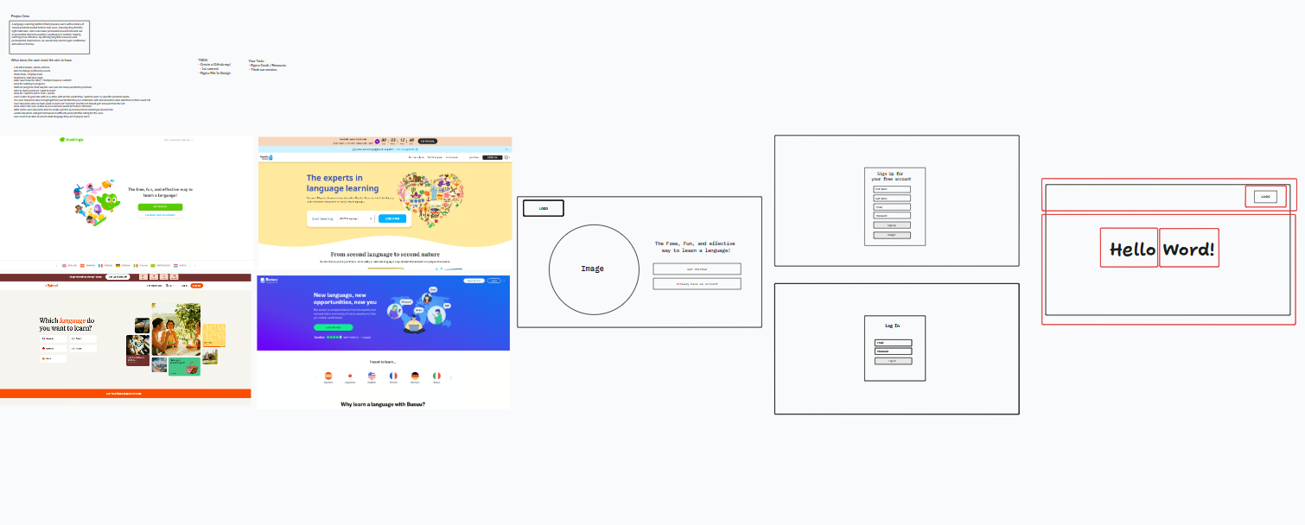



Vocora: Language Reinforcement with Stories
Andrea Garza, Mariana Resendez, Teresa Garza, Perla Lopez, Dr. Askar Nurbekov Department of Computer Science, College of Engineering and Computer Science
INTRODUCTION
This project is designed to serve as a resource for learning a language. A key feature of the app allows users to add words to personalized lists for future practice. Using Artificial Intelligence, users are able to generate stories using selected target words for the user while implementing image generation and audible vocabulary features for further reinforcement. Vocora will work to find and provide books and texts in the target language, categorized by different proficiency levels.
A user's language journey can take a quick downturn when the user cannot easily access content to reinforce vocabulary through texts.
Vocora is a web application that aims to bridge this gap between language learners and getting their practice in by reinforcing vocabulary words added by the users themselves through generating stories with paired visuals using OpenAI to further support the user's stories.
METHOD, PLAN or APPROACH
Technology decisions:
React.js (Typescript Framework)
Node.js (Server-Side)
Tailwind CSS (CSS Library)
Supabase (User Creation & Authorization)
OpenAI (Text Generation, Text-to-Speech Generation)
Fireworks AI (Text-to-Image Generation)
Vercel (Deployment)
Open AI enables high-quality, context-aware text generation and offers text-to-speech capabilities, enhancing user interaction with audio on our website.
Fireworks AI generates mages from text prompts, providing fast, high quality content creation to enhance user experience.
Supabase simplifies user management with easy integration and built-in authentication features.
Node.js facilitates communication between the client and the Supabase API endpoints.
Design decisions:
Figma helped us plan the layout of each page. Our goal for our website is to make language learning feel fun and less intimidating for users. A white and purple color scheme was selected to create a calming feel, along a MidJourney art style for its playful look to make the site welcoming for learners.
RESULTS/PROGRESS
Platform Development
User Authentication: Implemented secure login using Google OAuth.
Database Setup: Supabase used for storing user accounts, word lists, and AI-generated content
AI Integration: OpenAI API handles text generation, vocabulary reinforcement, image creation, and audio synthesis.
Key Features Implemented
Word List Management: Users can add and track words they "want to learn."
AI-Generated Stories: Users can create personalized texts using selected vocabulary.
AI-Generated Images: Visuals accompany generated text to support word association.
AI-Generated Audio: Text-to-speech functionality allows users to hear pronunciation.
RESULTS/PROGRESS
On the login page, users can log in with their preferred language and choose to log in with Google.
On the success page, users can add vocab words to their list, generate a story with an image, and listen to audio.
Supabase Messages table displaying vocab words linked to each user by uid.
GOALS
This project aims to create a resource for language learners to improve comprehension through reading.
Enhance Language Learning – Reinforce vocabulary by generating stories using user- picked words.
Introduce New Words – Integrate unfamiliar words into stories and allow users to save them for later study.
Personalized Learning – Adapt content to the user’s proficiency level for a customized learning experience.
Future Implementations – Incorporate a library of pre-existing books categorized by language proficiency levels.
Multiple Language Compatibility – Provide users with the ability to select and engage with content in various languages.
Supabase Users table displaying all registered accounts.
Every 1, 3, and 7 days since adding a word to their list, the user will be reminded to practice those words.
When a user hovers over a word, the definition will appear.
On the home page, users are greeted by our mascot and can switch between English, Spanish, and Mandarin
CONCLUSION
This platform enhances language learning by providing personalized, interactive experiences. AI-generated stories,
along with audio and images, help users engage with vocabulary in context. This approach makes learning more efficient,
enjoyable, and accessible for learners at any level.
Future Work
Quizzes & Testing: To evaluate user progress.
More Languages & Content: Expand available resources.
Advanced AI Features: Include real-time translation and grammar exercises.
Speech Recognition: For pronunciation practice.
Figma sketches outlining our website's layout, page designs, and visual inspiration

