Slide 1
CSE 205: Digital Logic Design
Dr. Tanzima Hashem
Associate Professor
CSE, BUET

Slide 2
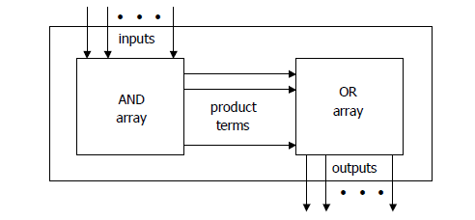
Programmable Logic Arrays (PLAs)
Pre-fabricated building block of many AND/OR gates
An array of programmable AND gates
can generate any product terms of the inputs
An array of programmable OR gates
can generate the sums of the products

Slide 3
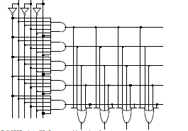
Programmable Logic Arrays (PLAs)
Before programming, all possible connections available before "programming“
”Personalized" by making or breaking connections among gates

Slide 4
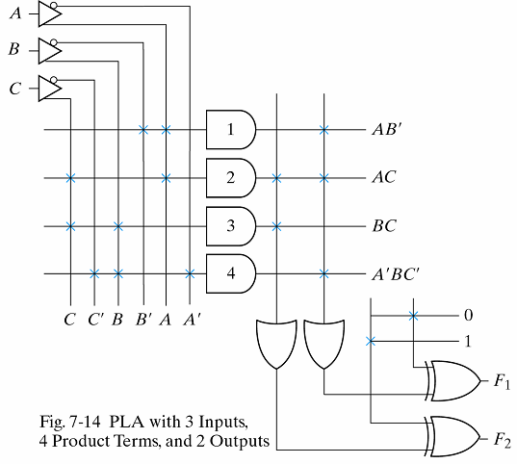
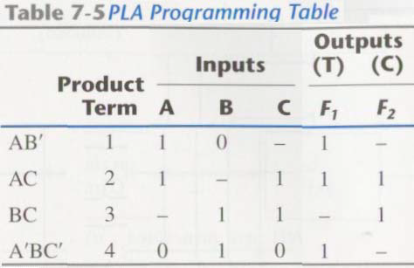
PLA Example
Example: AND/OR/XOR
F1 = AB′ + AC + A′BC′
F2 = (AC + BC)′
XOR gates can invert the outputs
invert: connected to 1
not change: connected to 0
PLA programming table: 3 sections
1. list the product terms
2. specify the required paths between inputs and AND gates
3. specify the paths between the AND and OR gates

Slide 5
Programmable Logic Arrays (PLAs)
Size of PLA: specified by # of inputs, product terms and outputs
n inputs, k product terms and m outputs
n buffer-inverter gates, k AND gates, m OR gates, and m XOR gates
Designing a digital system with a PLA
reduce the number of distinct product terms
the number of literals in a product is not important

Slide 6
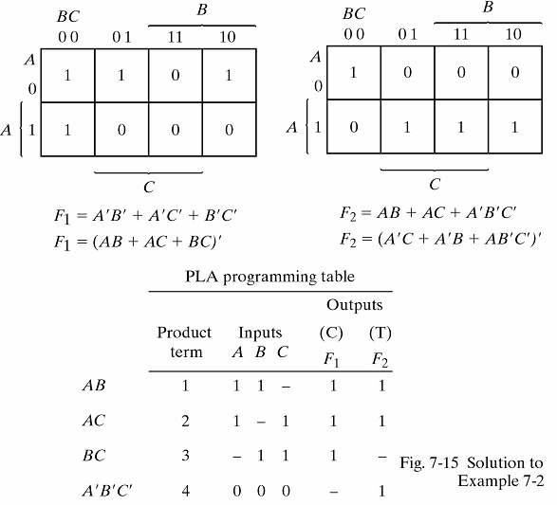
Implement with PLAs
F1(A, B, C) = Σ (0, 1, 2, 4); F2(A, B, C) = Σ (0, 5, 6, 7)
Simply both the true and complement of the functions in sum of products
Find the combination with minimum number of product terms
F1=(AB+AC+BC)’
F2=AB+AC+A’B’C’
Obtain the PLA programming table

Slide 7
Syllabus
Chapter 7:7.6

