Slide 1
CSE 205: Digital Logic Design

Slide 2
Boolean (Binary) Logic
Deals with binary variables and binary logic functions
Has two discrete values
0, False, Open
1, True, Close
Three basic logical operations
AND (.); OR (+); NOT (‘)
We need to define algebra for binary values
Boolean Algebra: Developed by George Boole in 1854

Slide 3
Boolean Algebra
Why study Boolean Algebra?
To find the simplest circuit implementation with the smallest number of gates or wires.
The simpler that we can make a Boolean function, the smaller the circuit that will result.
Simpler circuits are cheaper to build, consume less power, and run faster than complex circuits.
With this in mind, we always want to reduce our Boolean functions to their simplest form.

Slide 4
Algebra
What is an algebra?
Mathematical system consisting of
Set of elements
Set of operators
Axioms or postulates: facts that can be taken as true; they do not require proof

Slide 5
Axiomatic definition of Boolean Algebra
A Boolean algebra requires
A set of elements B, consisting of two elements (0 and 1)
Two binary operations OR and AND
The axioms below must always be true

Slide 6
Axiomatic definition of Boolean Algebra
Based on axiom #5, we can develop a unary (one-argument) operation NOT

Slide 7
Axiomatic definition of Boolean Algebra
The distributive laws
x | y | z | y+z | x．(y+z) | x．y | x．z | (x．y)+(x．z)
0 | 0 | 0 | 0 | 0 | 0 | 0 | 0
0 | 0 | 1 | 1 | 0 | 0 | 0 | 0
0 | 1 | 0 | 1 | 0 | 0 | 0 | 0
0 | 1 | 1 | 1 | 0 | 0 | 0 | 0
1 | 0 | 0 | 0 | 0 | 0 | 0 | 0
1 | 0 | 1 | 1 | 1 | 0 | 1 | 1
1 | 1 | 0 | 1 | 1 | 1 | 0 | 1
1 | 1 | 1 | 1 | 1 | 1 | 1 | 1

Slide 8
Duality principle
If an expression is valid in Boolean algebra, the dual of that expression is also valid.
To form the dual of an expression, replace all + operators with . operators, all . operators with + operators, all ones with zeros, and all zeros with ones.
Form the dual of the expression
a + (bc) = (a + b)(a + c)
Following the replacement rules…
a(b + c) = ab + ac

Slide 9
Duality principle
The left and right columns of axioms are duals
exchange all ANDs with ORs, and 0s with 1s

Slide 10
Basic theorems of Boolean Algebra
In addition to the axioms, additional laws can be derived; they are called theorems of Boolean Algebra
These theorems are useful in performing algebraic manipulations of Boolean expressions

Slide 11
Proof of x+x=x
We can only use Huntington postulates:
Show that x+x=x.
x+x = (x+x)·1 by 2(b)
= (x+x)(x+x’) by 5(a)
= x+xx’ by 4(b)
= x+0 by 5(b)
= x by 2(a)
We can now use Theorem 1(a) in future proofs
Post. 2: (a) x+0=x, (b) x·1=x
Post. 3: (a) x+y=y+x, (b) x·y=y·x
Post. 4: (a) x(y+z) = xy+xz, (b) x+yz = (x+y)(x+z)
Post. 5: (a) x+x’=1, (b) x·x’=0

Slide 12
Proof of x·x=x
Similar to previous proof
Show that x·x = x.
x·x = xx+0 by 2(a)
= xx+xx’ by 5(b)
= x(x+x’) by 4(a)
= x·1 by 5(a)
= x by 2(b)
Post. 2: (a) x+0=x, (b) x·1=x
Post. 3: (a) x+y=y+x, (b) x·y=y·x
Post. 4: (a) x(y+z) = xy+xz, (b) x+yz = (x+y)(x+z)
Post. 5: (a) x+x’=1, (b) x·x’=0
Th. 1: (a) x+x=x

Slide 13
Proof of x+1=1
Theorem 2(a): x + 1 = 1
x + 1 = 1．(x + 1) by 2(b)
=(x + x')(x + 1) 5(a)
= x + x' 1 4(b)
= x + x' 2(b)
= 1
Theorem 2(b): x．0 = 0 by duality
Theorem 4: (x')' = x
Postulate 5 defines the complement of x, x + x' = 1 and x x' = 0
The complement of x' is x is also (x')'
Post. 2: (a) x+0=x, (b) x·1=x
Post. 3: (a) x+y=y+x, (b) x·y=y·x
Post. 4: (a) x(y+z) = xy+xz, (b) x+yz = (x+y)(x+z)
Post. 5: (a) x+x’=1, (b) x·x’=0
Th. 1: (a) x+x=x, (b) x.x =x

Slide 14
Absorption Property (Covering)
Theorem 6(a): x + xy = x
x + xy = x．1 + xy by 2(b)
= x (1 + y) 4(a)
= x (y + 1) 3(a)
= x．1 Th 2(a)
= x 2(b)
Theorem 6(b): x (x + y) = x by duality
By means of truth table (another way to proof )
Post. 2: (a) x+0=x, (b) x·1=x
Post. 3: (a) x+y=y+x, (b) x·y=y·x
Post. 4: (a) x(y+z) = xy+xz, (b) x+yz = (x+y)(x+z)
Post. 5: (a) x+x’=1, (b) x·x’=0
Th. 1: (a) x+x=x, (b) x.x =x
Th. 2: (a) x + 1 = 1, (b) x.0 =0

Slide 15
Absorption Property (Covering)
Theorem 6(a): x + xy = x
x | y | xy | x+xy
0 | 0 | 0 | 0
0 | 1 | 0 | 0
1 | 0 | 0 | 1
1 | 1 | 1 | 1

Slide 16
DeMorgan’s Theorem
Theorem 5(a): (x + y)’ = x’y’
Theorem 5(b): (xy)’ = x’ + y’
By means of truth table
x | y | x’ | y’ | x+y | (x+y)’ | x’y’ | xy | x’+y' | (xy)’
0 | 0 | 1 | 1 | 0 | 1 | 1 | 0 | 1 | 1
0 | 1 | 1 | 0 | 1 | 0 | 0 | 0 | 1 | 1
1 | 0 | 0 | 1 | 1 | 0 | 0 | 0 | 1 | 1
1 | 1 | 0 | 0 | 1 | 0 | 0 | 1 | 0 | 0

Slide 17
Consensus Theorem
AB + A'C + BC = AB + A'C
The consensus or resolvent of the terms AB and A'C is BC
It is the conjunction of all the unique literals of the terms, excluding the literal that appears unnegated in one term and negated in the other

Slide 18
Consensus Theorem
xy + x’z + yz = xy + x’z
(x+y)•(x’+z)•(y+z) = (x+y)•(x’+z) -- (dual)
Proof: xy + x’z + yz = xy + x’z + (x+x’)yz = xy + x’z + xyz + x’yz = (xy + xyz) + (x’z + x’zy)
= xy(1+z) + x’z (1+y) = xy + x’z

Slide 19
Boolean Function
A Boolean function expresses the logical relationship between binary variables and is evaluated by determining the binary value of the expression for all possible values of the variables.
f(x,y,z) = (x + y’)z + x’
Some terminology, notation and precedence:
f is the name of the function.
(x,y,z) are the input variables, each representing 1 or 0.
A literal is a single variable within a term, in complemented or uncomplemented form. The function above has four literals: x, y’, z, and x’.
NOT has the highest precedence, followed by AND, and then OR.

Slide 20
Boolean Function
A Boolean function can be represented in a truth table.
f(x,y,z) = (x + y’)z + x’
f(0,0,0) = (0 + 1)0 + 1 = 1
f(0,0,1) = (0 + 1)1 + 1 = 1
f(0,1,0) = (0 + 0)0 + 1 = 1
f(0,1,1) = (0 + 0)1 + 1 = 1
f(1,0,0) = (1 + 1)0 + 0 = 0
f(1,0,1) = (1 + 1)1 + 0 = 1
f(1,1,0) = (1 + 0)0 + 0 = 0
f(1,1,1) = (1 + 0)1 + 0 = 1

Slide 21
Complement of a Function
The complement of a function always outputs 0 where the original function outputted 1, and 1 where the original produced 0.
f(x,y,z) = (x + y’)z + x’

Slide 22
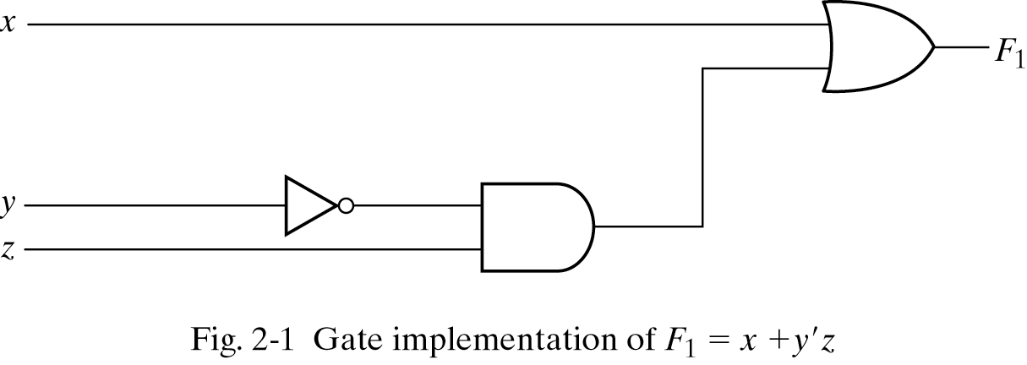
Gate Implementation of a Function

Slide 23
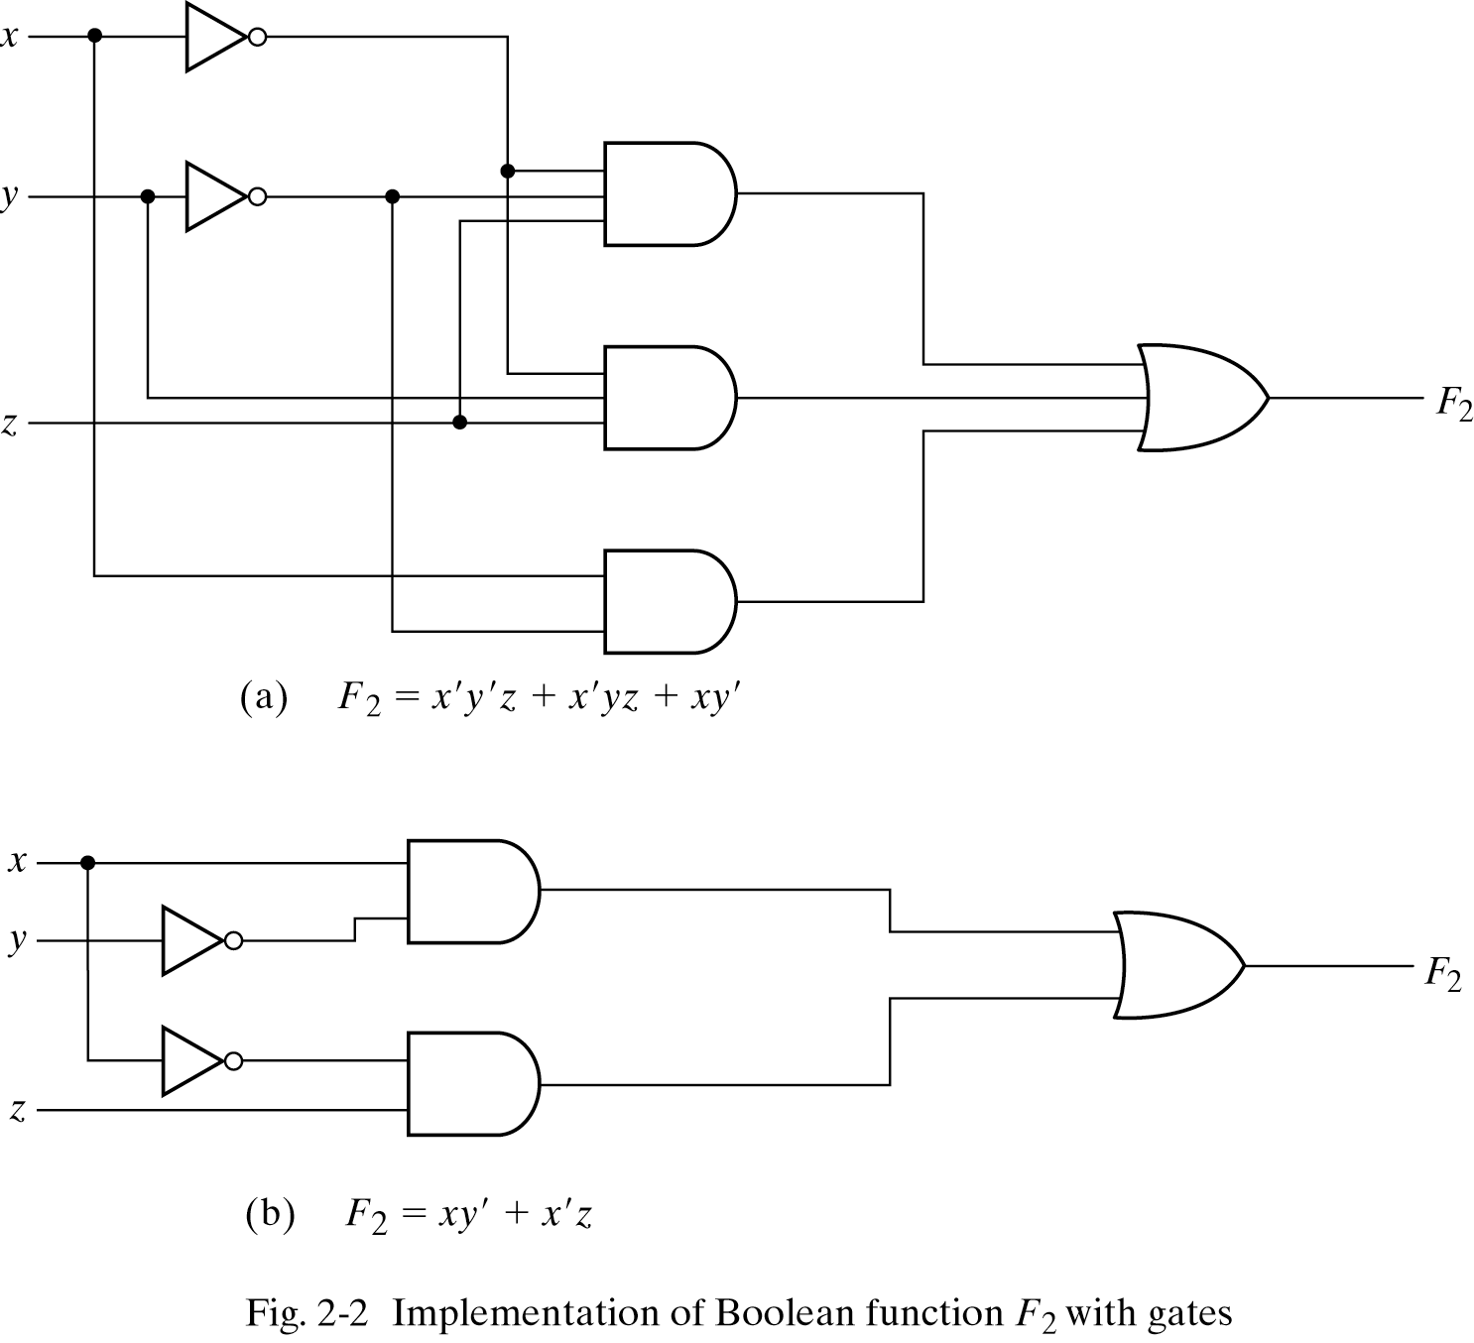
Gate Implementation of a Function

Slide 24
Practice
Simplify the following Boolean expressions to a minimum number of literals:
xyz + x'y + xyz’
(A + B)'(A' + B') '
xyz + x'y + xyz' = xy(z + z') + x'y = xy + x'y = y
(A + B)'(A' + B')' = (A'B')(A B) = (A'B')(BA) = 0

Slide 25
Complement of a Function
Applying DeMorgan’s theorems:
f(x,y,z) = x(y’z’ + yz)
f ’(x,y,z) = (x(y’z’ + yz))’ [ complement both sides ]
= x’ + (y’z’ + yz)’ [ because (xy)’ = x’ + y’ ]
= x’ + (y’z’)’ (yz)’ [ because (x + y)’ = x’ y’ ]
= x’ + (y + z)(y’ + z’) [ because (xy)’ = x’ + y’, twice]

Slide 26
Complement of a Function
By taking the dual of f and complementing each literal:
If f(x,y,z) = x(y’z’ + yz)…
…the dual of f is x + (y’ + z’)(y + z)…
…then complementing each literal gives
x’ + (y + z)(y’ + z’)…
…so f’(x,y,z) = x’ + (y + z)(y’ + z’)

Slide 27
Practice
Find the complement of the following expressions:
xy' + x'y
[(x' + y + z')(x + y')(x + z)]
F' = (xy' + x'y)'
= (xy')'(x'y)'
= (x' + y)(x + y')
= xy + x'y‘
F' = [(x' + y + z')(x + y')(x + z)]'
= (x' + y + z')' + (x + y')' + (x + z)'
= xy'z + x'y + x'z'

Slide 28
Minterms
A minterm is an AND term in which every variable or its complement in a function occurs once.
F(x,y) has 4 minterms x’y’, x’y, xy’, xy
An n variable function has 2^{n} valid minterms
A minterm equals 1 at exactly one input combination and is equal to 0 otherwise
Example: x’y’z’ = 1 only when x=0, y=0, z=0

Slide 29
Maxterms
A maxterm is an OR term in which every variable or its complement in a function occurs once
F(x,y) has 4 maxterms x’+y’, x’+y, x+y’, x+y
An n variable function has 2^{n} valid maxterms
A maxterm equals 0 at exactly one input combination and is equal to 1 otherwise
Example: (x+y+z) = 0 only when x=0, y=0, z=0

Slide 30
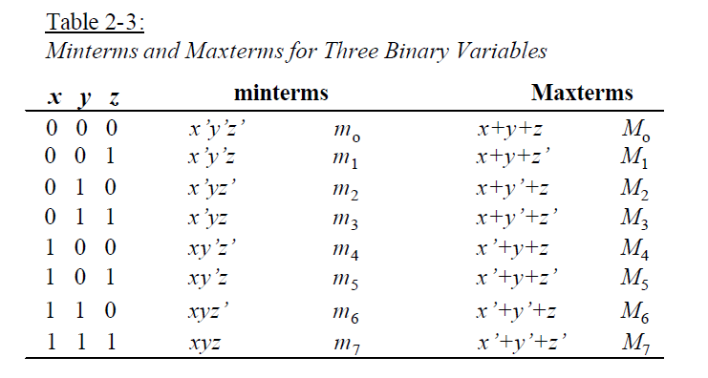
Example: Three Binary Variables

Slide 31
Canonical Form
Any boolean function that is expressed as a sum of minterms or as a product of maxterms is said to be in its canonical form.

Slide 32
Sum of Minterms
A Boolean function can be expressed algebraically from a given truth table
by forming a minterm for each combination of the variables that produces a 1 in the function and
then taking the OR of all those terms.

Slide 33
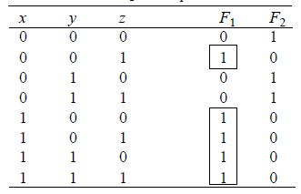
Sum of Minterms
F₁(x, y, z) = ∑(1,4,5,6,7) = m₁ + m₄ + m₅ + m₆ + m₇
=x' y' z + xy' z’ + xy' z + xyz’ + xyz

Slide 34
Sum of Minterms: Example
F = x + yz
= x(y + y’)(z + z’) + (x + x’)yz = xyz + xyz’ + xy’z + xy’z’ + xyz + x’yz = x’yz + xy’z’ + xy’z + xyz’ + xyz = Σ(3,4,5,6,7)
Or convert the expression into truth-table and then read the minterms from the table

Slide 35
Product of Maxterms
A Boolean function can be expressed algebraically from a given truth table
by forming a maxterm for each combination of the variables that produces a 0 in the function, and
then taking the AND of all those maxterms.

Slide 36
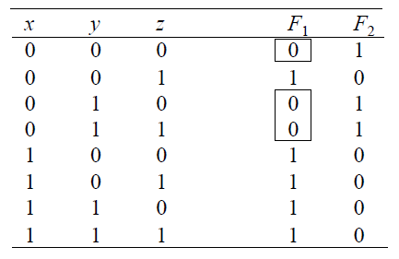
Product of Maxterms
F₁(x, y, z) = ∏(0,2,3) = M₀ ×M₂ ×M₃
= (x + y + z)(x + y'+z)(x + y'+z')

Slide 37
Product of Maxterms: Example
F = xy + x’z = (xy+x’)(xy+z)
= (x+x’)(y+x’)(x+z)(y+z) = (x’+y)(x+z)(y+z)
x’+y = x’+y+zz’ = (x’+y+z)(x’+y+z’) x+yz = (x+y)
x+z = x+z+yy’ = (x+y+z)(x+y’+z) (x+z)
y+z = y+z+xx ’ = (x+y+z)(x ’+y+z)
F =(x+y+z)(x+y’+z)(x’+y+z)(x’+y+z’)
=M₀M₂M₄M₅= ∏(0, 2, 4,5)
Or convert the expression into truth-table and then read the maxterms from the table

Slide 38
Conversion between Canonical Forms
Conversion between minterms and maxterms
m₀ = x’y’z’ = (x+y+z)’ = (M₀)’
In general, m_{i} = (M_{i})’
Sum of minterms → Product of maxterms:
f = Σ(0,1,2,3,6)
f’= Σ(4,5,7) = m₄ + m₅ + m₇
(f’)’= (m₄ + m₅ + m₇)’
f = m₄’ m₅’ m₇’ [DeMorgan’s law]
= M₄ M₅ M₇ = ∏(4,5,7)

Slide 39
Conversion between Canonical Forms
In general, to convert from one canonical form to another, interchange the symbols Σ and ∏ and list those numbers missing from the original form.
Example: f = Σ(0,1,2,3,6) = ∏(4,5,7)

Slide 40
Practice
Express the following function (four variables: A, B, C, D) as a sum of minterms and as a product of maxterms:
F = B'D + A'D + BD
F = ∑(1, 3, 5, 7, 9, 11,13, 15)
= ∏(0, 2, 4, 6, 8, 10, 12, 14)

Slide 41
Standard Form
Any boolean function that is expressed as a sum of products (SOP) or as a product of sums (POS), where each product-term or sum-term may contain one, two, or any number of variables, is said to be in its standard form.
SOP: f(x,y,z) = xy + x’yz + xy’z
POS: f(x,y,z) = (x’ + y’)(x + y’ + z’)(x’ + y + z’)

Slide 42
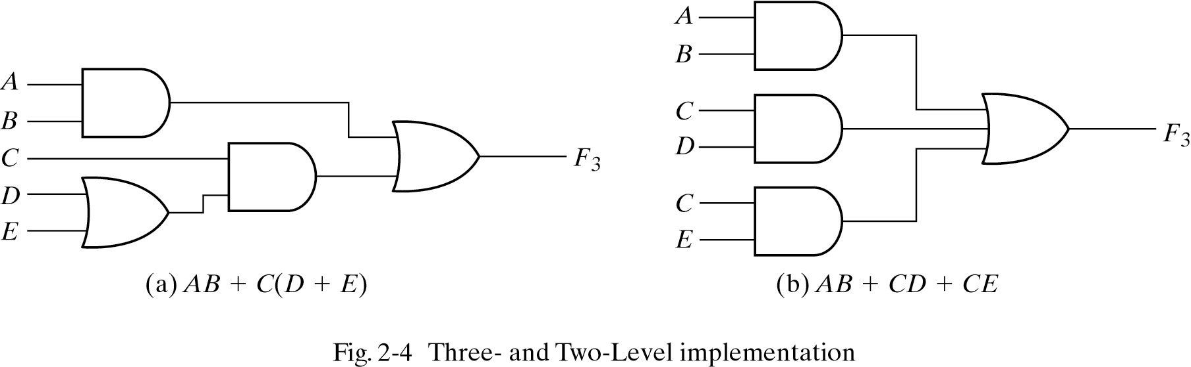
Non-Standard and Standard Forms

Slide 43
Practice
Convert the following expression into sum of products and product of sums:
(AB + C)(B + C'D)
(AB + C)(B + C'D)
= AB + BC + ABC'D + CC'D
= AB(1 + C'D) + BC
= AB + BC (SOP form)
= B(A + C) (POS form)

Slide 44
Canonical and Standard Forms
Canonical forms
Sum of minterms (SOM)
Product of maxterms (POM)
Standard forms (may use less gates)
Sum of products (SOP)
Product of sums (POS)
F = ab+a’ (already sum of products:SOP)
F = ab + a’(b+b’) (expanding term)
F = ab + a’b + a’b’ (it is canonical form:SOM)

Slide 45
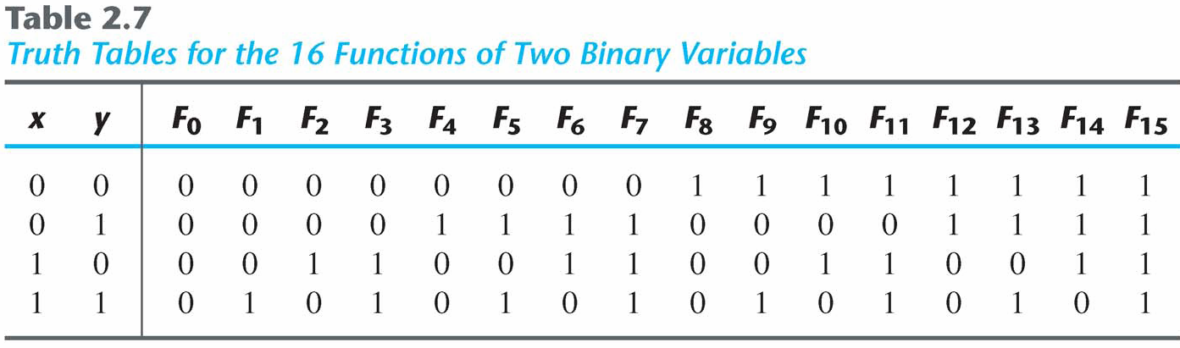
Other Logic Operations
2^{n} rows in the truth table of n binary variables.
2^{2n} functions for n binary variables.
16 functions of two binary variables.

Slide 46
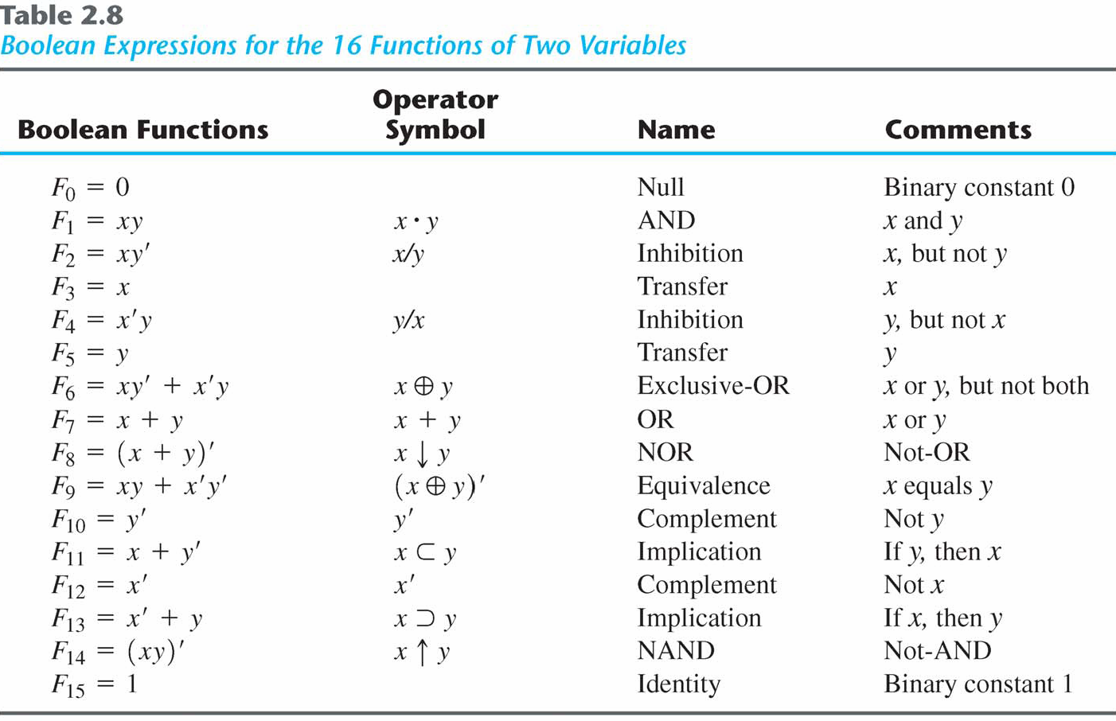
Boolean Expressions

Slide 47
Digital Logic Gates
Boolean expression: AND, OR and NOT operations
Constructing gates of other logic operations
The feasibility and economy;
The possibility of extending gate's inputs;
The basic properties of the binary operations (commutative and associative);
The ability of the gate to implement Boolean functions.

Slide 48
Summary of Logic Gates
Figure 2.5 Digital logic gates

Slide 49
Summary of Logic Gates
Figure 2.5 Digital logic gates

Slide 50
Multiple Inputs
Extension to multiple inputs
A gate can be extended to multiple inputs.
If its binary operation is commutative and associative.
AND and OR are commutative and associative.
OR
x+y = y+x
(x+y)+z = x+(y+z) = x+y+z
AND
xy = yx
(x y)z = x(y z) = x y z

Slide 51
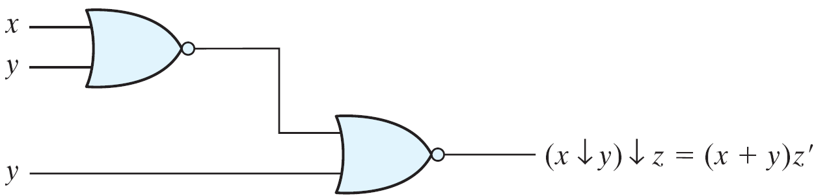
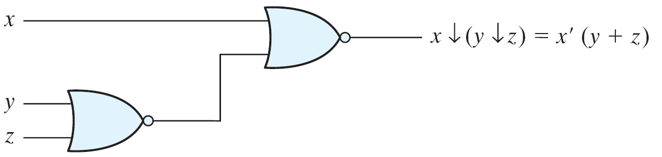
Multiple Inputs
NAND and NOR are commutative but not associative → they are not extendable.

Slide 52
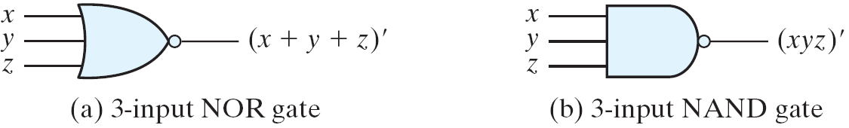
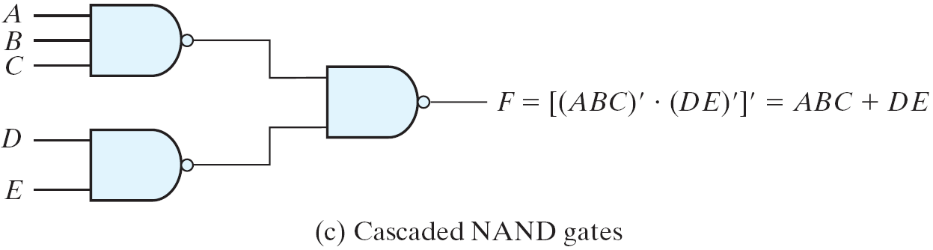
Multiple Inputs
Multiple NOR = a complement of OR gate, Multiple NAND = a complement of AND.
The cascaded NAND operations = sum of products.
The cascaded NOR operations = product of sums.

Slide 53
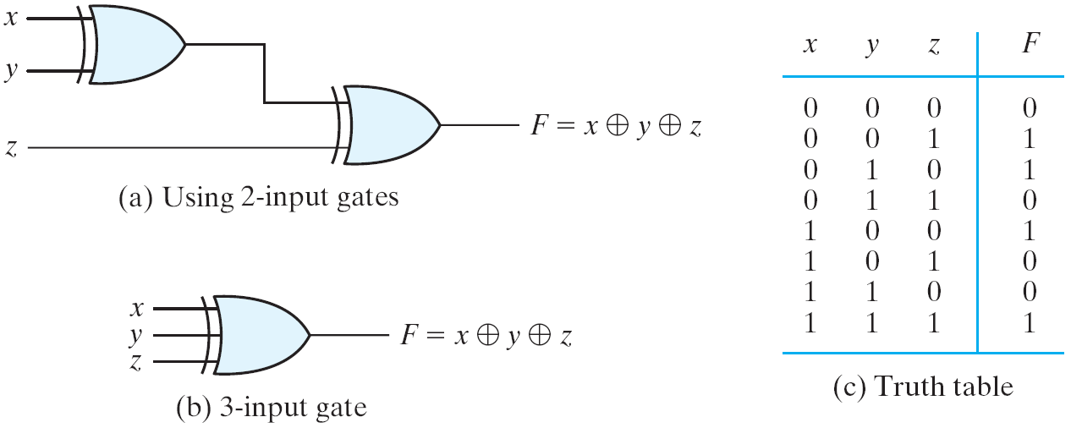
Multiple Inputs
The XOR and XNOR gates are commutative and associative.
Multiple-input XOR gates are uncommon
XOR is an odd function: it is equal to 1 if the inputs variables have an odd number of 1's.

Slide 54
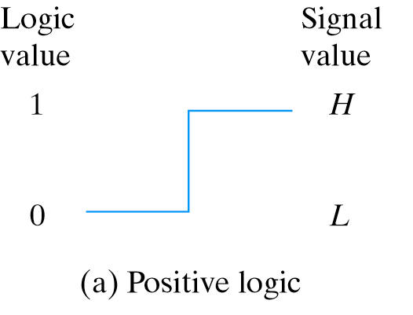

Positive and Negative Logic
Positive and Negative Logic
Two signal values <=> two logic values
Positive logic: H=1; L=0
Negative logic: H=0; L=1
Consider a TTL gate
A positive logic AND gate
A negative logic OR gate
The positive logic is used in this book

Slide 55
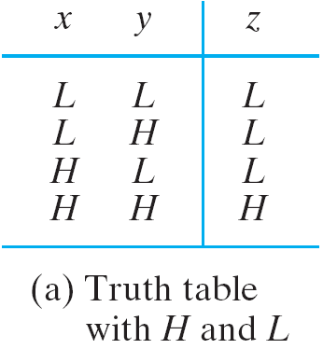
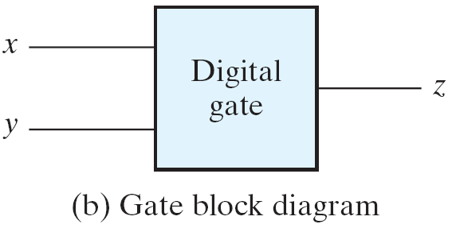
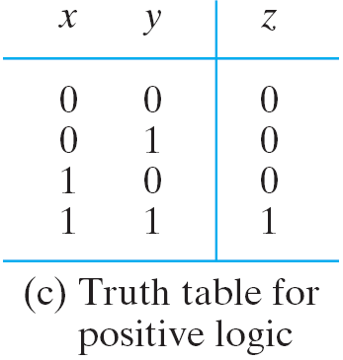
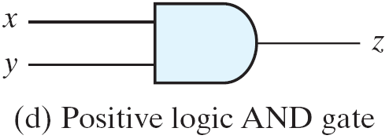
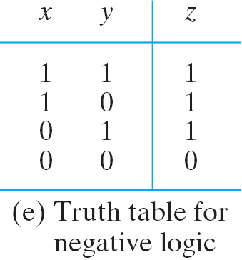
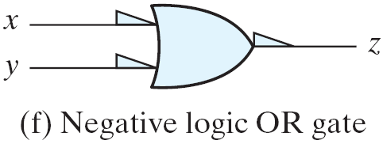
Positive and Negative Logic

Slide 56
Syllabus
Chapter 2 (Excluding Section 2.9)

