Slide 1
CSE 205: Digital Logic Design

Slide 2
Logic Minimization
The complexity of the digital logic gates
The complexity of the algebraic expression
Algebraic approaches:
The procedure of simplifying Boolean expressions is difficult since it lacks specific rules to predict the successive steps in the simplification process.

Slide 3
The Map Method
The Karnaugh map (K-Map)
A simple straight forward procedure
A pictorial form of a truth table
A diagram made up of squares
Each square represents one minterm

Slide 4
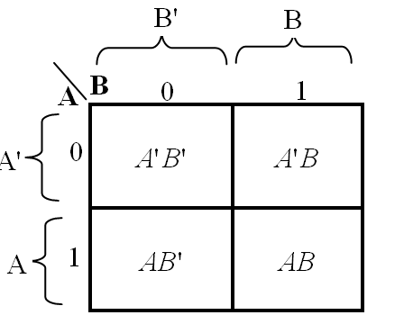
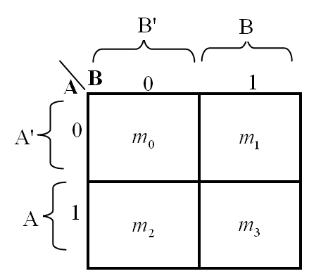
Two-Variable Map
Four minterms
A' = row 0; A = row 1
B' = column 0; B = column 1

Slide 5
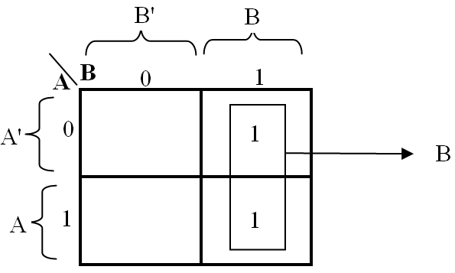
Example

Slide 6
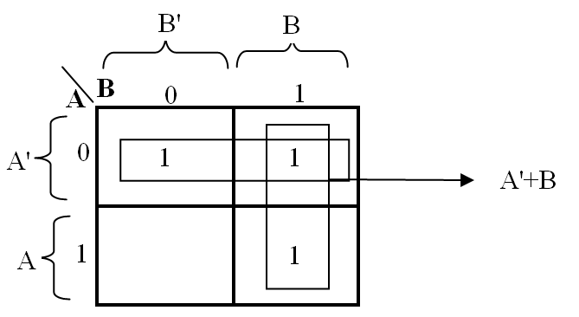
Example

Slide 7
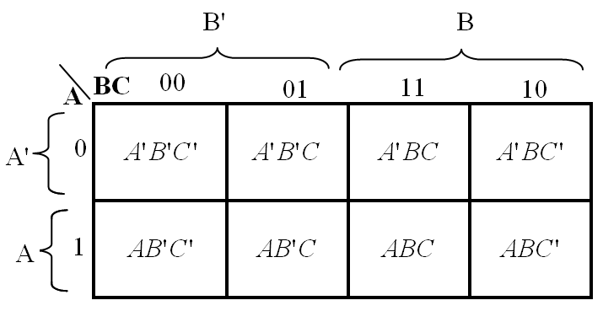
Three-Variable Map
Eight minterms
The Gray code sequence
Any two adjacent squares in the map differ by only on variable

Slide 8
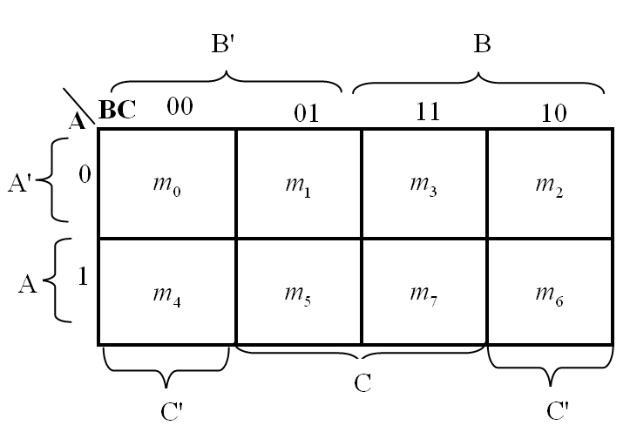
Three-Variable Map
m₀ and m₂ (m₄ and m₆) are adjacent
m₀+ m₂ = A'B'C' + A'BC' = A'C' (B'+ B) = A'C'
m₄+ m₆ = AB'C' + A'BC' = AC' (B'+ B) = AC'

Slide 9
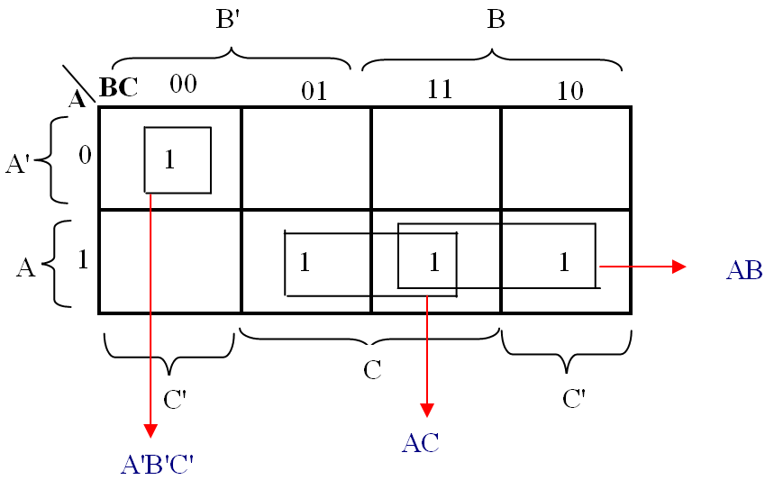
Example

Slide 10
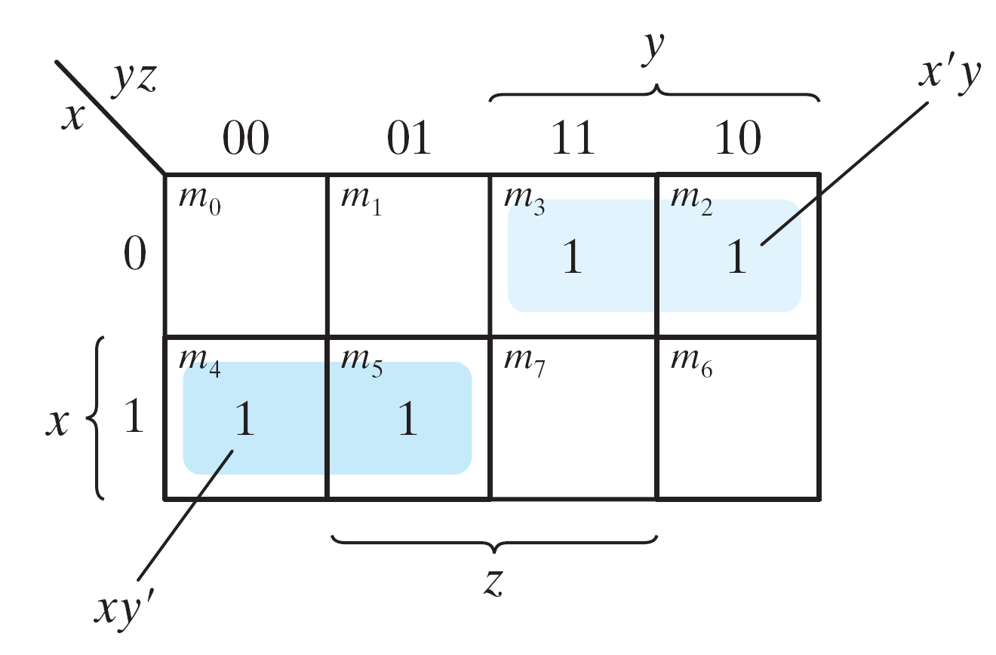
Example
Simplify the Boolean function F(x, y, z)= Σ(2, 3, 4, 5)
F(x, y, z) = Σ(2, 3, 4, 5) = x'y + xy'

Slide 11
Example
Simplify F(x, y, z) = Σ(3, 4, 6, 7)
F(x, y, z) = Σ(3, 4, 6, 7) = yz+ xz'

Slide 12
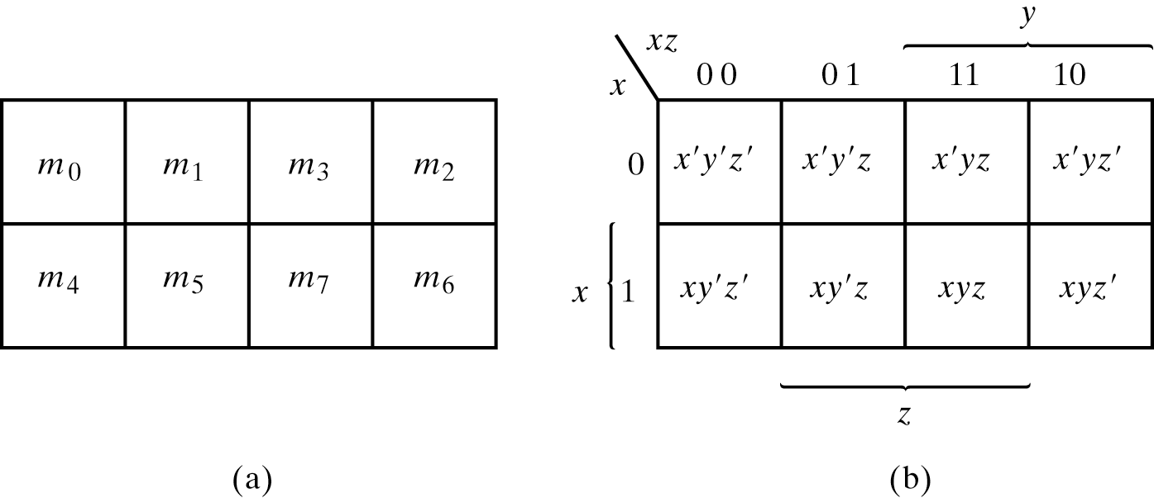
Four adjacent Squares
Consider four adjacent squares
m₀+m₂+m₄+m₆ = x'y'z'+x'yz'+xy'z'+xyz' = x'z'(y'+y) +xz'(y'+y) = x'z' + xz‘ = z'
m₁+m₃+m₅+m₇ = x'y'z+x'yz+xy'z+xyz =x'z(y'+y) + xz(y'+y) =x'z + xz = z

Slide 13
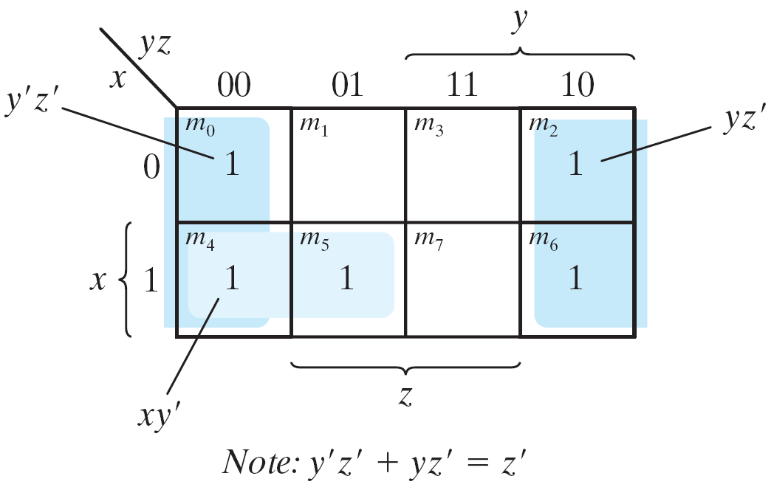
Example
Simplify F(x, y, z) = Σ(0, 2, 4, 5, 6)
F(x, y, z) = Σ(0, 2, 4, 5, 6) = z'+ xy'

Slide 14
Example
Let F = A'C + A'B + AB'C + BC
Express it in sum of minterms.
Find the minimal sum of products expression.
F(A, B, C) = Σ(1, 2, 3, 5, 7) = C + A'B

Slide 15
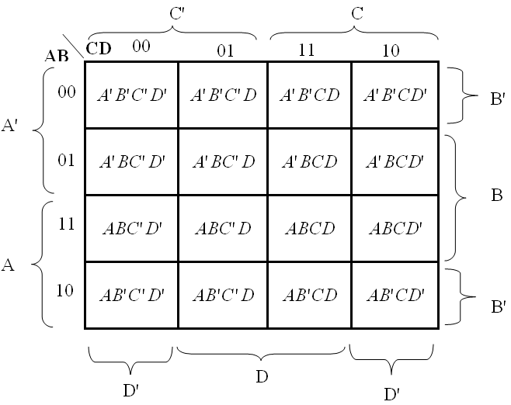
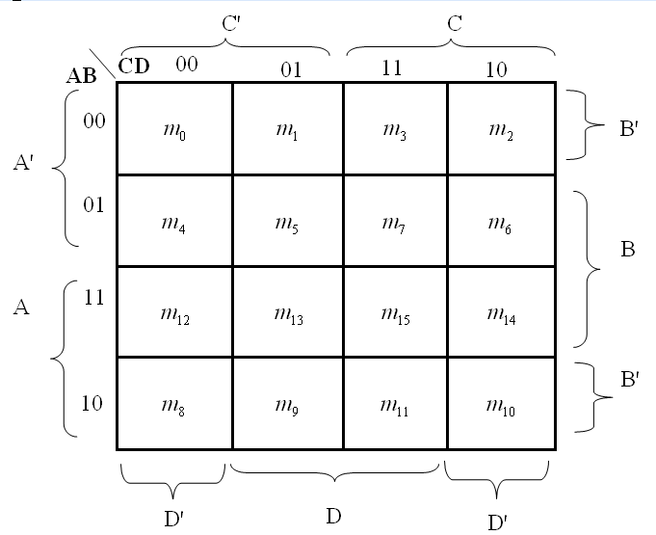
Four-Variable Map
16 minterms
Combinations of 2, 4, 8, and 16 adjacent squares

Slide 16
Example 3.5
F = y'+w'z'+xz'
Example 3.5: simplify F(w, x, y, z) = Σ(0, 1, 2, 4, 5, 6, 8, 9, 12, 13, 14)

Slide 17
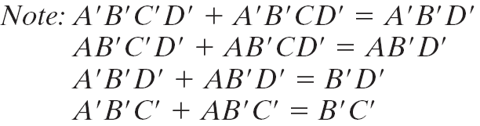
Example
A′B′C′ + B′CD′ + A′B′C′D′ + AB′C′= B′D′ + B′C′ +A′CD′
Simplify F = A′B′C′ + B′CD′ + A′B′C′D′ + AB′C′

Slide 18
Prime Implicants
All the minterms are covered.
Minimize the number of terms.
There are no redundant terms.
Implicant: A group of one or more k map cell
Prime implicant: an implicant that is not a subset of another implicant
Essential Prime Implicant: a prime implicant that covers at least one cell not covered by another prime implicant

Slide 19
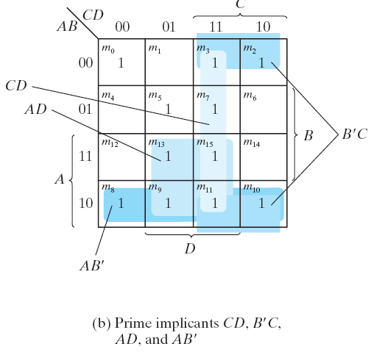
Prime Implicants
F(A, B, C, D) = Σ(0, 2, 3, 5, 7, 8, 9, 10, 11, 13, 15)
The simplified expression may not be unique
F = BD+B'D'+CD+AD = BD+B'D'+CD+AB'
= BD+B'D'+B'C+AD = BD+B'D'+B'C+AB'

Slide 20
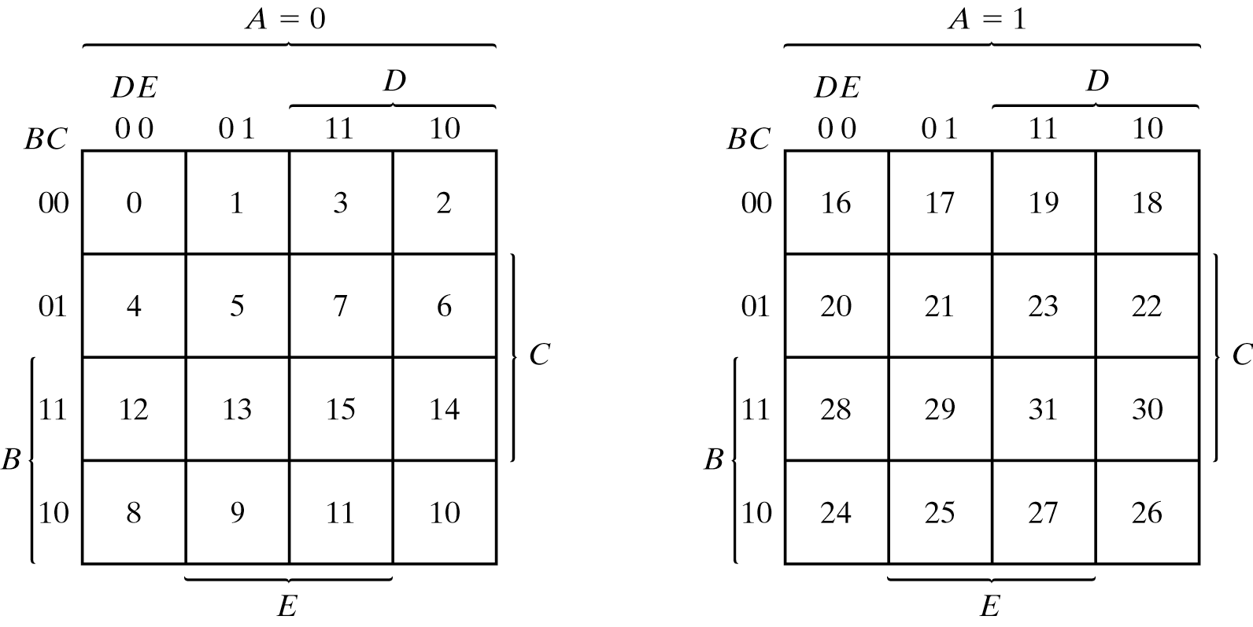
Five-Variable Map
Map for more than four variables becomes complicated
Five-variable map: two four-variable map (one on the top of the other).

Slide 21
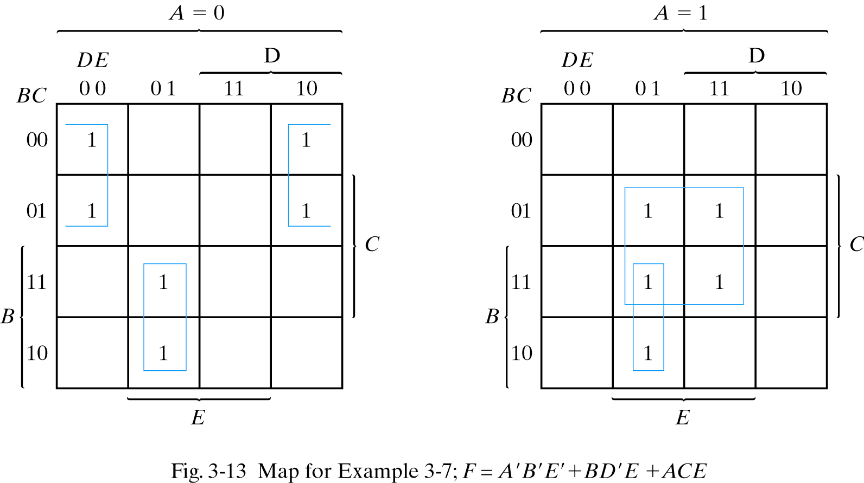
Example
F = A'B'E'+BD'E+ACE
Simplify F = Σ(0, 2, 4, 6, 9, 13, 21, 23, 25, 29, 31)

Slide 22
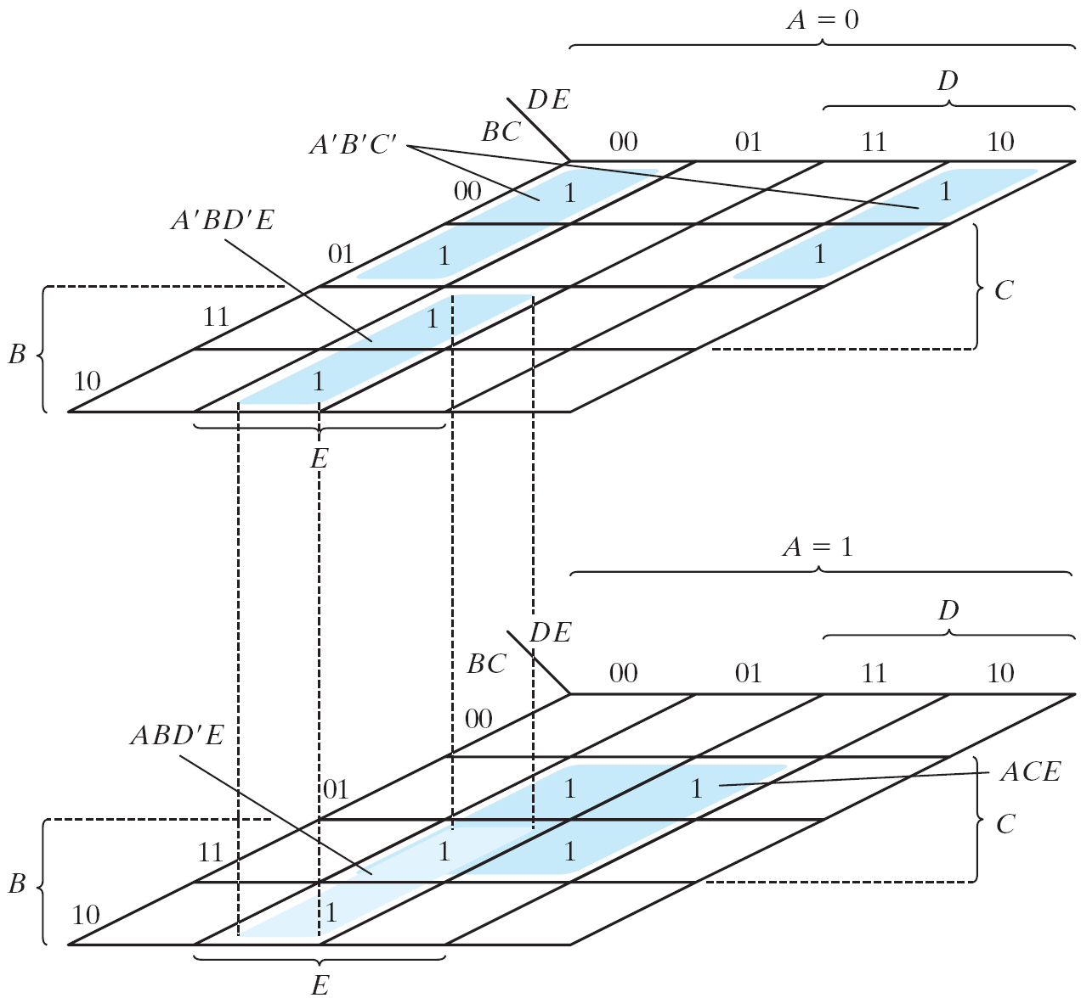
Example
Another Map for F = A'B'E'+BD'E+ACE

Slide 23
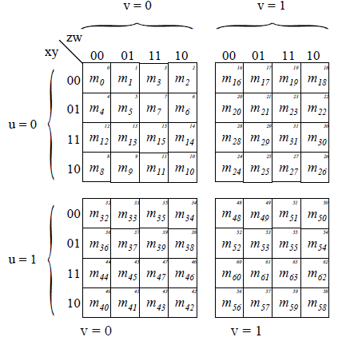
Six-Variable Map
Another Map for F = A'B'E'+BD'E+ACE

Slide 24
Don't-Care Conditions
The value of a function is not specified for certain combinations of variables
BCD; 1010-1111
The unspecified minterms of a function are called the don’t-care conditions, or simply the don’t-cares, and are denoted as Xs.
These don’t-care conditions can be used on a map to provide further simplification of the Boolean expression.
Can be implemented as 0 or 1

Slide 25
Example
Simplify F(w, x, y, z) = Σ(1, 3, 7, 11, 15) which has the don't-care conditions d(w, x, y, z) = Σ(0, 2, 5).
F = yz + w'x'; F = yz + w'z
F = Σ(0, 1, 2, 3, 7, 11, 15) ; F = Σ(1, 3, 5, 7, 11, 15)

Slide 26
Don't-Care Conditions
Either one of the above expressions satisfies the conditions stated.
Note that the above 2 expressions represent 2 functions that are algebraically unequal: each covers different don’t-care terms.
We may or may not include any of the Xs, while all the 1s must be included.

Slide 27
Product of Sums Simplification
Simplify F' in the form of sum of products
Apply DeMorgan's theorem F = (F')'
F': sum of products → F: product of sums

Slide 28
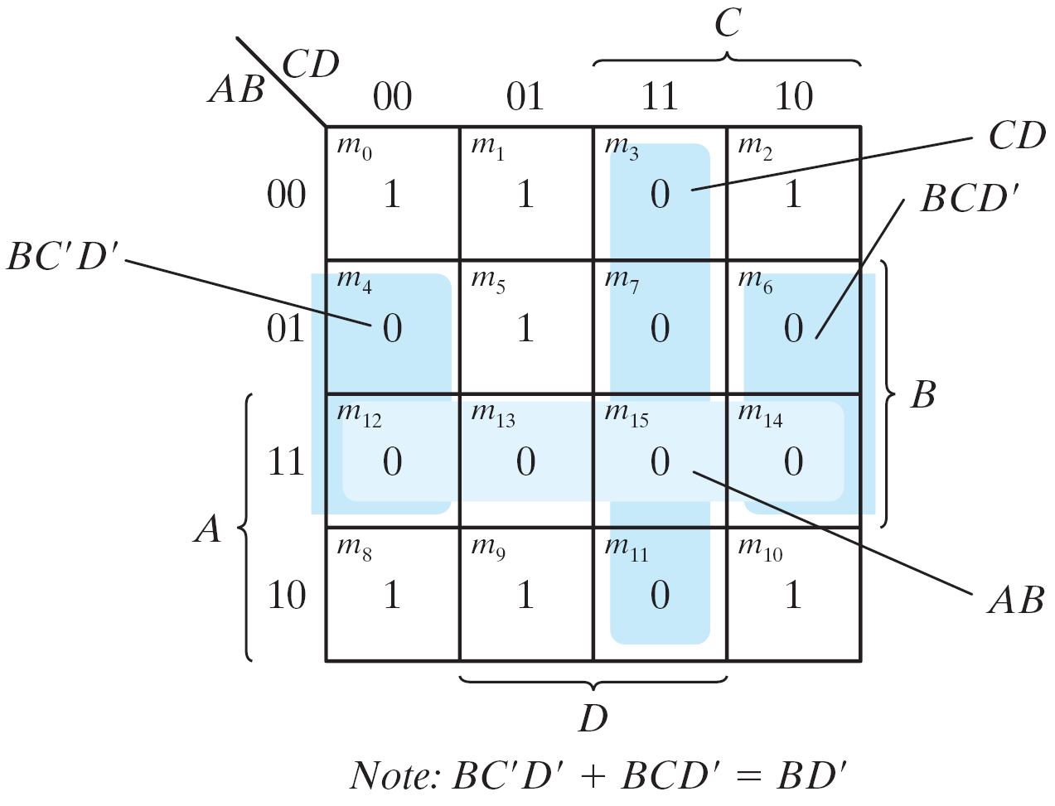
Example
F(A, B, C, D)= Σ(0, 1, 2, 5, 8, 9, 10) = B'D'+B'C'+A'C'D
F' = AB+CD+BD'
Apply DeMorgan's theorem; F=(A'+B')(C'+D')(B'+D)
Simplify F = Σ(0, 1, 2, 5, 8, 9, 10) into (a) sum-of-products form, and (b) product-of-sums form:

Slide 29
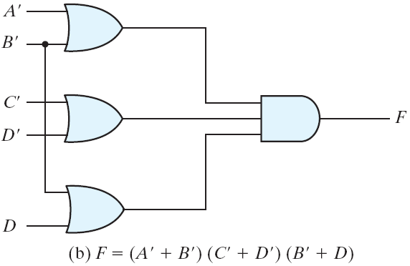
Example (cont.)
Sum-of products form
Product-of sums form
Figure 3.15 Gate Implementation of F = Σ(0, 1, 2, 5, 8, 9, 10)
Gate implementation of F = Σ(0, 1, 2, 5, 8, 9, 10)

Slide 30
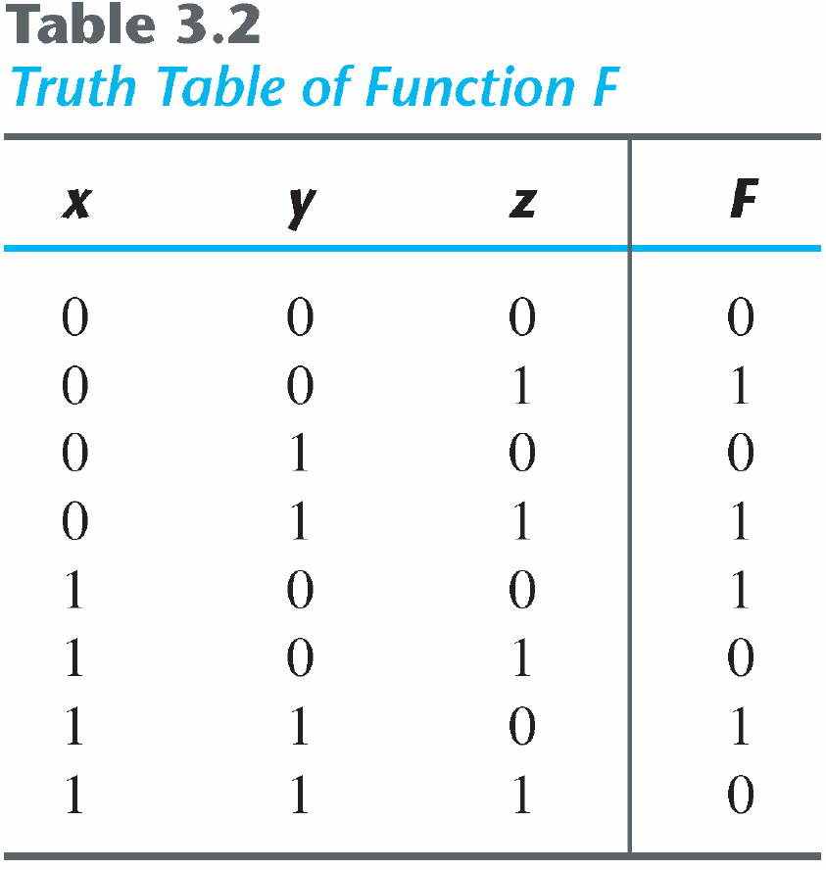
Product of Maxterms
Consider the function defined in Table 3.2.
In sum-of-minterm:
In sum-of-maxterm:

Slide 31
Product of Maxterms
'
Figure 3.16 Map for the function of Table 3.2
Consider the function defined in Table 3.2.
Combine the 1’s:
Combine the 0’s :
Taking the complement of F'

Slide 32
Map Method: Summary
Simplification procedure:
Generate K-map.
Determine PIs.
Select EPIs.
Find minimal cover (set) of PIs.

Slide 33
Simplification of Boolean functions
3 common methods:
Boolean algebra
The basis for all methods
Difficult to see the best path to take and to know when you are finished
Karnaugh maps
Fast and easy for 2 – 6 variables
Pictorial approach based on recognition of patterns
Difficult for large numbers of variables
Tabulation methods
Tedious to perform by hand, but well suited to computer implementation
No limit on the number of variables

Slide 34
Tabulation Methods
The tabulation method was first formulated by Quine and later improved by McCluskey. It is also known as the Quine-McCluskey method.
Simplification consists of two parts:
To find candidate prime implicants.
To choose the prime implicants that give an expression with the least number of literals (i.e., minimal cover generation).

Slide 35
Determination of prime implicants
Group minterms by number of 1s.
Compare minterms and find pairs with distance 1.
Generate subcubes.
Repeat the above procedure on generated subcubes until no more subcubes can be generated.

Slide 36
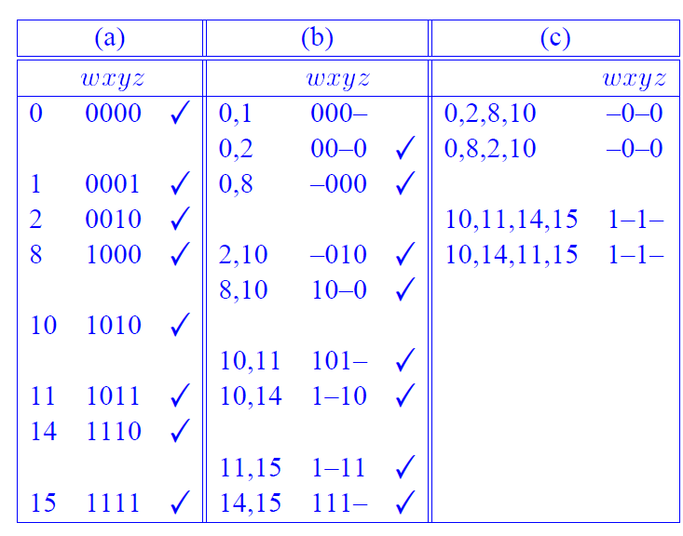
Determination of prime implicants
F(w,x,y,z) = ∑(0, 1, 2, 8, 10, 11, 14, 15)
= w'x'y' + x'z' + wy

Slide 37
Determination of prime implicants
Step 1: Group the minterms according to the number of 1s (see Column (a)).
Step 2: Combine any 2 minterms that differ from each other by exactly one variable (i.e., dist-1), the unmatched variable removed (see Column (b)). Try this for all possible pairs of minterms. A check (3) is placed to the right of both minterms if they have been used in a match.

Slide 38
Determination of prime implicants
Step 3: Repeat the process. Combine any 2 product terms from Step ­ that differ from each other by exactly one variable, the unmatched variable removed (see Column (c)).
Step 4: The unchecked terms in the table form the PIs. Some of the product terms may appear twice in the table. It of course is unnecessary to use the same term twice.

Slide 39
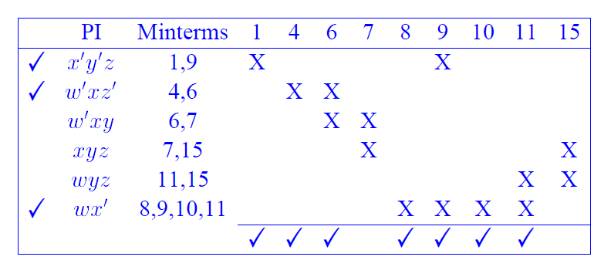
Minimal cover generation
The selection of PIs that form the minimized function is made from a PI table
F(w,x,y,z) = ∑(1, 4, 6, 7, 8, 9, 10, 11,15)

Slide 40
Minimal cover generation
F(w,x,y,z) = ∑(1, 4, 6, 7, 8, 9, 10, 11,15)
Essential Prime implicants are x’y’z, w’xz’, wx’
F(w,x,y,z) = x’y’z + w’xz’ + wx’ + xyz
PI | Minterms | 7 | 15
w’xy | 6, 7 | X
xyz | 7, 15 | X | X
wyz | 11, 15 |  | X

Slide 41
Minimal cover generation
Step 1: Check the PIs that cover minterms with a single X in their columns. These PIs are the EPIs.
Step 2: Check each column whose minterm is covered by the selected EPIs.
Step 3: If there are minterms left uncovered (7 & 15 in this example), some nonessential PIs have to be selected to cover them. We of course will select the PIs with a smallest total number of literals (xyz in this example).

Slide 42
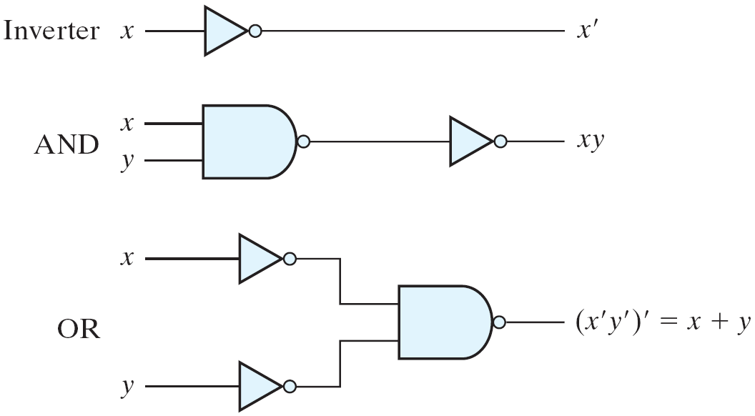
NAND and NOR Implementation
Logic Operations with NAND Gates
NAND gate is a universal gate
Can implement any digital system

Slide 43
NAND Gate
Two Graphic Symbols for NAND Gate
Two graphic symbols for a NAND gate

Slide 44
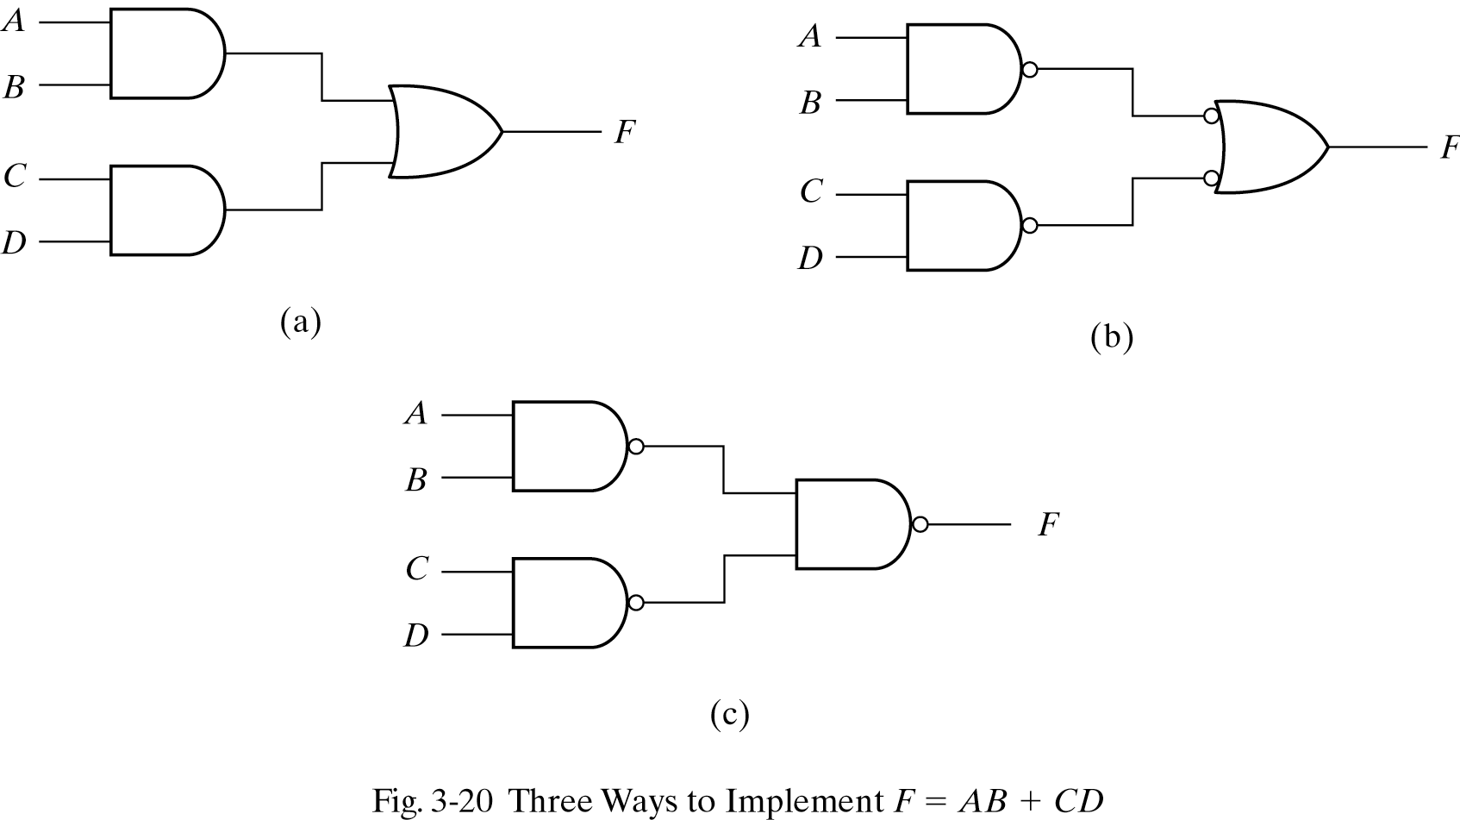
Two-level Implementation
Two-level logic
NAND-NAND = sum of products
Example: F = AB+CD
F = ((AB)' (CD)' )' =AB+CD

Slide 45
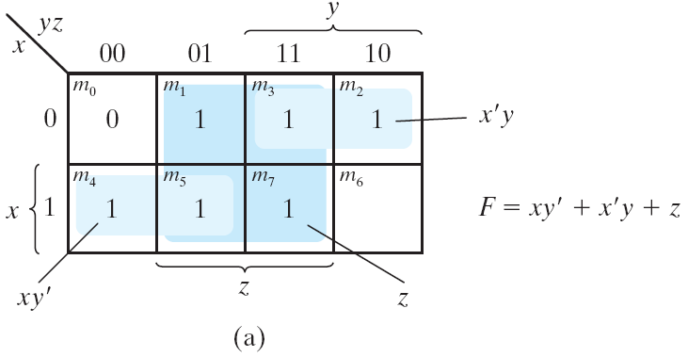
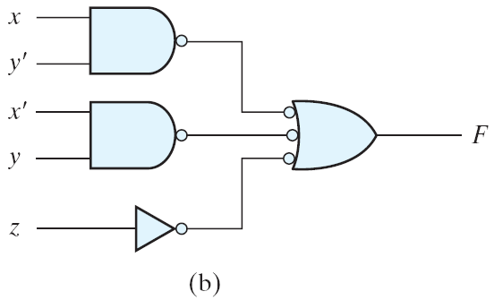
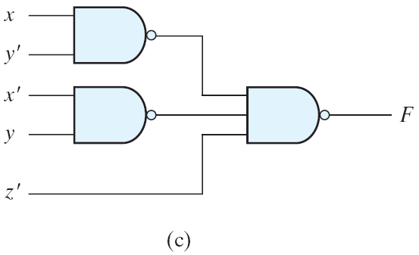
Example

Slide 46
Two -Level NAND Circuits
The procedure
Simplify the function and express it in SOP form
Draw a NAND gate for each product term
Draw a single gate using AND-invert or invert-OR symbol for the sum term
A term with single literal, complement if needed

Slide 47
Multilevel NAND Circuits
The procedure
Convert all AND gates to NAND gates
Convert all OR gates to NAND gates with invert-OR symbols
Balance all bubbles, insert an inverter if needed

Slide 48
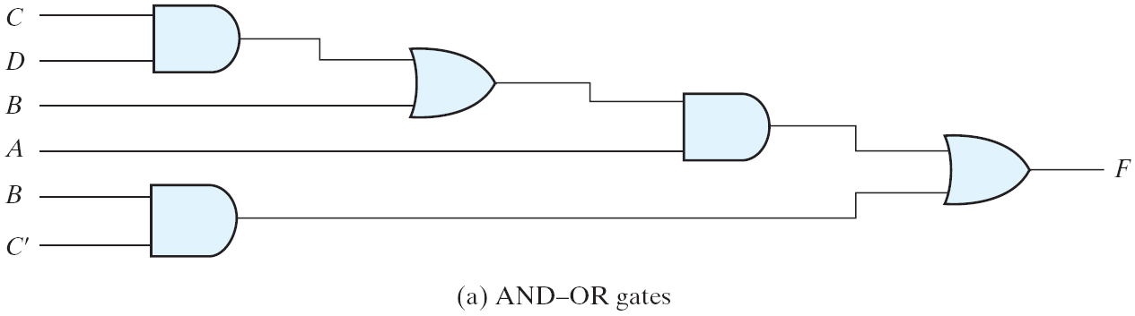
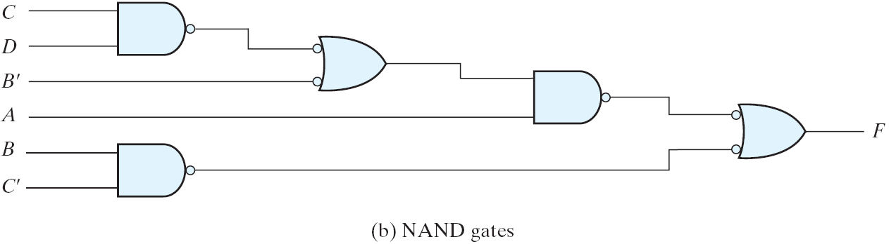
Multilevel NAND Circuits
F = A(CD + B) + BC′

Slide 49
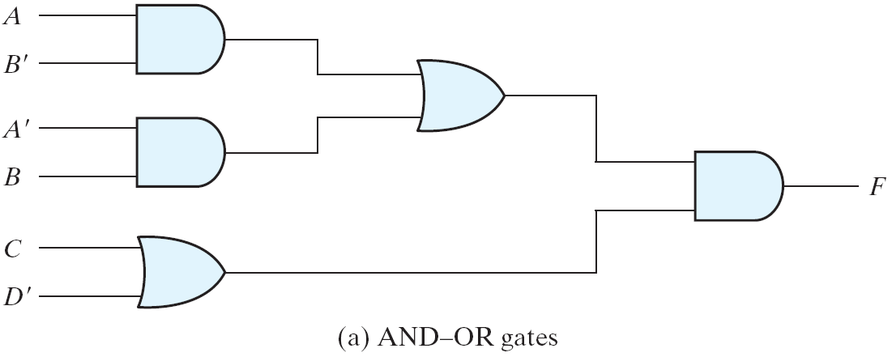
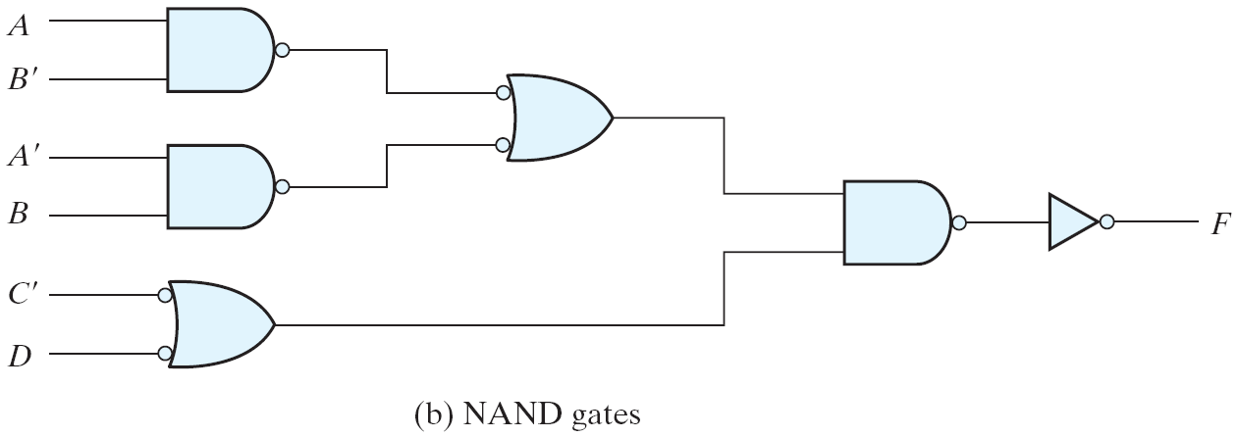
Multilevel NAND Circuits
F = (AB′ +A′B)(C+ D′)

Slide 50
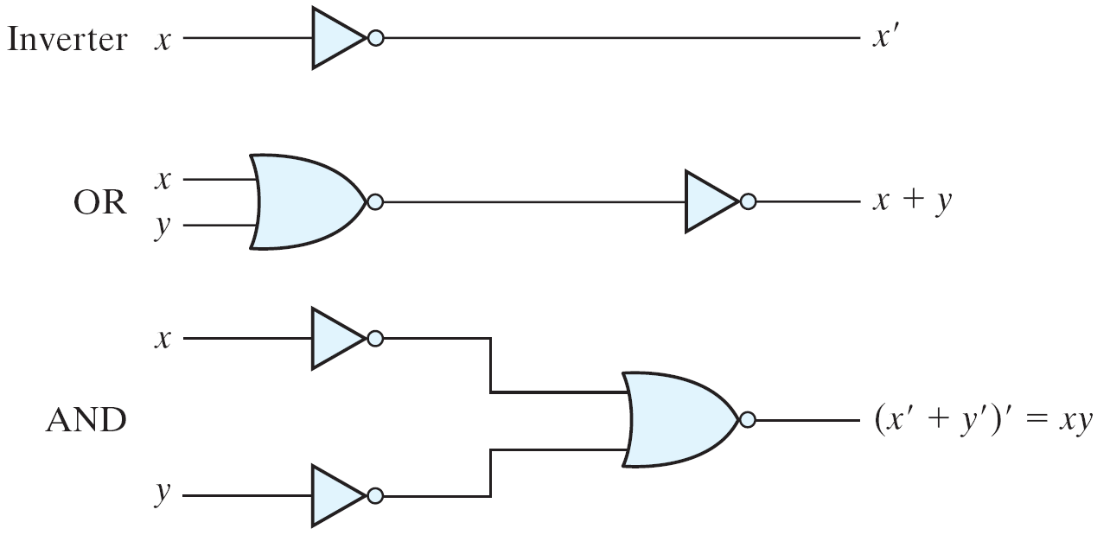
NOR Implementation
Logic Operation with NOR Gates
NOR function is the dual of NAND function.
The NOR gate is also universal.

Slide 51
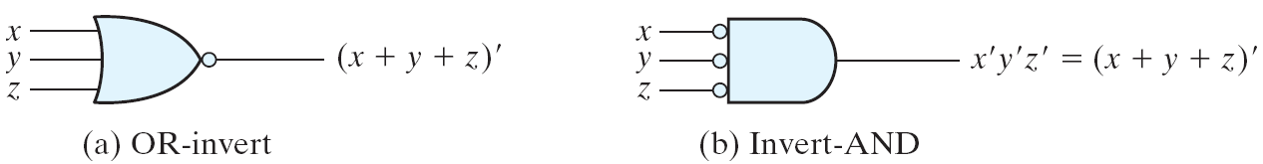
NOR Gate
Two Graphic Symbols for NOR Gate
Two graphic symbols for a NOR gate

Slide 52
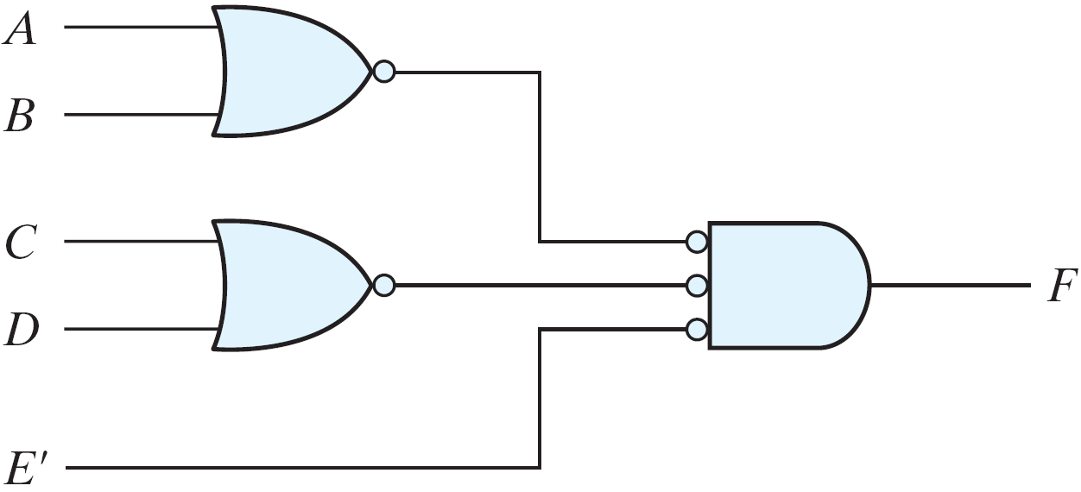
NOR Implementation
F = (A + B)(C + D)E

Slide 53
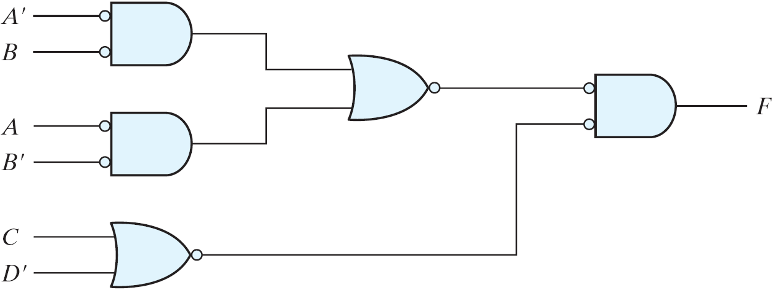
NOR Implementation
F = (AB′ +A′B)(C + D′)

Slide 54
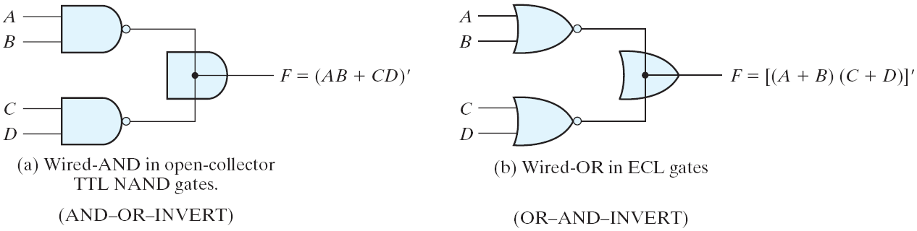
Other Two-level Implementations
AND-OR-INVERT function
OR-AND-INVERT function
Wired Logic
Wired logic
In some technologies, it is possible to short O/Ps of some logic gates

Slide 55
Non-degenerate Forms
16 possible combinations of two-level forms
Eight of them: degenerate forms = a single operation
AND-AND, AND-NAND, OR-OR, OR-NOR, NAND-OR, NAND-NOR, NOR-AND, NOR-NAND.
The eight non-degenerate forms
AND-OR, OR-AND, NAND-NAND, NOR-NOR, NOR-OR, NAND-AND, OR-NAND, AND-NOR.
AND-OR and NAND-NAND = sum of products.
OR-AND and NOR-NOR = product of sums.
NOR-OR, NAND-AND, OR-NAND, AND-NOR = ?

Slide 56
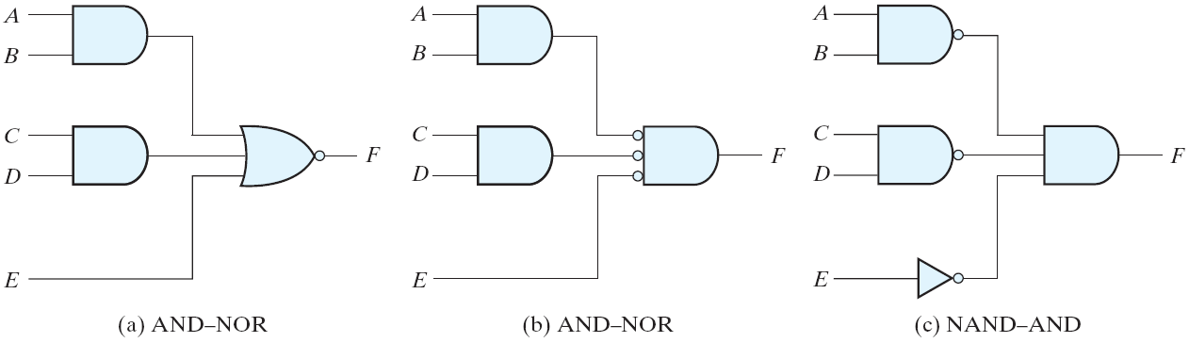
AND-OR-Invert Implementation
AND-OR-INVERT circuits, F = (AB +CD +E)′
AND-OR-INVERT (AOI) Implementation
NAND-AND = AND-NOR = AOI
F = (AB+CD+E)'
F' = AB+CD+E (sum of products)

Slide 57
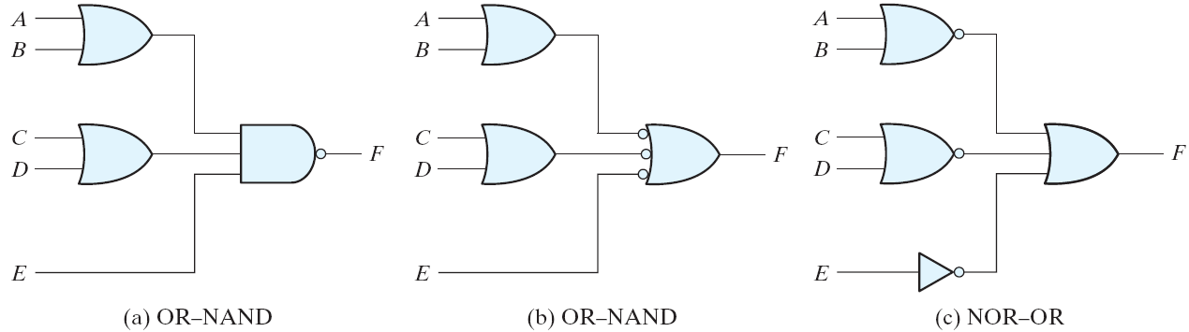
OR-AND-Invert Implementation
OR-AND-INVERT circuits, F = ((A+B)(C+D)E)'
OR-AND-INVERT (OAI) Implementation
OR-NAND = NOR-OR = OAI
F = ((A+B)(C+D)E)'
F' = (A+B)(C+D)E (product of sums)

Slide 58
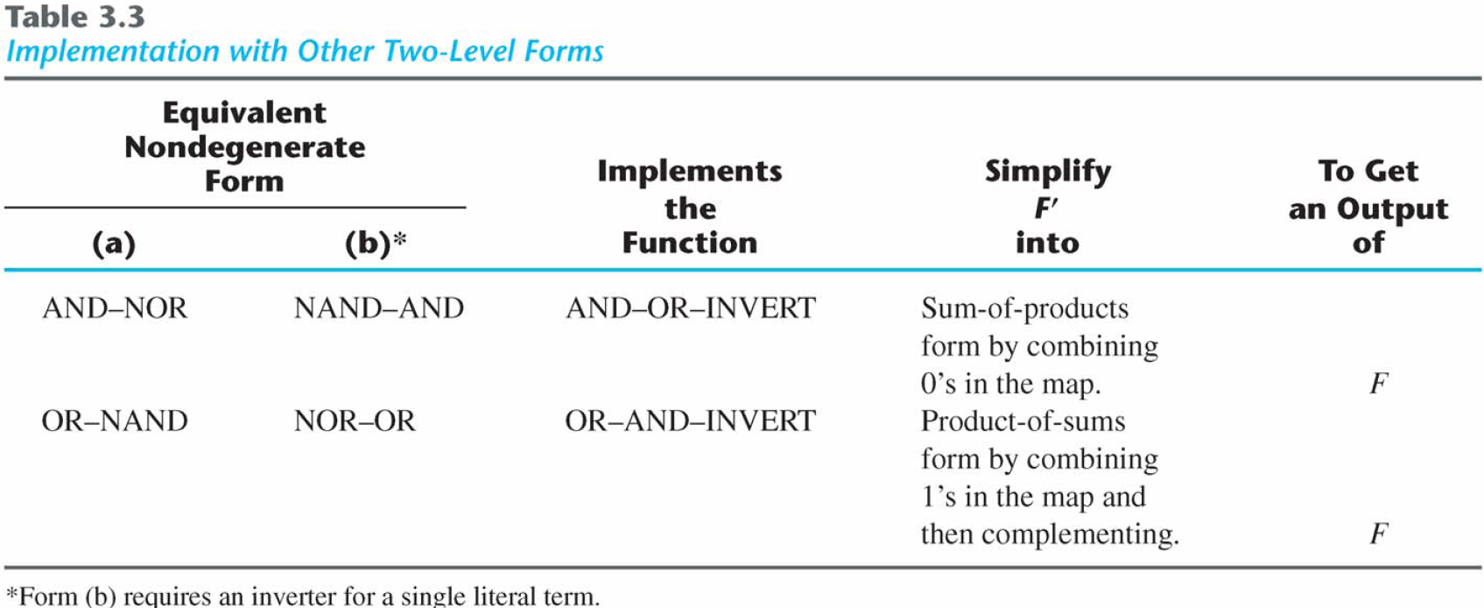
Tabular Summary and Examples

Slide 59
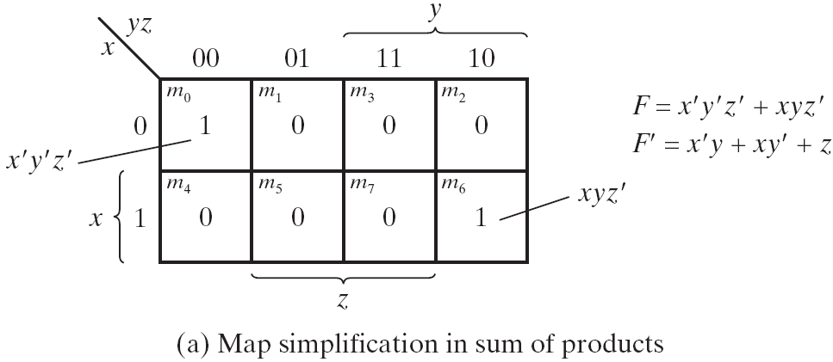
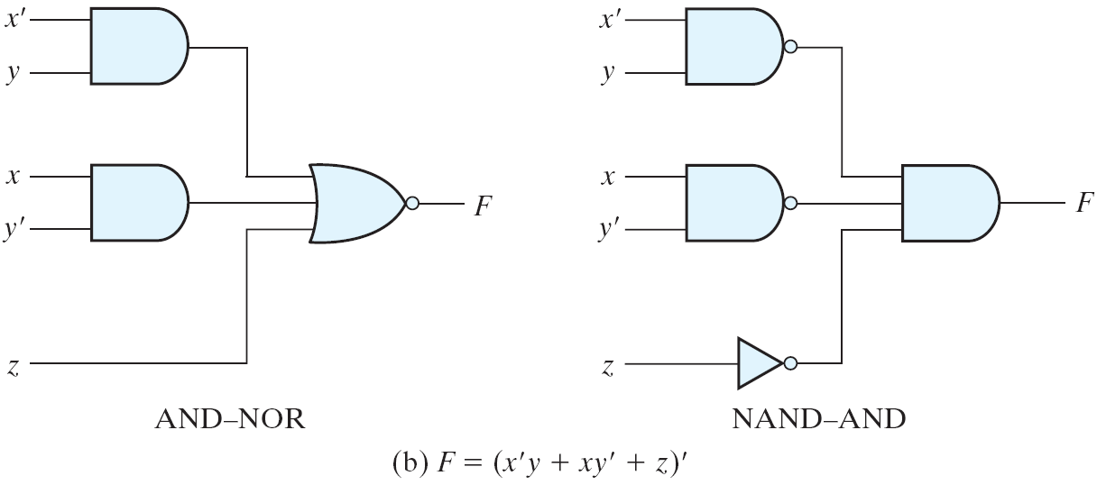

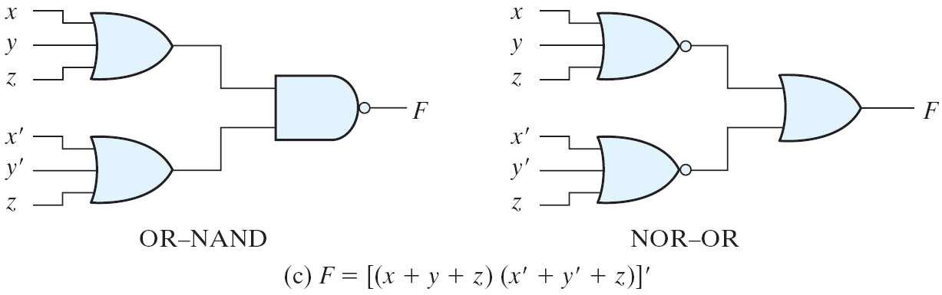
Example
Other Two-level Implementations

Slide 60
Exclusive-OR Function
Exclusive-OR (XOR)
x⊕y = xy'+x'y
Exclusive-NOR (XNOR)
(x⊕y)' = xy + x'y'
Some identities
x⊕0 = x
x⊕1 = x'
x⊕x = 0
x⊕x' = 1
x⊕y' = (x⊕y)'
x'⊕y = (x⊕y)'
Commutative and associative
A⊕B = B⊕A
(A⊕B) ⊕C = A⊕ (B⊕C) = A⊕B⊕C

Slide 61
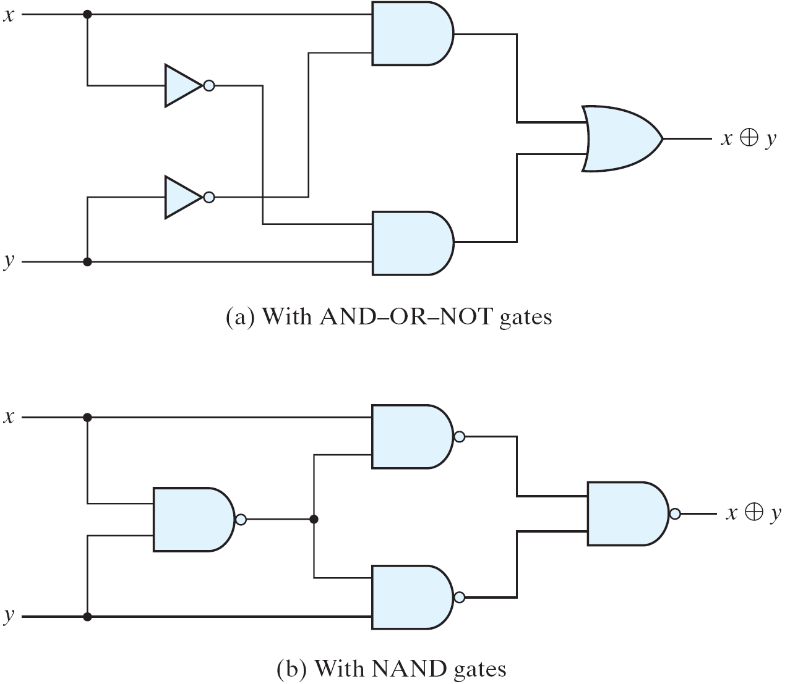
Exclusive-OR Implementations
Exclusive-OR Implementations
Implementations
(x'+y')x + (x'+y')y = xy'+x'y = x⊕y

Slide 62
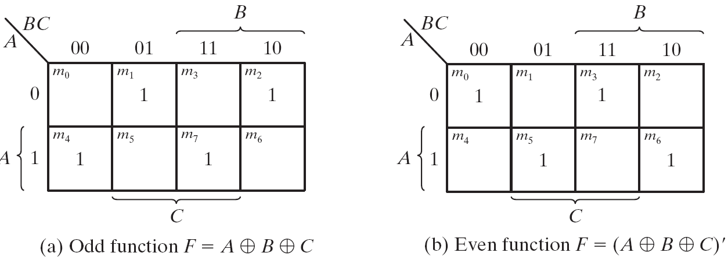
Odd Function
Map for a Three-variable Exclusive-OR Function
A⊕B⊕C = (AB'+A'B)C' +(AB+A'B')C = AB'C'+A'BC'+ABC+A'B'C = Σ(1, 2, 4, 7)
XOR is a odd function → an odd number of 1's, then F = 1.
XNOR is a even function → an even number of 1's, then F = 1.

Slide 63
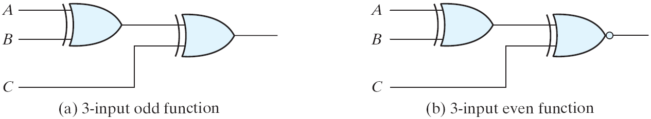
XOR and XNOR
Logic Diagram of Odd and Even Functions
Logic diagram of odd and even functions

Slide 64
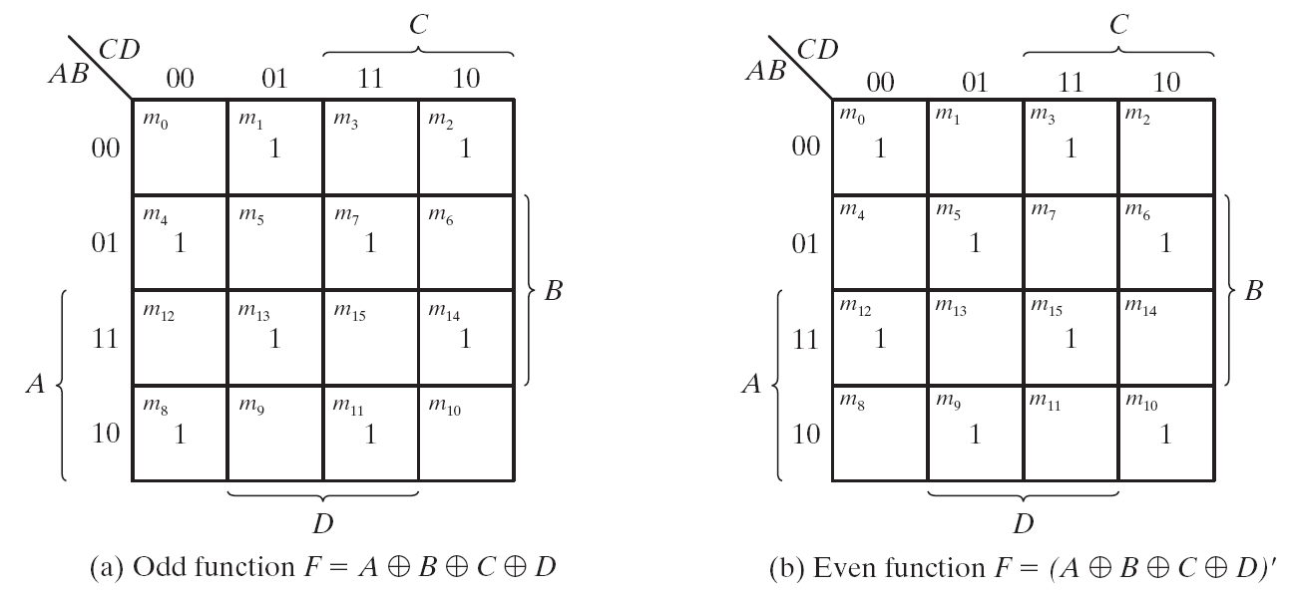
Four-variable Exclusive-OR function
Map for a Four-variable Exclusive-OR Function
Four-variable Exclusive-OR function
A⊕B⊕C⊕D = (AB'+A'B)⊕(CD'+C'D) = (AB'+A'B)(CD+C'D')+(AB+A'B')(CD'+C'D)

Slide 65
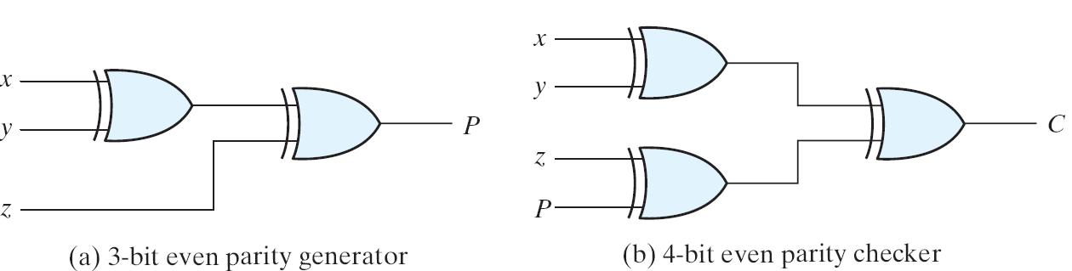
Parity Generation and Checking
Logic Diagram of a Parity Generator and Checker
Parity Generation and Checking
A parity bit: P = x⊕y⊕z
Parity check: C = x⊕y⊕z⊕P
C=1: one bit error or an odd number of data bit error
C=0: correct or an even # of data bit error

Slide 66
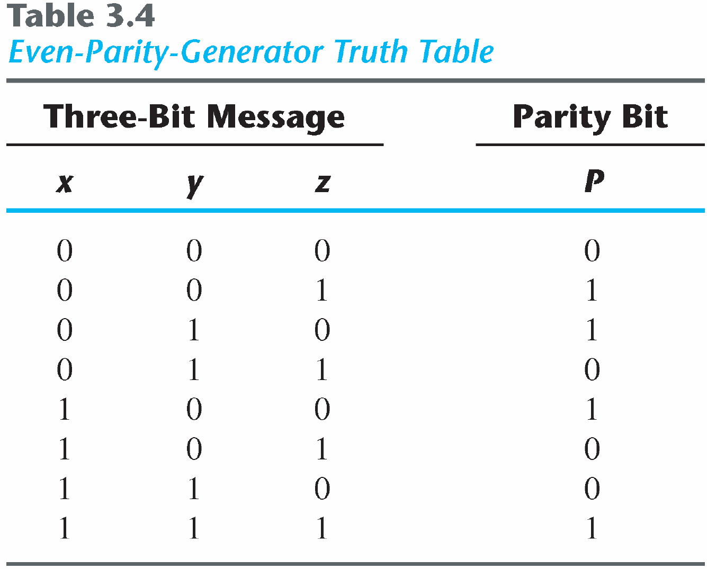
Parity Generation and Checking

Slide 67
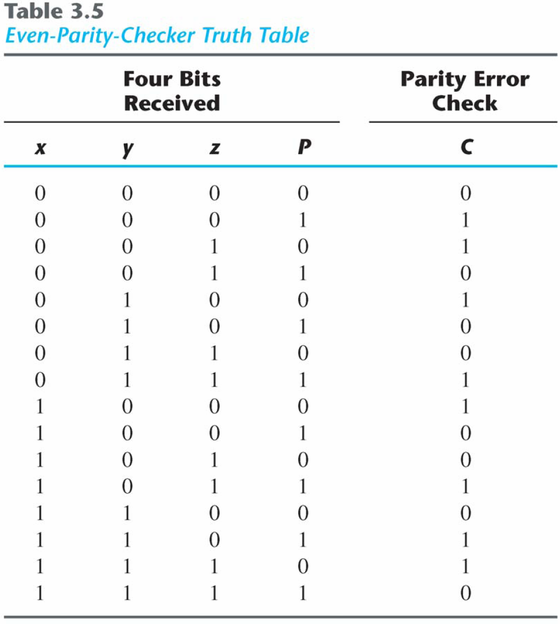
Parity Generation and Checking

