Slide 1
CSE 205: Digital Logic Design
Dr. Tanzima Hashem
Associate Professor
CSE, BUET

Slide 2
Textbook
Digital Design (5th Edition)
M. Morris Mano
Michael D. Ciletti

Slide 3
Combinational Logic
Combinational Logic:
Output depends only on current input
Has no memory

Slide 4
Sequential Logic
Sequential Logic:
Output depends not only on current input but also on past input values, e.g., design a counter
Need some type of memory to remember the past input values

Slide 5
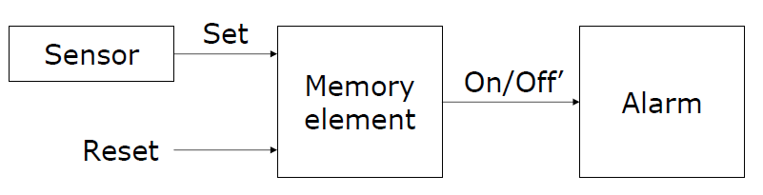
Alarm control system
Suppose we wish to construct an alarm circuit such that the output remains active (on) even after the sensor output that triggered the alarm goes off
The circuit requires a memory element to remember that the alarm has to be active until a reset signal arrives

Slide 6
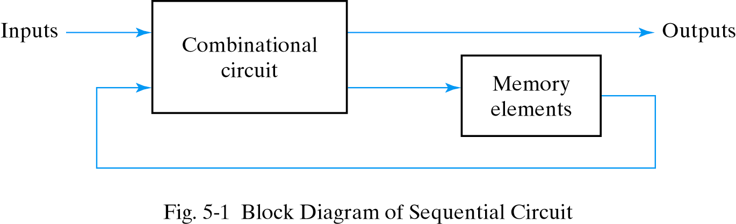
Sequential Circuits
Consist of a combinational circuit to which storage elements are connected to form a feedback path
State:  the state of the memory devices now, also called current state
Next states and outputs are functions of inputs and present states of storage elements

Slide 7
Two Types of Sequential Circuits
Synchronous sequential circuit
circuit output changes only at some discrete instants of time.
Synchronized by a periodic train of clock pulses
Much easier to design (preferred design style)
Asynchronous sequential circuit
circuit output can change at any time (clockless)
May have better performance but hard to design

Slide 8
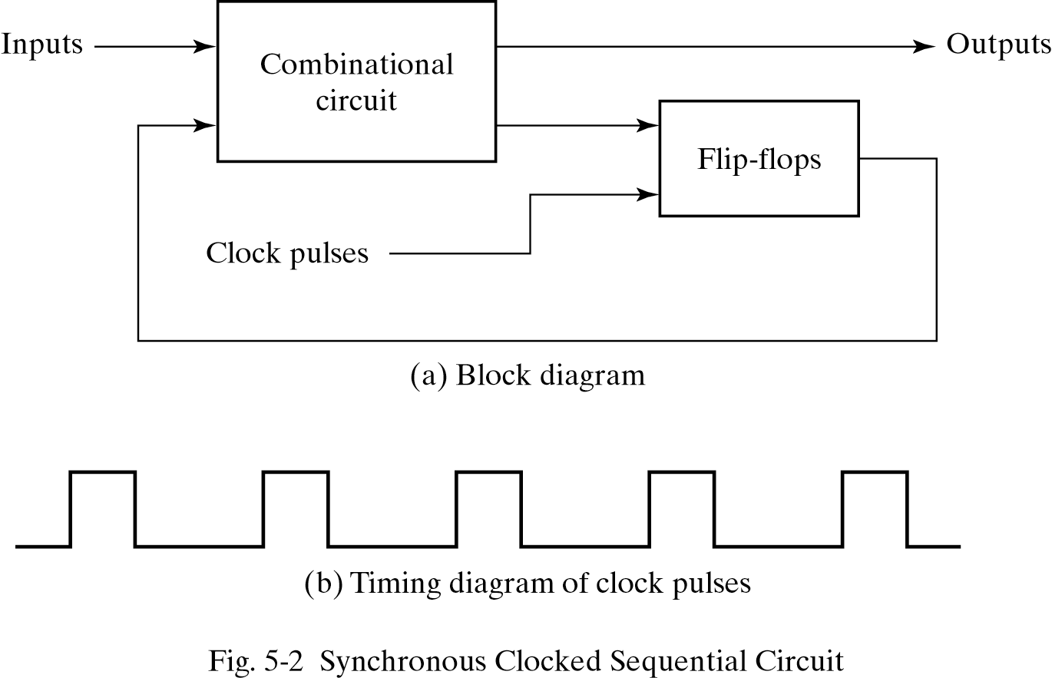
Synchronous Sequential Circuits

Slide 9
Memory elements
A digital circuit that can maintain a binary state indefinitely, until directed by an input signal to switch states
Differences among different types of storage elements depends on
The number of inputs they possess
The manner in which the inputs affect the binary state

Slide 10
Memory elements
Latch - a level-sensitive memory element
SR latches
D latches
Flip-Flop - an edge-triggered memory element
Master-slave flip-flop
Edge-triggered flip-flop
RAM and ROM  a mass memory element

Slide 11
Latches
A latch is binary storage element
Can store a 0 or 1
The most basic memory
Easy to build
Built with gates (NORs, NANDs, NOT)

Slide 12
Latches
S R Q₀ | Q | Q’
0 0 0
SR Latch
0 | 1
Q = Q₀
0
0
0
1
Initial Value

Slide 13
Latches
S R Q₀ | Q | Q’
0 0 0 | 0 | 1
0 0 1
SR Latch
Q = Q₀
1 | 0
Q = Q₀
0
1
0
0

Slide 14
Latches
S R Q₀ | Q | Q’
0 0 0 | 0 | 1
0 0 1 | 1 | 0
0 1 0 | 0
SR Latch
Q = Q₀
1
 | 1
Q = 0
0
0
1

Slide 15
Latches
S R Q₀ | Q | Q’
0 0 0 | 0 | 1
0 0 1 | 1 | 0
0 1 0 | 0 | 1
0 1 1
SR Latch
Q = Q₀
1
Q = 0
1
0 | 1
Q = 0
0
0

Slide 16
Latches
S R Q₀ | Q | Q’
0 0 0 | 0 | 1
0 0 1 | 1 | 0
0 1 0 | 0 | 1
0 1 1 | 0 | 1
1 0 0
SR Latch
Q = Q₀
0
0
Q = 0
1 | 0
Q = 1
1
1

Slide 17
Latches
S R Q₀ | Q | Q’
0 0 0 | 0 | 1
0 0 1 | 1 | 0
0 1 0 | 0 | 1
0 1 1 | 0 | 1
1 0 0 | 1 | 0
1 0 1
SR Latch
Q = Q₀
0
1
Q = 0
Q = 1
1 | 0
Q = 1
1
0

Slide 18
Latches
S R Q₀ | Q | Q’
0 0 0 | 0 | 1
0 0 1 | 1 | 0
0 1 0 | 0 | 1
0 1 1 | 0 | 1
1 0 0 | 1 | 0
1 0 1 | 1 | 0
1 1 0
SR Latch
Q = Q₀
1
0
Q = 0
Q = 1
0 | 0
Q = Q’
1
1
0

Slide 19
Latches
S R Q₀ | Q | Q’
0 0 0 | 0 | 1
0 0 1 | 1 | 0
0 1 0 | 0 | 1
0 1 1 | 0 | 1
1 0 0 | 1 | 0
1 0 1 | 1 | 0
1 1 0 | 0 | 0
1 1 1
SR Latch
Q = Q₀
1
1
Q = 0
0
Q = 1
Q = Q’
0 | 0
Q = Q’
1
0

Slide 20
SR Latch
S R | Q
0 0 | Q₀
0 1 | 0
1 0 | 1
1 1 | Q=Q’=0
No change
Reset
Set
Invalid
S R | Q
0 0 | Q=Q’=1
0 1 | 1
1 0 | 0
1 1 | Q₀
Invalid
Set
Reset
No change

Slide 21
SR Latch
S R | Q
0 0 | Q₀
0 1 | 0
1 0 | 1
1 1 | Q=Q’=0
No change
Reset
Set
Invalid
S’ R’ | Q
0 0 | Q=Q’=1
0 1 | 1
1 0 | 0
1 1 | Q₀
Invalid
Set
Reset
No change

Slide 22
Controlled Latches
SR Latch with Control Input
C S R | Q
0 x x | Q₀
1 0 0 | Q₀
1 0 1 | 0
1 1 0 | 1
1 1 1 | Q=Q’
No change
No change
Reset
Set
Invalid

Slide 23
Controlled Latches
Timing Diagram
D Latch (D = Data)
C
D
Q
t
C D | Q
0 x | Q₀
1 0 | 0
1 1 | 1
Output may change
No change
Reset
Set

Slide 24
Controlled Latches
Timing Diagram
D Latch (D = Data)
C
D
Q
C D | Q
0 x | Q₀
1 0 | 0
1 1 | 1
Output may change
No change
Reset
Set

Slide 25
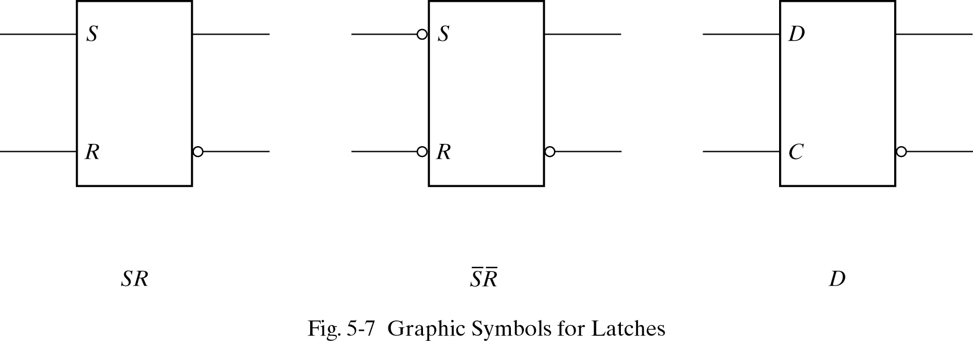
Graphic symbols for latches

Slide 26
Level versus edge sensitivity
Since the output of the D latch is controlled by the level (0 or 1) of the clock input, the latch is said to be level sensitive
All of the latches we have seen have been level sensitive
It is possible to design a storage element for which the output only changes at the point in time when the clock changes from one value to another
Such circuits are said to be edge triggered

Slide 27
Flip-Flops
Controlled latches are level-triggered
Flip-Flops are edge-triggered
C
CLK
Positive Edge
CLK
Negative Edge

Slide 28
Flip-Flops
Master-Slave D Flip-Flop
D Latch
(Master)
D Latch
(Slave)
D
D
C
Q
D
C
Q
Q
Master
Slave
CLK
CLK
D
Looks like it is negative edge-triggered
Q_{Master}
Q_{Slave}

Slide 29
Flip-Flops
The circuit samples the D input and changes its output at the negative edge of the clock, CLK.
When the clock is 0, the output of the inverter is 1. The slave latch is enabled and its output Q is equal to the master output Y. The master latch is disabled (CLK = 0).
When the CLK changes to high, D input is transferred to the master latch. The slave remains disabled as long as CLK is low. Any change in the input changes Y,but not Q.
The output of the flip-flop can change when CLK makes a transition 1 → 0

Slide 30
Flip-Flops
Edge-Triggered D Flip-Flop
D
Q
Q
Positive Edge
D
Q
Q
Negative Edge

Slide 31
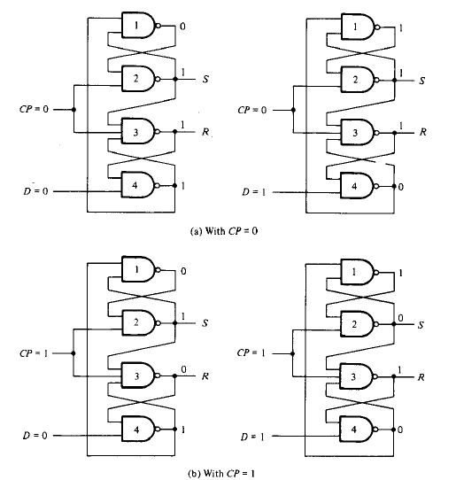
Flip-Flops: Edge-Triggered D Flip-Flop

Slide 32
Flip-Flops
Set-up time and hold time are times required before and after the clock transition that data must be present to be reliably clocked into the flip-flop.
Setup time is the minimum time for the data to be present before the clock.
D
CLK
Set-up time, t_{s}
Hold time is the minimum time for the data to remain after the clock.
D
CLK
Hold time, t_{H}

Slide 33
JK Flip-Flops
JK Flip-Flop : D = JQ’ + K’Q
When J = 1 and K = 0, D = 1 → next clock edge sets output to 1.
When J = 0 and K = 1, D = 0 → next clock edge resets output to 0.
When J = 1 and K = 1, D= Q’ → next clock edge complements output.
When J = 0 and K = 0, D= Q → next clock edge leaves output unchanged.

Slide 34
JK Flip-Flops
JK Flip-Flop
J
Q
D = JQ’ + K’Q
K
Q

Slide 35
T Flip-Flops
T Flip-Flop
T
J
Q
T
D
Q
Q
K
Q
T
Q
D = JQ’ + K’Q
D = TQ’ + T’Q = T ⊕ Q
Q

Slide 36
Flip-Flop Characteristic Tables
D | Q(t+1)
0 | 0
1 | 1
D
Q
Reset
Set
Q
J | K | Q(t+1)
0 | 0 | Q(t)
0 | 1 | 0
1 | 0 | 1
1 | 1 | Q’(t)
J
Q
No change
Reset
Set
Toggle
K
Q
T
Q
T | Q(t+1)
0 | Q(t)
1 | Q’(t)
No change
Toggle
Q

Slide 37
Flip-Flop Characteristic Equations
D | Q(t+1)
0 | 0
1 | 1
D
Q
Q(t+1) = D
Q
J | K | Q(t+1)
0 | 0 | Q(t)
0 | 1 | 0
1 | 0 | 1
1 | 1 | Q’(t)
J
Q
Q(t+1) = JQ’ + K’Q
K
Q
T
Q
T | Q(t+1)
0 | Q(t)
1 | Q’(t)
Q(t+1) = T ⊕ Q
Q

Slide 38
Flip-Flops with Asynchronous/Direct Inputs
Asynchronous Reset
R’ | D | CLK | Q(t+1)
0 | x | x | 0
1 | 0 | ↑ | 0
1 | 1 | ↑ | 1
D
Q
Q
R
Reset

Slide 39
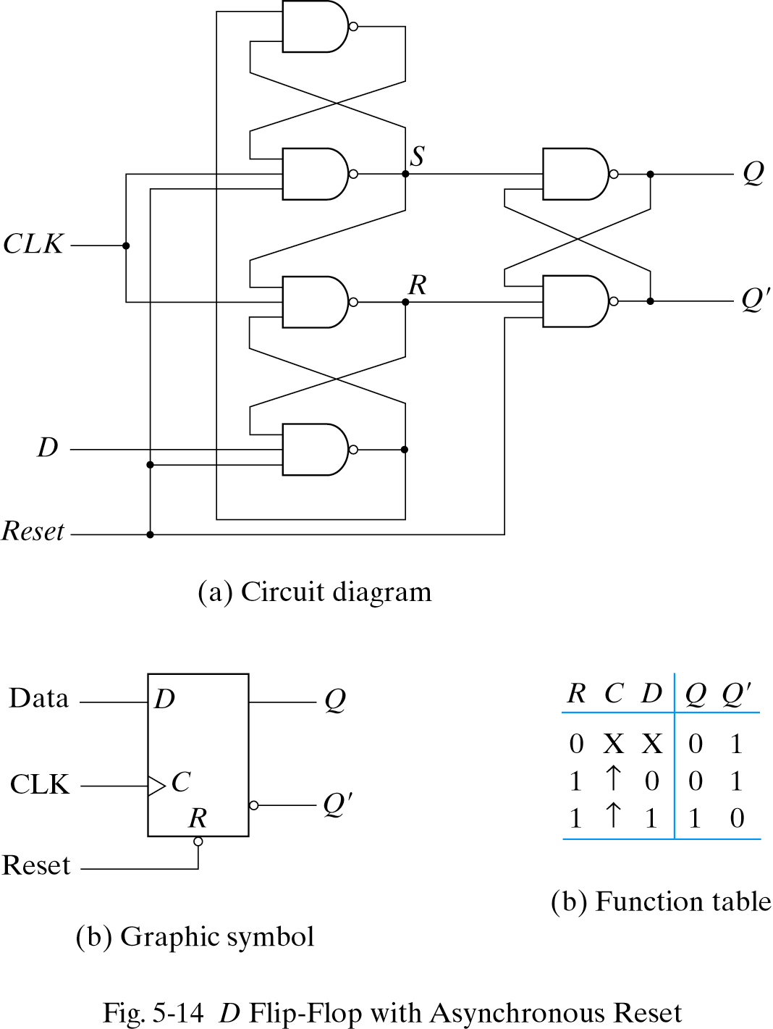
Flip-Flops with Direct Inputs
Asynchronous Reset

Slide 40
Flip-Flops with Direct Inputs
Asynchronous Preset and Clear
Preset
PR’ | CLR’ | D | CLK | Q(t+1)
1 | 0 | x | x | 0
0 | 1 | x | x | 1
1 | 1 | 0 | ↑ | 0
1 | 1 | 1 | ↑ | 1
PR
D
Q
Q
CLR
Reset

Slide 41
Analysis of Clocked Sequential Circuits: The State
State = Values of all Flip-Flops
Example
A B = 0 0

Slide 42
Analysis of Clocked Sequential Circuits: Terminology
State Equation: A state equation (transition equation) specifies the next state as a function of the present state and inputs.
State Table: A state table (transition table) consists of: present state, input, next state and output.
State Diagram: The information in a state table can be represented graphically in a state diagram. The state is represented by a circle and the transitions between states are indicated by directed lines connecting the circles.

Slide 43
Analysis of Clocked Sequential Circuits: State/Transition Equations
A(t+1) = D_{A}
= A(t) x(t)+B(t) x(t)
= A x + B x
B(t+1) = D_{B}
= A’(t) x(t)
= A’ x
y(t) = [A(t)+ B(t)] x’(t)
= (A + B) x’

Slide 44
Analysis of Clocked Sequential Circuits: State /Transition Table
Present State |  | Input | Next State |  | Output
A | B | x | A | B | y
0 | 0 | 0
0 | 0 | 1
0 | 1 | 0
0 | 1 | 1
1 | 0 | 0
1 | 0 | 1
1 | 1 | 0
1 | 1 | 1
0 0 0
0 1 0
0 0 1
1 1 0
0 0 1
1 0 0
0 0 1
1 0 0
A(t+1) = A x + B x
B(t+1) = A’ x
y(t) = (A + B) x’
t
t+1
t

Slide 45
Analysis of Clocked Sequential Circuits: State/Transition Table
Present State |  |  | Next State |  |  |  | Output
 |  |  | x = 0 |  | x = 1 |  | x = 0 | x = 1
A |  | B | A | B | A | B | y | y
0 |  | 0 | 0 | 0 | 0 | 1 | 0 | 0
0 |  | 1 | 0 | 0 | 1 | 1 | 1 | 0
1 |  | 0 | 0 | 0 | 1 | 0 | 1 | 0
1 |  | 1 | 0 | 0 | 1 | 0 | 1 | 0
t
t+1
t
A(t+1) = A x + B x
B(t+1) = A’ x
y(t) = (A + B) x’

Slide 46
Analysis of Clocked Sequential Circuits: State Diagram
Present State |  |  | Next State |  |  |  | Output
 |  |  | x = 0 |  | x = 1 |  | x = 0 | x = 1
A |  | B | A | B | A | B | y | y
0 |  | 0 | 0 | 0 | 0 | 1 | 0 | 0
0 |  | 1 | 0 | 0 | 1 | 1 | 1 | 0
1 |  | 0 | 0 | 0 | 1 | 0 | 1 | 0
1 |  | 1 | 0 | 0 | 1 | 0 | 1 | 0
AB
input/output
0/0
1/0
0/1
0 0
1 0
0/1
1/0
0/1
1/0
0 1
1 1
1/0

Slide 47
Analysis of Clocked Sequential Circuits: D Flip-Flops
Example:
x
D
Q
A
y
Present State | Input |  | Next State
A | x | y | A
0 | 0 | 0
0 | 0 | 1
0 | 1 | 0
0 | 1 | 1
1 | 0 | 0
1 | 0 | 1
1 | 1 | 0
1 | 1 | 1
CLK
Q
0
1
1
0
1
0
0
1
A(t+1) = D_{A} = A ⊕ x ⊕ y
01,10
0
1
00,11
00,11
01,10

Slide 48
Analysis of Clocked Sequential Circuits: JK Flip-Flops
Example:
Present State |  | I/P | Next State |  | Flip-Flop Inputs
A | B | x | A | B | J_{A} | K_{A} | J_{B} | K_{B}
0 | 0 | 0
0 | 0 | 1
0 | 1 | 0
0 | 1 | 1
1 | 0 | 0
1 | 0 | 1
1 | 1 | 0
1 | 1 | 1
0 1
0 0
1 1
1 0
1 1
1 0
0 0
1 1
0 0 1 0
0 0 0 1
1 1 1 0
1 0 0 1
0 0 1 1
0 0 0 0
1 1 1 1
1 0 0 0
J_{A} = B K_{A} = B x’
J_{B} = x’ K_{B} = A ⊕ x
A(t+1) = J_{A} Q’_{A} + K’_{A} Q_{A}
= A’B + AB’ + Ax
B(t+1) = J_{B} Q’_{B} + K’_{B} Q_{B}
= B’x’ + ABx + A’Bx’

Slide 49
Analysis of Clocked Sequential Circuits: JK Flip-Flops
Example:
Present State |  | I/P | Next State |  | Flip-Flop Inputs
A | B | x | A | B | J_{A} | K_{A} | J_{B} | K_{B}
0 | 0 | 0
0 | 0 | 1
0 | 1 | 0
0 | 1 | 1
1 | 0 | 0
1 | 0 | 1
1 | 1 | 0
1 | 1 | 1
0 1
0 0
1 1
1 0
1 1
1 0
0 0
1 1
0 0 1 0
0 0 0 1
1 1 1 0
1 0 0 1
0 0 1 1
0 0 0 0
1 1 1 1
1 0 0 0
1
0
1
0 0
1 1
0
0
0
0 1
1 0
1
1

Slide 50
Analysis of Clocked Sequential Circuits: T Flip-Flops
Example:
Present State |  | I/P | Next State |  | F.F Inputs |  | O/P
A | B | x | A | B | T_{A} | T_{B} | y
0 | 0 | 0
0 | 0 | 1
0 | 1 | 0
0 | 1 | 1
1 | 0 | 0
1 | 0 | 1
1 | 1 | 0
1 | 1 | 1
0 0
0 1
0 1
1 0
1 0
1 1
1 1
0 0
0 0
0 1
0 0
1 1
0 0
0 1
0 0
1 1
0
0
0
0
0
0
1
1
T_{A} = B x T_{B} = x
y = A B
A(t+1) = T_{A} Q’_{A} + T’_{A} Q_{A}
= AB’ + Ax’ + A’Bx
B(t+1) = T_{B} Q’_{B} + T’_{B} Q_{B}
= x ⊕ B

Slide 51
Analysis of Clocked Sequential Circuits: T Flip-Flops
Example:
Present State |  | I/P | Next State |  | F.F Inputs |  | O/P
A | B | x | A | B | T_{A} | T_{B} | y
0 | 0 | 0
0 | 0 | 1
0 | 1 | 0
0 | 1 | 1
1 | 0 | 0
1 | 0 | 1
1 | 1 | 0
1 | 1 | 1
0 0
0 1
0 1
1 0
1 0
1 1
1 1
0 0
0 0
0 1
0 0
1 1
0 0
0 1
0 0
1 1
0
0
0
0
0
0
1
1
0
0
0 0/0
1
0 1/0
1
1
1 1/1
1 0/0
0
0
1

Slide 52
Mealy and Moore Models
The Mealy model: the outputs are functions of both the present state and inputs
The outputs may change if the inputs change during the clock pulse period.
The Moore model: the outputs are functions of the present state only
The outputs are synchronous with the clocks.

Slide 53
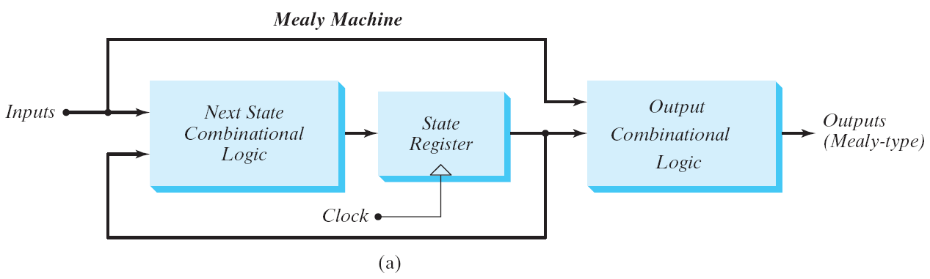
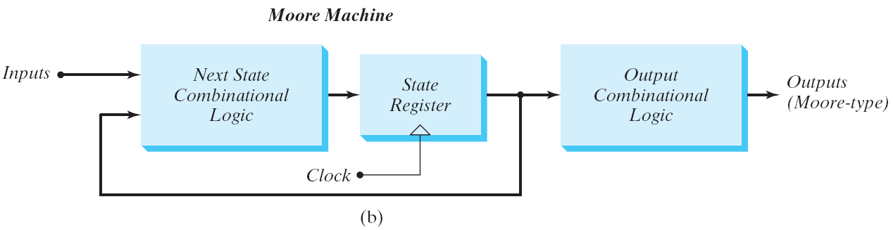
Mealy and Moore Models
Block diagram of Mealy and Moore state machine

Slide 54
Mealy and Moore Models
Mealy
Moore
Present State |  | I/P | Next State |  | O/P
A | B | x | A | B | y
0 | 0 | 0 | 0 | 0 | 0
0 | 0 | 1 | 0 | 1 | 0
0 | 1 | 0 | 0 | 0 | 1
0 | 1 | 1 | 1 | 1 | 0
1 | 0 | 0 | 0 | 0 | 1
1 | 0 | 1 | 1 | 0 | 0
1 | 1 | 0 | 0 | 0 | 1
1 | 1 | 1 | 1 | 0 | 0
Present State |  | I/P | Next State |  | O/P
A | B | x | A | B | y
0 | 0 | 0 | 0 | 0 | 0
0 | 0 | 1 | 0 | 1 | 0
0 | 1 | 0 | 0 | 1 | 0
0 | 1 | 1 | 1 | 0 | 0
1 | 0 | 0 | 1 | 0 | 0
1 | 0 | 1 | 1 | 1 | 0
1 | 1 | 0 | 1 | 1 | 1
1 | 1 | 1 | 0 | 0 | 1
For the same state, the output changes with the input
For the same state, the output does not change with the input

Slide 55
Moore State Diagram
State / Output
0
0
1
0 0 / 0
0 1 / 0
1
1
1 1 / 1
1 0 / 0
1
0
0

Slide 56
State reduction
Sequential circuit analysis
Circuit diagram state table (or state diagram)
Sequential circuit design
State diagram (state table) circuit diagram
Redundant state may exist in a state diagram (or table)
By eliminating them may reduce the # of flip-flops

Slide 57
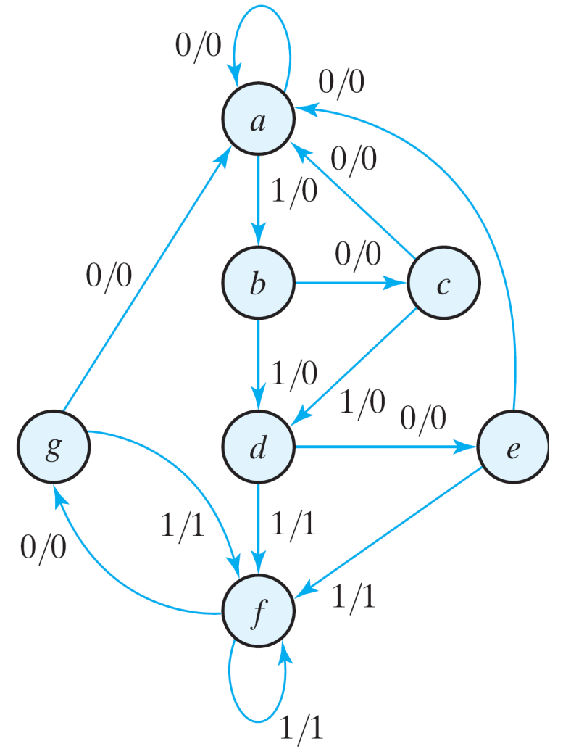
State Reduction
State: | a | a | b | c | d | e | f | f | g | f | g | a
Input: | 0 | 1 | 0 | 1 | 0 | 1 | 1 | 0 | 1 | 0 | 0
Output: | 0 | 0 | 0 | 0 | 0 | 1 | 1 | 0 | 1 | 0 | 0
Only the input-output sequences are important.
Two circuits are equivalent
Have identical outputs for all input sequences;
The number of states is not important.
State diagram

Slide 58
State Reduction
Equivalent states
Two states are said to be equivalent
For each member of the set of inputs, they give exactly the same output and send the circuit to the same state or to an equivalent state.
One of them can be removed.

Slide 59
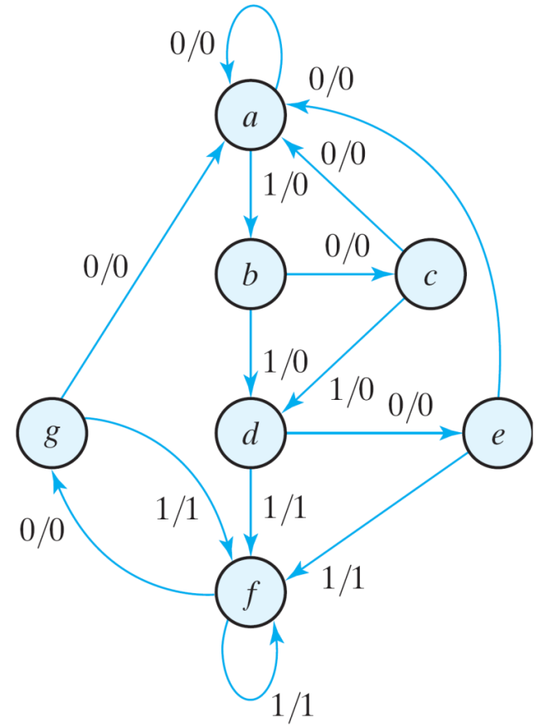
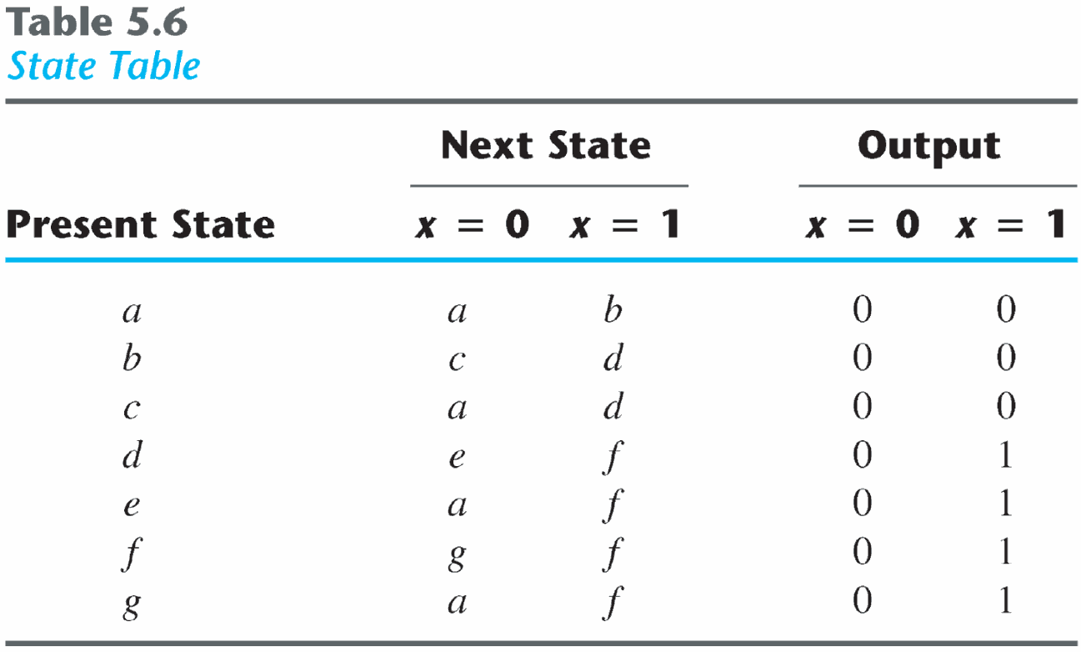
State Reduction

Slide 60
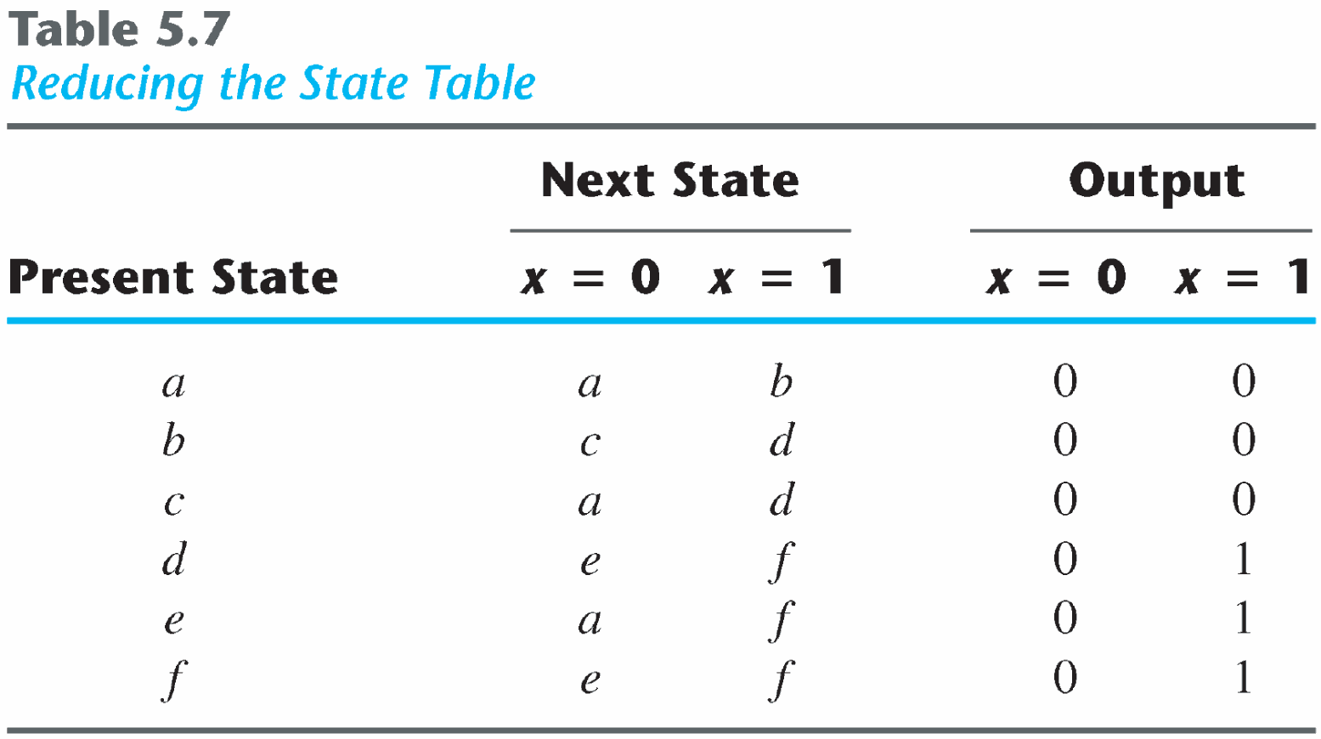
State Reduction
Reducing the state table
e = g (remove g);
d = f (remove f);

Slide 61
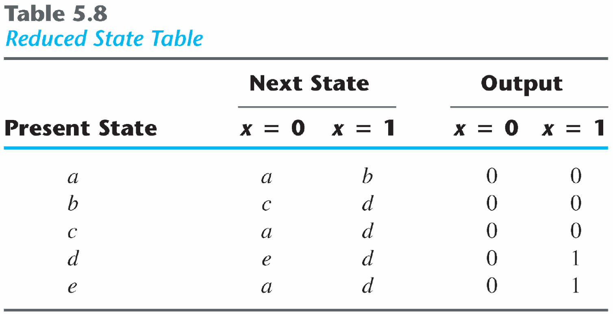
State Reduction
State: | a | a | b | c | d | e | d | d | e | d | e | a
Input: | 0 | 1 | 0 | 1 | 0 | 1 | 1 | 0 | 1 | 0 | 0
Output: | 0 | 0 | 0 | 0 | 0 | 1 | 1 | 0 | 1 | 0 | 0
The reduced finite state machine

Slide 62
State Reduction: Implication Table
The state-reduction procedure for completely specified state tables is based on the algorithm that two states in a state table can be combined into one if they can be shown to be equivalent.
There are occasions when a pair of states do not have the same next states, but, nonetheless, go to equivalent next states
The checking of each pair of states for possible equivalence in a table with a large number of states can be done systematically by means of an implication table.

Slide 63
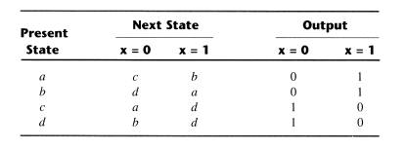
State Reduction: Implication Table
(a, b) imply (c, d) and (c, d) imply (a, b). Both pairs of states are equivalent; i.e., a and b are equivalent as well as c and d.

Slide 64
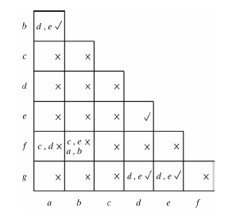
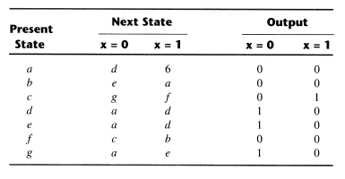
State Reduction:Implication Table

Slide 65
State Reduction: Implication Table
Finally, all the squares that have no crosses are recorded with check marks. The equivalent states are: (a, b), (d, e), (d, g), (e, g).
We now combine pairs of states into larger groups of equivalent states. The last three pairs can be combined into a set of three equivalent states (d, e, g) because each one of the states in the group is equivalent to the other two.

Slide 66
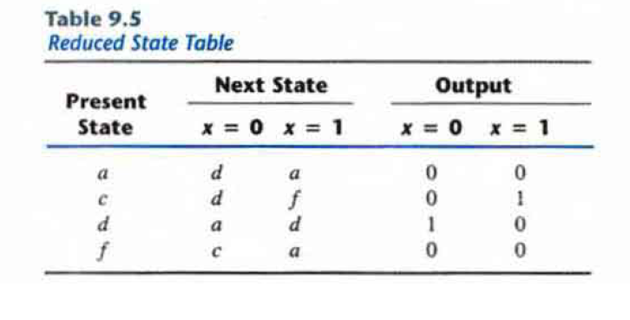
State Reduction: Implication Table
The final partition of these states consists of the equivalent states found from the implication table, together with all the remaining states in the state table that are not equivalent to any other state: (a, b) (c) (d, e, g) (f)

Slide 67
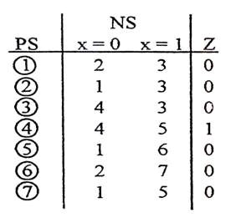
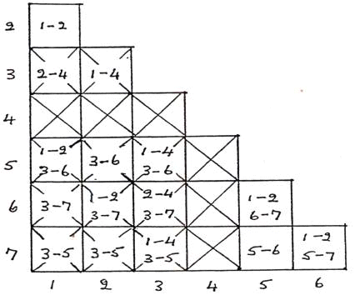
Implied Equivalences Extending Over a Number of States
5 = 6 if 6 = 7, 5 = 7 if 5 = 6, 6 = 7 if 5 =7
1 = 2 and 5 = 6, 5 = 7, 6 = 7 i.e. 5 = 6 = 7

Slide 68
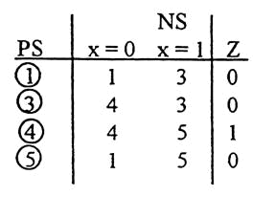
Implied Equivalences Extending Over a Number of States
5 = 6 if 6 = 7, 5 = 7 if 5 = 6, 6 = 7 if 5 =7
1 = 2 and 5 = 6, 5 = 7, 6 = 7 i.e. 5 = 6 = 7

Slide 69
Implied Equivalences Extending Over a Number of States
Alternative definition of equivalence:
Two circuit states with the same output conditions can be made equivalent, unless the equivalence depends upon a known non- equivalence.

Slide 70
State Assignment
Assign coded binary values to the states for physical implementation
For a circuit with m states, the codes must contain n bits where 2^{n} >= m
Unused states are treated as don’t care conditions during the design
Don’t cares can help to obtain a simpler circuit
There are many possible state assignments
Have large impacts on the final circuit size

Slide 71
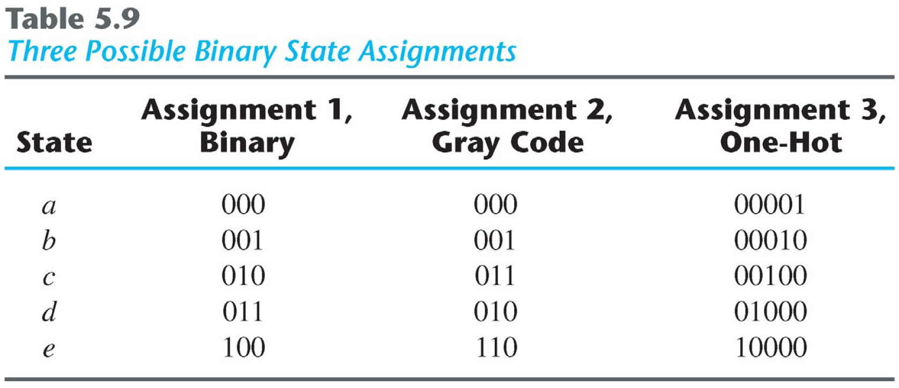
Popular State Assignment

Slide 72
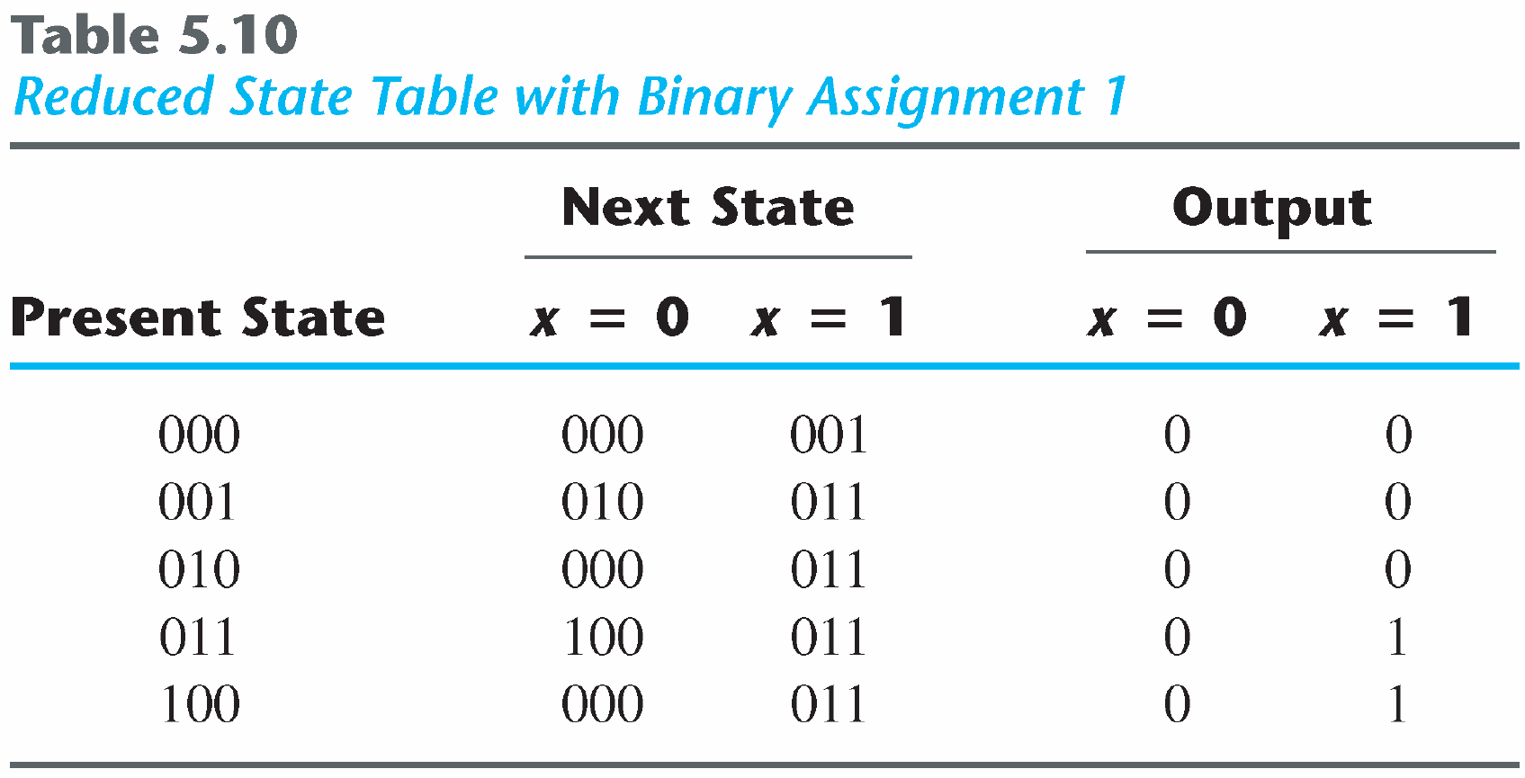
State Assignment
Any binary number assignment is satisfactory as long as each state is assigned a unique number
Use binary assignment 1

Slide 73
Design Procedure
Derive a state diagram for the circuit from specifications
Reduce the number of states if necessary
Assign binary values to the states
Obtain the binary-coded state table
Choose the type of flip-flop to be used
Derive the simplified flip-flop input equations and output equations
Draw the logic diagram

Slide 74
Design of Clocked Sequential Circuits
Example:
Detect 3 or more consecutive 1’s
0
1
S₀ / 0
S₁ / 0
State | A B
S₀ | 0 0
S₁ | 0 1
S₂ | 1 0
S₃ | 1 1
0
0
1
0
S₃ / 1
S₂ / 0
1
1

Slide 75
Design of Clocked Sequential Circuits
Example:
Detect 3 or more consecutive 1’s
Present State |  | Input | Next State |  | Output
A | B | x | A | B | y
0 | 0 | 0
0 | 0 | 1
0 | 1 | 0
0 | 1 | 1
1 | 0 | 0
1 | 0 | 1
1 | 1 | 0
1 | 1 | 1
0
1
S₀ / 0
S₁ / 0
0 0 0
0 1 0
0 0 0
1 0 0
0 0 0
1 1 0
0 0 1
1 1 1
0
0
1
0
S₃ / 1
S₂ / 0
1
1

Slide 76
Design of Clocked Sequential Circuits
Example:
Detect 3 or more consecutive 1’s
Present State |  | Input | Next State |  | Output
A | B | x | A | B | y
0 | 0 | 0
0 | 0 | 1
0 | 1 | 0
0 | 1 | 1
1 | 0 | 0
1 | 0 | 1
1 | 1 | 0
1 | 1 | 1
Synthesis using D Flip-Flops
0 0 0
0 1 0
0 0 0
1 0 0
0 0 0
1 1 0
0 0 1
1 1 1
A(t+1) = D_{A} (A, B, x)
= ∑ (3, 5, 7)
B(t+1) = D_{B} (A, B, x)
= ∑ (1, 5, 7)
y (A, B, x) = ∑ (6, 7)

Slide 77
Design of Clocked Sequential Circuits with D F.F.
Example:
Detect 3 or more consecutive 1’s
Synthesis using D Flip-Flops
 |  |  |  | B
 |  | 0 | 0 | 1 | 0
A |  | 0 | 1 | 1 | 0
 |  |  | x
D_{A} (A, B, x) = ∑ (3, 5, 7)
= A x + B x
D_{B} (A, B, x) = ∑ (1, 5, 7)
= A x + B’ x
y (A, B, x) = ∑ (6, 7)
= A B
 |  |  |  | B
 |  | 0 | 1 | 0 | 0
A |  | 0 | 1 | 1 | 0
 |  |  | x
 |  |  |  | B
 |  | 0 | 0 | 0 | 0
A |  | 0 | 0 | 1 | 1
 |  |  | x

Slide 78
Design of Clocked Sequential Circuits with D F.F.
Example:
Detect 3 or more consecutive 1’s
Synthesis using D Flip-Flops
D_{A} = A x + B x
D_{B} = A x + B’ x
y = A B

Slide 79
Flip-Flop Excitation Tables
Present State | Next State | F.F. Input
Q(t) | Q(t+1) | D
0 | 0
0 | 1
1 | 0
1 | 1
Present State | Next State | F.F. Input
Q(t) | Q(t+1) | J | K
0 | 0
0 | 1
1 | 0
1 | 1
0 0 (No change)
0 1 (Reset)
0
1
0
1
0 x
1 x
x 1
x 0
1 0 (Set)
1 1 (Toggle)
0 1 (Reset)
1 1 (Toggle)
0 0 (No change)
1 0 (Set)
Q(t) | Q(t+1) | T
0 | 0
0 | 1
1 | 0
1 | 1
0
1
1
0

Slide 80
Design of Clocked Sequential Circuits with JK F.F.
Example:
Detect 3 or more consecutive 1’s
Present State |  | Input | Next State |  | Flip-Flop Inputs
A | B | x | A | B | J_{A} | K_{A} | J_{B} | K_{B}
0 | 0 | 0 | 0 | 0
0 | 0 | 1 | 0 | 1
0 | 1 | 0 | 0 | 0
0 | 1 | 1 | 1 | 0
1 | 0 | 0 | 0 | 0
1 | 0 | 1 | 1 | 1
1 | 1 | 0 | 0 | 0
1 | 1 | 1 | 1 | 1
Synthesis using JK F.F.
0 x
0 x
0 x
1 x
x 1
x 0
x 1
x 0
0 x
1 x
x 1
x 1
0 x
1 x
x 1
x 0
J_{A} (A, B, x) = ∑ (3)
d_{JA} (A, B, x) = ∑ (4,5,6,7)
K_{A} (A, B, x) = ∑ (4, 6)
d_{KA} (A, B, x) = ∑ (0,1,2,3)
J_{B} (A, B, x) = ∑ (1, 5)
d_{JB} (A, B, x) = ∑ (2,3,6,7)
K_{B} (A, B, x) = ∑ (2, 3, 6)
d_{KB} (A, B, x) = ∑ (0,1,4,5)

Slide 81
Design of Clocked Sequential Circuits with JK F.F.
Example:
Detect 3 or more consecutive 1’s
Synthesis using JK Flip-Flops
 |  |  |  | B
 |  | 0 | 0 | 1 | 0
A |  | x | x | x | x
 |  |  | x
 |  |  |  | B
 |  | x | x | x | x
A |  | 1 | 0 | 0 | 1
 |  |  | x
J_{A} = B x K_{A} = x’
J_{B} = x K_{B} = A’ + x’
 |  |  |  | B
 |  | 0 | 1 | x | x
A |  | 0 | 1 | x | x
 |  |  | x
 |  |  |  | B
 |  | x | x | 1 | 1
A |  | x | x | 0 | 1
 |  |  | x

Slide 82
Design of Clocked Sequential Circuits with T F.F.
Example:
Detect 3 or more consecutive 1’s
Present State |  | Input | Next State |  | F.F. Input
A | B | x | A | B | T_{A} T_{B}
0 | 0 | 0 | 0 | 0
0 | 0 | 1 | 0 | 1
0 | 1 | 0 | 0 | 0
0 | 1 | 1 | 1 | 0
1 | 0 | 0 | 0 | 0
1 | 0 | 1 | 1 | 1
1 | 1 | 0 | 0 | 0
1 | 1 | 1 | 1 | 1
Synthesis using T Flip-Flops
0
0
0
1
1
0
1
0
0
1
1
1
0
1
1
0
T_{A} (A, B, x) = ∑ (3, 4, 6)
T_{B} (A, B, x) = ∑ (1, 2, 3, 5, 6)

Slide 83
Design of Clocked Sequential Circuits with T F.F.
Example:
Detect 3 or more consecutive 1’s
Synthesis using T Flip-Flops
T_{A} = A x’ + A’ B x
T_{B} = A’ B + B ⊕ x
 |  |  |  | B
 |  | 0 | 0 | 1 | 0
A |  | 1 | 0 | 0 | 1
 |  |  | x
 |  |  |  | B
 |  | 0 | 1 | 1 | 1
A |  | 0 | 1 | 0 | 1
 |  |  | x

Slide 84
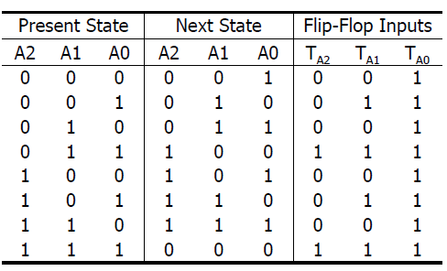
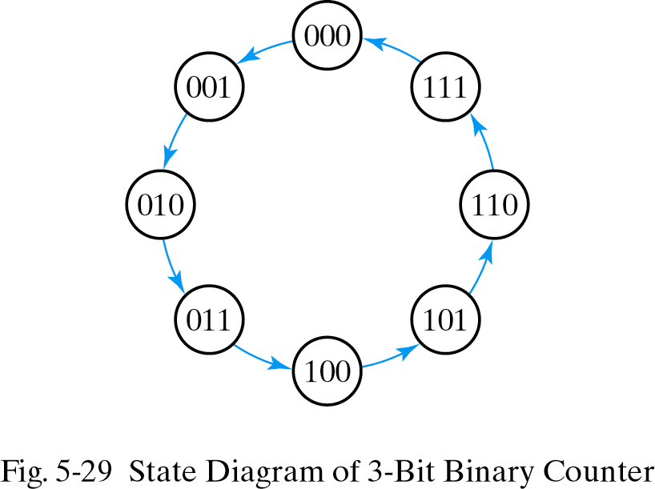
Design of Clocked Sequential Circuits with T F.F.
Example:
3-bit binary counter

Slide 85
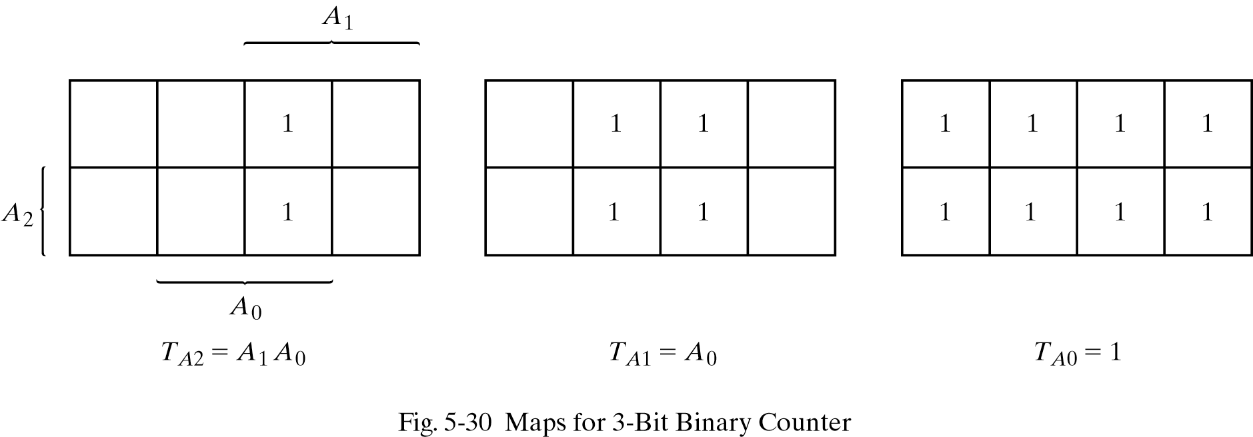
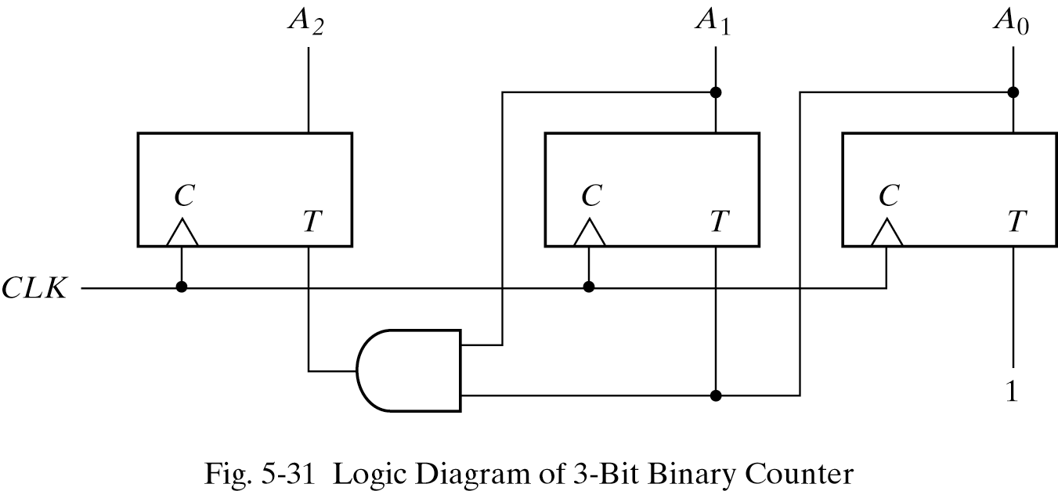
Design of Clocked Sequential Circuits with T F.F.

Slide 86
Design of Clocked Sequential Circuits with D F.F.
Design a one-input, one-output serial 2's complementer. The circuit accepts a string of bits from the input and generates the 2's complement at the output. The circuit can be reset asynchronously to start and end the operation.

Slide 87
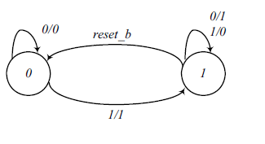
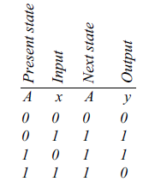

Design of Clocked Sequential Circuits with D F.F.

Slide 88
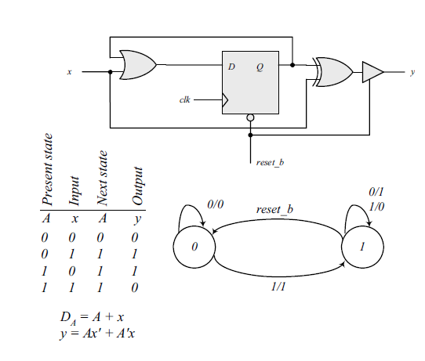
Design of Clocked Sequential Circuits with D F.F.

Slide 89
Syllabus
Chapter 5 (Excluding Section 5.6)

